Slide 1

React JS
Step 1
Reza Mousavian

Slide 2



What Is React?
React is a JavaScript library created by Facebook
React is a User Interface (UI) library
React is a tool for building UI components
React web site:
React is a declarative, efficient, and flexible JavaScript library for building user interfaces. It lets you compose complex UIs from small and isolated pieces of code called “components”.

Slide 3

Library Vs FrameWork
Frameworks and libraries are both code written by someone else that helps you perform some common tasks in a less verbose way.
A framework inverts the control of the program. It tells the developer what they need. A library doesn’t. The programmer calls the library where and when they need it.

Slide 4
Library Vs FrameWork
Examples of libraries: Network protocols, compression, Angular,Django,….
Examples of frameworks: Web application system, Plug-in manager,ReactJS,VueJs, ....

Slide 5
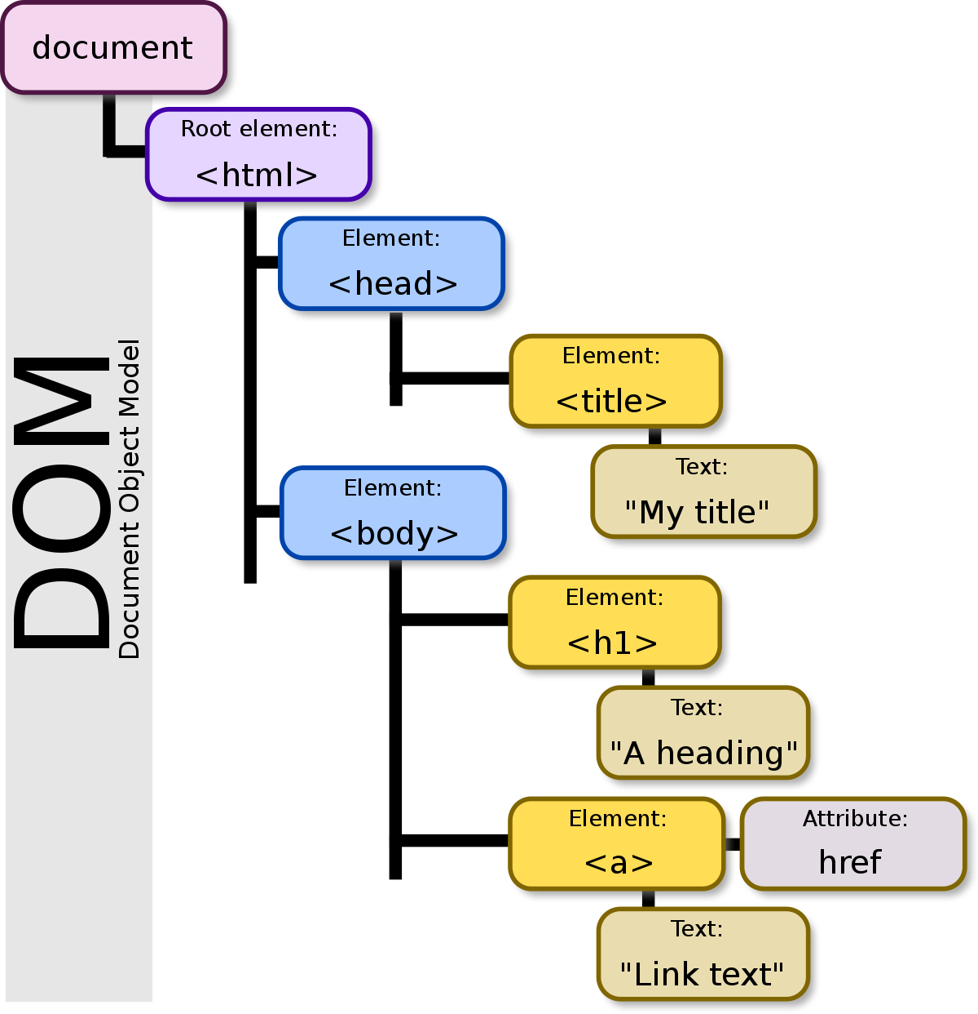
DOM
The Document Object Model (DOM) is the data representation of the objects that comprise the structure and content of a document on the web.

Slide 6
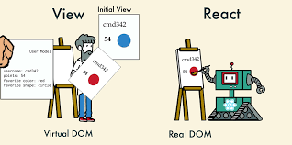
Virtual Dom
That’s where the concept of virtual DOM comes in and performs significantly better than the real DOM. The virtual DOM is only a virtual representation of the DOM. Every time the state of our application changes, the virtual DOM gets updated instead of the real DOM.
Virtual Dom is faster than real DOM !!!

Slide 7
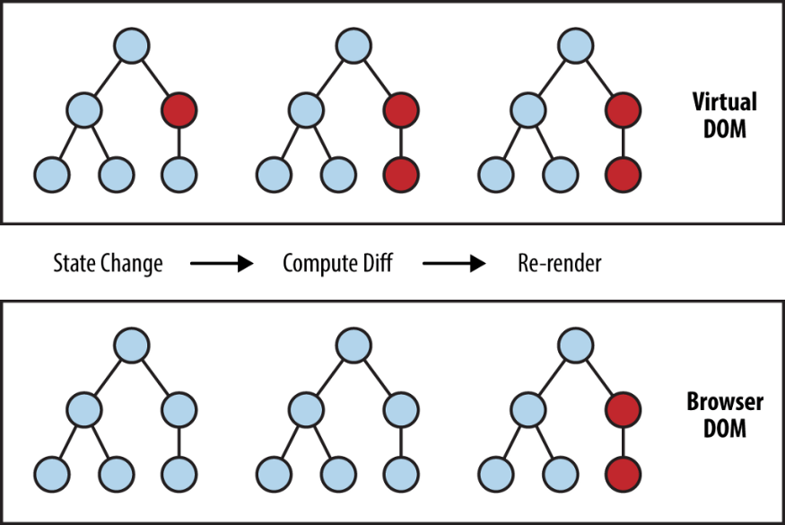
How is Virtual DOM faster?

Slide 8
Some code
<div id="root"></div>
<!-- Load React API -->
<script src="https://unpkg.com/react@16/umd/react.production.min.js"></script>
<!-- Load React DOM-->
<script src="https://unpkg.com/react-dom@16/umd/react-dom.production.min.js"></script>
<script>
class Hello extends React.Component {
render() {
return React.createElement('div', null, `Hello ${this.props.toWhat}`);
}
}
ReactDOM.render(
React.createElement(Hello, { toWhat: 'World' }, null),
document.getElementById('root'),
);
</script>

Slide 9
JSX
JSX is an extension to JavaScript which allows you to declaratively create custom UI components. JSX has important benefits:
Easy, declarative markup.
Colocated with your component.
Separate by concern, (e.g., UI vs state logic, vs side-effects) not by technology (e.g., HTML, CSS, JavaScript).
Abstract away DOM differences.
Abstract away from underlying tech so you can target many different
Timer code :)

Slide 10
JSX vs HTML Tag
HTML Tag =<div>....</div>
JSX= <div>....</div> ==>x transpile to ReactJs functions=
React.createElement('div', null, `Hello ${this.props.toWhat}`);

Slide 11
Pros and Cons
Pros | Cons
It is easy to learn. | JSX syntax.
A virtual DOM is used. | Fast development pace.
There are reusable components. | Somewhat slow documentation.
Operates on a one-way data flow.

Slide 12
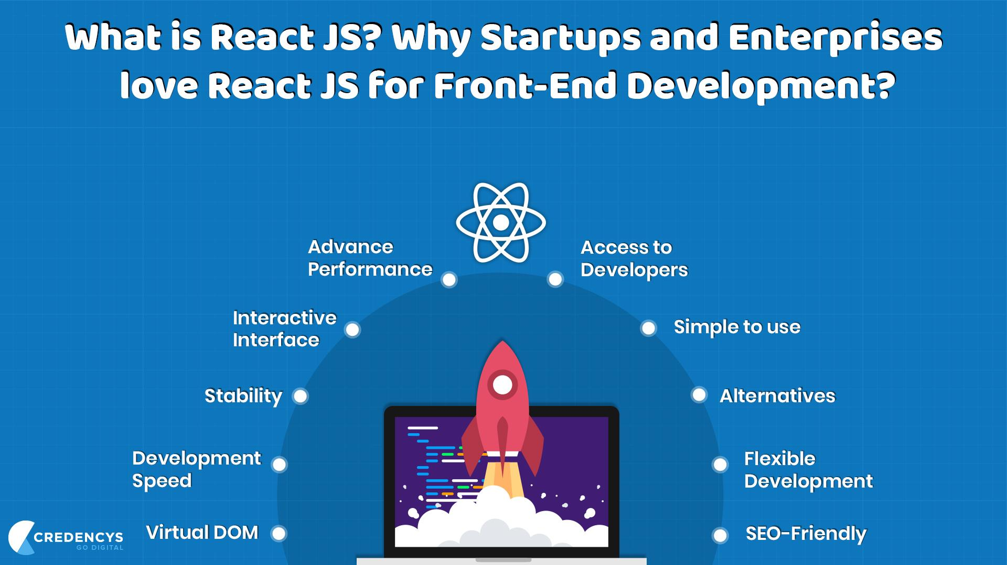

Slide 13
TODO
Run command npx create-react-app {react-app-name}
Go to folder
Run npm start
:)

Slide 14
More
How to React render items
Component
State
Data flow in react
Architecture of React
Create react app module
Config React project without using create-react-app
babel

Slide 15
Resource
https://www.freecodecamp.org/news/the-difference-between-a-framework-and-a-library-bd133054023f/
https://www.reactjs.org
https://developer.mozilla.org/en-US/docs/Web/API/Document_Object_Model/Introduction
https://payalpaul2436.medium.com/10-main-core-concept-you-need-to-know-about-react-303e986e1763
https://medium.com/javascript-scene/the-missing-introduction-to-react-62837cb2fd76
https://www.altexsoft.com/blog/engineering/the-good-and-the-bad-of-reactjs-and-react-native/

