Slide 1
MLContext
(Singleton)
depends
HTTP requests
ITransformer
(ML Model)
(Singleton)
depends
“expensive” to create
PredictionEngine
Predict()
Not Thread safe while “expensive” to create.
Transient/PerCall is NOT an optimal approach

Slide 2
MLModelEngine class
MLContext
_mlModel
(Singleton)
depends
ITransformer
_mlModel
HTTP requests
(Singleton)
_objectPool
“expensive” to create
PredictionEngine
PredictionEngine
Predict()
PredictionEngine
‘n’ PredictionEngine objects in a pool.
Not Thread safe while “expensive” to create.
PredictionEngine
…

Slide 3
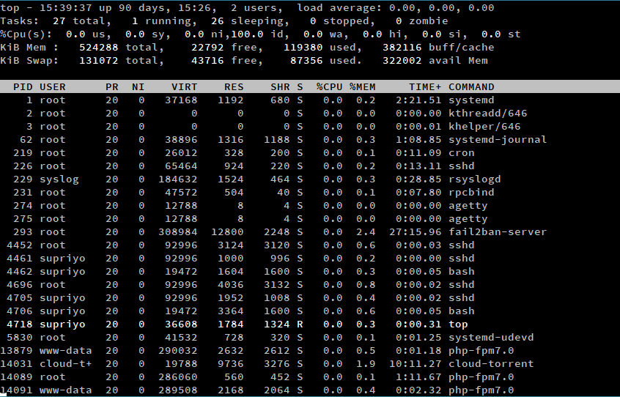
“Top” area is
‘always’ there.
“Extensible” and optional area
for advanced users, etc.

