Slide 1
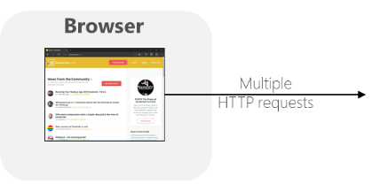
ASP.NET Core
WebAPI / App
Many clients
Thread 1
Your code
(Objects)
Thread 2
Thread 3
Thread 4
Thread ‘n’
Thread pool

Slide 2
ASP.NET Core
WebAPI / App
Your code
Controller
Obj 1
Obj 2
Transient lifetime
object
Transient lifetime
object

Slide 3
MLContext
(Singleton)
depends
HTTP requests
ITransformer
(ML Model)
(Singleton)
depends
“expensive” to create
PredictionEngine
Predict()
Not Thread safe while “expensive” to create.
Transient/PerCall is NOT an optimal approach

Slide 4
MLModelEngine class
(Singleton)
HTTP requests
_mlContext
(MLContext)
MLModel
(ITransformer)
_objectPool
(ObjectPool<PredictionEngine>)
- “expensive” to create
- Surfaced as property for ‘bulk predictions’
PredictionEngine
PredictionEngine
Pick one..
Predict()
PredictionEngine
Return
after used.
‘n’ PredictionEngine objects in a pool.
Solves problem:
“Not Thread safe while ‘expensive’ to create”.
PredictionEngine
…

Slide 5
ASP.NET Core WebAPI / App
MLModelEngine object
Controller instances
(Singleton lifetime)
.NET Core
threads
Controller
_objectPool
(ObjectPool<PredictionEngine>)
(Transient lifetime)
.Predict()
Thread 1
Many clients
Controller
PredictionEngine
(Transient lifetime)
.Predict()
Thread 2
PredictionEngine
Controller
(Transient lifetime)
.Predict()
PredictionEngine
Thread 3
Controller
PredictionEngine
(Transient lifetime)
.Predict()
…
Thread ‘n’
Controller
(Transient lifetime)
MLModel
(ITransformer)
_mlContext
(MLContext)
.Transform()

Slide 6
Here's a high level end-to-end architecture diagram of the Web API using the MLModelEngine with the Object Pool of PredictionEngine objects.

