Slide 1

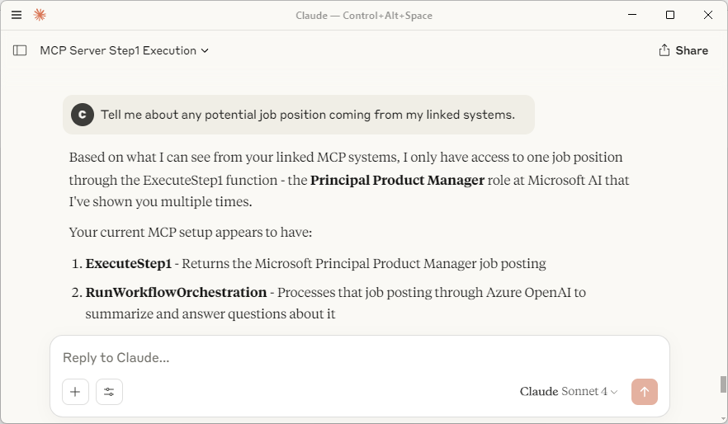


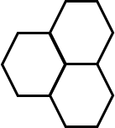
1. Simple MCP+SemanticKernel POC Multi-Agent Architecture
Chat UI
Claude, GitHub CoPilot, etc.
MCP
(stdio)
AI Agent
Orchestrator
MCP client
User
LLM
MCP
(stdio)
MCP
(stdio)
AI Agent
Summarizer
AI Agent
Identifier
LLM
LLM
MCP
(stdio)
MCP
(stdio)
MCP Server
Ad-Hoc Content

Slide 2

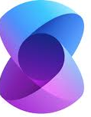

1. Simple MCP+SemanticKernel POC Multi-Agent Architecture
Chat UI
Claude, GitHub CoPilot, etc.
AI Agent
Orchestrator
AI Agent
Identifier
MCP
(stdio)
MCP client
MCP
(stdio)
User
Model Context Protocol
Semantic
Kernel
C#
Model Context Protocol
Semantic
Kernel
C#
MCP
(stdio)
MCP
(stdio)
MCP
(stdio)
LLM
LLM
MCP Server
Ad-Hoc Content
Model Context Protocol
C#

Slide 3
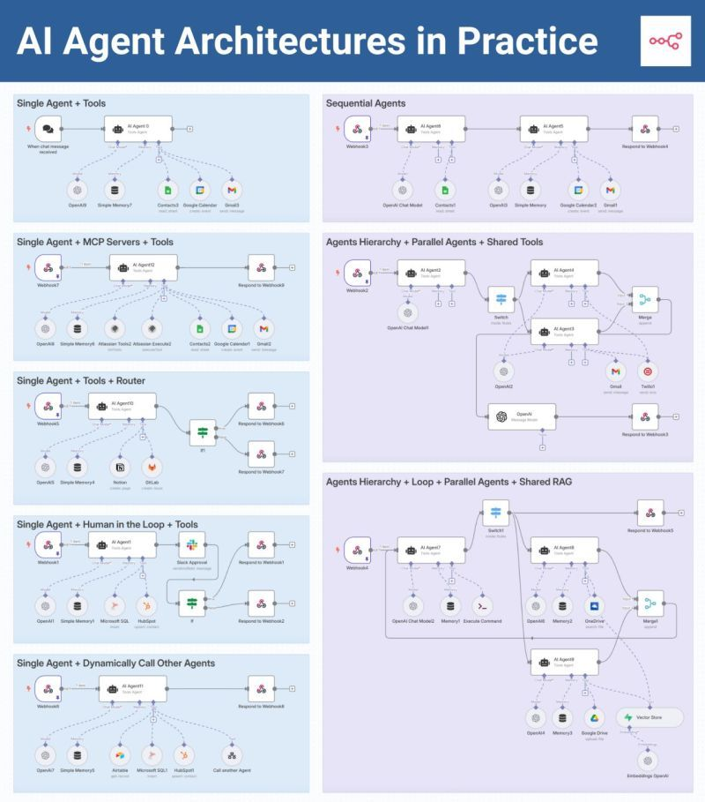

Slide 6
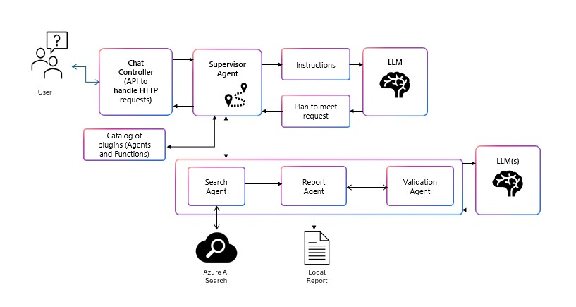

Slide 7
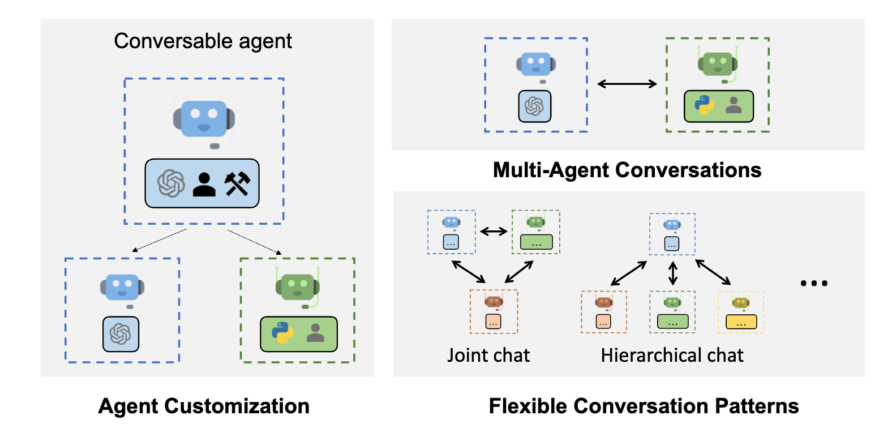

Slide 8
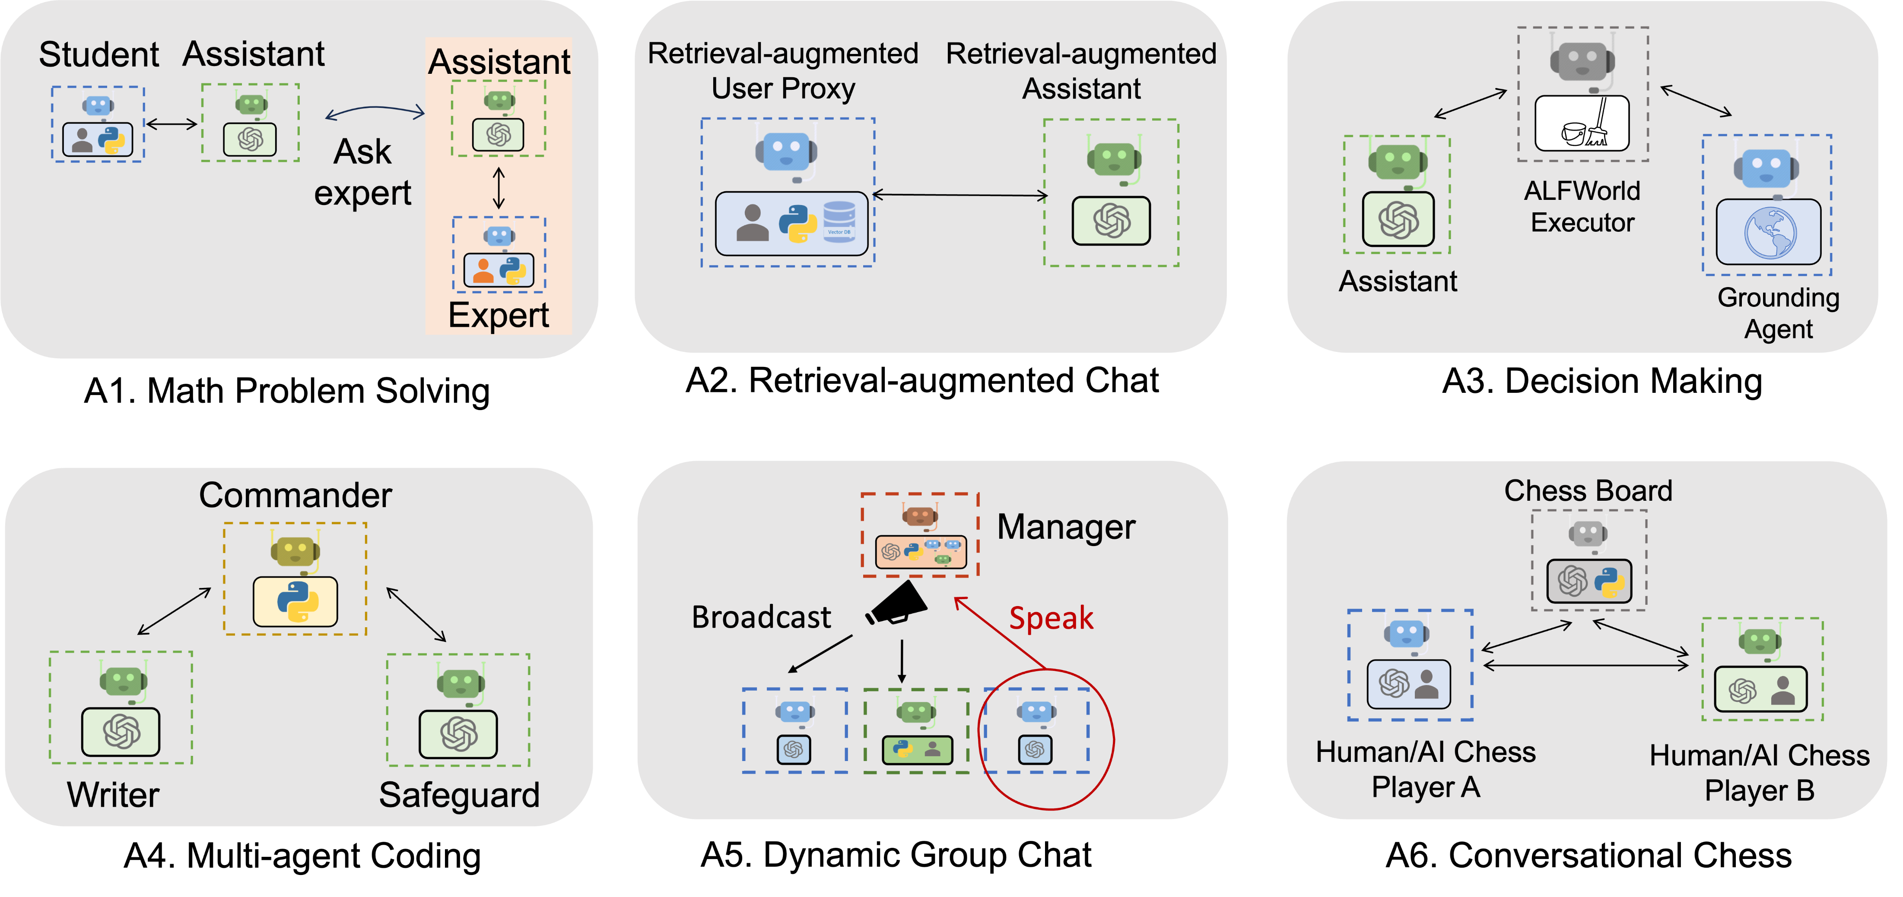

Slide 9
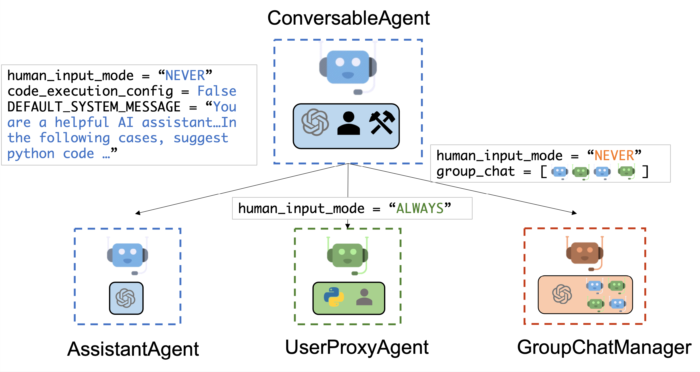

Slide 10
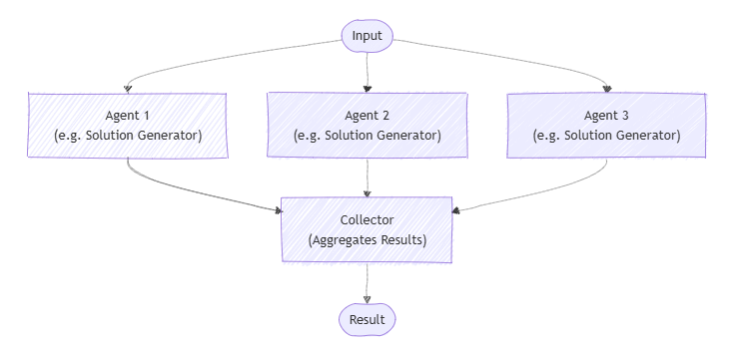
Semantic Kernel diagrams - Concurrent
Concurrent Agent Orchestration | Microsoft Learn

Slide 11
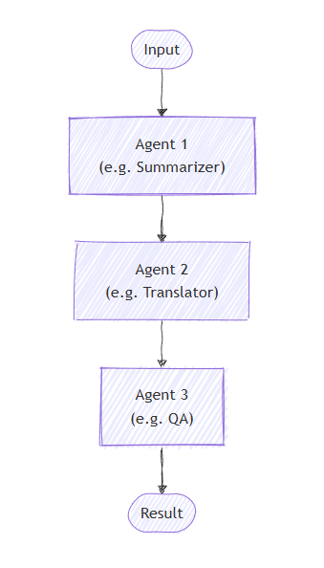
Semantic Kernel diagrams - Sequential

Slide 12
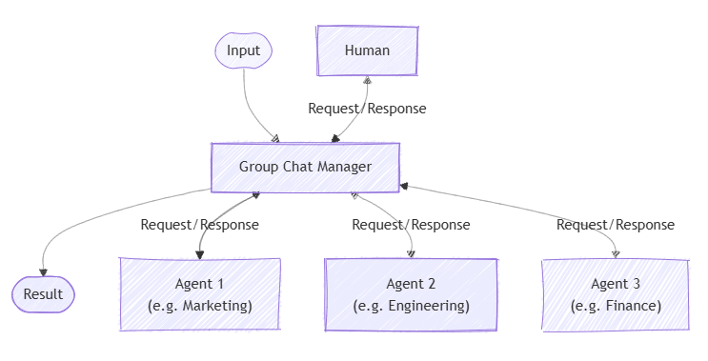
Semantic Kernel diagrams – Group Chat

Slide 13
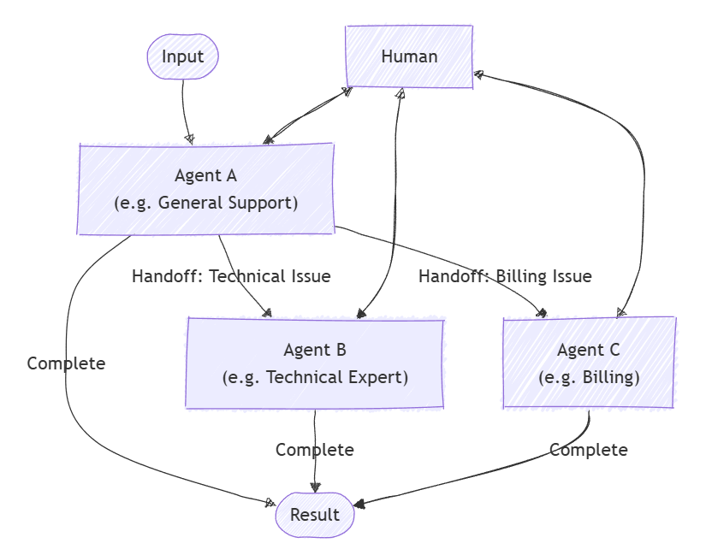
Semantic Kernel diagrams - Handoff

Slide 14
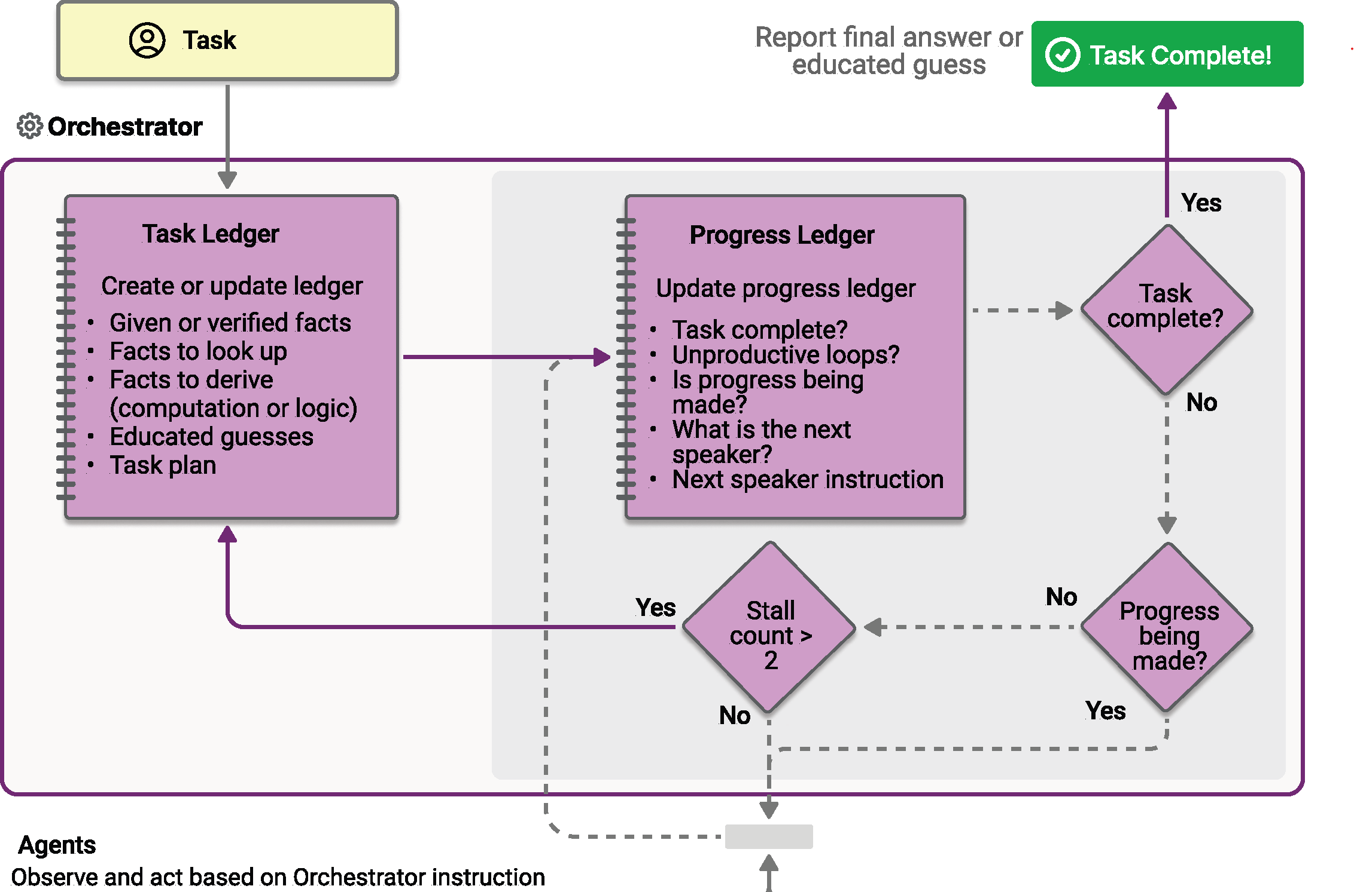
Magentic Agent Orchestration | Microsoft Learn

Slide 15
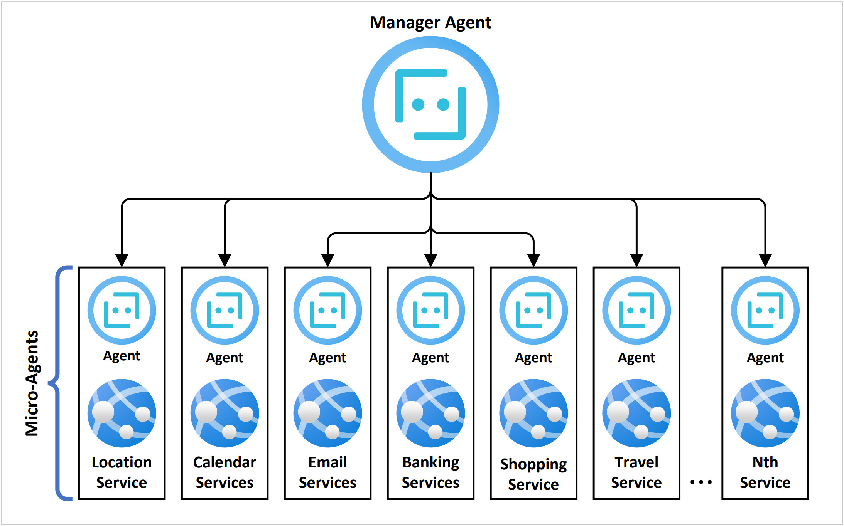

Slide 16
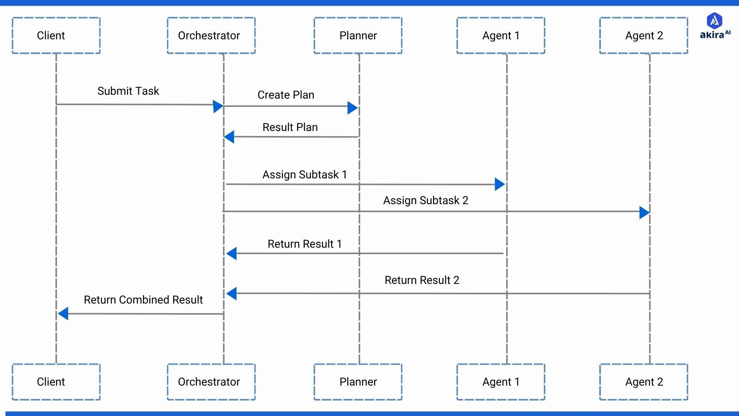

Slide 17
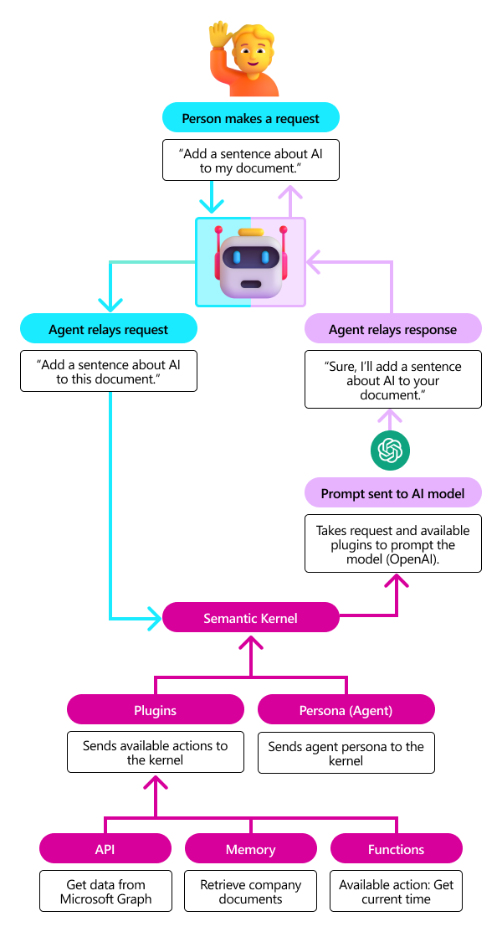

Slide 18
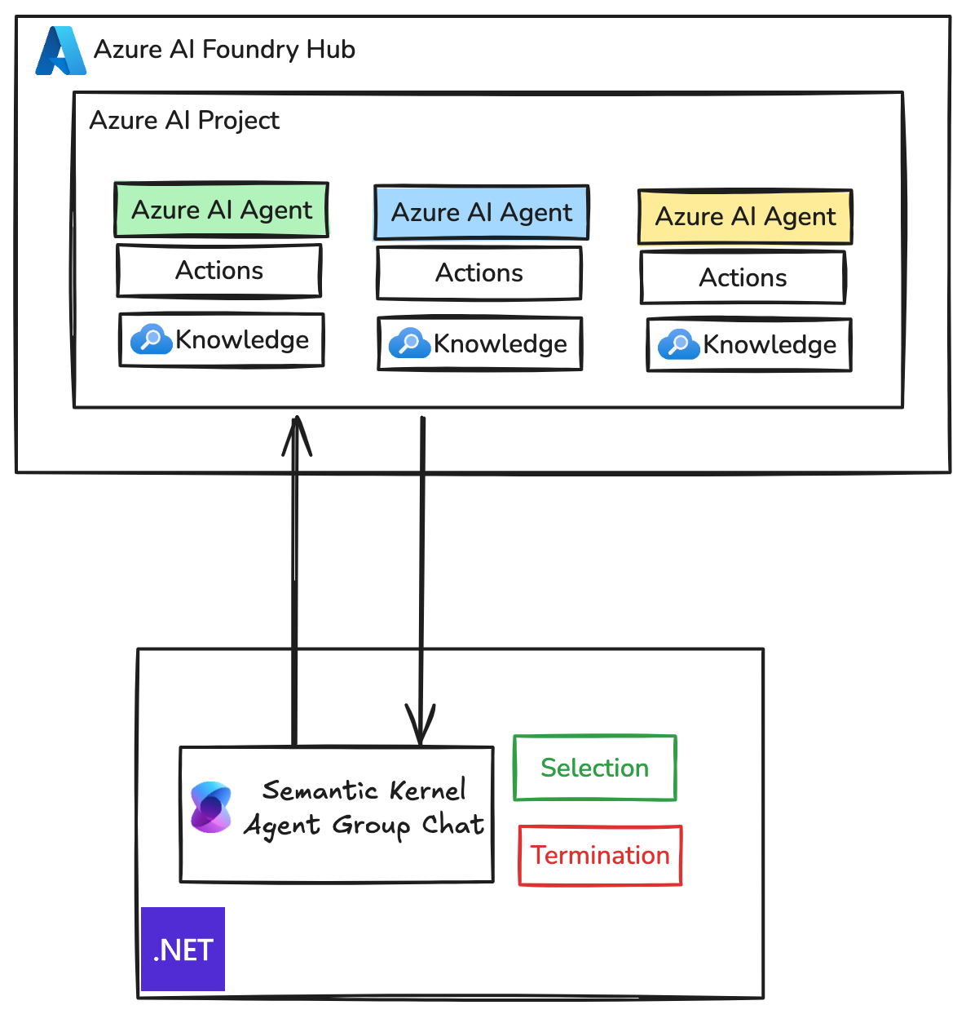

Slide 19
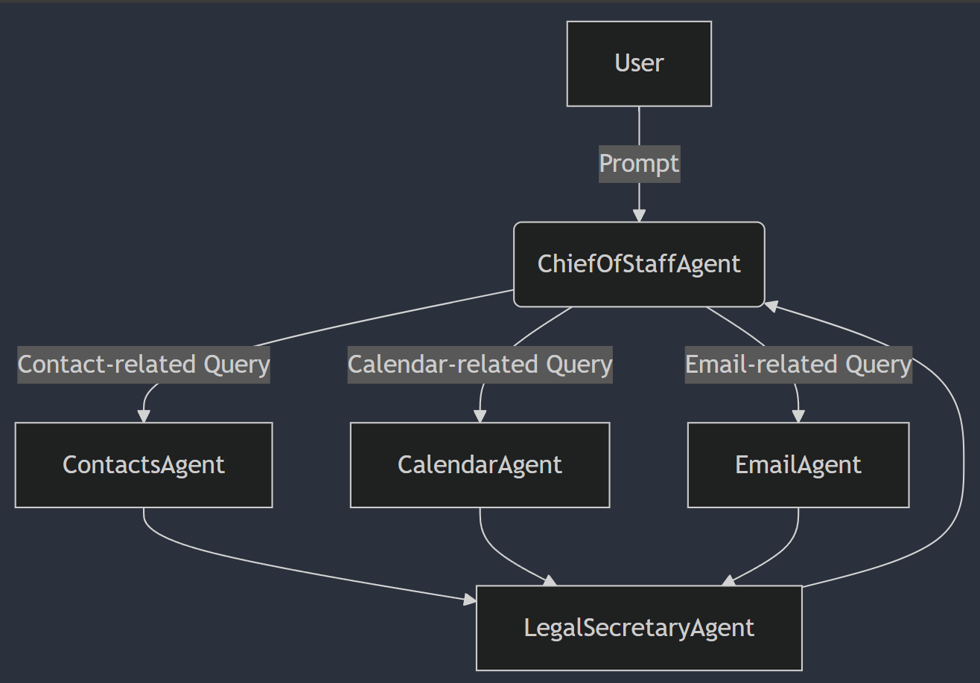

Slide 20
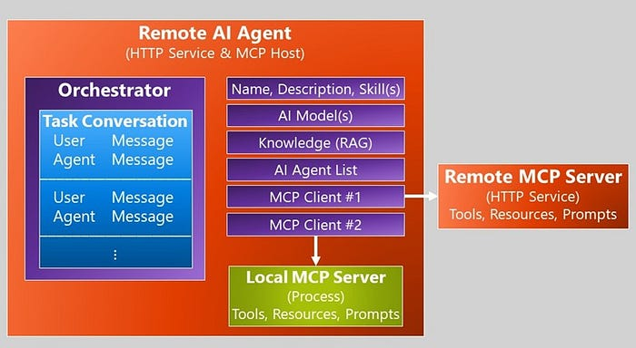
AI Agent Architecture via A2A/MCP | by Jeffrey Richter | Jun, 2025 | Medium

Slide 21
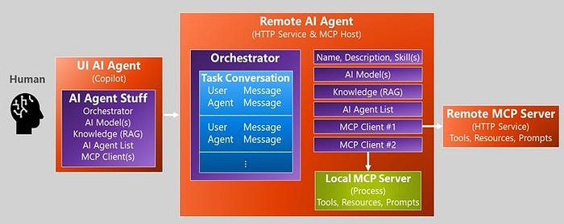

Slide 22
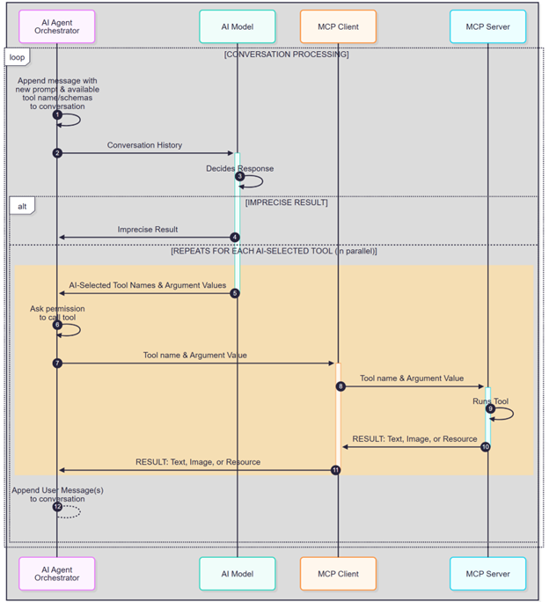
AI Agent Architecture via A2A/MCP | by Jeffrey Richter | Jun, 2025 | Medium

Slide 23




Azure
AI Foundry
LLM
OpenAI
gpt-4o-mini

