Slide 1


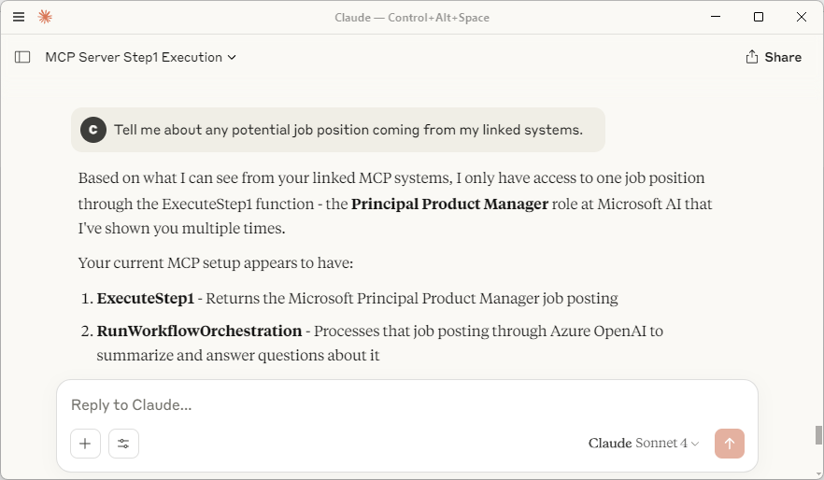

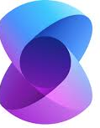



Prototype/POC Architecture Diagram
Chat UI
Claude, GitHub CoPilot, etc.
AI Agent
Orchestrator
AI Agent
Chat
MCP
(stdio)
MCP client
MCP
(stdio)
User
Model Context Protocol
Semantic
Kernel
C#
Model Context Protocol
Semantic
Kernel
C#
MCP
(stdio)
MCP
(stdio)
MCP
(stdio)
LLM
LLM
MCP Server
KB Content
Model Context Protocol
C#

