Slide 1


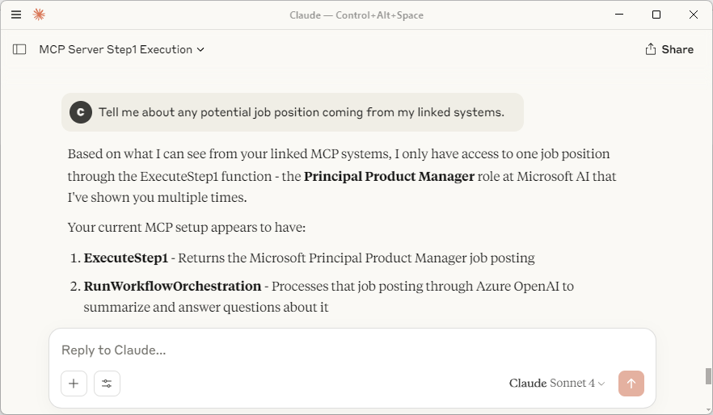

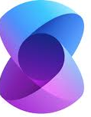



Initial prototype/POC Architecture Diagram
Chat UI
Claude, GitHub CoPilot, etc.
AI Agent
Orchestrator
AI Agent
Chat Agent
(ChatCompletionAgent)
MCP
(stdio)
MCP client
Model Context Protocol
Semantic
Kernel
User
C#
Semantic
Kernel
C#
Optional
For testing
MCP
(stdio)
MCP
(stdio)
LLM
MCP Server
KB Content
Model Context Protocol
C#

Slide 2
VNext - Prototype/POC Architecture Diagram
Chat UI
Claude, GitHub CoPilot, etc.
AI Agent
Orchestrator
AI Agent
Chat
MCP
(stdio)
MCP client
MCP
(stdio)
User
Model Context Protocol
Semantic
Kernel
C#
Model Context Protocol
Semantic
Kernel
C#
MCP
(stdio)
MCP
(stdio)
MCP
(stdio)
LLM
LLM
MCP Server
KB Content
Model Context Protocol
C#

