Slide 1
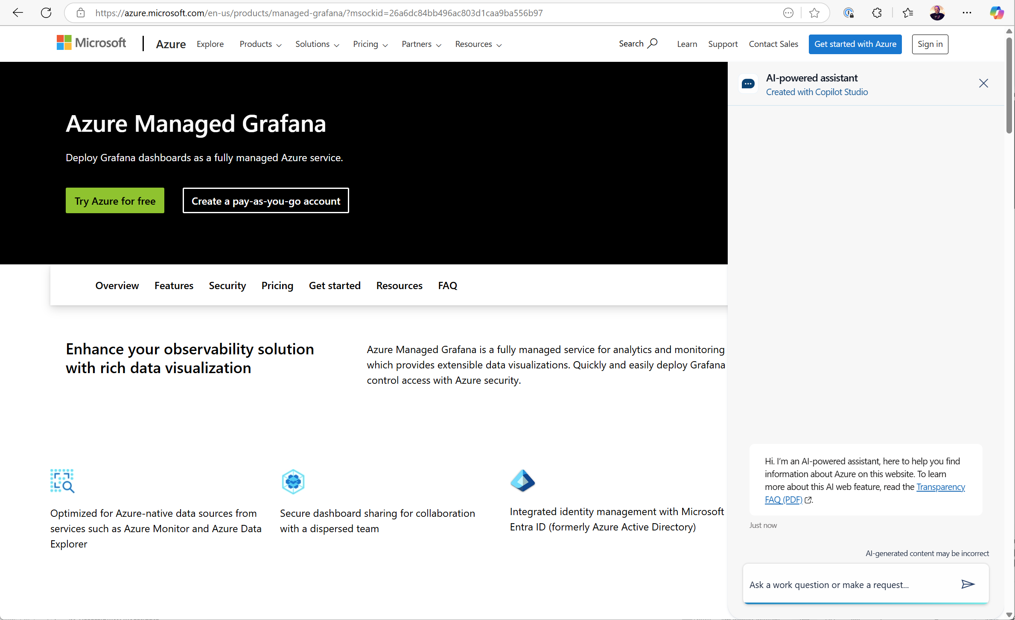
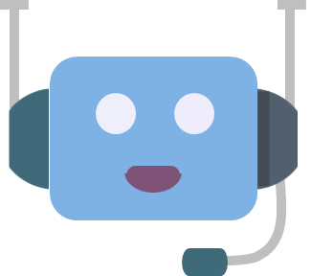


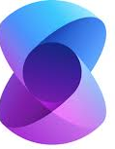

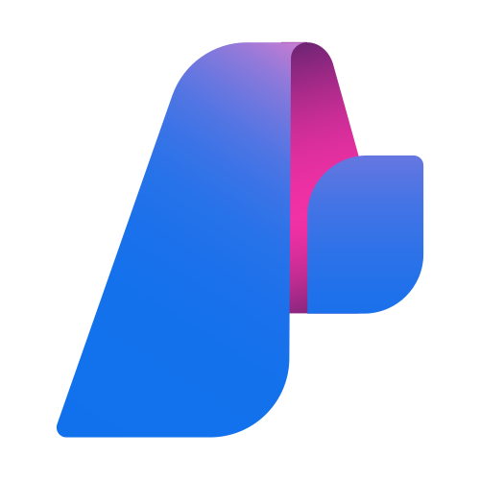
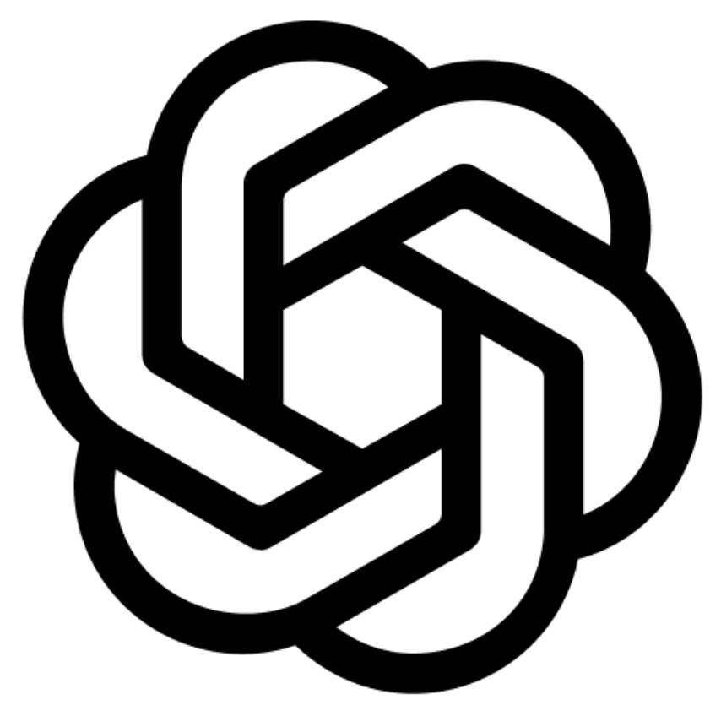
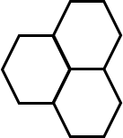
Vision: My custom and domain specific Agentic system
Example domain: Azure Managed Grafana
AI Agent
Orchestrator
AI Agent
Chat Agent
(ChatCompletionAgent)
ChatBot
UI
MCP
Model Context Protocol
Semantic
Kernel
C#
Semantic
Kernel
C#
User
Azure Foundry
MCP
LLM
MCP Server
KB Content
Example domain
Knowledge Base on
Azure Managed Grafana
(or “any other”)
Model Context Protocol
C#

Slide 2
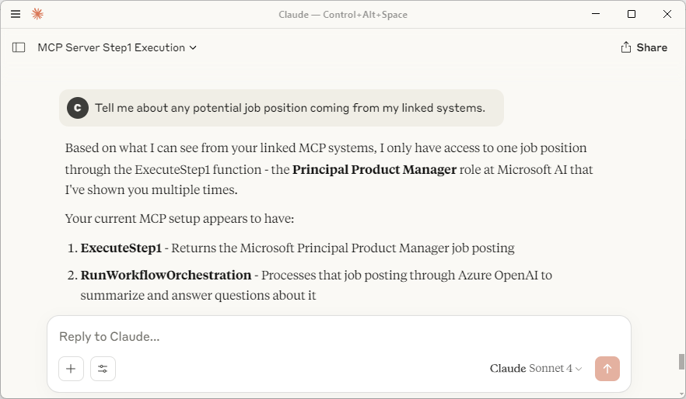
Initial prototype/POC Architecture Diagram (Local Agent/PC-Server processes)
Chat UI
Claude, GitHub CoPilot, etc.
AI Agent
Orchestrator
AI Agent
Chat Agent
(ChatCompletionAgent)
MCP
(stdio)
MCP client
Model Context Protocol
Semantic
Kernel
User
C#
Semantic
Kernel
C#
Azure Foundry
Optional
For testing
MCP
(stdio)
MCP
(stdio)
LLM
MCP Server
KB Content
Model Context Protocol
C#

Slide 3
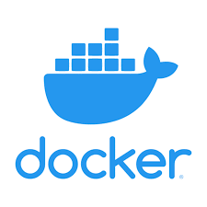
Dockerized - Architecture Diagram (Decoupled Agents/MCP-servers as Docker containers)
Container
Container
Chat UI
Claude, GitHub CoPilot, etc.
AI Agent
Orchestrator
AI Agent
Chat
HTTP
HTTP
MCP client
Model Context Protocol
Semantic
Kernel
Model Context Protocol
Semantic
Kernel
User
C#
C#
Azure Foundry
Azure Foundry
Optional
For testing
HTTP
HTTP
MCP
(stdio)
LLM
LLM
Container
MCP Server
KB Content
Model Context Protocol
C#

Slide 4
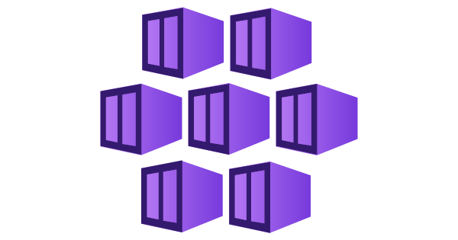
Cloud-Native - Architecture Diagram (Decoupled Agents / MCP servers as containers in Kubernetes/Azure [*])
AKS
AKS
Container
Container
Chat UI
Claude, GitHub CoPilot, etc.
AI Agent
Orchestrator
AI Agent
Chat
HTTP
HTTP
MCP client
Model Context Protocol
Semantic
Kernel
Model Context Protocol
Semantic
Kernel
User
C#
C#
Azure Foundry
Azure Foundry
Optional
For testing
HTTP
HTTP
MCP
(stdio)
LLM
LLM
AKS
Container
MCP Server
KB Content
Model Context Protocol
C#
[*] Deployment in Azure could be Azure Kubernetes Service (AKS) or Azure Container Apps (ACA), depending on the system’s complexity.

