Slide 1
Client A vs Client B Performance Review
Last 2 Years · Auto-generated insights

Slide 2
Agenda
Dataset overview
Comparative performance (A vs B)
Demographics & flavour deep dive
Efficiency & market share
Key insights & recommendations

Slide 3
Dataset Overview
Observations: 88
Quarters: 8
Clients: 2 (A & B)
Measures: Value, Units, Buyers, Trips, Raw Trips
Dimensions: Demographic Group, Retailer (Allmart), Flavour, Quarter

Slide 4
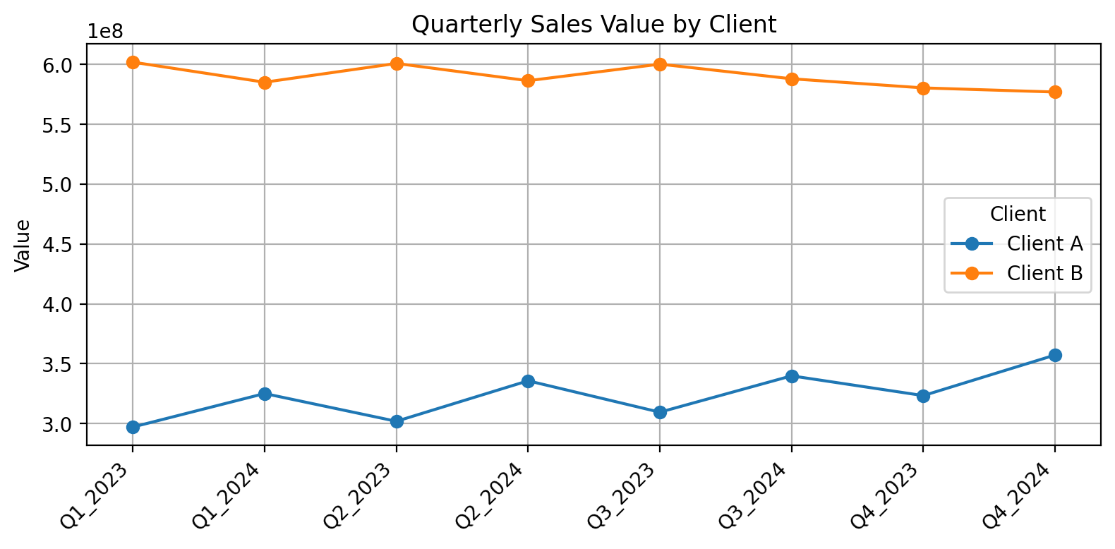
Quarterly Sales Value by Client
Notes:
Sales trend by quarter. Highlight peaks/drops.
Call out periods where Client B outgrows Client A and vice versa.

Slide 5
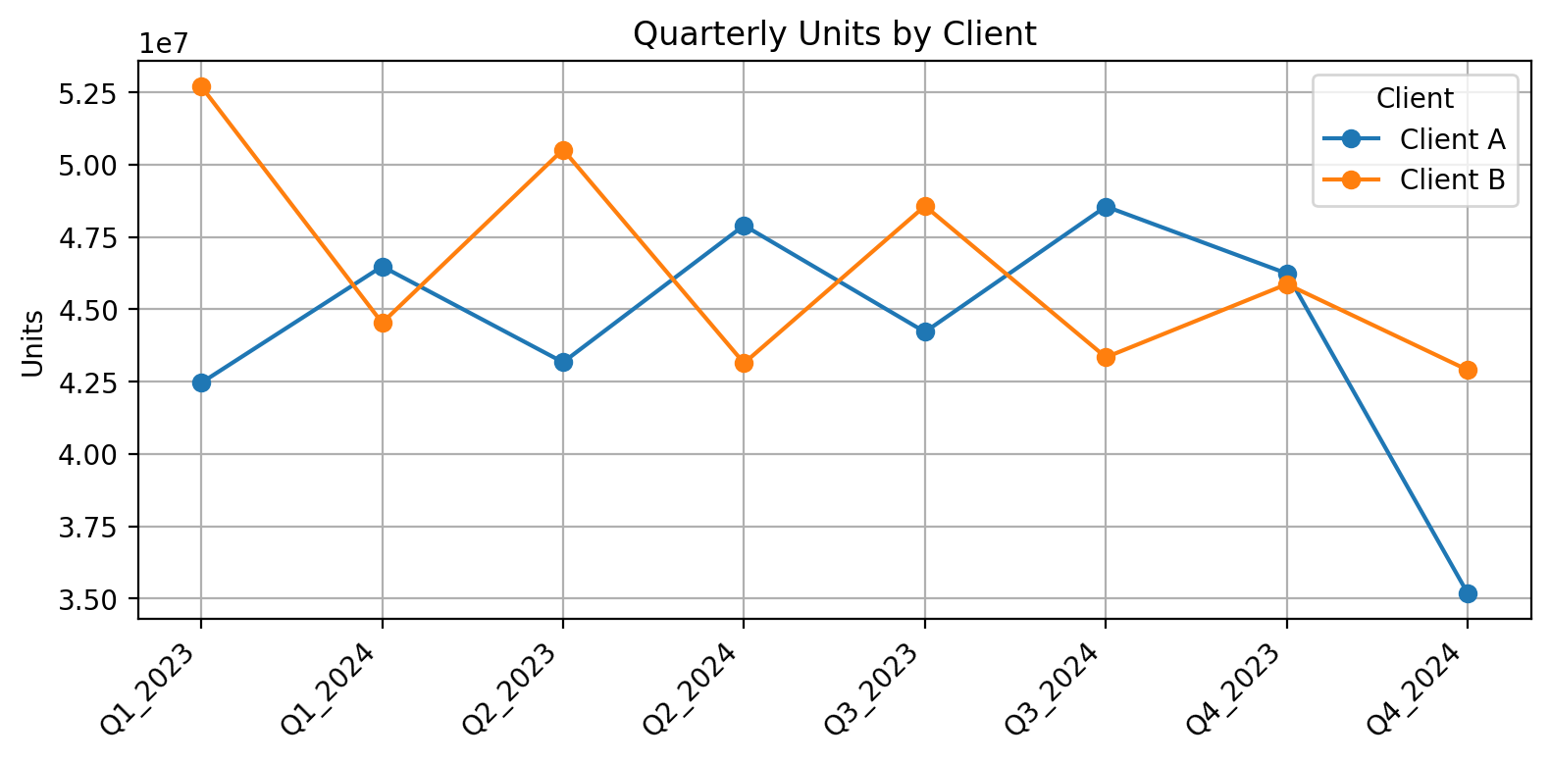
Quarterly Units by Client
Notes:
Units trend complements Value; check mix and pack-size effects.

Slide 6
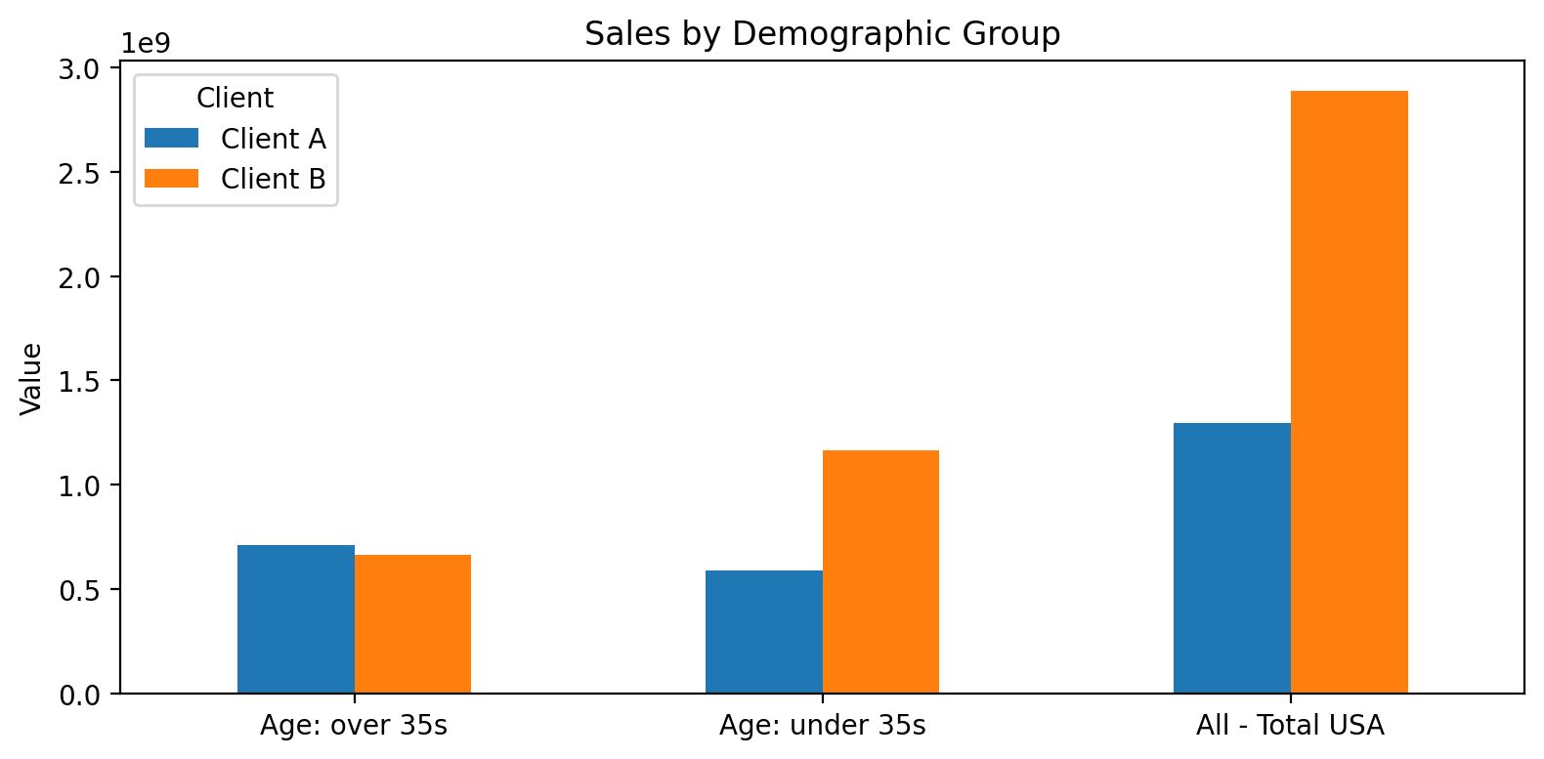
Sales by Demographic Group
Notes:
Identify over/under-performance among under 35s vs over 35s; prioritize growth pockets.

Slide 7
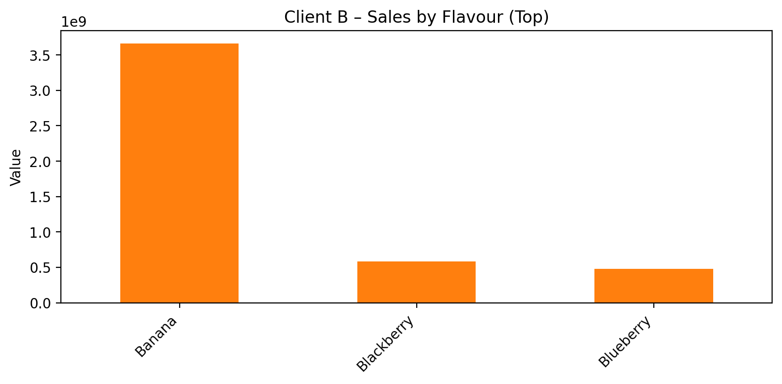
Client B – Sales by Flavour
Notes:
Top flavours for B. Decide defend vs. expand vs. fix underperformers.

Slide 8
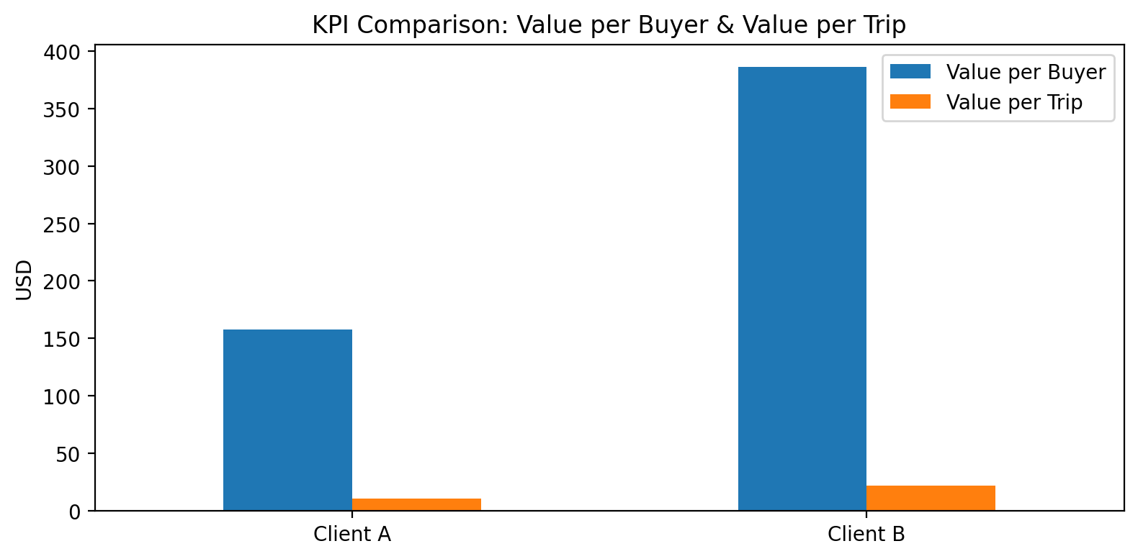
KPI Comparison: Value per Buyer & per Trip
Notes:
Monetization efficiency: who extracts more value per buyer/trip?

Slide 9
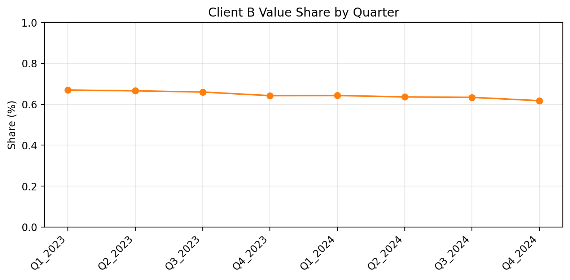
Client B Value Share by Quarter
Notes:
Share trajectory: is Client B gaining ground overall or seasonally?

Slide 10
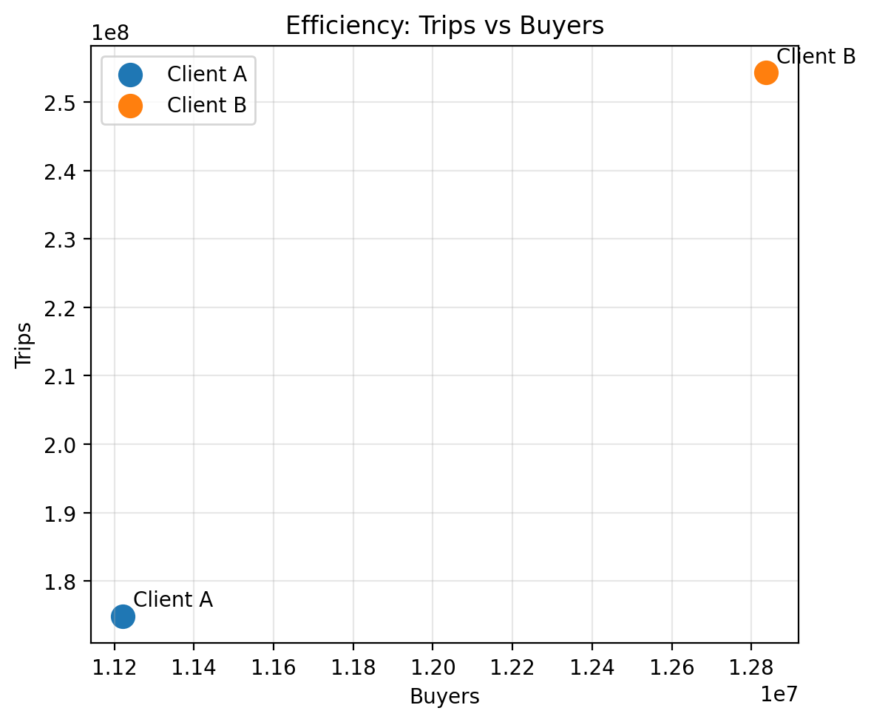
Efficiency: Trips vs Buyers
Notes:
Is B a 'frequency' player or a 'reach' player? Align strategy (loyalty vs. acquisition).

Slide 11
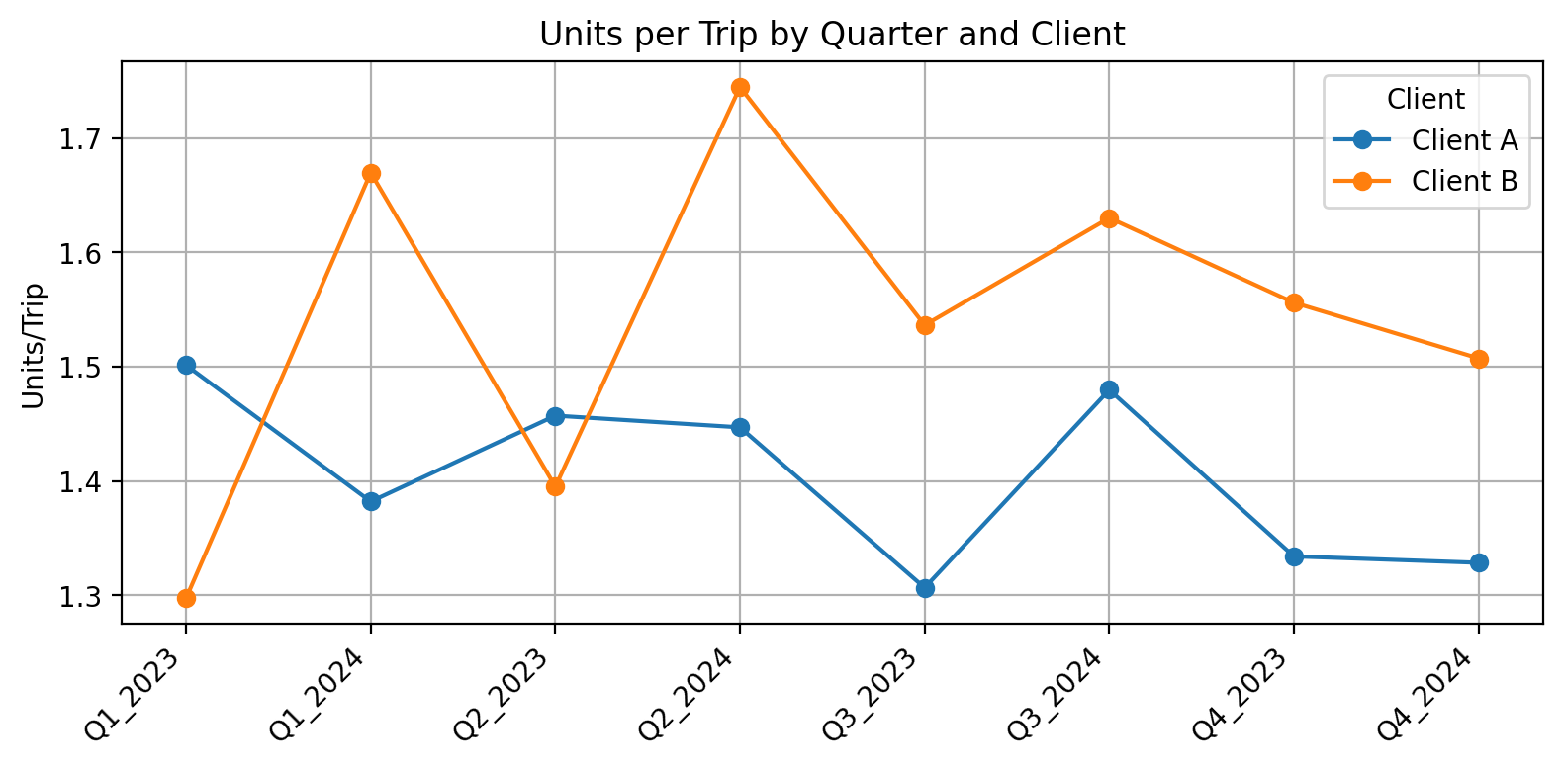
Units per Trip by Quarter and Client
Notes:
Basket depth proxy; watch for promo intensity or pack-size shifts.

Slide 12
Key Insights & Next Steps
Client B’s growth pockets by flavour and demographics
Efficiency levers: increase trips or value per trip
Prioritize quarters/flavours where B gains share
Test & learn: targeted promos for underperforming segments
Data wish-list: promo calendar, price, distribution coverage

