Slide 1
H₂O Isotope using BeTR
Jinyun Tang

Slide 2
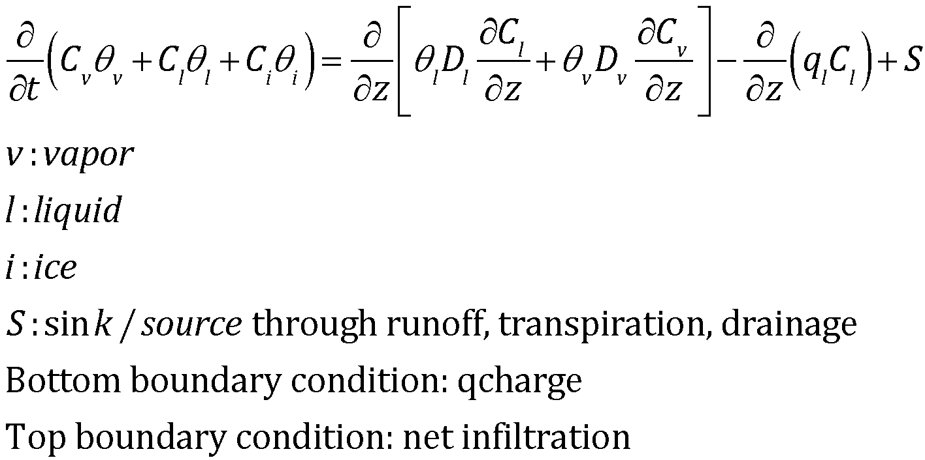
Equations solved

Slide 3
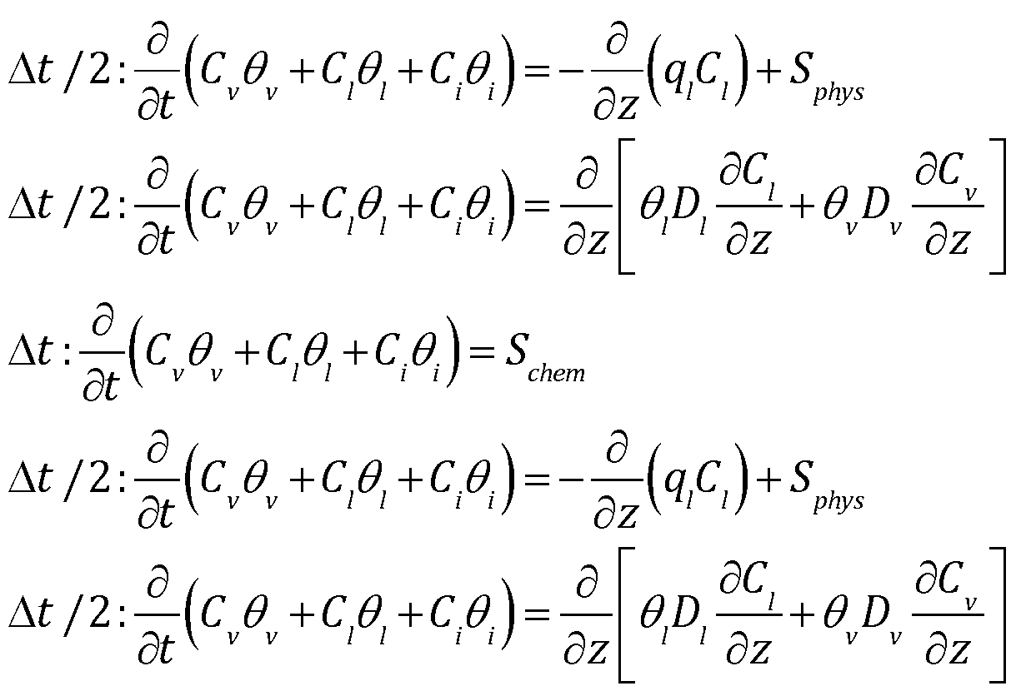
Solution strategy: operator splitting, in BetrBGCMod.F90
Residual snow, Dew formulation, runoff
Call tracer_gw_transport
Call do_tracer_advection
Call do_tracer_gw_diffusion
Call bgc_reaction%calc_bgc_reaction
Call do_tracer_advection
Call do_tracer_gw_diffusion
Drainage: call run_betr_one_step_with_drainage
Notes:
The red rectangular is implemented as run_betr_one_step_without_drainage

Slide 4
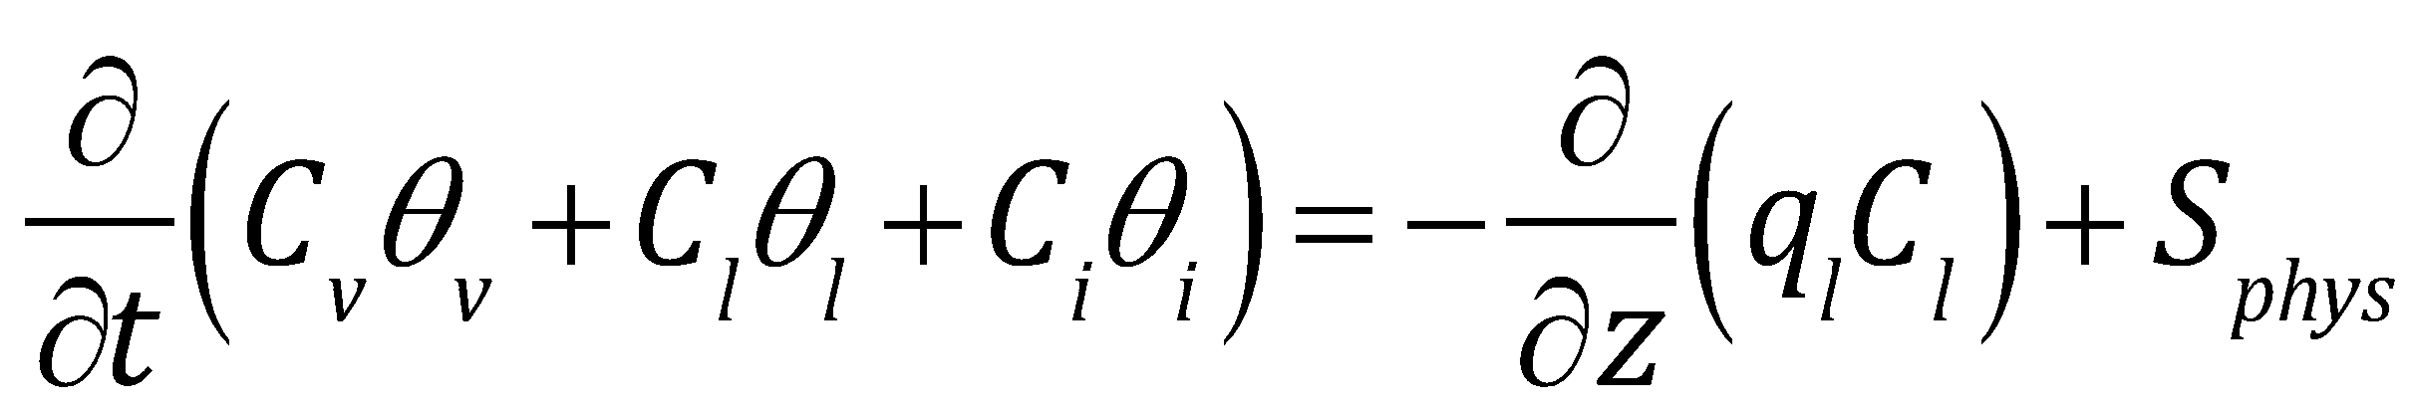
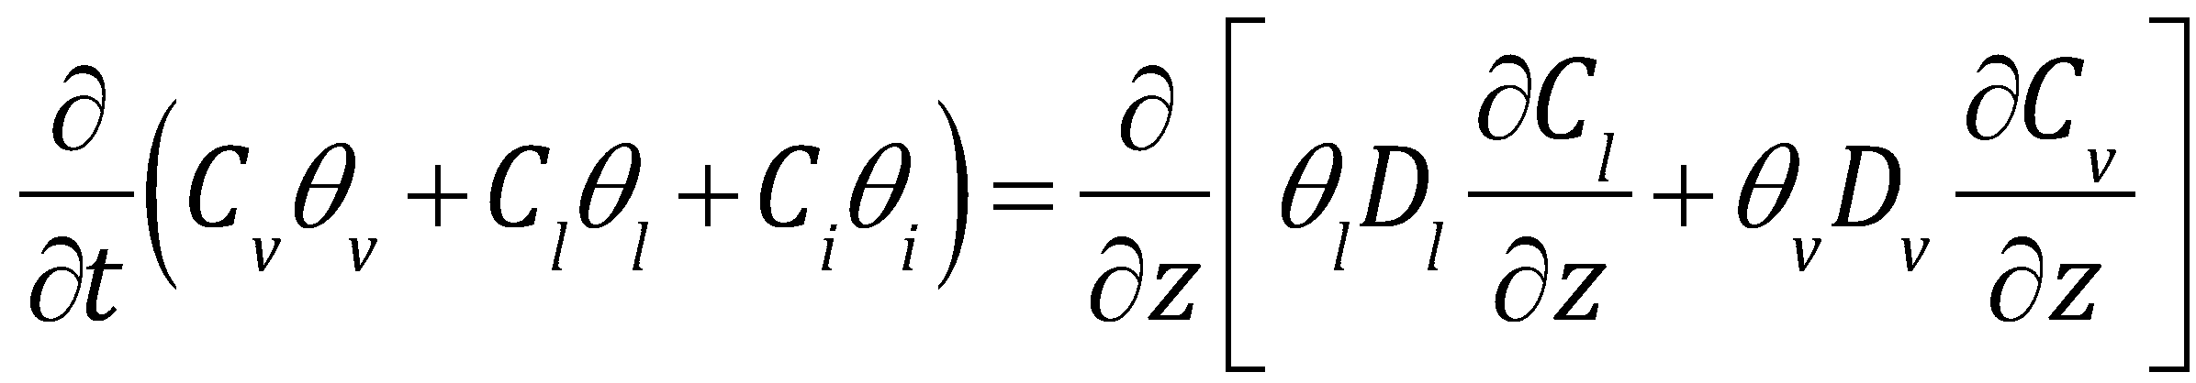
Boundary conditions
Advective boundary condition for advection, incoming flux at the upper boundary
specified as actual infiltraiton
Flux boundary condition at upper boundary for isotope vapor, and prescribed concentration for other tracers. Non-volatile tracer should use zero flux boundary condition. Zero flux condition at lower boundary. For a consistent implementation, the water isotope should also use concentration based top boundary condition, but it is hard to do it with CLM, because it uses flux boundary condition to solve the Richard’s equation. A discussion can be found in Riley et al. (2002) paper.

Slide 5
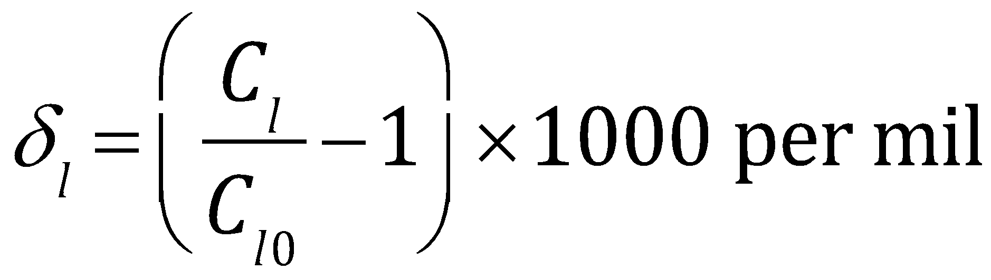
Modeling assumption
Water is dominated by the abundant H₂O¹⁶, such that the evaporation/condensation of isotope species, H₂O¹⁸, and H₂O¹⁷, and HDO¹⁶, does not affect the energy budget of the soil column.
Therefore here C_{l0}=h2osoi_liq/(dz*denh2o) and C_{l} has similar magnitude as C_{l0.}
CLM does not have water vapor, the water vapor is calculated using the Kelvin equation.

Slide 6
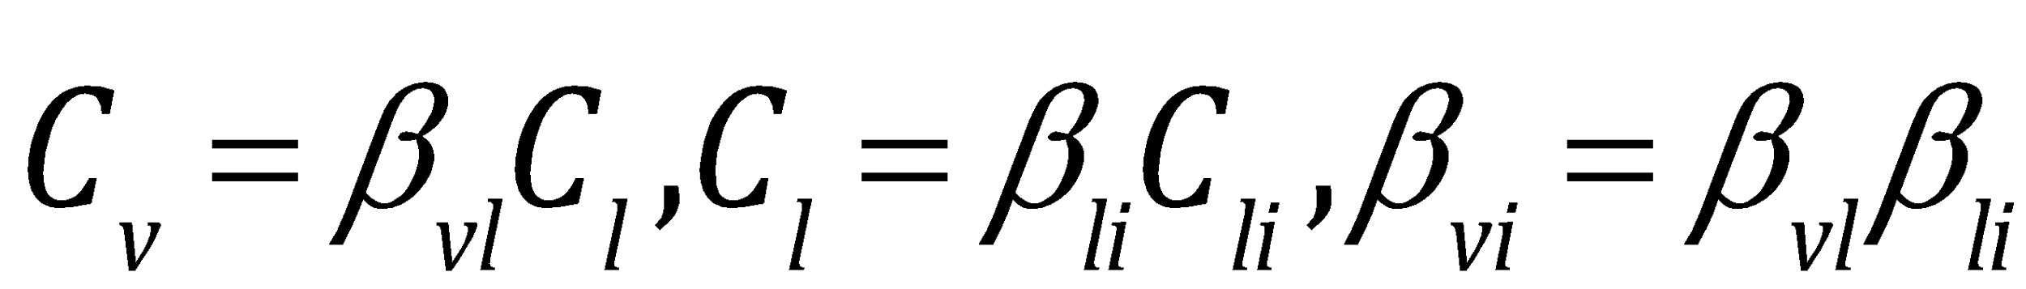
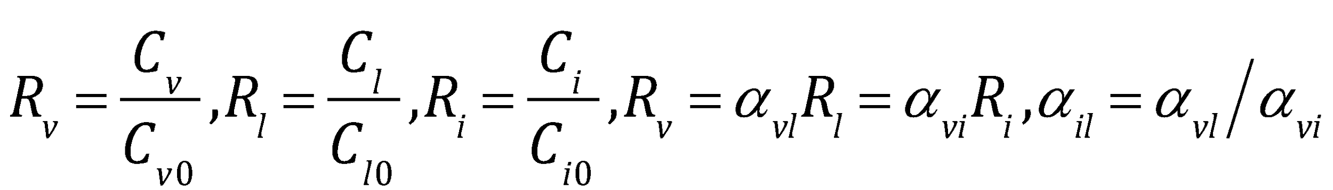
Equilibrium partitioning
For the isotope species
Relation to the standard water (H₂O¹⁶)
Reference: Braud, Bariac, Gaudet and Vauclin, J. Hydrology, 309, 2005.
Roche, GMD, 6, 1481-1491, 2013
Riley, Still, Torn and Berry, GBC, 16(4), 1095, 2002
Functions in TracerParamsMod.F90
α_{lv}: get_equi_lv_h2oiso_fractionation
α_{iv}: get_equi_sv_h2oiso_fractionation
α_{il}: get_equi_sl_h2oiso_fractionation

Slide 7
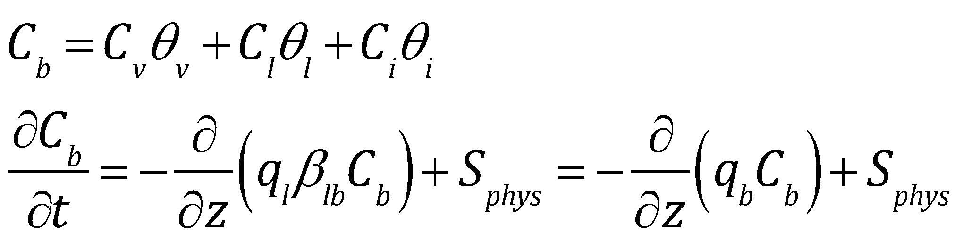
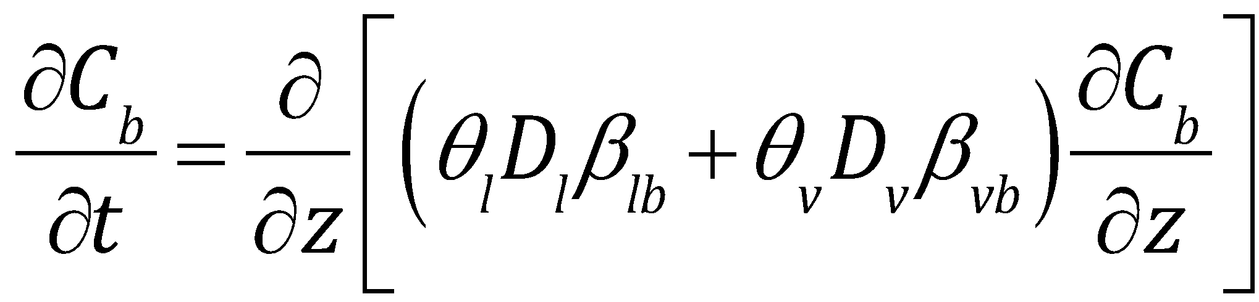
Transformed equation
The equilibrium partitioning allows transforming the governing equations (in splited form) into
The advection equation is solved using backward tracing semi-lagrangian approach, the diffusion equation is solved implicitly.

Slide 8
Steps to couple with COO¹⁸
Besides assigning proper equations in the following functions, Functions in TracerParamsMod.F90 α_{lv}: get_equi_lv_h2oiso_fractionation α_{iv}: get_equi_sv_h2oiso_fractionation α_{il}: get_equi_sl_h2oiso_fractionation all other work would be done in BGCReactionsO18IsotopeType.F90, in particular the subroutine calc_bgc_reaction and set_boundary_conditions

Slide 9
Needed Modifications
subroutine set_boundary_conditions This sets up proper top boundary conditions. Currently, the conductance is only based on diffusivity in air (using fixed value). A proper formulation should also consider additional resistance from snow and ponding water (this could refer to the ch4mod.F90) and the wicking process (this is discussed in Tang and Riley, HESS, 2013)

Slide 10
Needed Modifications
subroutine calc_bgc_reaction This only need to pull heterotrophic respiration and root respiration which is already calculated by the bgc model. Then apply the approach documented in Riley et al. (2002) to do the O18 exchange between water and CO₂.

Slide 11
Aboveground hydrology
Currently, I only use infiltration and transpiration flux from CLM and assume no fractionation. This should follow the approach documented in Riley et al (2002) to consistently derive the isotope fluxes through dew formulation, dripping, transpiration, interception, canopy evaporation and obtain actual infiltration and evapotranspiration fluxes for the isotope.
I also have not considered the isotope processes in the snow, which may require some parameterization. Ideally, the reactive-transport approach should be extended into snow, but that requires restructuring the snow model for a long-term fix.

Slide 12
Additional changes
One may consider add a betr simulation type to the restart file, so that a consistency check could be done to avoid using a restart file from one type of simulation to another.

Slide 13
The mock simulation
BGCReactionsMockRunType.F90 documents an example to transport five gas species, N₂, O₂, Ar, CO₂ and CH₄ through different pathways. But no chemical source/sink is involved.

