Slide 1
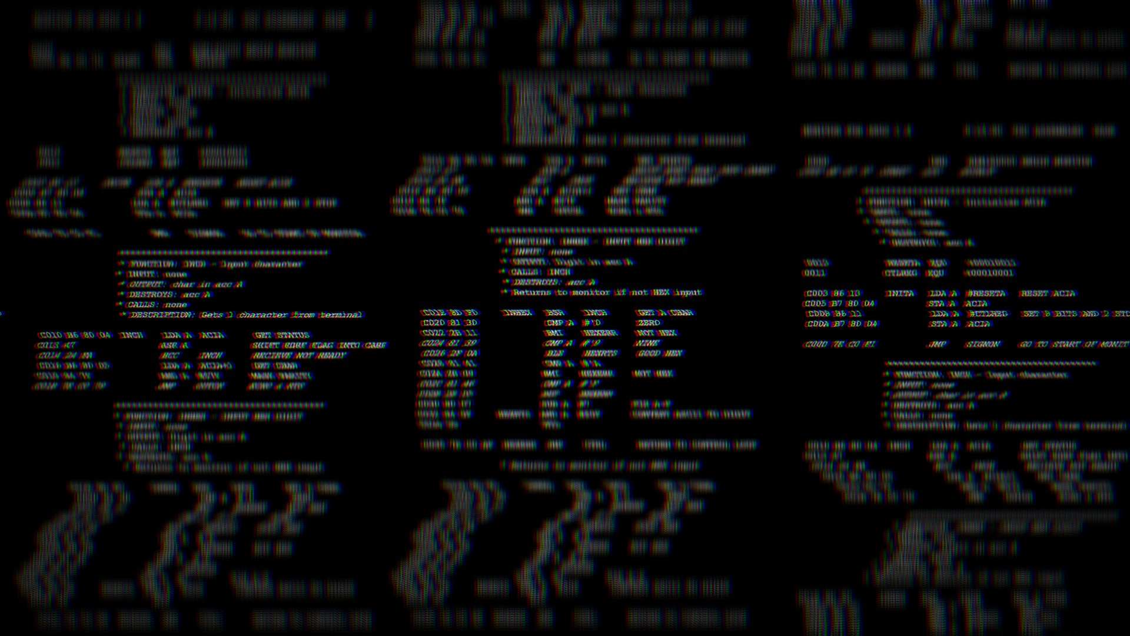
STUXNET
THE FIRST CYBER WEAPON
Presentation by Charlotte Strobl
For CSCI 405 – Principles of Cybersecurity
Holley, M. (1980). Motorola 6800 assembly language [Image]. Public Domain.
Modified by Charlotte Strobl. https://en.wikipedia.org/wiki/File:Motorola_6800_Assembly_Language.png
Notes:
Hello Everyone
Charlotte Strobl
My Presentation:
Stuxnet – the first cyber weapon

Slide 2
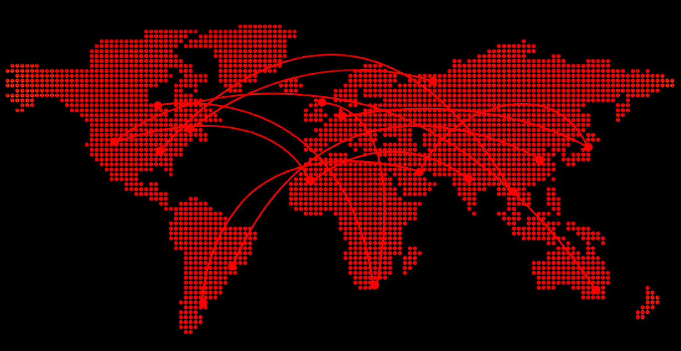
C:\Overview
Understanding Stuxnet
Worm Structure
Propagation Phase
Triggering Phase
Execution Phase
Zero Day Exploits
Windows Shortcut
Print Spooling
PNGarts. (n.d.). World map transparent background PNG [PNG file]. PNGarts.
https://www.pngarts.com/explore/108718. Modified by Charlotte Strobl.
Notes:
In this presentation, we will cover
General understanding of the events of Stuxnet
The worm phase structure including
How it spread,
What triggered it,
And what it exploited
And the zero day exploits it utilized

Slide 3
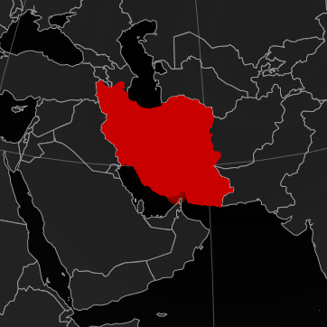
C:\Understanding_STUXNET\
Stuxnet is a highly sophisticated computer worm that innovated cyber attacks. It was active from 2007 – 2010 and marked the beginning of cyber warfare (Knapp & Langill, 2015).
TARGET: Iran’s Uranium Enrichment Facilities
INTENT: Destroy real-world machinery using a computer program
P30Carl. (1941). Map of Iran [Map]. GNU Free Documentation License.
https://aquarius.geomar.de. Modified by Charlotte Strobl.
Notes:
Highly sophisticated
Computer worm
Revolutionized cyber attacks
active from 2007 – 2010
Attacked Uranium Enrichment Facilities
Destroyed machinery
Up until this point, cyber attacks only affected things within computers.
Data
Information
Files
Never external consequences
====================================================
Knapp, E. D., & Langill, J. T. (2015). Hacking Industrial Control Systems. Industrial Network Security, 171–207. https://doi.org/10.1016/b978-0-12-420114-9.00007-1

Slide 4
C:\Worm-Structure\Phases
Worms follow a four-phase process: dormant, propagation, triggering, and execution.
This is the process that allowed Stuxnet to spread and damage machinery.
PROPAGATION
TRIGGERING
EXECUTION
Spread & multiply
Activation
Payload delivery
Notes:
It was able to do this through
Four phases of a worm
Dormant, propagation, triggering, and execution
For this presentation
Not look at dormant phase
Spread + Access devices → waits for an activation condition → unloads malicious functions

Slide 5
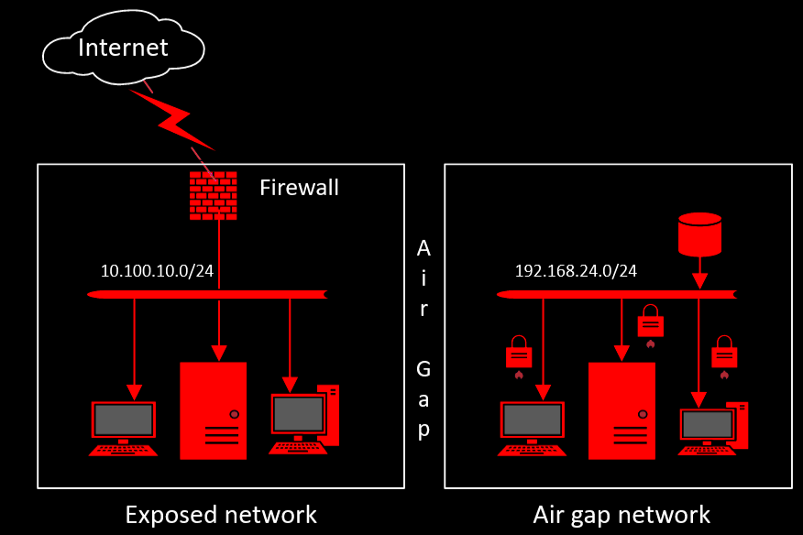
C:\Worm-Structure\Propagation
Most worms spread via the internet, but the Uranium Enrichment Facility had an isolated network (also known as an “air gap” network).
> ENTRY ALTERNATIVES:
> Infected USB
> Compromised Employee Laptop
> Social Engineering
Speculos. (2023). Air gap network topology [mage]. Wikimedia Commons.
https://commons.wikimedia.org/w/index.php?curid=138639069 Modified by Charlotte Strobl
Notes:
Spread as much as possible
Usually across the internet
But the facility had an isolated network
Air gap
Alternative entry points
USB, employee laptops
Social engineering:
someone pretending to be employee
sneaks in with worm code
========================================
“Stuxnet could spread stealthily between computers running Windows—even those not connected to the Internet” (Kushner, 2024)
Kushner, D. (2024, May 24). The real story of stuxnet. IEEE Spectrum. https://spectrum.ieee.org/the-real-story-of-stuxnet

Slide 6
C:\Worm-Structure\Triggering
In the triggering phase, Stuxnet looked for:
> WIN-CC:
> Machine Operating System
> Managed Industrial Process
> Siemen’s Step 7:
> Software for Programmable Logic Controllers (operates centrifuges)
!
!
Accessed
Infected Device
Programmable
Logic Controller
Notes:
In the triggering phase,
Stuxnet looked for
WinCC
Machine Operating System
Managed Industrial Processes
Or
Siemen’s Step 7 Software
programs PLCs
Programmable Logic Controllers
operate Centrifuges
Once this is discovered,
It initiates the execution phase ===========================
Visuals made by me

Slide 7
C:\Worm-Structure\Execution
Centrifuges
In the execution phase, the worm delivers the payload, meaning the main function or purpose of the virus is carried out.
> PAYLOAD FUNCTIONS:
> Alter centrifuge code to spin out of control
> Feed artificial data to the Industrial Control System
!
Programmable
Logic Controller
Industrial Control System
Notes:
In the execution phase,
The worm delivers the payload
(carries out the main function / purpose of the virus)
In this case,
Payload:
alter centrifuge instructions to make it spin uncontrollably
feed the industrial control system (monitoring software) fake data
so that no one will suspect a thing
===========================
Visuals made by me

Slide 8
C:\Zero-Day\Exploits
Zero Days are vulnerabilities unknown to developers.
It is undetectable against antivirus software since its signature is unknown (IBM, 2024).
They cannot patch or defend against an attack they are not aware of.
Stuxnet used 4 Zero Days, two of which being a Windows shortcut vulnerability and Print Spooling.
Notes:
Stuxnet did this utilized what’s called a “Zero Day” exploit
Zero day exploits are vulnerabilities unknown to developers
Only the hacker knows
“known for zero days”
How can they defend against something they didn’t know existed?
Stuxnet used 4 total
Two will be discussed in this presentation
Windows shortcut vulnerability
Print Spooling
=============================================
“…the signature is unknown or as yet unavailable, and therefore undetectable by many antivirus software solutions…”
IBM. (2024, September 11). What is a zero-day exploit?. IBM. https://www.ibm.com/topics/zero-day Visuals made by me

Slide 9
C:\Zero-Day\Windows-Shortcut
Vulnerability in Windows Shell Could Allow Remote Code Execution
MS10-046
Viewing an icon could allow for remote code execution (Microsoft Security Bulletin, 2010)
If exploited could give a hacker the same user rights as the local user (Microsoft Security Bulletin, 2010)
!
!
Notes:
If the malware got into a USB stick,
Then just viewing an icon
Remote execution
If crafted accordingly
This is how Stuxnet got passed the isolated network.
It altered the icon
Upon viewing
Executed the malware
Allowing it to infect further
===============================================================
Microsoft Security bulletin MS10-046 - critical. Microsoft Learn. (2010, August 2). https://learn.microsoft.com/en-us/security-updates/securitybulletins/2010/ms10-046
Visuals made by me

Slide 10
C:\Zero-Day\Print-Spooling
!
Vulnerability in Print Spooler Service Could Allow Remote Code Execution
> MS10-061
A print request could allow for remote code execution (Microsoft Security Bulletin, 2010)
This could give access to other devices connected to the printer
Notes:
Another zero day involved print spooling
Print spooling is the process of printer sending a print request
During this, the documents are temporarily stored before printing
Afterwards, they are deleted
But Stuxnet used this vulnerability
Sent a special print request
Containing executable code
It used this to spread to other devices
connected to the printer
===========================
Microsoft Security Bulletin. (2010, September 14). Microsoft Security bulletin MS10-061 - critical. Microsoft Learn. https://learn.microsoft.com/en-us/security-updates/securitybulletins/2010/ms10-061
Visuals made by me

Slide 11
C:\Summary
Understanding Stuxnet
Worm Structure
Propagation Phase
Triggering Phase
Execution Phase
Zero Day Exploits
Windows Shortcut
Print Spooling
PNGarts. (n.d.). World map transparent background PNG [PNG file]. PNGarts.
https://www.pngarts.com/explore/108718. Modified by Charlotte Strobl.
Notes:
In this presentation, we discussed
(read off slide)

Slide 12
D:\References
Knapp, E. D., & Langill, J. T. (2015). Hacking Industrial Control Systems. Industrial Network Security, 171–207. https://doi.org/10.1016/b978-0-12-420114-9.00007-1 Kushner, D. (2024, May 24). The real story of stuxnet. IEEE Spectrum. https://spectrum.ieee.org/the-real-story-of-stuxnet
IBM. (2024, September 11). What is a zero-day exploit?. IBM. https://www.ibm.com/topics/zero-day
Microsoft Security Bulletin. (2010, September 14). Microsoft Security bulletin MS10-061 - critical. Microsoft Learn. https://learn.microsoft.com/en-us/security-updates/securitybulletins/2010/ms10-061

