Slide 1
nightwatch
Created by: Charlotte Strobl
Date: 04/25/2025
Degree: Cybersecurity
Project Advisor: Prof. Henderson

Slide 2
Statement of Purpose
Problem:
> Challenging to understand a network
> Learning PowerShell takes time
> Programs like NMAP are noisy
Solution:
> Visual representations
> Easy to use with a PowerShell backend
> No elevated privileges required
Notes:
It can be challenging to understand a network
Especially as a student / beginner in the field
Learning powershell takes time
Even using nmap might
Fortunately, Nightwatch solves these problems by providing
Visual representations for visual learners
An easy to use interface that uses powershell on the back end
All without elevated privilege,

Slide 3





Resources
Electron Cross-platform desktop app framework
Node.js Backend logic and PowerShell integration
JavaScript Back end PowerShell output processing
PowerShell Executes diagnostic commands
HTML/CSS Front-end layout and interactivity

Slide 4
Features & Requirements
System Information:
> System Name, IP, and OS
> Network adapter Information
> Disk status & health
Network Discovery:
> Display active devices
> Hostnames and MAC address
> Ping times
Port Scanning:
> Display open and closed ports
> Check common ports
> Visual grid layout

Slide 5
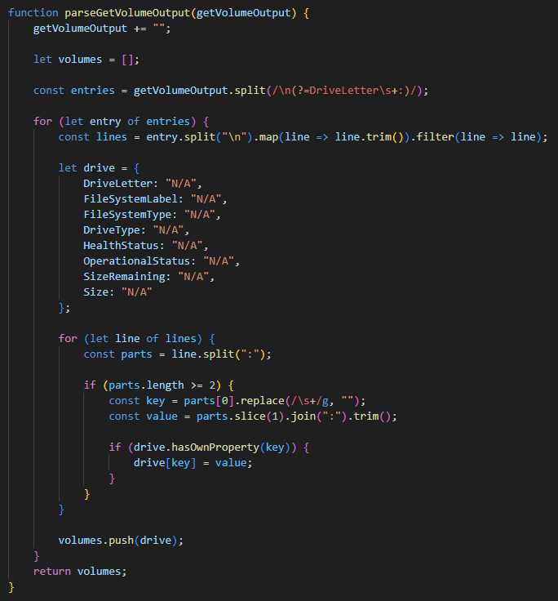
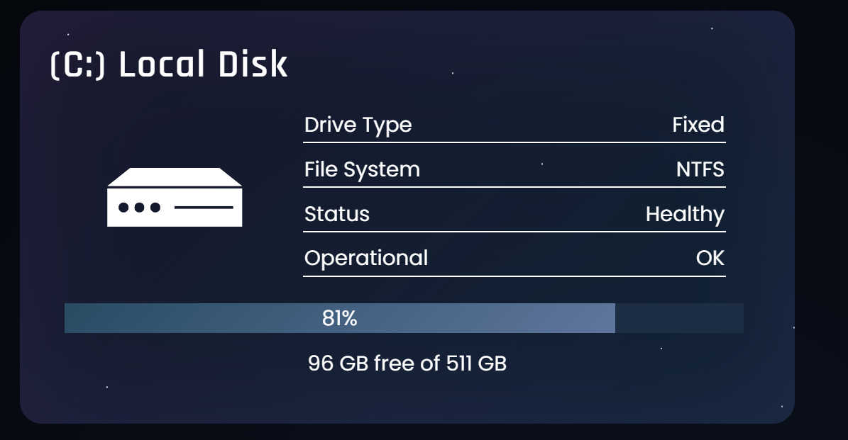
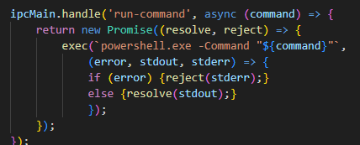

Implementation
Node.js
JavaScript
HTML/CSS
Sends a command for PowerShell to execute and waits for the results
Parses PowerShell output into an array of objects
Information displayed to users on the front-end
PowerShell
Runs command and sends the output back

Slide 6
Project Demo
Demo

Slide 7
Test Plan
Objectives
> No bugs / glitches
> Input validation
> Accurate results
> Functional on various networks
> Peer feedback

Slide 8
Test Results
Passed functionality test cases
Peer feedback & status:
Improved UI design Implemented
Ping multiple at a time Implemented
Enter your own subnet Planned
Device drop down for more info Planned

Slide 9
Future Enhancements
New Features
> Traceroute
> File Transfer Speeds
Improve Features
> Network discovery device information
> Port Scanning response time
> More user guides

Slide 10
Questions
Questions?

