Slide 1
Intro to Climate Risk Management
James Doss-Gollin

Slide 2
Decisions We Face

Slide 3
Example Decisions
Update land use / zoning regulations?
Notes:
Target: 1:01. Hook: start with concrete decisions to motivate the course. Move through examples quickly (~1 min each).

Slide 4
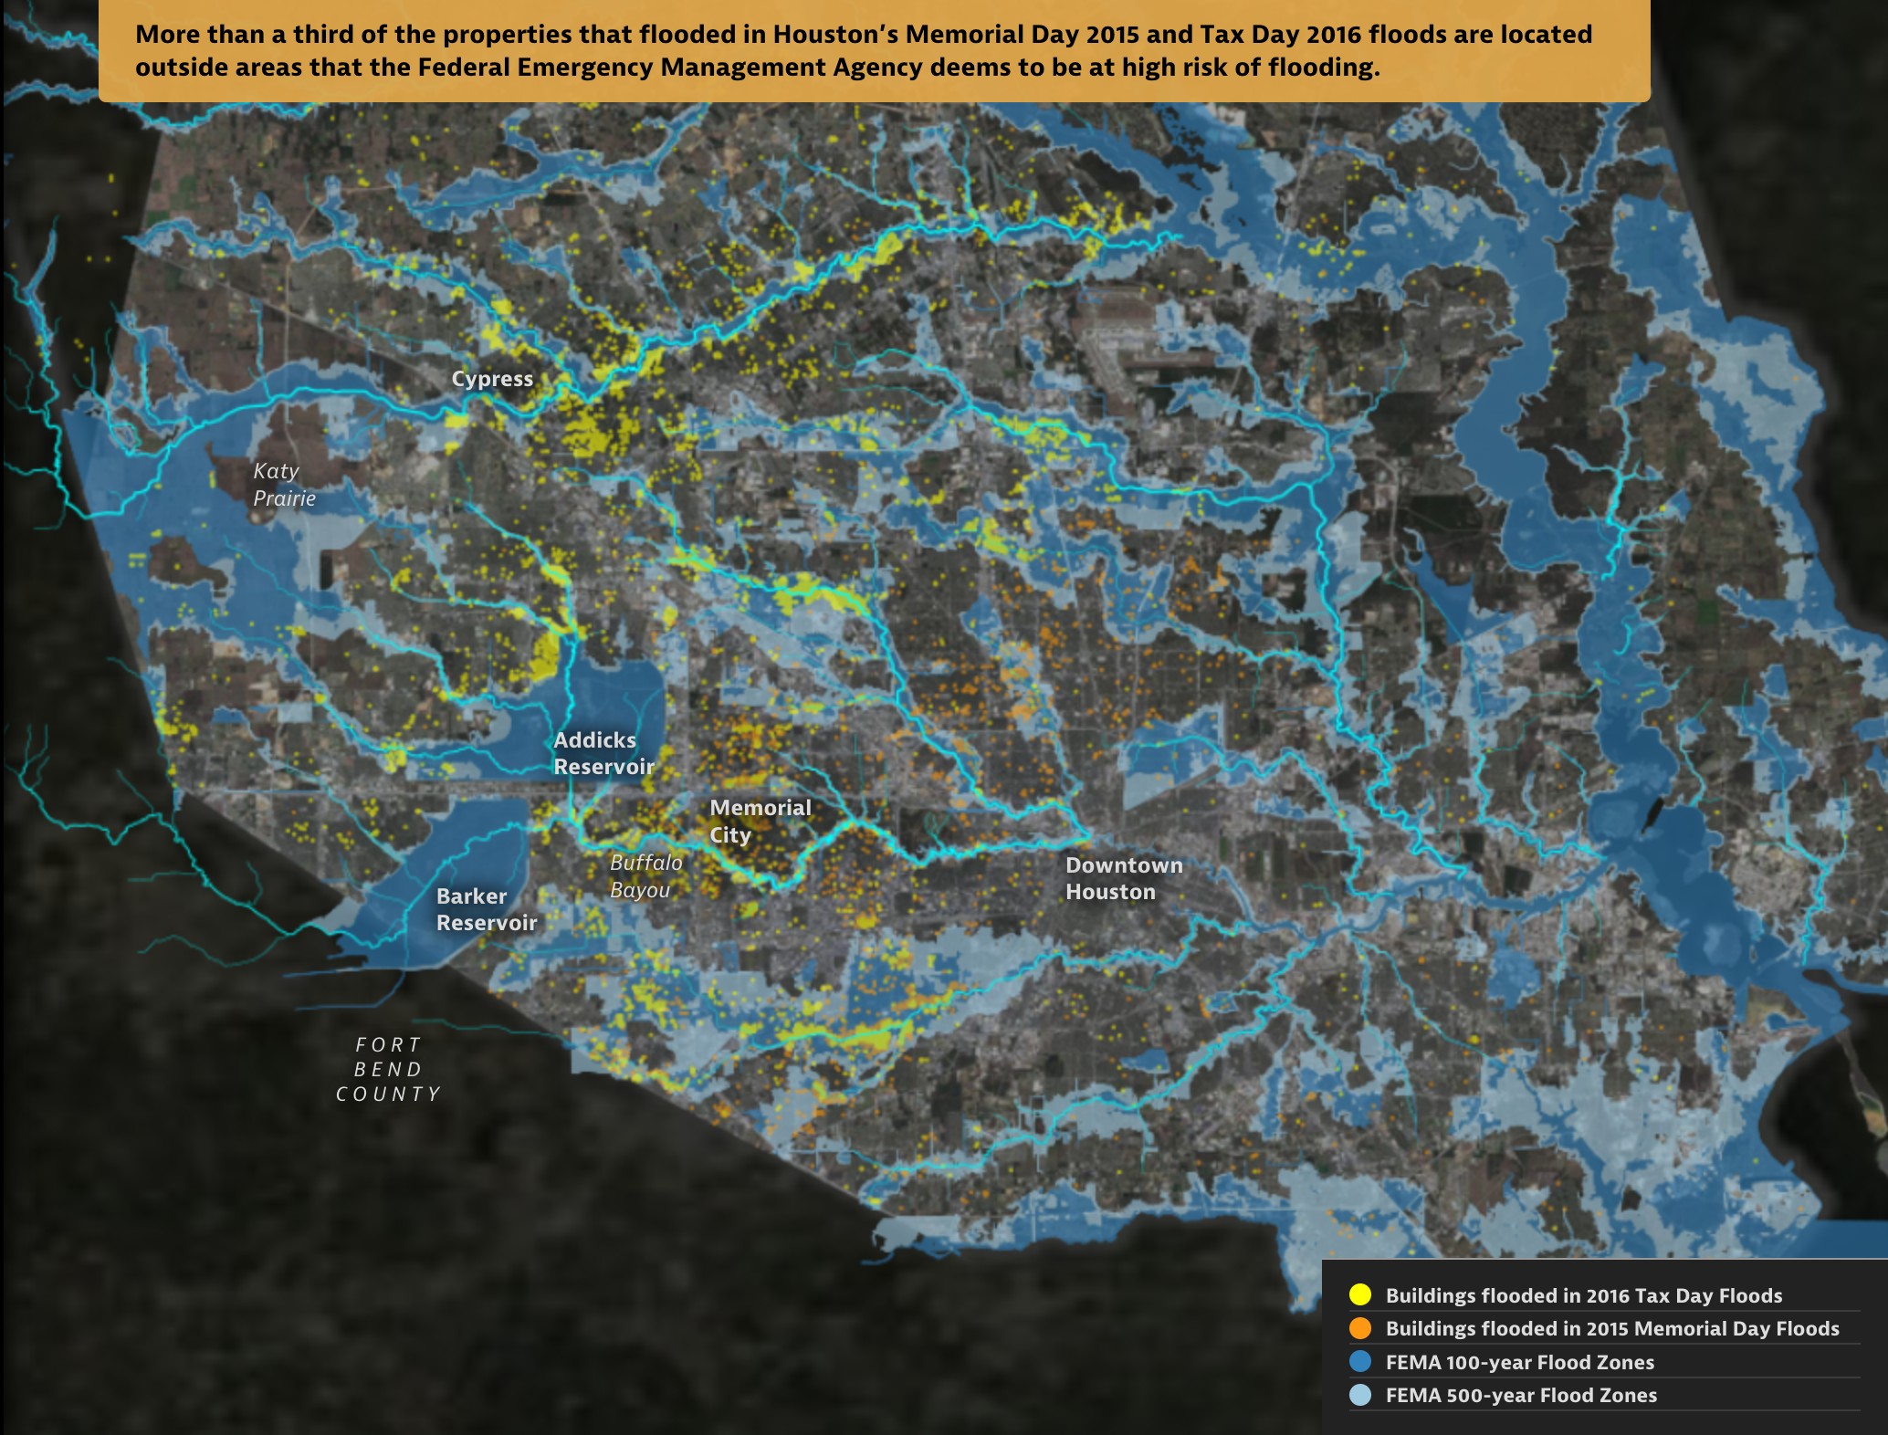
: Satija et al. (2016)

Slide 5
Example Decisions
How to size stormwater infrastructure?

Slide 6
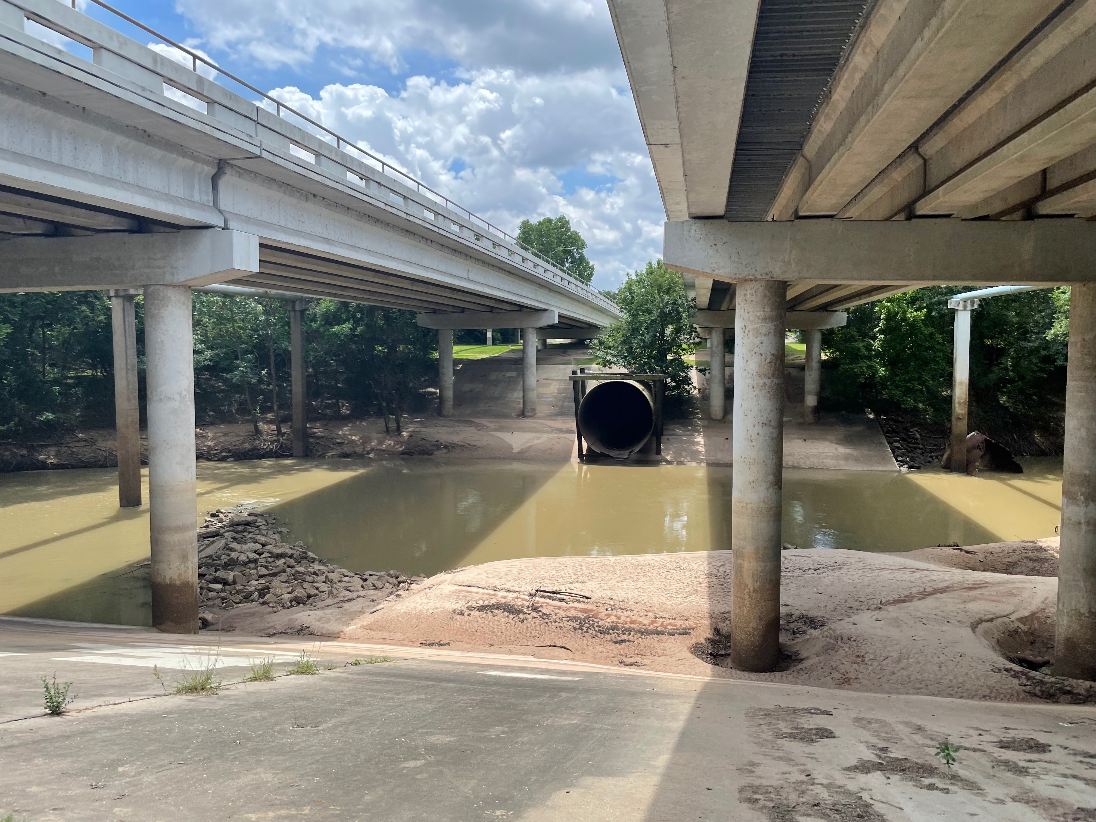
: Doss-Gollin

Slide 7
Example Decisions
How high to elevate a house for proactive flood protection?

Slide 8
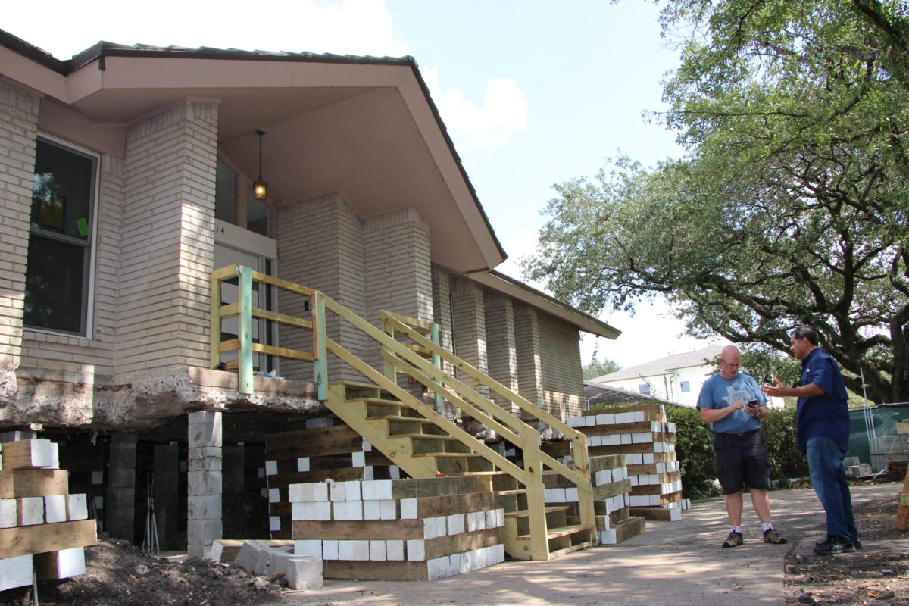
: Allison Lee / Houston Public Media

Slide 9
Example Decisions
Require weatherization of privately owned electricity infrastructure?

Slide 10
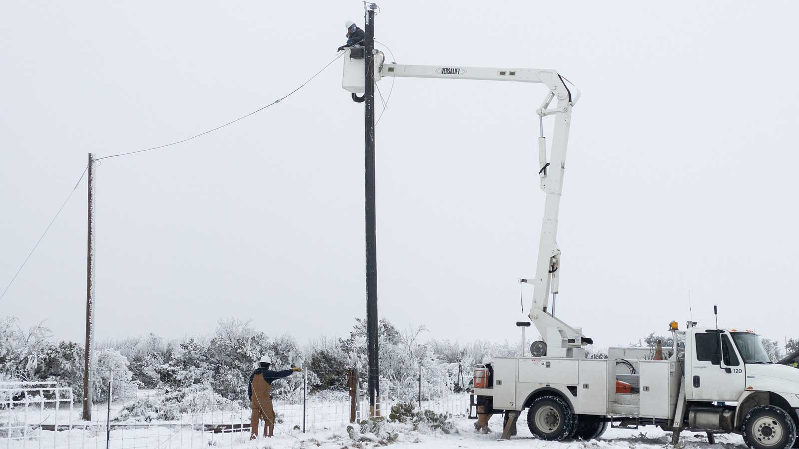
: Jonathan Cutrer / Flickr.

Slide 11
Example Decisions
How to prioritize grid hardening for a growing, electrifying city?

Slide 12
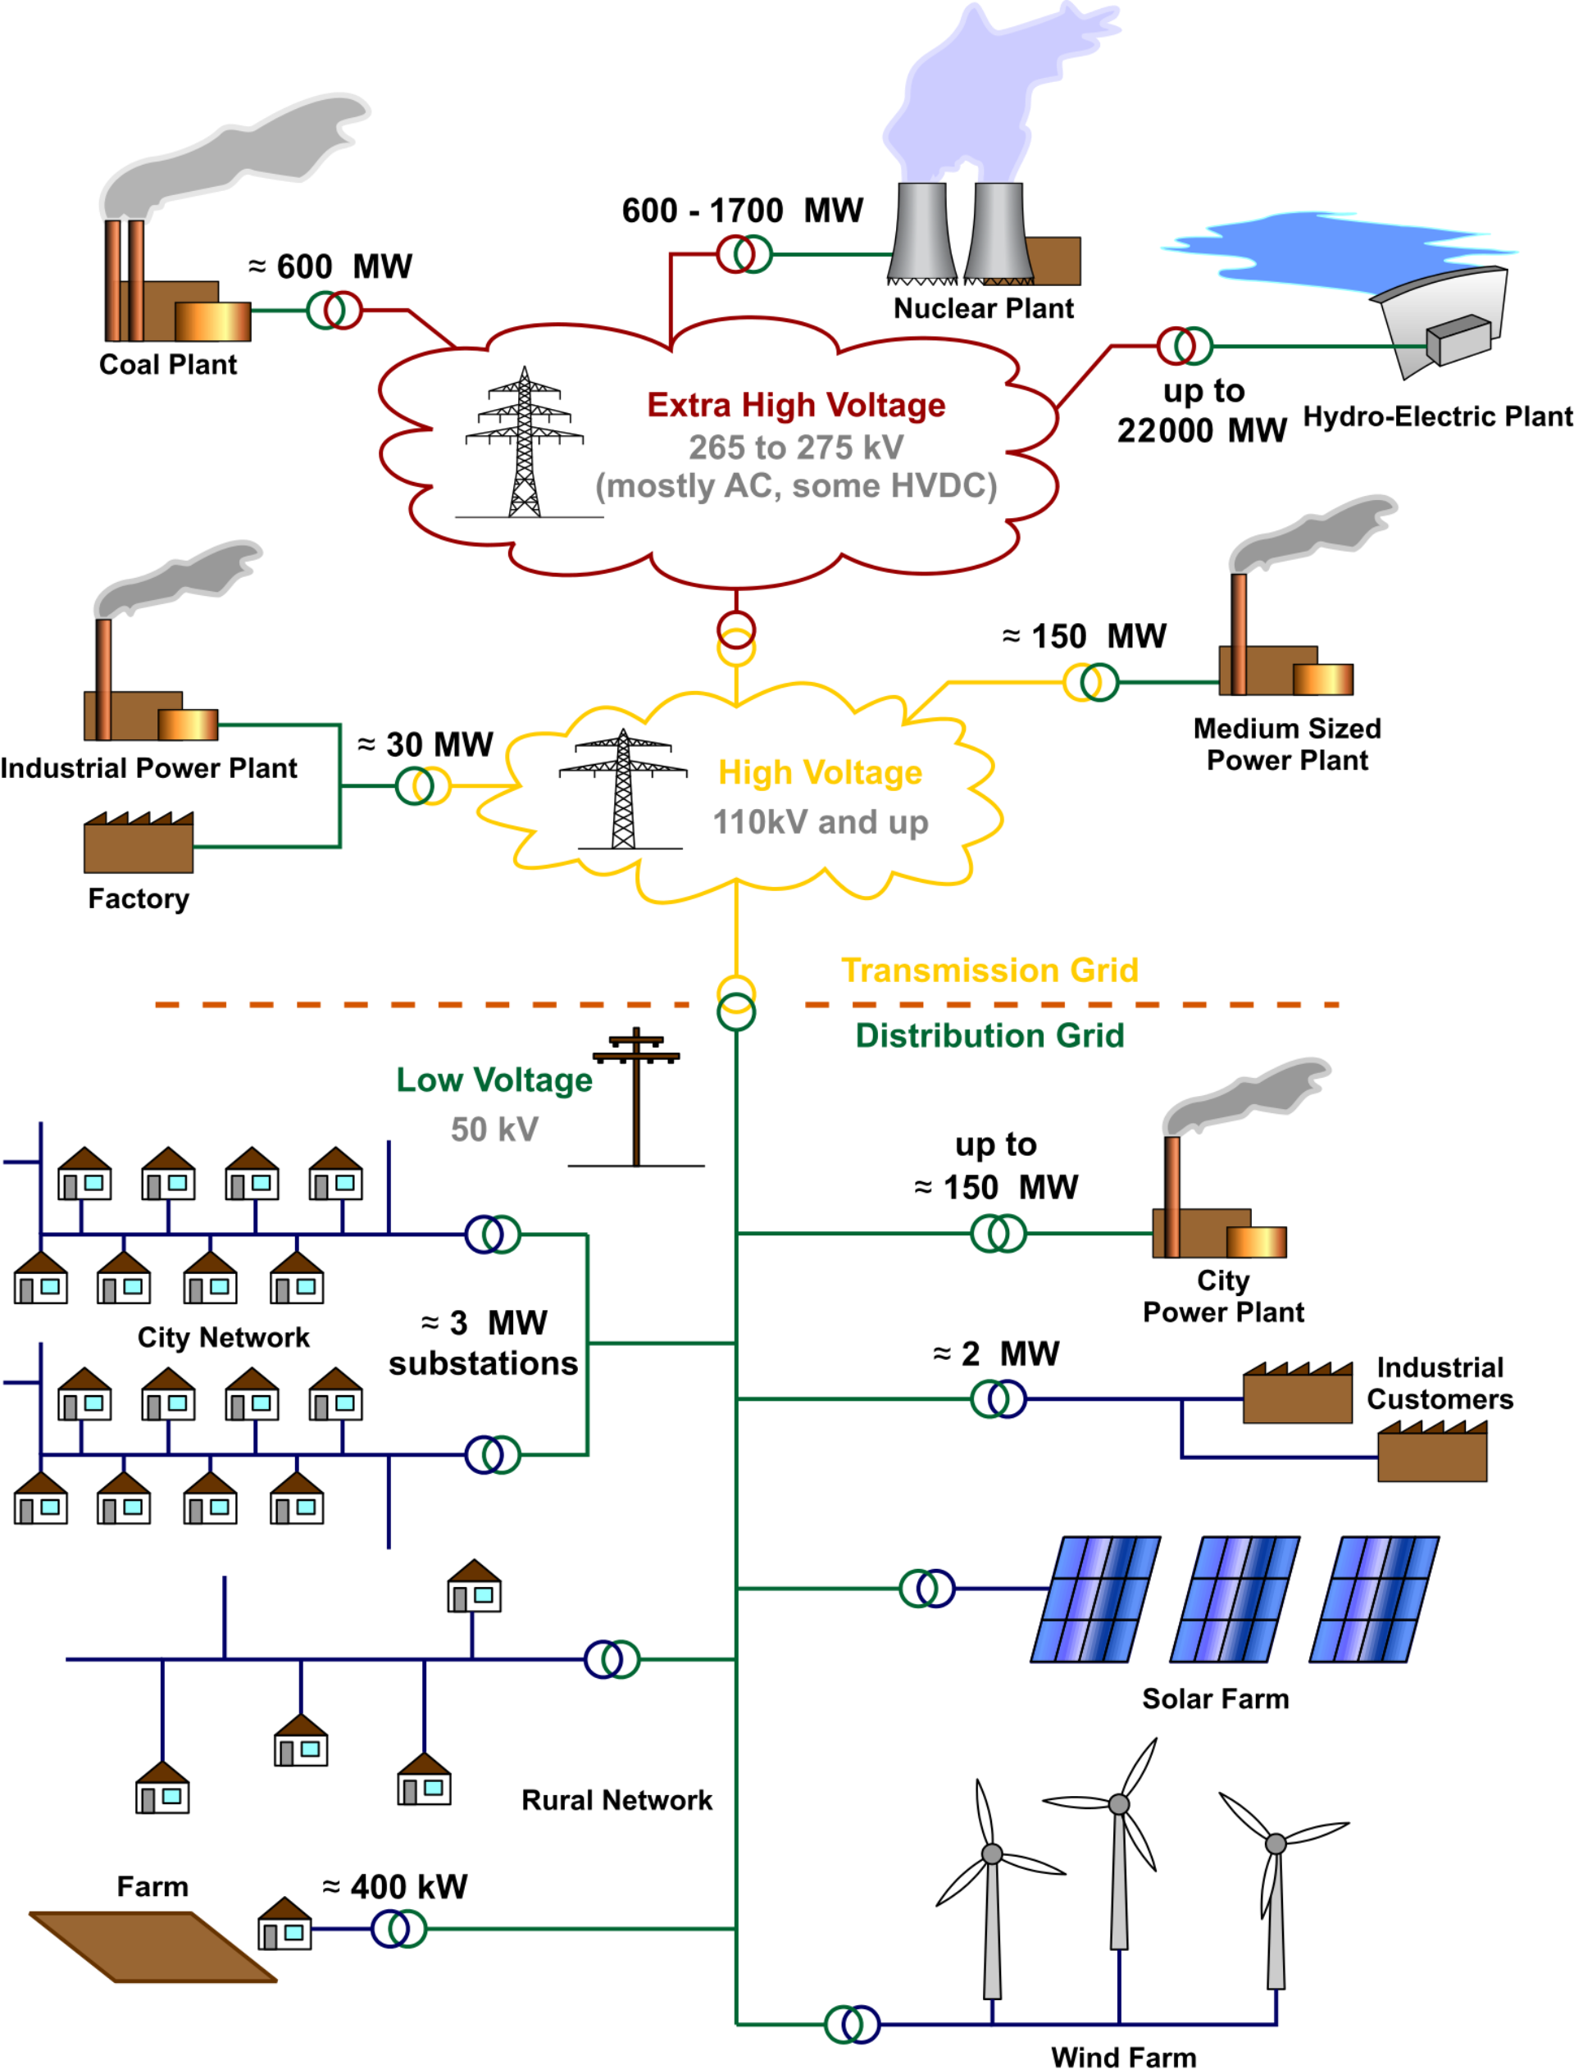
: Wikimedia Commons / CC-BY-3.0

Slide 13
Frameworks and Concepts

Slide 14
Your Turn
Tip
How would you help a decision-maker choose the “best” option? What tools or frameworks would you reach for?
Notes:
Target: 1:06. Pause for thinking, then invite responses. Listen for: data, models, economics, optimization.

Slide 15
Foundations We’ll Draw On
Economic theory: utility, welfare, cost-benefit analysis
Stochastic optimization: optimal decisions under uncertainty
Uncertainty quantification: characterizing what we don’t know
Robust decision making: strategies that work across scenarios
Engineering systems analysis: modeling complex systems
Notes:
Target: 1:08. Connect to what students said. These are the theoretical pillars of the course.

Slide 16
Climate
Notes:
Target: 1:10. Quick definition – don’t belabor.

Slide 17
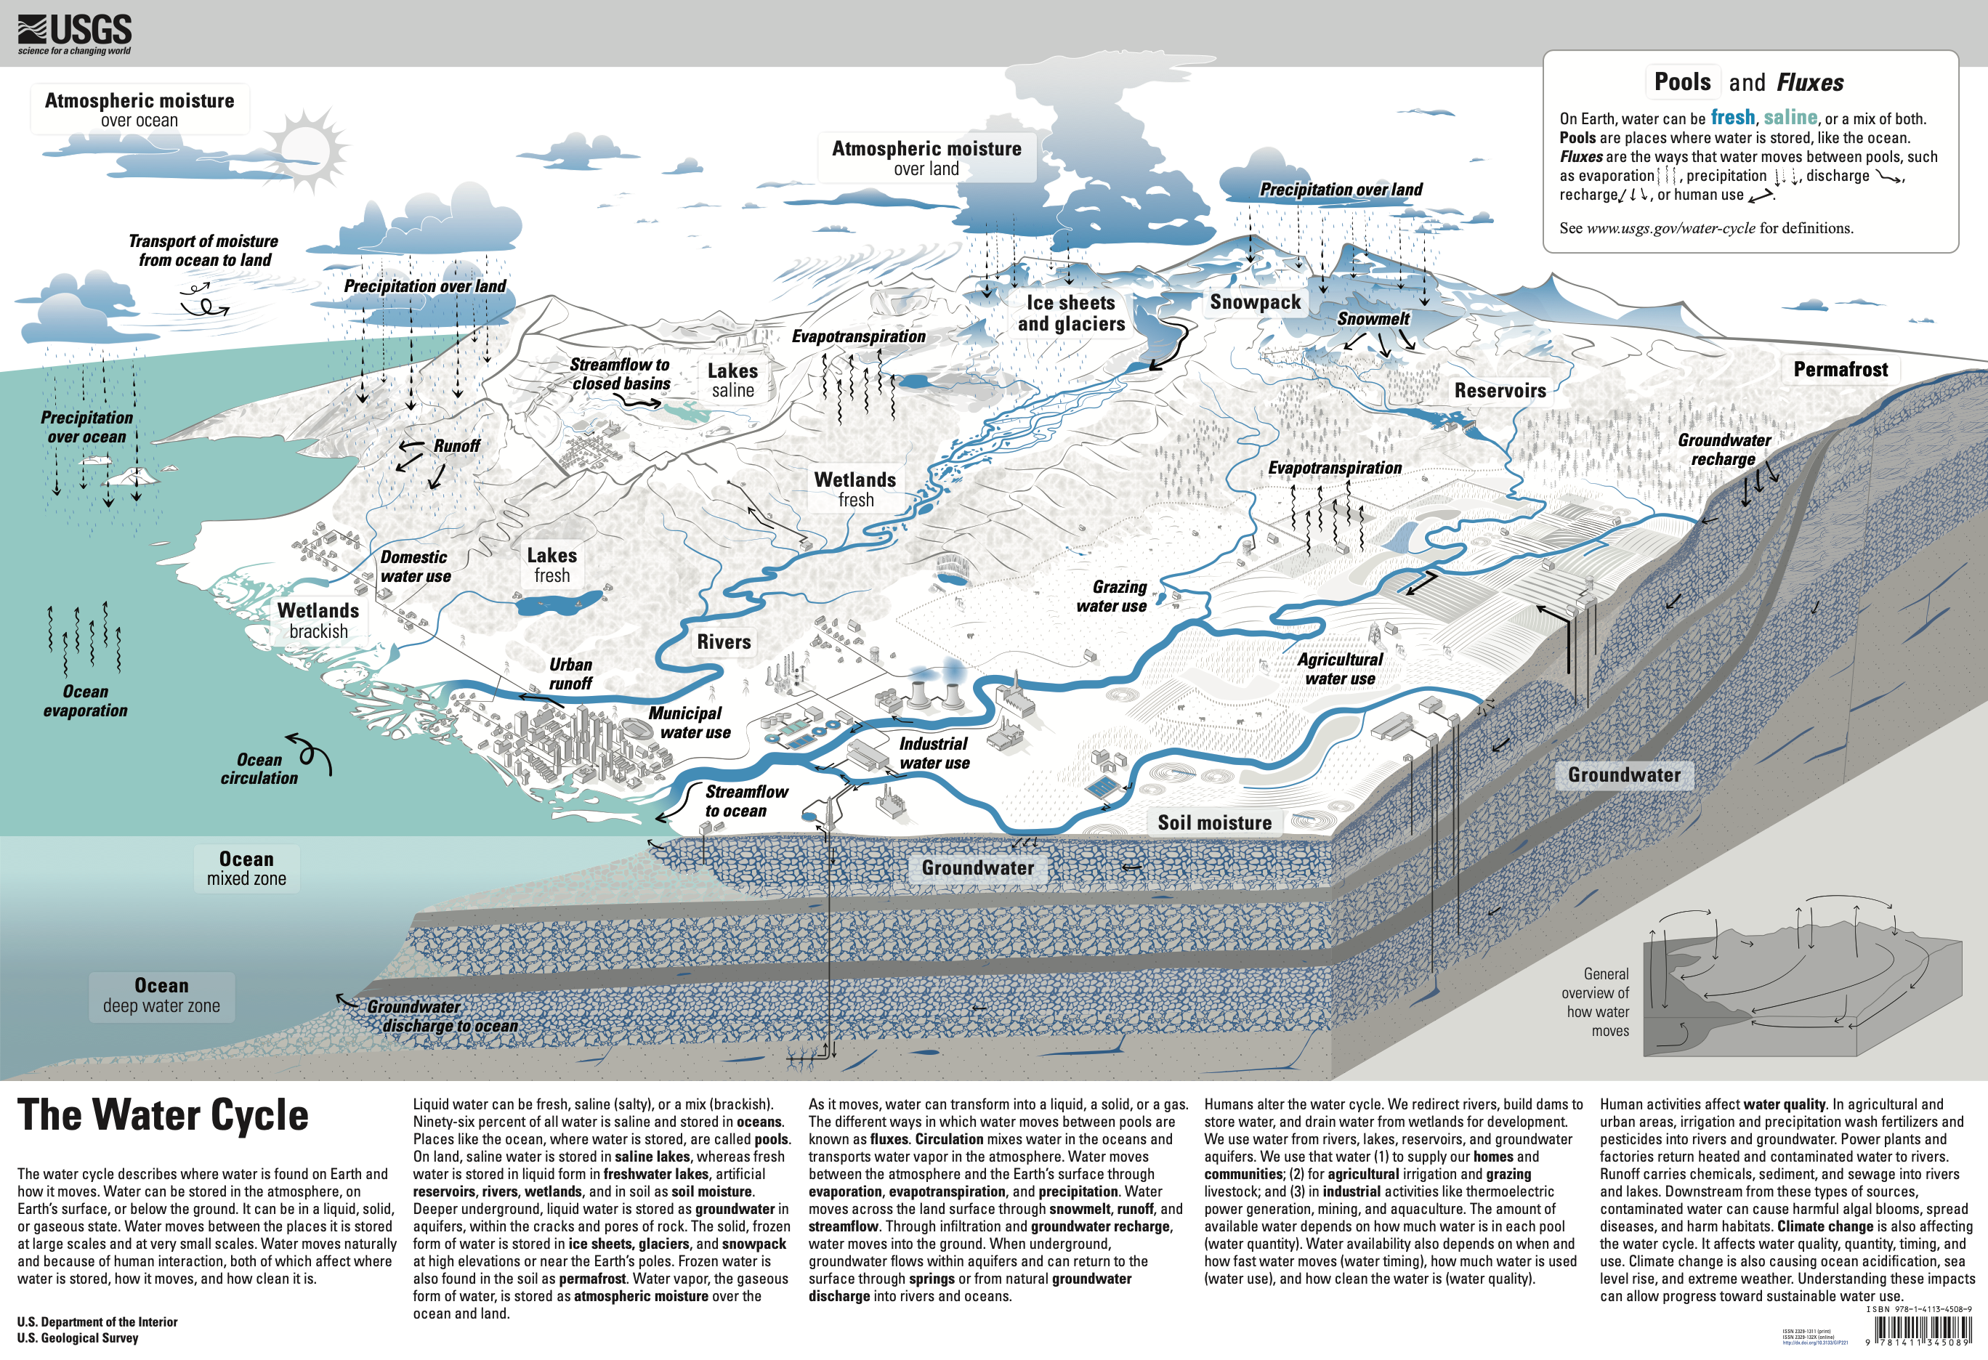
The slowly varying aspects of the atmosphere–hydrosphere–land surface system.
AMS Glossary of Meteorology
: USGS Water Cycle

Slide 18
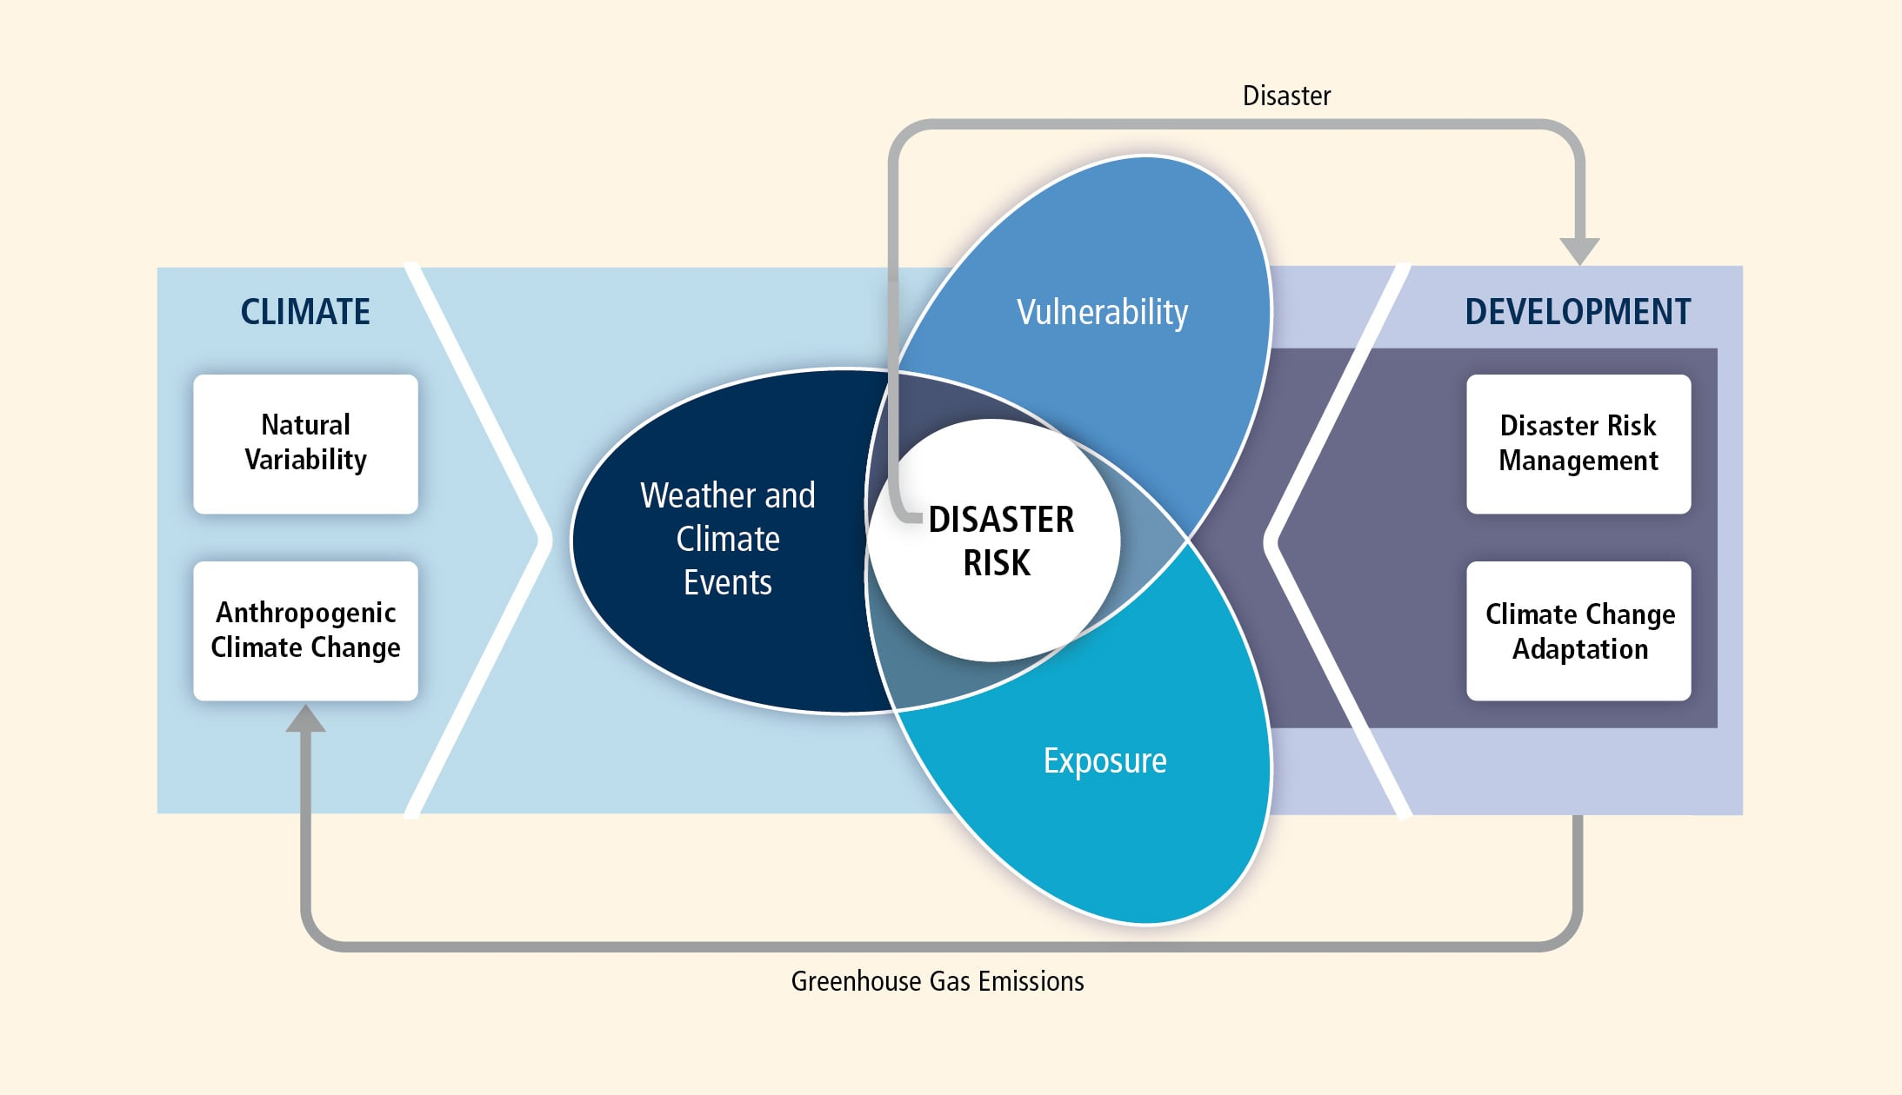
Risk Framework
: IPCC AR5 WG2
Notes:
Target: 1:12. IPCC risk framework: Risk = f(Hazard, Exposure, Vulnerability). Point out all three components.

Slide 19
Climate Risks
Your turn!
What climate risks have you heard of?
Notes:
Target: 1:14. Quick brainstorm – call on a few students.

Slide 20
Climate Risk Management
Your turn!
What climate risk management strategies have you heard of?
Financial instruments (e.g., insurance)
Floodproof buildings
Zoning codes
Major infrastructure
Improve emergency planning
Notes:
Target: 1:17. Another quick brainstorm. Reveal fragments after hearing responses.

Slide 21
XLRM Framework
We’ll use XLRM to structure our thinking about decisions:
X = eXogenous uncertainties (what we can’t control)
L = Levers (decisions we can make)
R = Relationships (how the system works)
M = Metrics (what we care about)
Notes:
Target: 1:20. Key framework for the semester. Will revisit many times. X-L-R-M mnemonic.

Slide 22
About Us

Slide 23
About Me
Notes:
Target: 1:22.

Slide 24
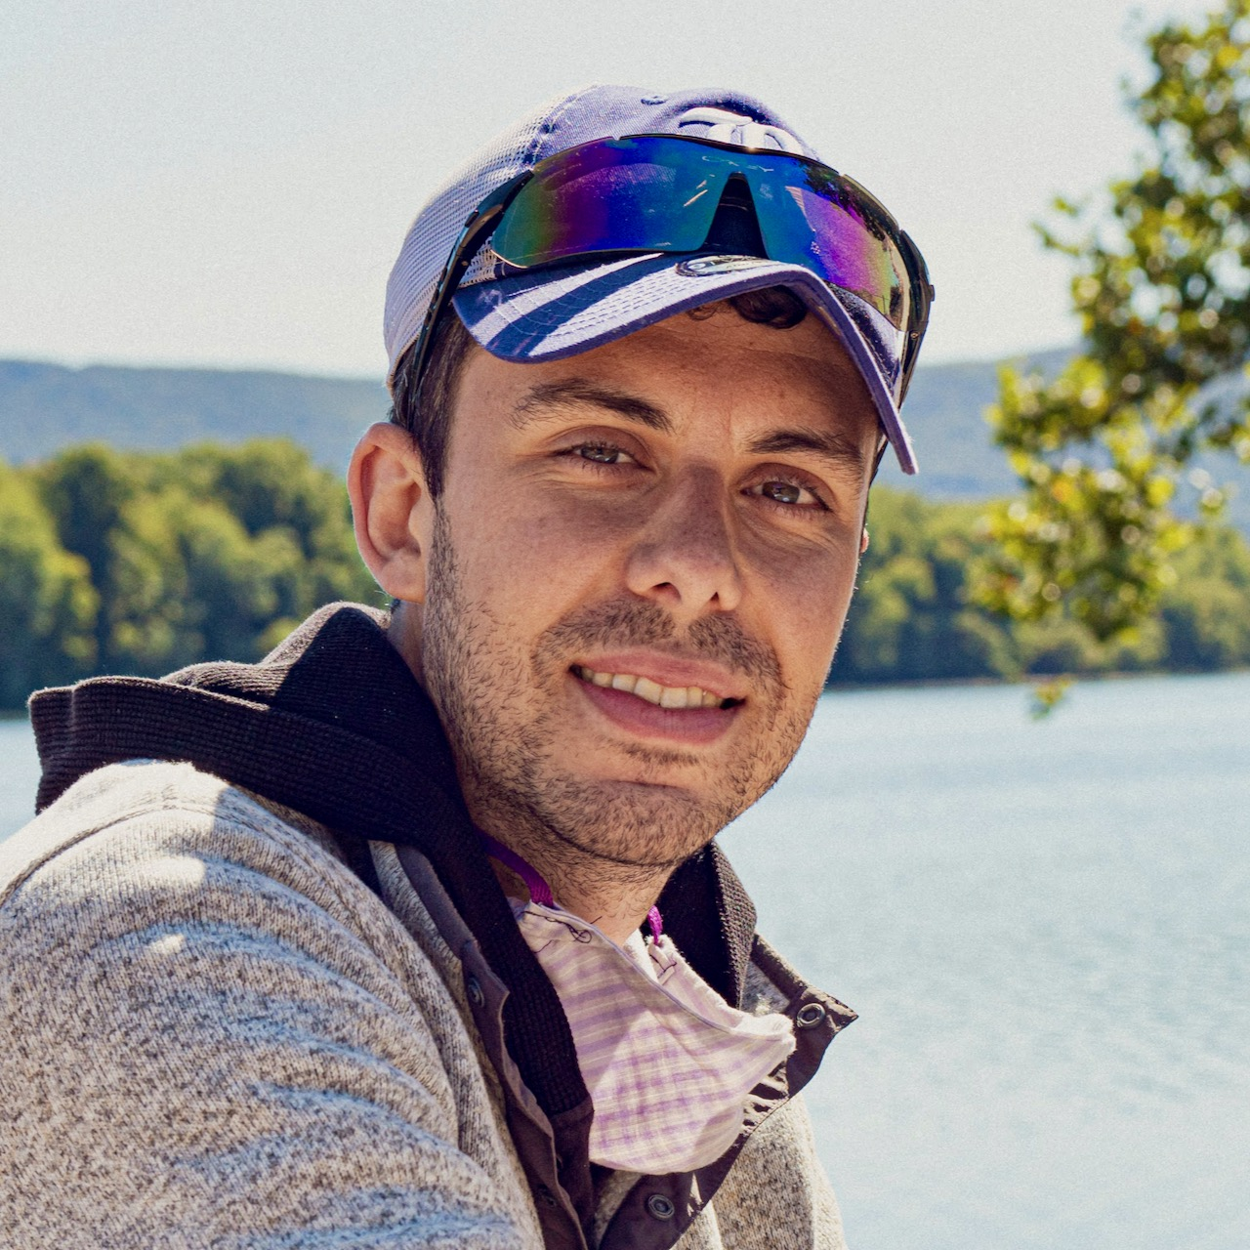
Assistant Professor of Civil and Environmental Engineering
dossgollin-lab.github.io
jdossgollin@rice.edu
Office hours Wednesday 12-1 (before class) or by appointment
Dr. James Doss-Gollin

Slide 25
Your turn
Let’s go around quickly:
Name / what you prefer to be called
Year and major / research area
Notes:
Target: 1:27. Brief intros—name and background.

Slide 26
About the Course

Slide 27
Course goals
Climate risk management is a very broad field. We will:
Survey how it is implemented in different fields
Develop a deep understanding of how to assess proposed climate risk strategies
Apply these methods to a real-world problem
Notes:
Target: 1:30. Transition to course logistics.

Slide 28
Final Project
In small teams, you’ll act as expert consultants auditing a real-world climate plan.
Three Audit Memos: Analyze the plan’s framework, evidence, and robustness
Executive Briefing: Present your findings in Week 14
Written Report: Due during finals week
Notes:
Target: 1:32. Emphasize “expert consultants” – they’re practicing a marketable skill.

Slide 29
Three modules
Risk Analysis (Weeks 1-5): Characterize hazards and quantify uncertainty
Decision Analysis (Weeks 6-9): Evaluate options under uncertainty
Optimization Under Uncertainty (Weeks 10-13): Find robust strategies
Week 14: Final Project Presentations
Notes:
Target: 1:34. Quick overview – they’ll see this structure repeated.

Slide 30
Class structure: Weekly rhythm
Day | Activity | Laptops?
Monday | Lecture | No
Wednesday | Quiz + Paper Discussion | No
Friday | Lab Studio | Yes
Notes:
Target: 1:36. Emphasize no laptops Mon/Wed—this is intentional for discussion quality.

Slide 31
No laptops Mon/Wed helps us focus on discussion. Exceptions: tablet note-taking or documented accommodations.

Slide 32
The syllabus is online!
Course website: https://ceve-421-521.github.io/
Syllabus: https://ceve-421-521.github.io/syllabus/
Read it by Wednesday!
Questions? Ask now or later!

Slide 33
Grading
CEVE 421 (Undergrad)
CEVE 521 (Graduate)
Category | Weight
Quizzes | 20%
Exams (3 × 20%) | 60%
Final Project | 20%
Category | Weight
Quizzes | 15%
Exams (3 × 15%) | 45%
Final Project | 20%
Seminar Leadership | 20%

Slide 34
Graduate students: Discussion leadership
CEVE 521 Requirement
You will lead one Wednesday discussion session.
Design an active learning experience—not just a presentation
Contact me to schedule your session
This signals to everyone: Wednesdays are active, not passive

Slide 35
About those exams
No cumulative final!
Exam 1 (Week 6): Covers Module 1 (Risk Analysis)
Exam 2 (Week 9): Covers Module 2 (Decision Analysis)
Exam 3 (Finals Week): Covers Module 3 only
Finals week = Exam 3 + Written Report

Slide 36
About the labs
Labs are ungraded but essential:
Solutions posted immediately for self-correction
Wednesday quizzes may include lab content
Exams will test your ability to apply these methods
You may attend labs in-person or on Zoom.

Slide 37
A community of learning
We all benefit from a diverse, safe, welcoming, and inclusive environment
Analysis is not value neutral
Assume good faith and engage in good faith yourself
Notes:
Target: 1:45.

Slide 38
AI and LLMs
LLMs are useful for some tasks, notably coding, if you really know what you’re doing. You should learn to use them appropriately.
Your use should be guided by purpose (here: learning!)
I want us to discuss how we use these tools rather than to police your use.
Full policy: ceve-421-521.github.io/ai.html
Notes:
Target: 1:47.

Slide 39
Accommodations
If you have a documented disability, scheduling conflicts, or otherwise need accommodations, please let me know as soon as possible.
Viruses are circulating and everyone’s immune system is different. If you need others to wear a mask to protect you, please let me know – no health disclosures needed.

Slide 40
Logistics

Slide 41
Reading for Wednesday
Two articles on flood risk management in New Jersey:
Frank (2022)
Crawford (2025)
Readings and guiding questions are on the class website
Come prepared for discussion
Quiz should be easy if you do the reading!
PDFs also available on Canvas

Slide 42
Lab 1: Friday
Julia setup and “Hello World”
Start early! Installation can be tricky.
Friday lab session is for troubleshooting and Q&A

Slide 43
This Week’s To-Dos
Before Wednesday
Read the syllabus
Complete the reading (Frank (2022) and Crawford (2025))
Before Friday
Start Lab 1 — complete the “Before Lab” setup steps
Notes:
Target: 1:50. End on time. Repeat key actions: read syllabus, do reading, start Lab 1 setup.

Slide 44
References
Crawford, Susan. 2025. “Floods and Storms Are Ravaging the Jersey Shore. Why Do We Keep Building It Back?” Rolling Stone, December 5. https://www.rollingstone.com/culture/culture-features/floods-storms-jersey-shore-beach-rebuilding-1235477927/.
Frank, Thomas. 2022. “Bold New Jersey Shore Flood Rules Could Be Blueprint for Entire U.S. Coast.” Scientific American, August 22. https://www.scientificamerican.com/article/bold-new-jersey-shore-flood-rules-could-be-blueprint-for-entire-u-s-coast/.
Satija, Nina, Kiah Collier, and Al Shaw. 2016. “Boomtown, Flood Town.” ProPublica: Hell and High Water (Houston, TX), December 7. https://projects.propublica.org/houston-cypress/.

