Slide 1
Hazard, Exposure, Vulnerability
Lecture James Doss-Gollin

Slide 2
What Is a Fair Insurance Premium?
You own a house in a flood zone.
An insurance company offers you a policy.
How do they decide what to charge you?
Today: The math behind flood risk pricing.
Notes:
Target: 1:00. Open with a question that motivates the math.

Slide 3
Quick Estimate
Scenario | Probability | Damage
No flood | 80% | $0
3 ft flood | 20% | $50,000
A house faces two possible flood scenarios this year:
Notes:
Target: 1:03. Get brains working immediately. Give 30 seconds to think, then cold call 2-3 students.

Slide 4
What’s the expected annual damage?
(30 seconds to think)

Slide 5
Quick Estimate: Answer
$$E[\text{Damage}]=0.8×\$0+0.2×\$50,000=\$10,000$$
This simple calculation is the core of risk analysis.
Today: How do we do this when floods and damages are continuous?
Notes:
Target: 1:05. Key insight: we weight by probability.

Slide 6
Today
Define key vocabulary: hazard, exposure, vulnerability
See how these combine to produce risk
Learn why $E[f(x)]≠f(E[x])$ (Jensen’s inequality)
Introduce Monte Carlo for complex damage functions
Notes:
Target: 1:07. Quick roadmap.

Slide 7
Risk Analysis Vocabulary

Slide 8
Hazard
Hazard: The physical event or phenomenon
Flood depth at a location
Wind speed during a storm
Ground shaking from an earthquake
Extreme temperature
Key insight: Hazards are characterized by probability distributions, not single values.
Notes:
Target: 1:10. Emphasize that hazard is the physical event, not the damage.

Slide 9
Exposure: What’s at Risk?
Notes:
Target: 1:12. Exposure is about WHAT is at risk, not how vulnerable it is.

Slide 10
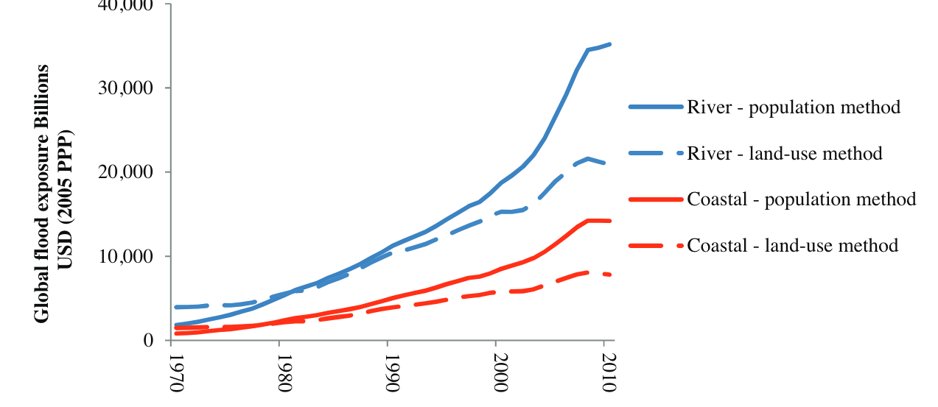
Exposure = assets that could be affected
Buildings and infrastructure
People and livelihoods
Agricultural land
Economic activity
Figure 1: Global flood exposure has grown 10× since 1970. Source: Jongman et al. (2012)

Slide 11
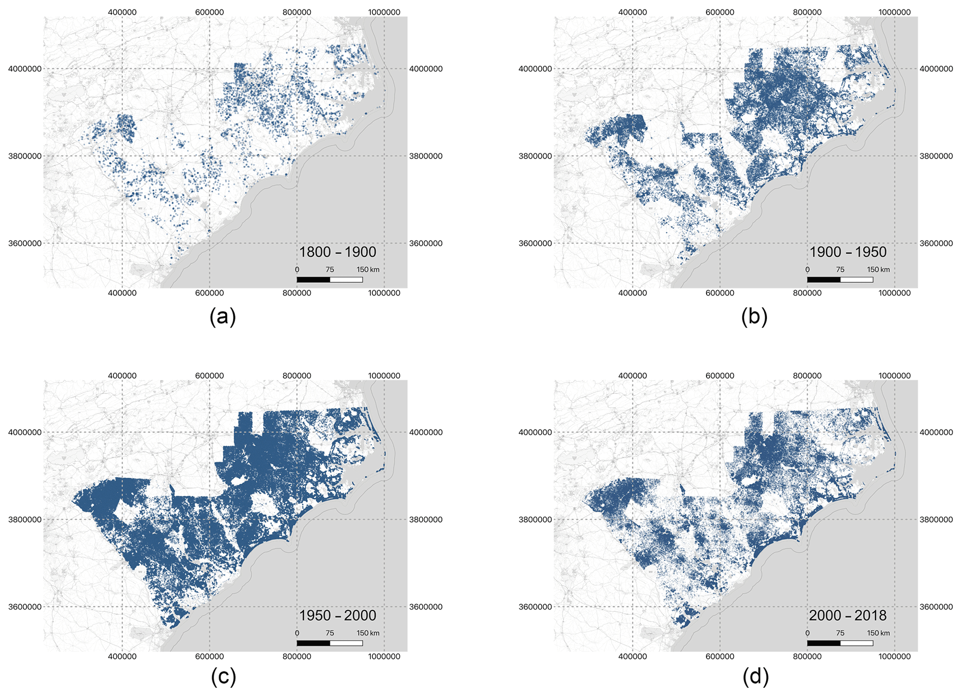
Exposure Changes Over Time
Figure 2: Houston’s built footprint 1800-2018. Development into flood-prone areas increases exposure. Source: Tedesco et al. (2020)
Notes:
Target: 1:14. Local example: Houston’s footprint has exploded.

Slide 12
Vulnerability
Vulnerability: Propensity to suffer damage given exposure to hazard
Important distinction:
Fragility: Probability of failure (binary)
Vulnerability: Degree of damage (continuous, 0-1)
Notes:
Target: 1:16. This is where depth-damage functions come in.

Slide 13
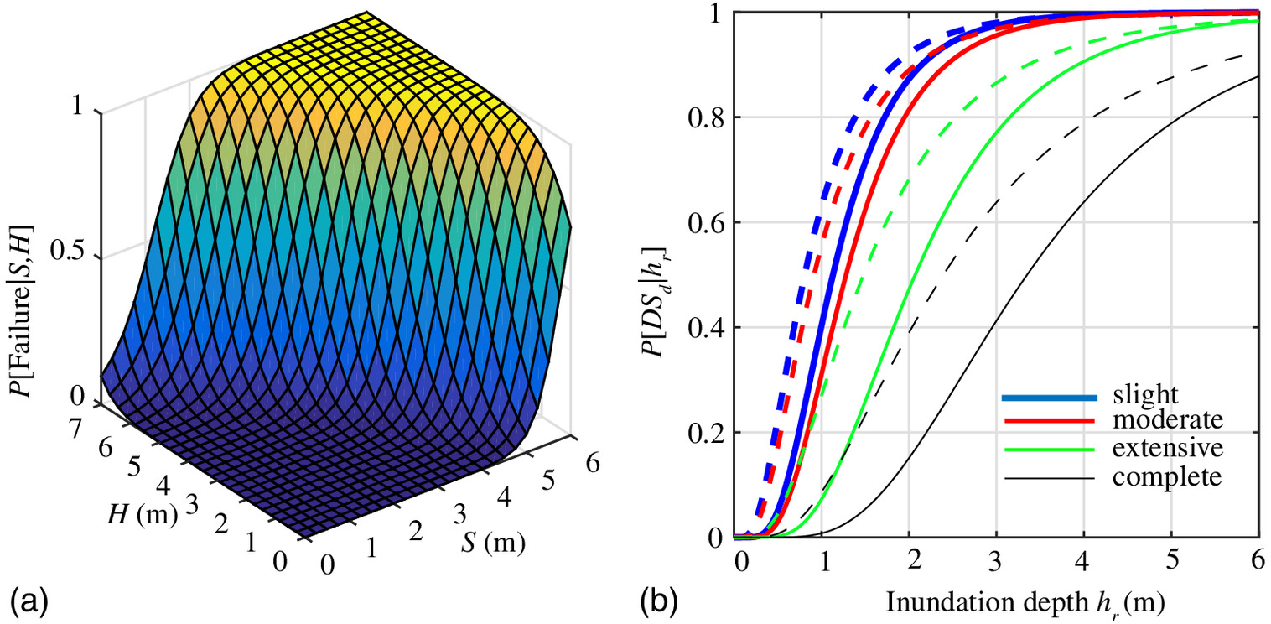
Fragility vs. Vulnerability
Figure 3: Fragility surfaces (a) and curves (b) show probability of damage given hazard intensity. Source: Gidaris et al. (2017)
Notes:
Target: 1:18. Show the Gidaris figure - panel (a) is a 3D fragility surface, panel (b) shows fragility curves.

Slide 14
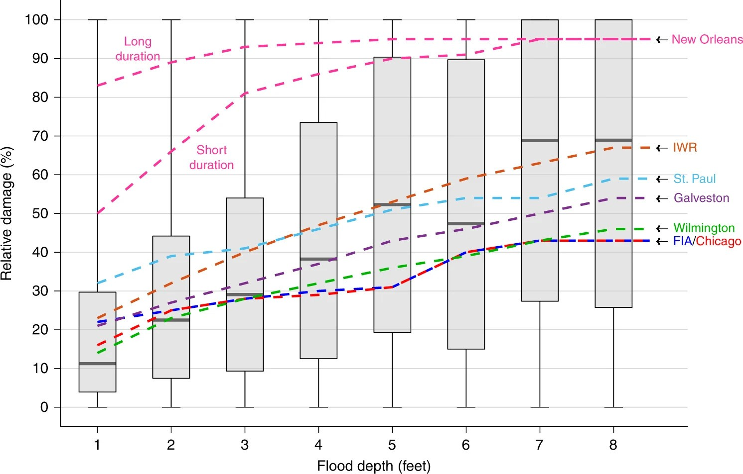
Depth-Damage Functions
For floods, depth-damage functions quantify vulnerability:
Figure 4: Empirical depth-damage from NFIP claims data. Boxplots: Wing et al. (2020) analysis. Lines: USACE engineering curves.
Notes:
Target: 1:20. Show the Wing figure. Discuss the huge uncertainty in these relationships.

Slide 15
What Do You Notice?
From the depth-damage data:
Damage increases with depth (obvious)
Huge uncertainty at any given depth
Empirical data differs from engineering curves
First foot of water causes significant damage
Notes:
Target: 1:22. Pause and ask students what they observe.

Slide 16
From Components to Risk

Slide 17
Risk = f(Hazard, Exposure, Vulnerability)
The fundamental equation:
$$\text{Damage}=\text{Vulnerability}(h)×\text{Exposure}$$
where $h$ is the hazard intensity (e.g., flood depth).
For expected damages, we integrate over the hazard distribution:
$$E[\text{Damage}]=∫\text{Vulnerability}(h)×\text{Exposure}×p(h) dh$$
Notes:
Target: 1:24. Core equation for the course. Write on board.

Slide 18
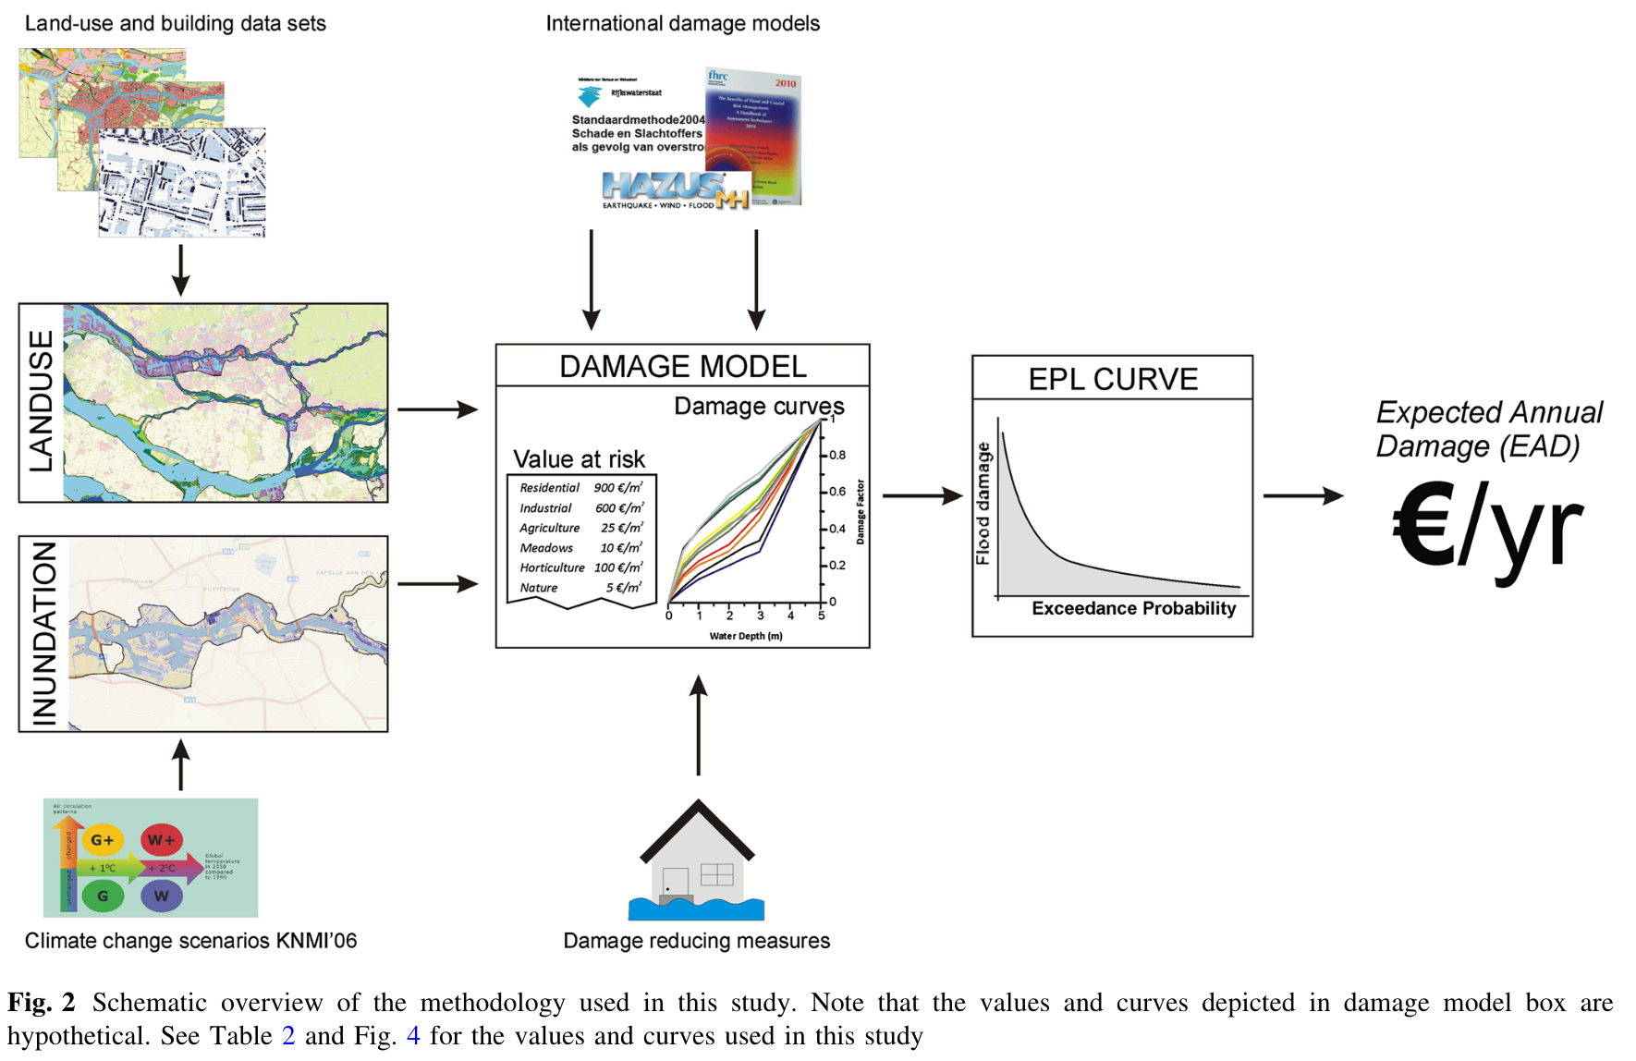
Annual Expected Damages at Scale
Figure 5: From hazard and exposure data through damage models to expected annual damage (EAD). Source: de Moel et al. (2014)
Notes:
Target: 1:26. This figure shows the full workflow from data to expected annual damage.

Slide 19
Your Turn
A city is deciding whether to build a new seawall.
Identify the hazard, exposure, and vulnerability.
Discuss with a neighbor for 60 seconds.
Notes:
Target: 1:28. Give students 60 seconds to think. Then cold call 2-3 students.

Slide 20
Convolution: Hazard → Damages

Slide 21
The Key Mathematical Idea
We have:
A hazard distribution $p(h)$: probability of each flood depth
A damage function $D(h)$: damage given flood depth
We want:
The damage distribution $p(D)$: probability of each damage level
This transformation is called convolution.
Notes:
Target: 1:32. This is the bridge to Friday’s lab. Draw on board if helpful.

Slide 22
Convolution Illustrated
Notes:
Target: 1:34. Simple example to build intuition.

Slide 23
Hazard Distribution
50% chance: no flood (h=0)
30% chance: minor flood (h=2ft)
20% chance: major flood (h=6ft)
Damage Function
h=0 → $0 damage
h=2ft → $10,000 damage
h=6ft → $100,000 damage

Slide 24
Damage Distribution:
50% chance: $0
30% chance: $10,000
20% chance: $100,000
Expected damage = $0.5(0) + 0.3(10k) + 0.2(100k) = $23,000

Slide 25
Jensen’s Inequality
For any nonlinear function $f$:
$$E[f(x)]≠f(E[x])$$
This will be on assessments. Know it.
Notes:
Target: 1:36. Critical conceptual point. This equation WILL be on assessments. Draw convex function with secant line above curve.

Slide 26
Jensen’s Inequality: Example
Notes:
Target: 1:38. Concrete example demonstrating the inequality.

Slide 27
Hazard:
50% chance: 2 ft flood
50% chance: 8 ft flood
$E[h]=5$ ft
Damage function:
$D(2)=\$5,000$
$D(8)=\$90,000$
$D(5)=\$20,000$

Slide 28
$D(E[h])=D(5)=\$20,000$
$E[D(h)]=0.5(\$5k)+0.5(\$90k)=\$47,500$
The difference matters: $27,500 underestimate.

Slide 29
Why Monte Carlo?
For continuous distributions, expected damage is an integral:
$$E[D]=∫D(h)⋅p(h) dh$$
This integral is intractable for nontrivial damage functions or probability density functions.
Solution: Monte Carlo integration approximates it with samples.
Notes:
Target: 1:40. Connect Monte Carlo to the integration problem.

Slide 30
The Law of Large Numbers
If we draw $N$ samples $h_{1},h_{2},…,h_{N}$ from $p(h)$:
$$\frac{1}{N}\sum_{i=1}^{N}{D}(h_{i})\overset{N→∞}{→}E[D]$$
The sample average converges to the true expected value.
More samples → better approximation
Notes:
Target: 1:42. Keep it simple - just the intuition.

Slide 31
Monte Carlo Recipe
Sample $N$ flood scenarios from hazard distribution
Apply damage function: compute $D(h_{i})$ for each
Summarize the damage samples
Once we have samples, we can compute any statistic:
Mean (expected annual damage)
Variance (how much does damage vary year-to-year?)
Quantiles (what’s the 99th percentile damage?)
This is exactly what you’ll implement on Friday.
Notes:
Target: 1:43. Procedural summary connecting to lab.

Slide 32
Extreme Value Theory

Slide 33
Why Extremes Matter
Most flood damage comes from rare, extreme events.
The problem: Normal distributions underestimate extreme risks.
We need specialized tools for modeling the tails of distributions.
Notes:
Target: 1:44. Just planting the seed here. Deeper coverage in Week 4.

Slide 34
The GEV Distribution
The Generalized Extreme Value (GEV) distribution is designed for annual maxima.
Three parameters:
$μ$ (location): Where the distribution is centered
$σ$ (scale): How spread out it is
$ξ$ (shape): How heavy the tail is
$ξ>0$ means fat tails: extreme events are more likely than a normal distribution predicts.
Notes:
Target: 1:45. Keep it light. Just enough to use in lab.

Slide 35
GEV in Practice
In lab on Friday, you will:
Define a GEV distribution for storm surge
Sample thousands of possible flood scenarios
Pass each through a depth-damage function
Analyze the resulting damage distribution
This is uncertainty quantification in action.
Notes:
Target: 1:46. Preview what they’ll do in lab.

Slide 36
The House Elevation Problem

Slide 37
A Concrete Decision
Notes:
Target: 1:47. Set up the problem students will use all semester.

Slide 38
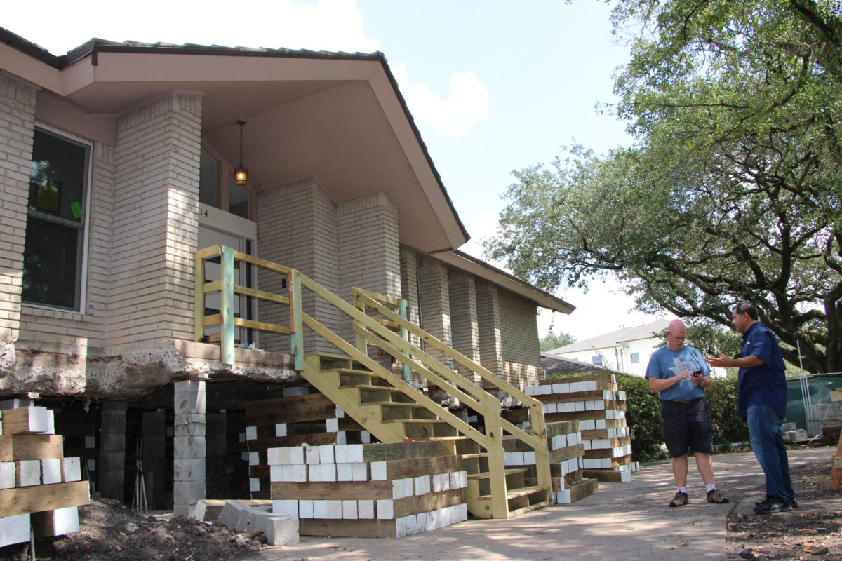
A homeowner faces a choice:
How high should I elevate my house?
Higher elevation = more upfront cost, but less future flood damage.
House elevation in Meyerland, Houston. Photo: Allison Lee / Houston Public Media

Slide 39
The Trade-off
Elevate 0 feet: No construction cost, high expected damages
Elevate 14 feet: High construction cost, near-zero damages
Somewhere in between: ???
Finding the optimal elevation requires:
A hazard model (GEV distribution for surge)
A damage model (depth-damage function)
A cost model (construction costs by elevation)
Notes:
Target: 1:48. Draw on board if helpful.

Slide 40
This Semester’s Sandbox
Week | Topic | What We Add
2 | Hazard-Damage Convolution | Basic Monte Carlo
3-5 | Risk Metrics | EAD, VaR, CVaR
6-8 | Decision Analysis | Optimal static decisions
10-13 | Deep Uncertainty | Robust optimization
We’ll use the house elevation problem throughout the course:
Notes:
Target: 1:48. Connect to the iCOW model and SimOptDecisions.

Slide 41
Wrap Up

Slide 42
Key Takeaways
Risk emerges from the interaction of hazard, exposure, and vulnerability
Exposure is growing: More assets in harm’s way
Convolution transforms hazard distributions into damage distributions
Monte Carlo lets us handle complex, nonlinear systems
The house elevation problem gives us a concrete sandbox
Notes:
Target: 1:49. Summarize main points.

Slide 43
Lab Preview: Friday
On Friday, you will:
Define a GEV distribution for storm surge
Implement a depth-damage function
Use Monte Carlo to compute damage distributions
Extend to 100 houses at varying elevations
Begin using the SimOptDecisions.jl framework
Notes:
Target: 1:50. Connect to Friday’s lab.

Slide 44
References
Gidaris, Ioannis, Jamie E. Padgett, Andre R. Barbosa, et al. 2017. “Multiple-Hazard Fragility and Restoration Models of Highway Bridges for Regional Risk and Resilience Assessment in the United States: State-of-the-Art Review.” Journal of Structural Engineering 143 (3): 04016188. https://doi.org/10.1061/(ASCE)ST.1943-541X.0001672.
Jongman, Brenden, Philip J Ward, and Jeroen C J H Aerts. 2012. “Global Exposure to River and Coastal Flooding: Long Term Trends and Changes.” Global Environmental Change 22 (4): 823–35. https://doi.org/10.1016/j.gloenvcha.2012.07.004.
Moel, Hans de, Mathijs van Vliet, and Jeroen C. J. H. Aerts. 2014. “Evaluating the Effect of Flood Damage-Reducing Measures: A Case Study of the Unembanked Area of Rotterdam, the Netherlands.” Regional Environmental Change 14 (3): 895–908. https://doi.org/10.1007/s10113-013-0420-z.
Tedesco, Marco, Steven McAlpine, and Jeremy R. Porter. 2020. “Exposure of Real Estate Properties to the 2018 Hurricane Florence Flooding.” Natural Hazards and Earth System Sciences 20 (3): 907–20. https://doi.org/10.5194/nhess-20-907-2020.
Wing, Oliver E. J., Nicholas Pinter, Paul D. Bates, and Carolyn Kousky. 2020. “New Insights into US Flood Vulnerability Revealed from Flood Insurance Big Data.” Nature Communications 11 (1, 1): 1444. https://doi.org/10.1038/s41467-020-15264-2.

