Slide 1
Climate Science and Scenarios
Lecture James Doss-Gollin

Slide 2
Motivating Questions
What causes climate hazards?
What have we not observed that is still possible?
How might these pattern change in the future?
Notes:
Frame the lecture around these two questions.

Slide 3
The Climate System

Slide 4
A Fluid on a Rotating Sphere
Climate is governed by the Navier-Stokes equations on a rotating sphere, heated unevenly by the sun.
Conservation of mass, momentum, energy
Ocean + atmosphere + land + ice + water cycle
Nonlinear interactions across scales
Notes:
Flash the equations—don’t derive them. Point is: this is physics, not magic.

Slide 5
Notes:
Don’t explain the equations. Just show that climate models solve physics.

Slide 6
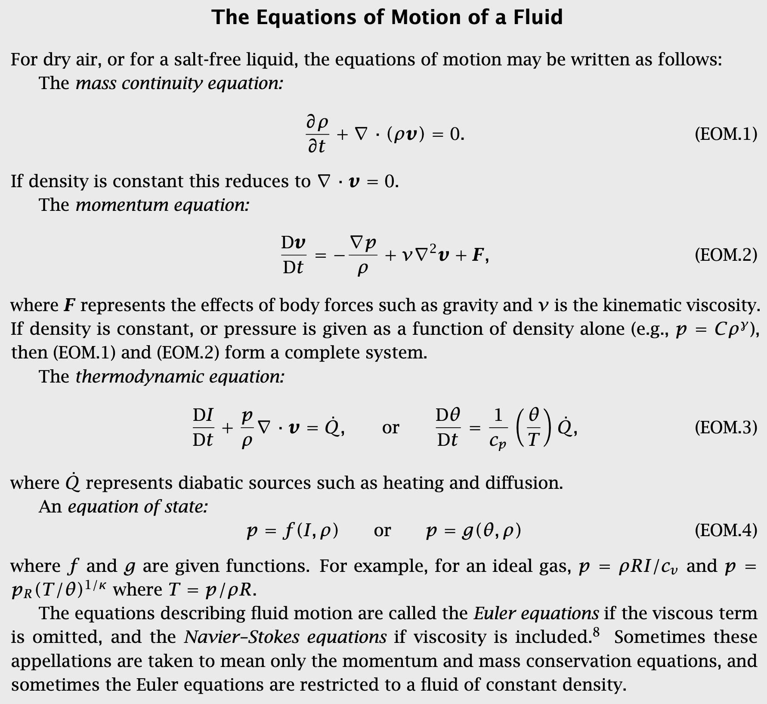
Equations of Motion
Vallis (2006)

Slide 7
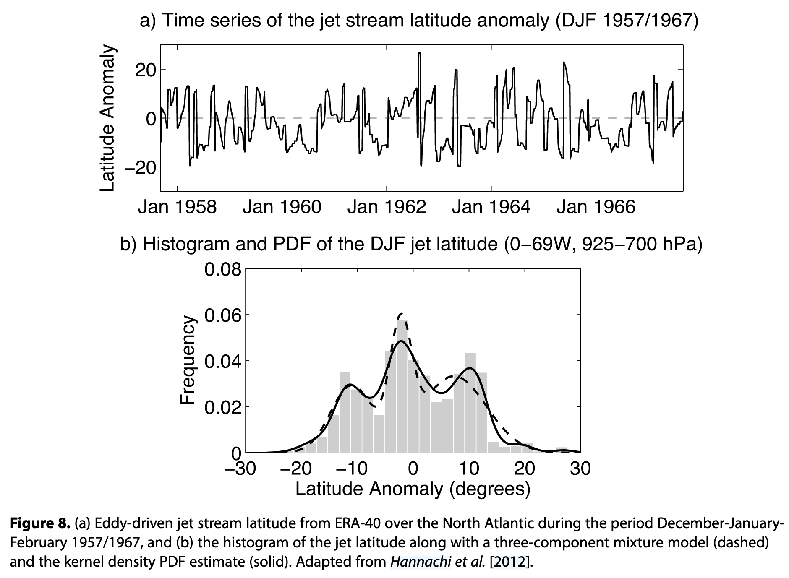
Chaos and regimes
The climate behaves as a nonlinear dynamical system with characteristic modes or regimes.
Hannachi et al. (2017)

Slide 8
Weather vs. Climate
Weather Prediction
An initial value problem
Sensitive to starting conditions
Errors grow exponentially
Predictability limit: ~2 weeks
Climate Projection
A boundary value problem
Driven by energy inputs/outputs
Shape of the attractor
Statistics over decades

Slide 9
What This Means for Risk
We cannot predict what the weather will be on January 26, 2100. We can project the statistical properties:
What temperature will it be on average?
How likely is it that we get at least 2” of rain?
What is the probability distribution of maximum wind speeds?

Slide 10
What Generates Extremes?

Slide 11
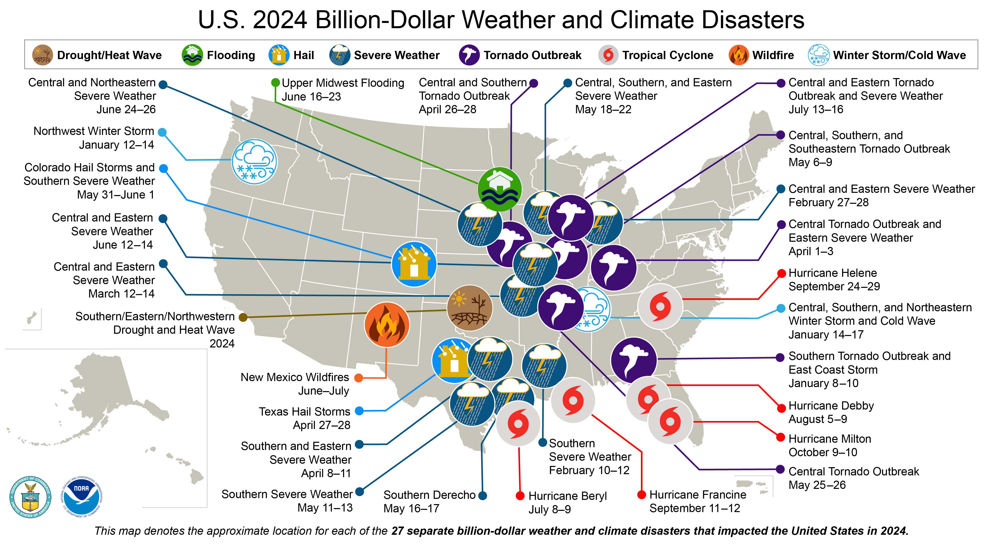
Billion Dollar Disasters
U.S. billion-dollar weather and climate disasters. Source: NOAA NCEI

Slide 12
Notes:
ARs are narrow corridors of concentrated moisture transport. They cause extreme precipitation when they make landfall.

Slide 13
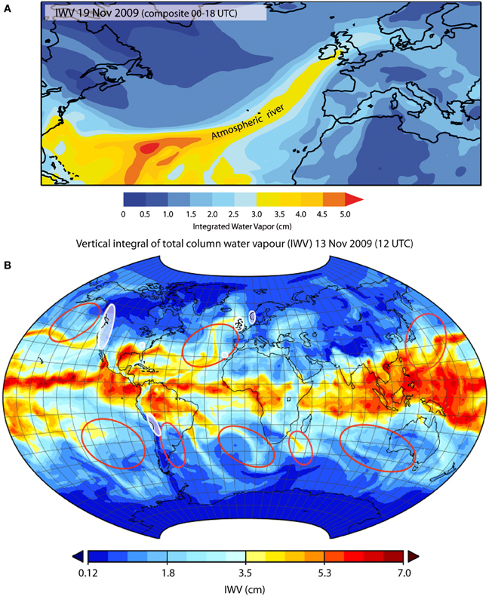
Atmospheric Rivers
Organized moisture transport from warm tropical and subtropical oceans drives a large fraction of midlatitude rainfall.
Gimeno et al. (2014)

Slide 14
Tropical Cyclones
Notes:
TCs are organized vortices that convert ocean heat to kinetic energy. Harvey, Maria, Katrina—these are the billion-dollar events.

Slide 15
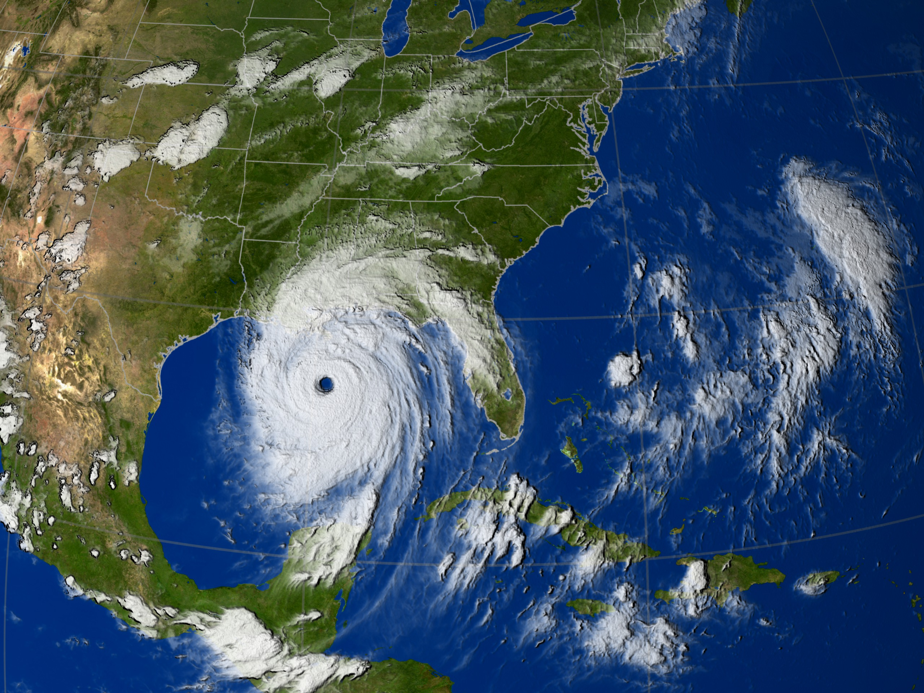
Organized vortices that convert ocean heat to kinetic energy:
Require warm SSTs (> 26°C) and low wind shear
Strongest at landfall → storm surge, wind, rainfall
Examples: Harvey (2017), Maria (2017), Katrina (2005)
Hurricane Katrina (2005) from GOES-12 infrared satellite. Source: NASA/NOAA

Slide 16
Mesoscale Convective Systems
Notes:
MCS are clusters of thunderstorms that organize and persist. They cause flash floods and severe weather.

Slide 17
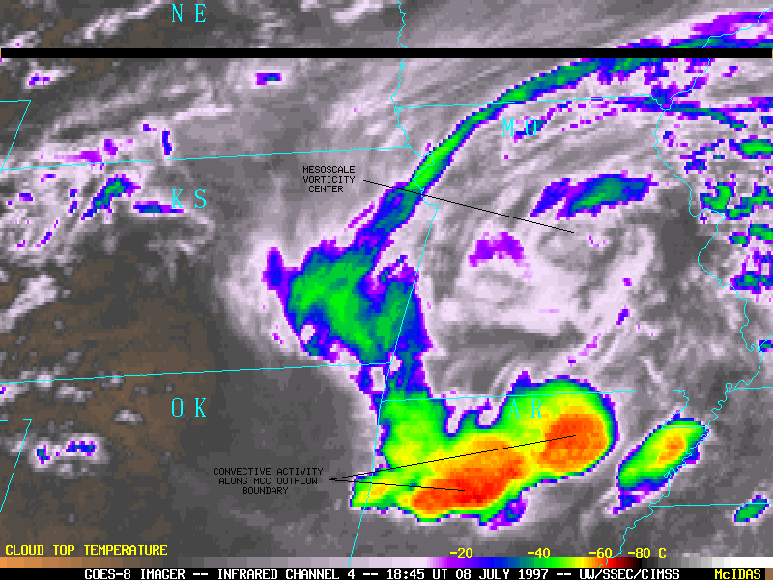
Organized clusters of thunderstorms (10–100 km):
Persist longer than individual cells
Responsible for most warm-season extreme rainfall
Flash floods, derechos, hail
Mesoscale convective complex over the Great Plains (July 8, 1997). Source: CIMSS Wisconsin

Slide 18
Blocking Patterns
Notes:
Blocking = persistent high pressure that diverts the jet stream. Causes both heat waves and cold snaps depending on location.

Slide 19
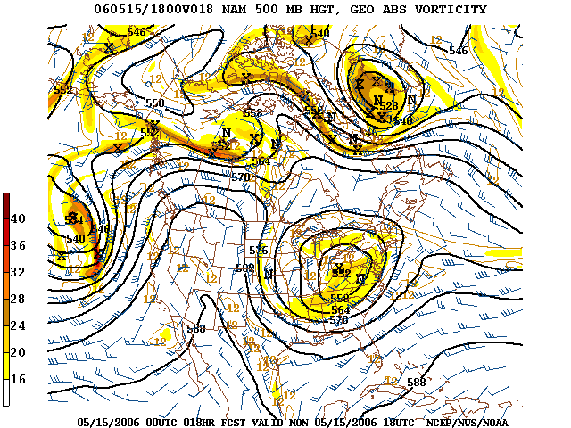
Persistent high-pressure systems that “block” normal flow:
Divert the jet stream for days to weeks
Heat waves (2021 Pacific Northwest, 2003 Europe)
Can also cause persistent cold (Polar vortex disruptions)
500 hPa geopotential height showing omega block over North America. Source: Wikipedia

Slide 20
Variability and Persistence

Slide 21
Climate Risks Cluster in Time
Notes:
Key insight: climate risk is not white noise. Temporal clustering = compound risk. Use the megadrought figure to show multi-decade droughts.

Slide 22
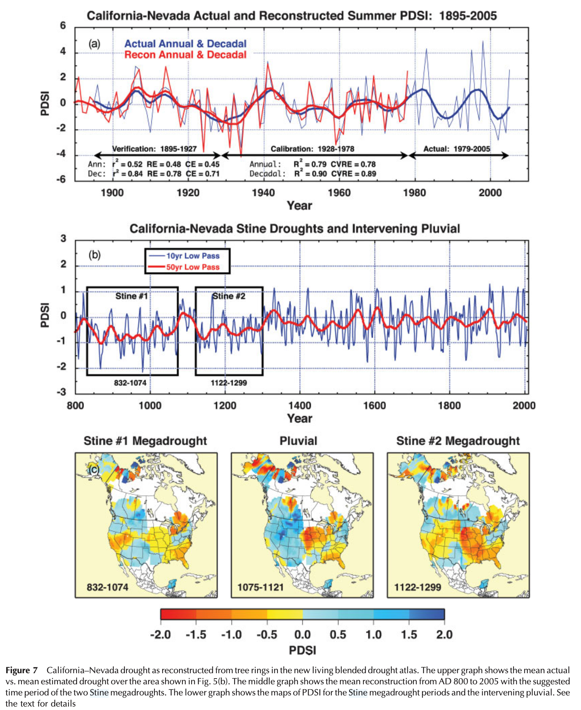
Climate extremes are not independent events.
Droughts persist for years
Wet periods cluster together
Hurricane seasons vary dramatically
Megadroughts in North America over the past 1200 years. Cook et al. (2010)

Slide 23
Climate Risks Cluster in Space
Notes:
Use Bonnafous figure to show correlated risk across space.

Slide 24
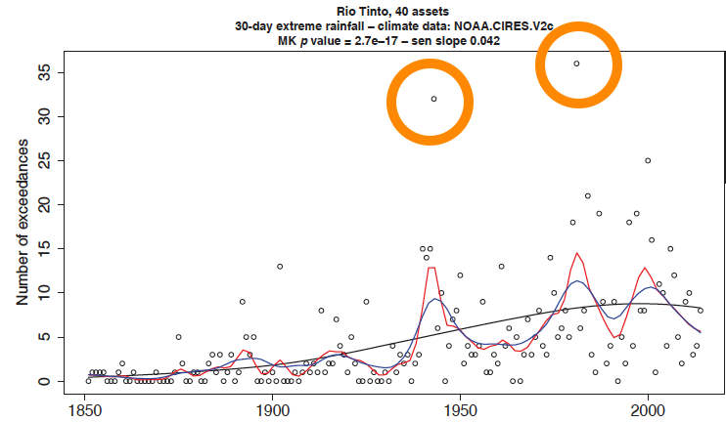
Extremes are spatially correlated.
Regional droughts affect portfolios
Flood losses cluster geographically
Insurance and infrastructure implications
Spatial clustering of water risk exposure. Bonnafous et al. (2017)

Slide 25
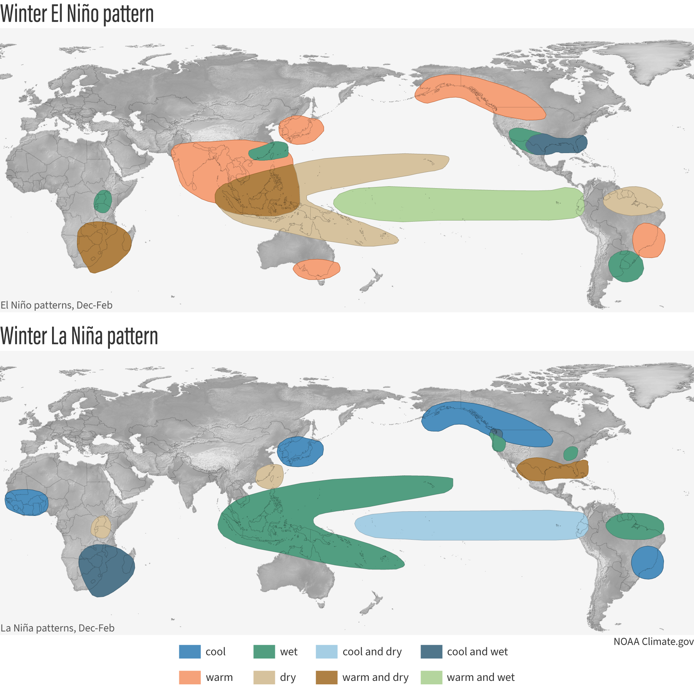
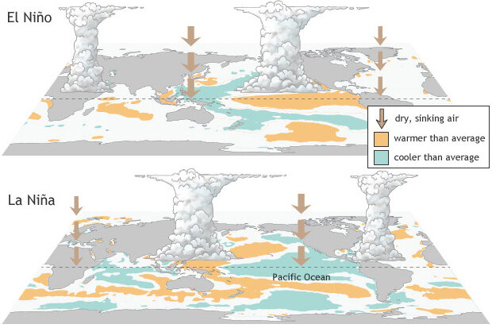
ENSO
The El Niño-Southern Oscillation (ENSO) is the leading mode of variability of the tropical Pacific, with global teleconnections.
NOAA climate.gov
NOAA climate.gov

Slide 26
Modes of Variability
Large-scale patterns organize climate variability:
PDO: Pacific Decadal Oscillation (20–30 years)
NAO: North Atlantic Oscillation
AMO: Atlantic Multidecadal Oscillation

Slide 27
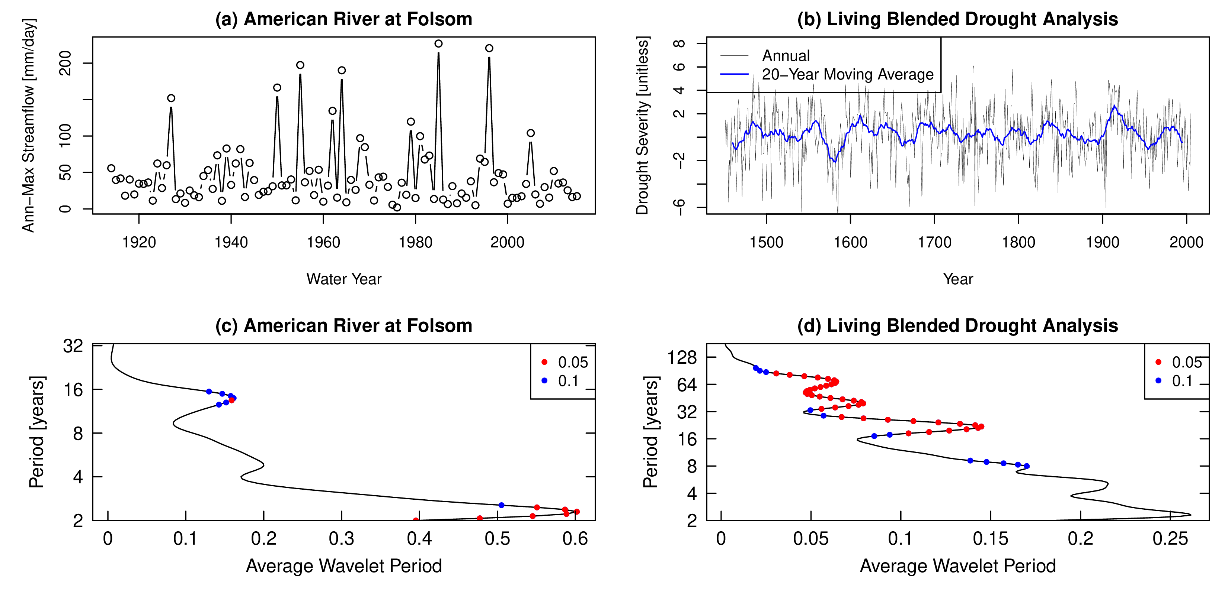
Multiscale Variability
Wavelet analysis reveals variability at multiple timescales. Doss-Gollin et al. (2019)
Notes:
Show the wavelet analysis—variability at multiple timescales.

Slide 28
Not just climate change
The paleo record shows:
Multi-decade droughts occurred without human influence
The instrumental record (150 years) is a small sample
Even without climate change, the recent past is a flawed predictor of future hazard.
Notes:
Drive home the point.

Slide 29
Models and Their Limits

Slide 30
General Circulation Models
General Circulation Models (GCMs) solve physics on a 3D grid:
Conservation equations for mass, energy, momentum
Atmosphere, ocean, land, ice components
Typical resolution: ~100 km grid cells
Notes:
What GCMs actually do—numerical physics on a grid.

Slide 31
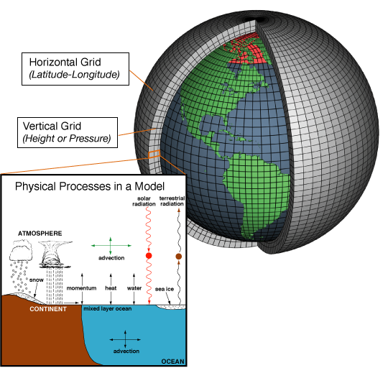
How GCMs Work
Climate models divide Earth into a 3D grid of cells. Source: NOAA Climate.gov
Notes:
Use schematic to show grid structure.

Slide 32
Resolution Limits
Hazard | Typical Scale
Tropical cyclones | ~50 km eye
Thunderstorms | ~10 km
Tornadoes | ~1 km
GCMs resolve features larger than ~100 km.
Many hazards are smaller:
Notes:
Important for understanding what models can and cannot resolve.

Slide 33
Sub-grid processes must be parameterized, not resolved.

Slide 34
Downscaling
Translating GCM output to local scales:
Notes:
Two approaches, each with assumptions.

Slide 35
Statistical Downscaling
Empirical relationships
Assumes stationarity of relationships
Computationally cheap
Dynamical Downscaling
Higher-resolution physics models
Computationally expensive
Inherits GCM biases

Slide 36
Critical Distinction: Scenarios vs. Projections
Concept | Definition | Example
Prediction | What WILL happen | Tomorrow’s weather
Projection | What WOULD happen IF | Temperature if CO₂ doubles
Scenario | Plausible pathway | RCP 8.5 emissions
Notes:
This distinction is CRITICAL for Lab 3. Make sure students understand the difference.

Slide 37
Confusing these leads to poor decisions.

Slide 38
Notes:
RCP 8.5 ≠ business as usual. This sets up Wednesday’s IPCC reading discussion.

Slide 39
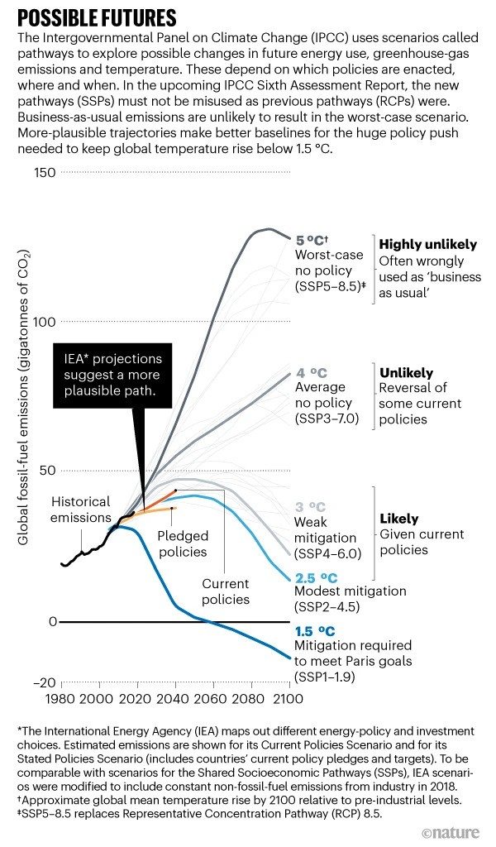
Scenarios Are Not Predictions
Scenarios are “what if” storylines
They bracket human choices
No probabilities attached
Hausfather and Peters (2020)

Slide 40
Sea Level Rise

Slide 41
Integrating Case Study
Sea level rise integrates everything we’ve discussed:
Physical system (thermal expansion, ice dynamics)
Variability (interannual, decadal)
Model limitations (ice sheet uncertainty)
Scenarios vs. projections
Notes:
SLR is the Lab 3 topic—apply all the concepts.

Slide 42
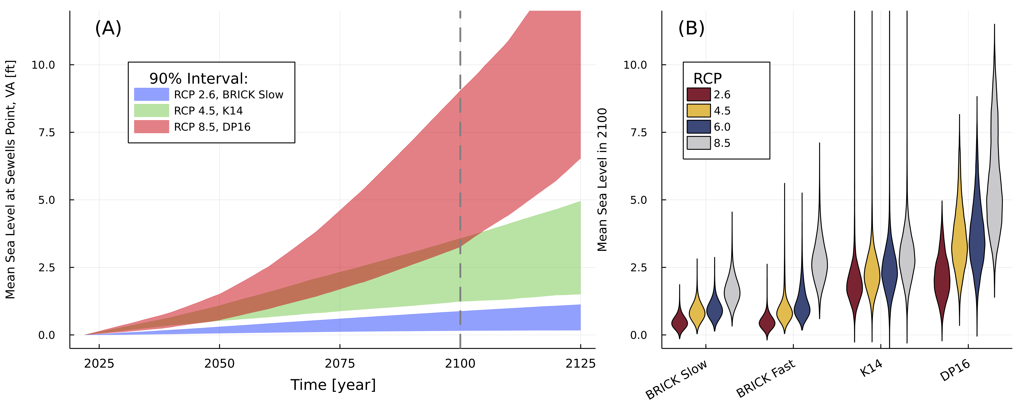
Components of Sea Level Rise
Local sea level is affected by multiple processes. Source: NOAA
Notes:
Use figure to explain multiple contributors.

Slide 43
Two Very Different Sources
Notes:
Thermal expansion vs ice melt have very different uncertainty structures.

Slide 44
Thermal Expansion
Simple physics (warmer water expands)
Well-constrained
Scenario-driven uncertainty
Ice Sheet Melt
Complex, threshold behaviors
MISI/MICI processes
Structural uncertainty dominates

Slide 45
The Ice Sheet Problem
Marine Ice Sheet Instability (MISI) and Marine Ice Cliff Instability (MICI):
Potential for rapid, irreversible ice loss
Physical processes are real but poorly constrained
This is the tail risk for SLR
These processes are the “synoptic generators” of the SLR tail.
Notes:
MISI/MICI are the “synoptic generators” of SLR tail risk.

Slide 46
Local Factors
Local sea level ≠ global mean:
Land subsidence: The ground is sinking
Ocean circulation: Gulf Stream effects
Gravitational fingerprints: Ice mass redistribution
Notes:
Why Norfolk sees faster rise than global average.

Slide 47
Wrap Up

Slide 48
Key Takeaways
The System: Climate is chaotic physics; weather ≠ climate
Synoptic Generators: Extremes come from organized structures
Variability: Risk clusters in time and space; paleo shows what’s possible
Model Limits: GCMs are useful but not magic; resolution matters
Sea Level Rise: Integrates all uncertainties; Lab 3 case study
Notes:
Summarize the five parts.

Slide 49
Looking Ahead
Wednesday: IPCC reading discussion on observed and projected changes
Friday (Lab 3):
Load NOAA scenarios and BRICK projections for Sewells Point
Compare scenario uncertainty vs. structural uncertainty
Ask: Which matters more for the tail?
Notes:
Connect to Wednesday’s discussion and Friday’s lab.

Slide 50
References
Bonnafous, Luc, Upmanu Lall, and Jason Siegel. 2017. “A Water Risk Index for Portfolio Exposure to Climatic Extremes: Conceptualization and an Application to the Mining Industry.” Hydrology and Earth System Sciences 21 (4): 2075–106. https://doi.org/10/f96k67.
Cook, Edward R, Richard Seager, Richard R Heim Jr, Russell S Vose, Celine Herweijer, and Connie Woodhouse. 2010. “Megadroughts in North America: Placing IPCC Projections of Hydroclimatic Change in a Long-Term Palaeoclimate Context.” Journal of Quaternary Science 25 (1): 48–61. https://doi.org/10.1002/jqs.1303.
Doss-Gollin, James, David J. Farnham, Scott Steinschneider, and Upmanu Lall. 2019. “Robust Adaptation to Multiscale Climate Variability.” Earth’s Future 7 (7): 734–47. https://doi.org/10.1029/2019ef001154.
Gimeno, Luis, Raquel Nieto, Marta Vázquez, and David A Lavers. 2014. “Atmospheric Rivers: A Mini-Review.” Frontiers in Earth Science 2 (March): 1063. https://doi.org/10.3389/feart.2014.00002.
Hannachi, Abdel, David M Straus, Christian L E Franzke, Susanna Corti, and Tim Woollings. 2017. “Low-Frequency Nonlinearity and Regime Behavior in the Northern Hemisphere Extratropical Atmosphere.” Reviews of Geophysics 55 (1): 199–234. https://doi.org/10.1002/2015rg000509.
Hausfather, Zeke, and Glen P. Peters. 2020. “Emissions – the ’Business as Usual’ Story Is Misleading.” Nature 577 (7792, 7792): 618–20. https://doi.org/10.1038/d41586-020-00177-3.
Vallis, Geoffrey K. 2006. Atmospheric and Oceanic Fluid Dynamics: Fundamentals and Large-Scale Circulation. Cambridge University Press.

