Slide 1
Island City On a Wedge
Paper Discussion James Doss-Gollin

Slide 2
Galveston, 1900
Notes:
Target: 1:00. Open with the deadliest natural disaster in US history. Don’t linger—move to the problem they faced.

Slide 3
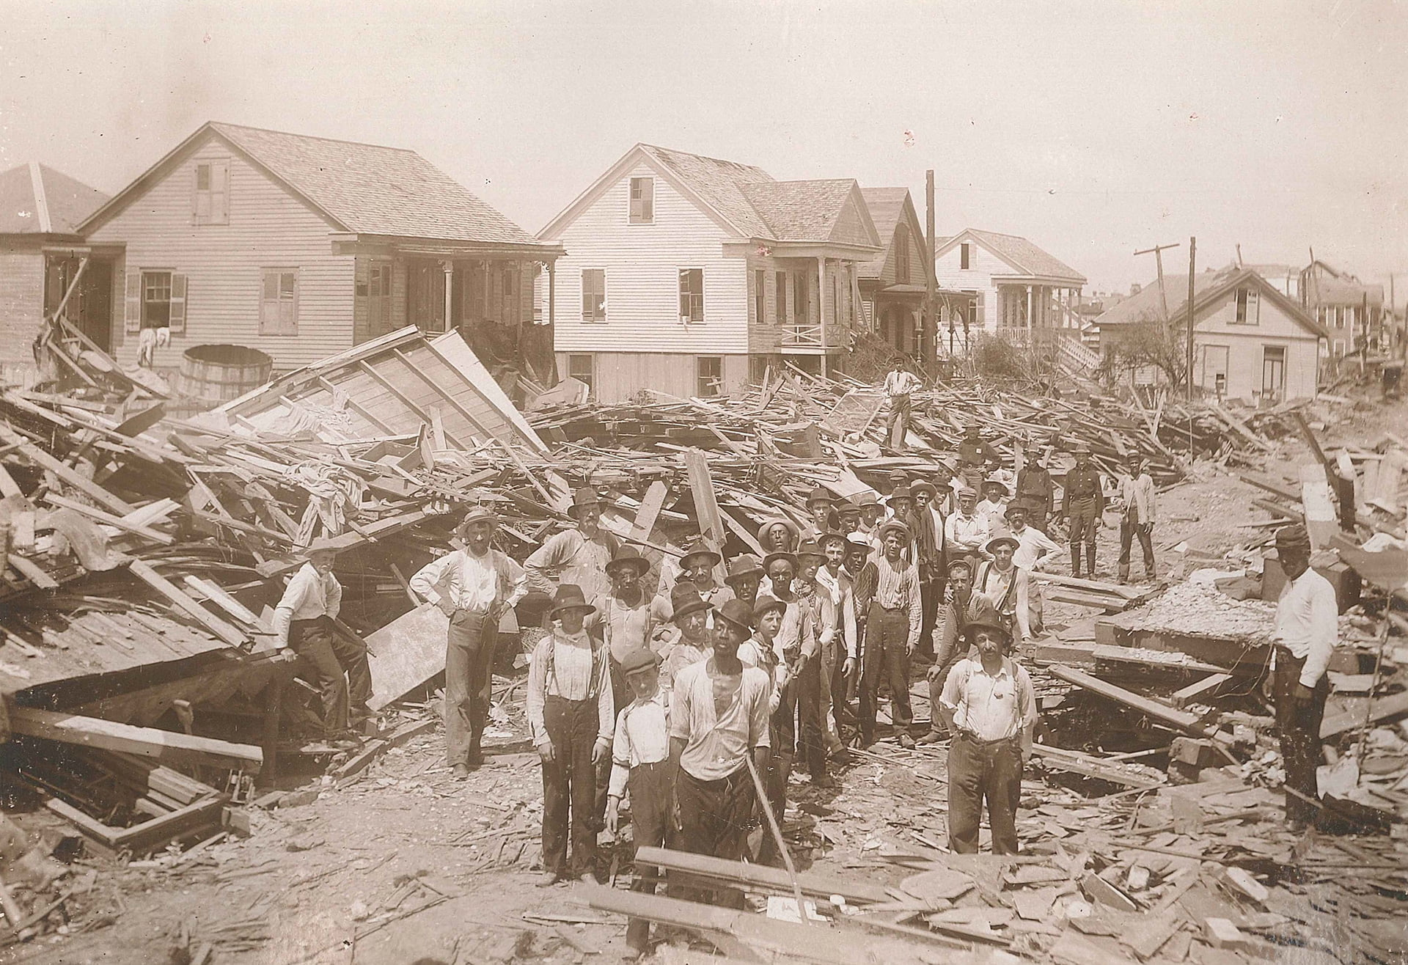
September 8, 1900: Category 4 hurricane, 8,000+ deaths
The response:
17-foot seawall (still standing)
Raised the entire city by up to 17 feet
Moved thousands of buildings
The question: Build a wall? Raise the land? Retreat? All three?
Source: Galveston Historical Foundation

Slide 4
ICOW: The Middle Path
ICOW = Island City On a Wedge (Ceres et al. 2019)
Fast: evaluate millions of strategy combinations
Rich: graduated damage (not binary)
Flexible: portfolios of defenses (wall + retreat + elevate)
Key insight: You don’t need every street corner—just the right abstraction.
Notes:
Target: 1:03. Introduce ICOW as the solution.

Slide 5
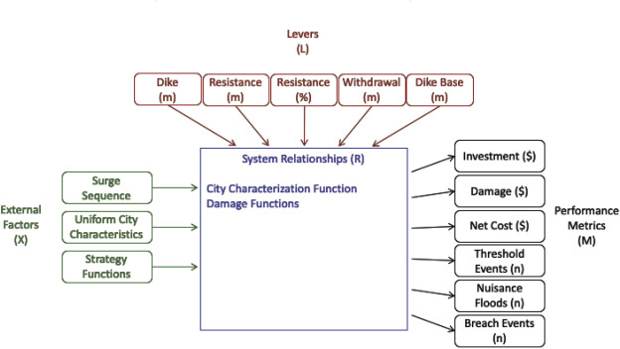
How ICOW Works
ICOW takes city geometry + defense choices → computes expected damages. Source: Ceres et al. (2019)
Notes:
Target: 1:07. High-level overview of inputs and outputs. We’ll unpack each piece over the next slides.

Slide 6
The Wedge Geometry

Slide 7
Picture a Coastal City
Notes:
Target: 1:08. Build intuition for why the wedge is a good abstraction. The ICOW paper uses Lower Manhattan as its case study.

Slide 8
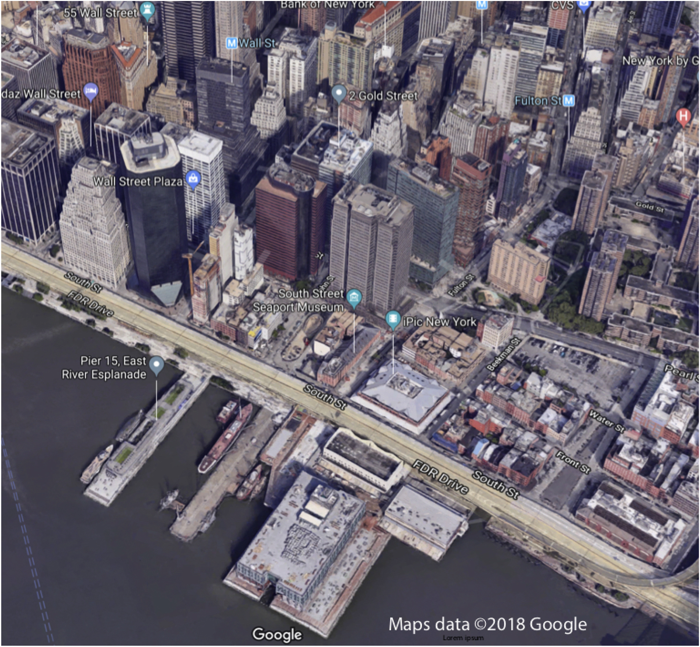
What do coastal cities share?
Waterfront at low elevation
Terrain rises inland
Density highest near water
The ICOW paper was modeled after Lower Manhattan. Source: Ceres et al. (2019)

Slide 9
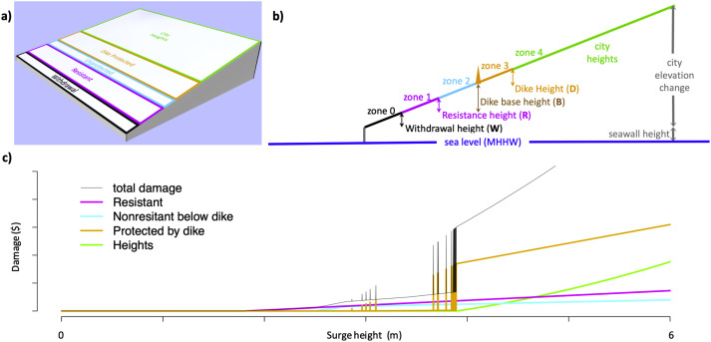
The Wedge Abstraction
The wedge geometry captures essential features. Source: Ceres et al. (2019)
Notes:
Target: 1:10. Explain the geometry. These are the parameters students will estimate in the activity.

Slide 10
What Gets Flooded?
Notes:
Target: 1:12. Use the wedge figure to build intuition about zone-based damage. Pause after each question to let students think before revealing answer.

Slide 11
If water reaches Zone 4—what’s the damage?
→ Three zones underwater (large fraction of city value)
If water reaches Zone 3?
→ Zero… unless the dike fails
What happens when dikes fail?
Source: Ceres et al. (2019)

Slide 12
Key Parameters
Parameter | Symbol | Meaning
Maximum elevation | $H_{\text{city}}$ | How high does the city rise?
City depth | $D_{\text{city}}$ | How far inland does the city extend?
Coastline length | $W_{\text{city}}$ | How long is the waterfront?
Seawall height | $H_{\text{seawall}}$ | Existing protection height
Notes:
Target: 1:14. These are the parameters you’ll estimate in the activity. Values are from the ICOW paper—ask students if they seem reasonable.

Slide 13
From the paper (Manhattan): $H_{\text{city}}≈17$ m, $D_{\text{city}}≈2$ km, $W_{\text{city}}≈43$ km
Do these seem reasonable? (We’ll check in the activity.)

Slide 14
The Five Defense Levers
Lever | What it does | Real-world example
Withdrawal ($W$) | Vacate low-lying land | Managed retreat, buyouts
Dike Base ($B$) | Where the wall starts | Seawall location
Dike Height ($D$) | How tall the wall is | Seawall height
Resistance Height ($R$) | Flood-proof buildings | Elevating structures
Resistance Fraction ($P$) | What % of buildings | Retrofit programs
Notes:
Target: 1:15. Key vocabulary. Students don’t need to memorize—just recognize.

Slide 15
The key constraint: $W+B+D≤H_{\text{city}}$
You can’t withdraw past the city limits, and you can’t build a dike taller than the land behind it.

Slide 16
The Economics

Slide 17
Damage Isn’t Binary
Simple models say: flood = total loss, no flood = zero.
Reality: A 1-foot flood ruins your carpet. A 10-foot flood destroys the structure.
ICOW computes damage based on volume flooded:
$$\text{Damage}=\text{Zone Value}×\frac{\text{Volume Flooded}}{\text{Total Volume}}×0.39$$
The 0.39 is an empirically-derived depth-damage parameter: the fraction of zone value destroyed at full inundation (from flood damage curves).
This connects to Monday’s EAD formula (Week 4 lecture)—but now we can compute damage for any surge height.
Notes:
Target: 1:17. Contrast with simple models. Key insight: damage depends on what’s underwater and how deep.

Slide 18
Dikes Aren’t Perfect
A dike doesn’t magically hold until overtopped, then fail.
Fragility curve: Failure probability ramps up as water approaches the crest
Water below 95% of crest: very low failure probability
Water at 95%+: failure probability ramps linearly
At 100%: certain overtopping
The levee effect: People behind dikes often don’t evacuate. If the dike fails, they’re caught off guard. ICOW models this: damage behind a failed dike is 1.3× worse than open flooding.
Notes:
Target: 1:19. The fragility curve is intuitive. This creates interesting risk trade-offs.

Slide 19
Activity: Map Your City

Slide 20
The Task
Work in pairs. Use Google Maps to estimate ICOW geometry parameters for a real coastal city.
You’ll need:
Google Maps with terrain view
ICOW.jl documentation: https://dossgollin-lab.github.io/ICOW.jl/equations.html#parameters
Notes:
Target: 1:21. Clear instructions. Make sure everyone has Google Maps open.

Slide 21
Make a Prediction
Before we look anything up—take 30 seconds:
Which city do you think has the steepest geometry? (highest $H_{\text{city}}/D_{\text{city}}$ ratio)
Notes:
Target: 1:23. Quick prediction to create cognitive investment before the activity. Have students write down a guess before seeing any data.

Slide 22
Miami Beach
Galveston
New Orleans
Rotterdam
Mumbai
Venice

Slide 23
Write down your guess. We’ll check later.

Slide 24
Pick a City
Notes:
Target: 1:25. Assign cities if students hesitate: “Table 1 takes Miami, Table 2 takes Rotterdam…”

Slide 25
Galveston, TX
Miami Beach, FL
New Orleans, LA
Boston, MA
Mumbai, India
Jakarta, Indonesia
Lagos, Nigeria
Shanghai, China

Slide 26
Estimate These Parameters
Parameter | How to Estimate
$H_{\text{city}}$ | Elevation change: waterfront → highest urban point
$D_{\text{city}}$ | Horizontal distance: waterfront → highest point
$W_{\text{city}}$ | Length of exposed coastline
$H_{\text{seawall}}$ | Existing protection height (search online)
Notes:
Target: 1:27. Give 6 minutes for estimation. Students need ALL four parameters for Friday’s lab.
Circulate and address common issues: - “Where does the city end?” → Focus on the flood-prone coastal zone, not the whole metro area - “I can’t find elevation” → Try Google Earth, or search “[city] topography” - “What’s a seawall?” → Any hard barrier at the water’s edge - “My city has no seawall” → Use 0m. The model handles this—it just means no existing protection. - “The terrain isn’t really a wedge” → Focus on the flood-prone coastal zone, not the whole metropolitan area. Most waterfronts approximate a wedge locally.

Slide 27
Tools: Google Maps terrain view, Google Earth elevation, Wikipedia
You’ll need all four parameters for Friday’s lab!

Slide 28
Share Out
Pair up with a table that studied a different city:
Compare your $H_{\text{city}}/D_{\text{city}}$ ratios
Which city is steeper? Which is flatter?
What does that imply for dike strategy?
Class discussion: A steep city vs. a flat city—who benefits more from a 3m dike?
Notes:
Target: 1:33. Call time. Facilitate cross-table comparisons. Look for interesting contrasts (e.g., Miami vs. Rotterdam, steep vs. flat cities).

Slide 29
Key Takeaways
ICOW abstracts complex cities into a few key parameters
The wedge geometry captures essential physics: higher surges flood more area
Different cities → different optimal strategies
Friday’s lab: You’ll use ICOW.jl to compute EAD for a single year
Notes:
Target: 1:41. Debrief: “Notice how different geometries suggest different strategies.”

Slide 30
Preview: Friday’s Lab
Friday we’ll implement single-year EAD analysis:
Use the same parameters you estimated today
Add a storm surge distribution
Compute expected annual damage
Explore how the five levers change EAD
Notes:
Target: 1:44. Brief preview.

Slide 31
One More Thing…
Rotterdam is 6 meters below sea level.
How does ICOW even work there?
(We’ll find out Friday.)
Notes:
Target: 1:47. Hook for Friday—leave them thinking.

Slide 32
References
Ceres, Robert L., Chris E. Forest, and Klaus Keller. 2019. “Optimization of Multiple Storm Surge Risk Mitigation Strategies for an Island City On a Wedge.” Environmental Modelling & Software 119 (September): 341–53. https://doi.org/10.1016/j.envsoft.2019.06.011.

