Slide 1
Probabilistic Risk and Tail Risks
Lecture James Doss-Gollin

Slide 2
From Climate Risk to Insurance Premiums
Notes:
Target: 1:00. Open with current events that students have likely seen in the news. Don’t dive deep into insurance business—just use it as a hook.
Discussion prompts (pick 1-2 if time):
Why would an insurance company leave a market entirely rather than raise prices?
What happens to homeowners who can’t get private insurance?
If “100-year floods” keep happening every few years, what does that tell us about the models?
Optional listening: NYT Daily podcast on climate insurance

Slide 3
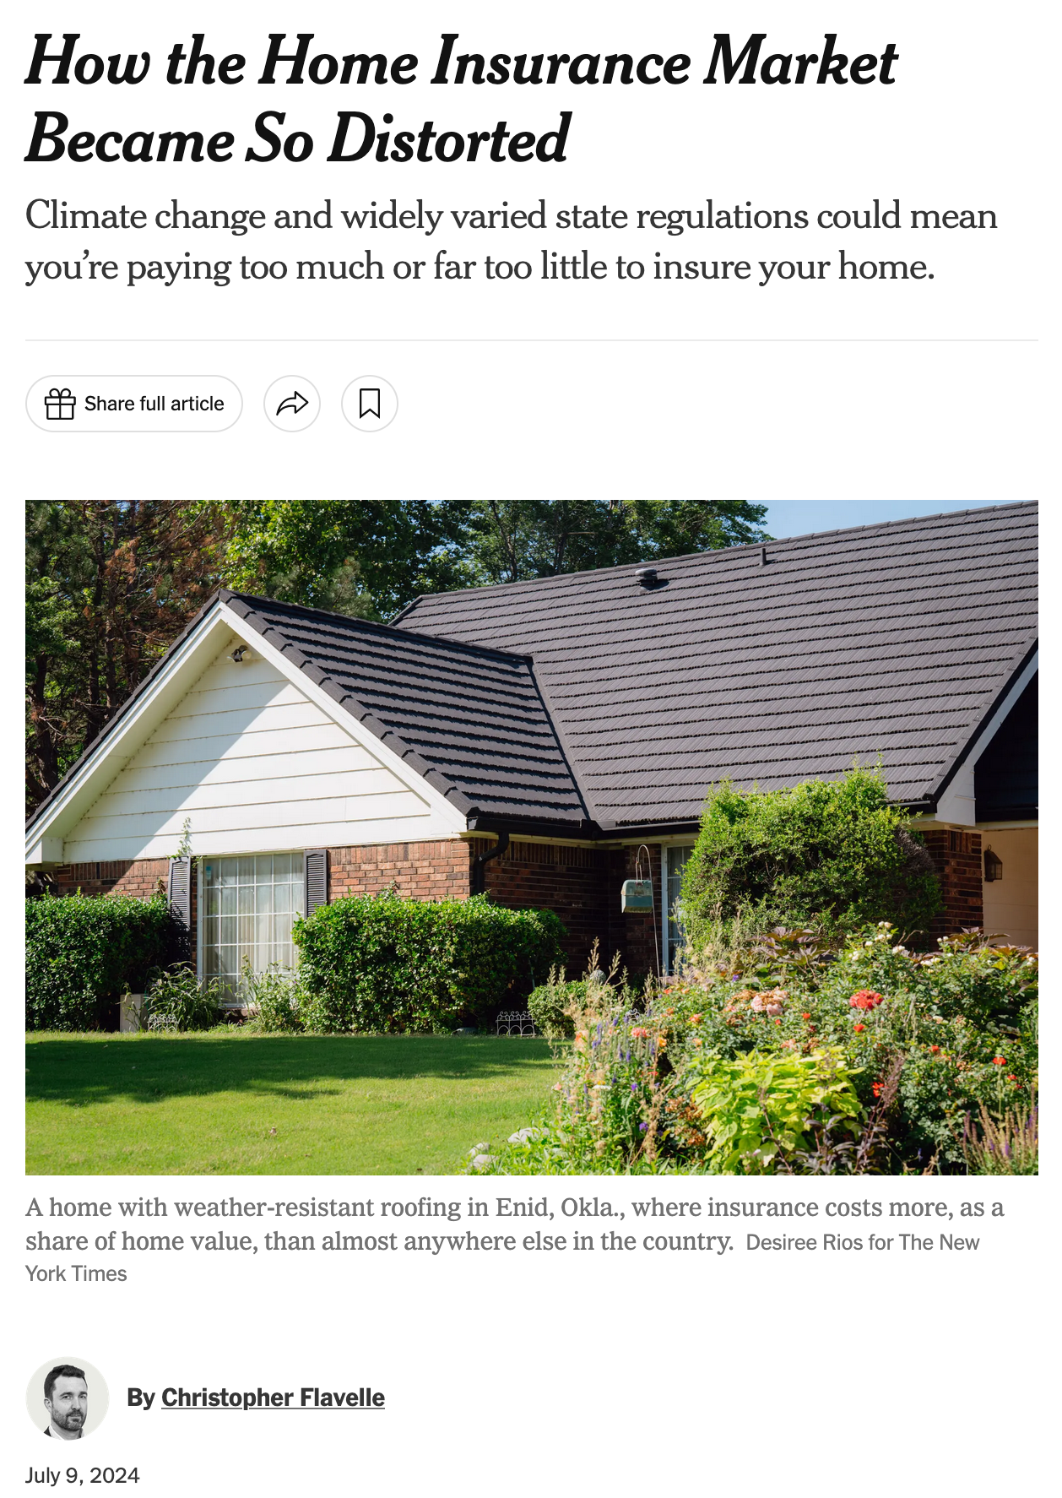
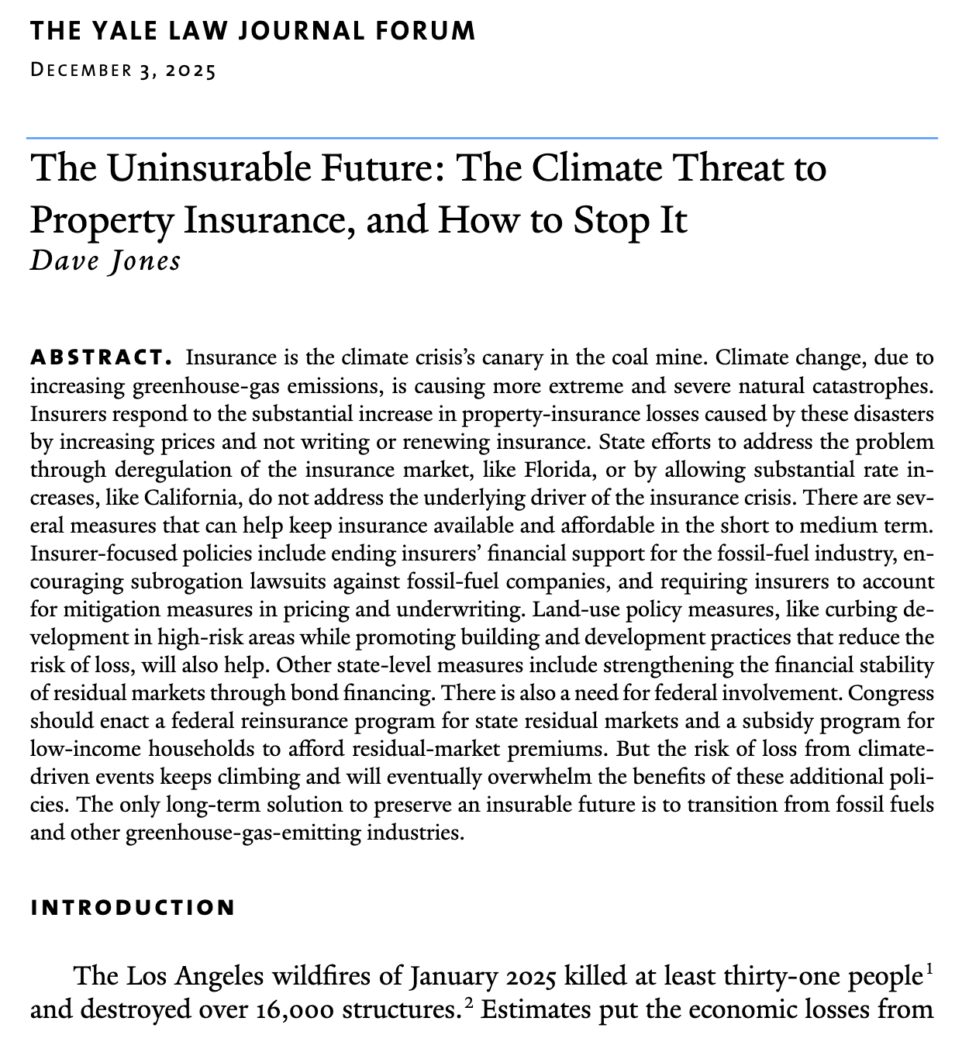

Slide 4
The common thread: When the “worst case” keeps happening, models break down.
Today: The vocabulary and tools to talk about these tail risks.

Slide 5
Building on Week 2
$$\begin{matrix}E[D] & =∫D(h)⋅p(h) dh \\ & ≈\frac{1}{N}\sum_{i=1}^{N}{D}(h_{i}) & \text{if }h_{i}∼p(h)\end{matrix}$$
The problem: With fat tails, this expectation is hard to estimate.
Rare extreme events dominate the sum
Different assumptions about tail shape → very different $E[D]$
Notes:
Target: 1:02. Connect to convolution—what happens when damage function meets hazard distribution. Key point: the integral is hard, so we approximate with Monte Carlo.

Slide 6
Today’s Roadmap
Vocabulary: Return periods and return levels
Fat tails: When extremes dominate
Risk metrics: EAD, VaR, CVaR
Monte Carlo: Computing any metric from samples
Notes:
Target: 1:04. Quick roadmap.

Slide 7
Vocabulary: Extreme Value Statistics

Slide 8
Two Ways to Ask the Same Question
Notes:
Target: 1:07. Core vocabulary slide. These two questions are inverses of each other.

Slide 9
Return Period ($T$)
“How often does a flood this big happen?”
Average time between exceedances
$T=1/p$ where $p$ is annual exceedance probability
Return Level ($x_{T}$)
“How big is a T-year flood?”
The intensity exceeded once every $T$ years on average
$x_{T}=F^{−1}(1−1/T)$

Slide 10
These are inverse operations on the CDF.

Slide 11
“100-Year Floods” and Your Mortgage
Over 30 years: $1−(0.99)^{30}=26\%$ chance of at least one
Houston experienced three “500-year” floods in three years (Harvey, Tax Day, Memorial Day)
What are possible explanations?
Notes:
Explanations include
unlucky
they were “500 year floods” in different dimensions and places over a big area
climate change
all of the above

Slide 12
Return Level Calculation
For a GEV distribution with parameters $(μ,σ,ξ)$:
$$x_{T}=μ+\frac{σ}{ξ}\left[{\left(−ln\left(1−\frac{1}{T}\right)\right)}^{−ξ}−1\right]$$
In Julia, this is just:
quantile(gev_dist, 1 - 1/T)
Notes:
Target: 1:12. Show how to compute return levels from a distribution.

Slide 13
Return Levels in Practice
# Define a GEV for storm surge (typical Gulf Coast parameters) gev = GeneralizedExtremeValue(5.0, 1.5, 0.2) # μ=5ft, σ=1.5ft, ξ=0.2 # Calculate return levels return_periods = [2, 5, 10, 25, 50, 100, 250, 500] return_levels = [quantile(gev, 1 - 1 / T) for T in return_periods] # Plot fig = Figure(size=(700, 400)) ax = Axis(fig[1, 1], xlabel="Return Period (years)", ylabel="Return Level (ft)", xscale=log10, title="Storm Surge Return Levels") scatterlines!(ax, return_periods, return_levels, markersize=12) ax.xticks = return_periods fig
Notes:
Target: 1:14. Code example showing return level calculation.

Slide 14
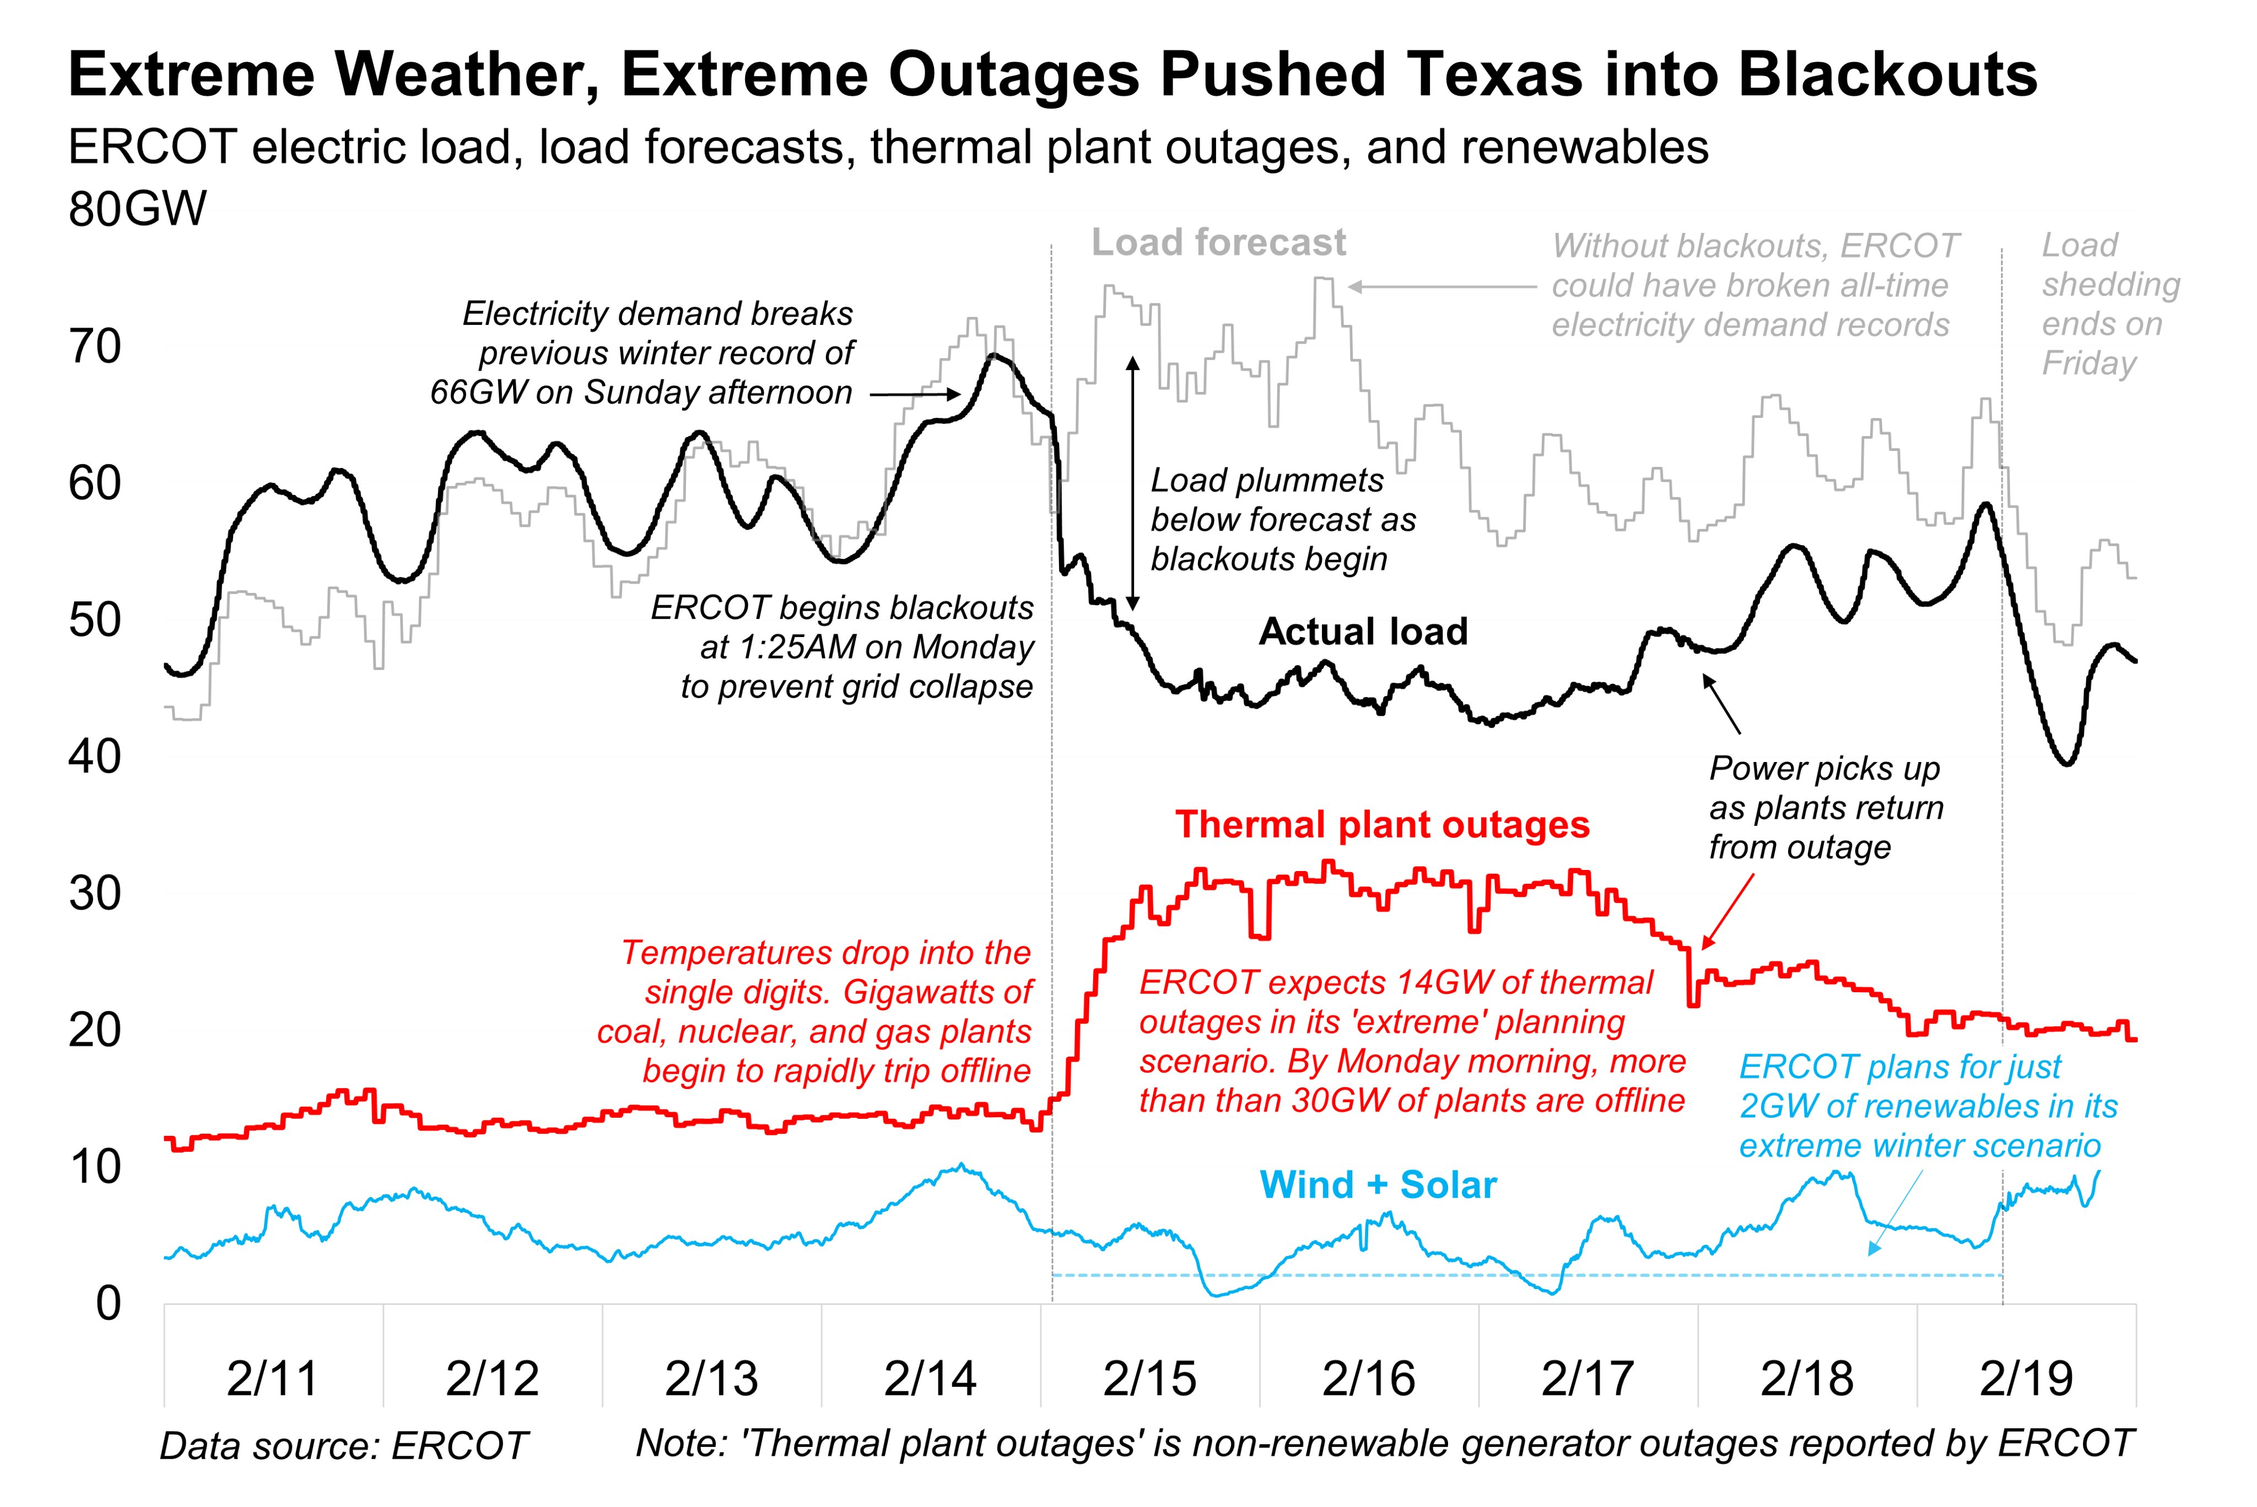
2021 Texas Freeze
Figure 1: Electricity demand (blue) exceeded supply (red) for multiple consecutive days. Source: Bryan Bartholomew on Twitter
Notes:
Target: 1:16. Start with the concrete example. Show the graph of electricity demand vs. generation during the freeze. Point out the multi-day duration of the shortage.

Slide 15
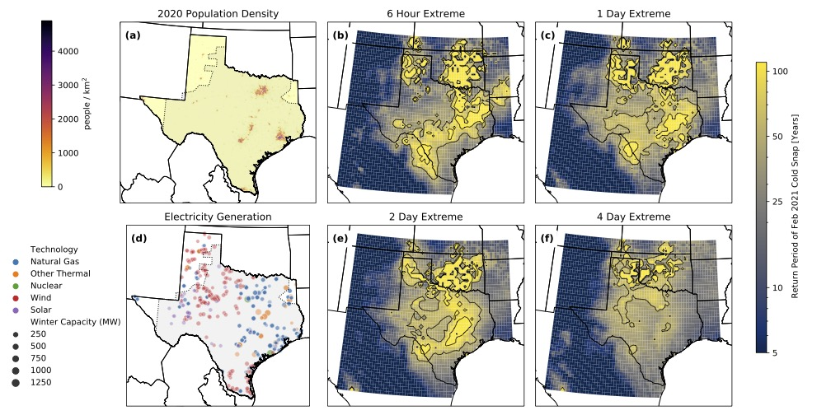
How extreme was the cold?
Figure 2: Return period of heating demand as across space (Doss-Gollin et al. 2021).

Slide 16
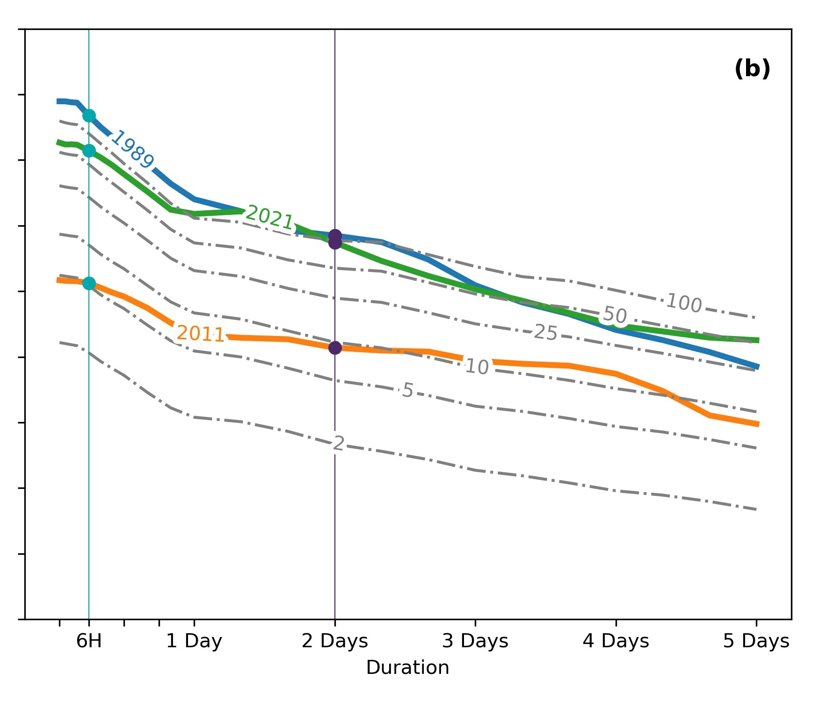
Return Period vs. Duration
Figure 3: Return period of heating demand during Feb 2021 as a function of event duration (Doss-Gollin et al. 2021).
Notes:
Target: 1:18. Show how the return period changes as a function of event duration. The 1-day event is relatively common, but the 5-day event is much rarer. This explains why the system wasn’t designed for it.

Slide 17
Intensity Measures Matter
ERCOT Example | Return Period | Impact
1-day cold snap | ~10 years | Grid can handle
5-day cold snap | ~50 years | Cascading failures
Key insight: Return period depends on how you define the event.
Notes:
Target: 1:20. Draw out the unified lesson from ERCOT. How we define the hazard determines the return period. Use consistent table format throughout.

Slide 18
General principle: The choice of intensity measure affects everything downstream.
There are statistical approaches to specifying return periods for multivariate or compound extremes, such as copulas.

Slide 19
Fat Tails

Slide 20
Normal vs. Fat-Tailed
let fig = Figure(size=(800, 400)) # Define distributions with different tail behavior # Match location/scale to make comparison "fair" xmin = 1.0 # Pareto distributions with different tail indices (alpha) # α ≥ 2: finite mean and variance (physically plausible) # α ∈ [1, 2): finite mean, infinite variance (some extreme events) # α < 1: infinite mean and variance (very extreme, unlikely in nature) pareto_α2 = Pareto(2.0, xmin) # α = 2: physically plausible pareto_α15 = Pareto(1.5, xmin) # α = 1.5: very heavy tail pareto_α08 = Pareto(0.8, xmin) # α = 0.8: infinite mean/variance # LogNormal for comparison (light-tailed relative to Pareto) lognormal = LogNormal(log(3), 0.8) # Left panel: PDFs ax1 = Axis(fig[1, 1], xlabel=L"x", ylabel=L"p(x)", title="Probability Density Functions") x = range(xmin, 10, length=1_000) lines!(ax1, x, pdf.(lognormal, x), label=L"$\text{LogNormal}$", linewidth=2, color=:blue) lines!(ax1, x, pdf.(pareto_α2, x), label=L"Pareto($\alpha=2$)", linewidth=2, linestyle=:dash, color=:orange) lines!(ax1, x, pdf.(pareto_α15, x), label=L"Pareto($\alpha=1.5$)", linewidth=2, linestyle=:dot, color=:red) axislegend(ax1, position=:rt) # Right panel: Log-scale to see tails ax2 = Axis(fig[1, 2], xlabel=L"x", ylabel=L"\log(p(x))", title="Tails on Log Scale") x2 = range(5, 50, length=500) lines!(ax2, x2, logpdf.(lognormal, x2), label=L"$\text{LogNormal}$", linewidth=2, color=:blue) lines!(ax2, x2, logpdf.(pareto_α2, x2), label=L"Pareto($\alpha=2$)", linewidth=2, linestyle=:dash, color=:orange) lines!(ax2, x2, logpdf.(pareto_α15, x2), label=L"Pareto($\alpha=1.5$)", linewidth=2, linestyle=:dot, color=:red) lines!(ax2, x2, logpdf.(pareto_α08, x2), label=L"Pareto($\alpha=0.8$)", linewidth=2, linestyle=:dashdot, color=:purple) axislegend(ax2, position=:rt) fig end
Notes:
Target: 1:22. Visual comparison is key here.
Left panel shows they look similar near the center. Right panel (log scale) reveals the difference in the tails. LogNormal has exponential decay (light tail). Pareto has power-law decay - the smaller alpha, the heavier the tail.

Slide 21
The Pareto Tail Index
$α$ | Mean | Variance | Physical Plausibility
$α≥2$ | Finite | Finite | Most climate/flood risks
$1<α<2$ | Finite | Infinite | Some extreme events
$α<1$ | Infinite | Infinite | Unlikely in nature
For a Pareto distribution: $P(X>x)∼x^{−α}$ as $x→∞$
Tail index $α$ controls both tail heaviness and moment existence:
Notes:
Target: 1:24. Define alpha mathematically, show estimation formula, discuss pitfalls.

Slide 22
Estimating the Tail Index
Hill estimator for tail index from the $k$ largest observations:
$$\hat{α}={\left[\frac{1}{k}\sum_{i=1}^{k}{ln}\frac{X_{(i)}}{X_{(k+1)}}\right]}^{−1}$$
Pitfalls:
Requires choosing threshold $k$ (how many extremes to use?)
Need many observations in the tail to estimate reliably
Historical data often too short for rare extremes
Notes:
Target: 1:26. Show Hill estimator and its pitfalls.

Slide 23
Why Do Fat Tails Matter?
For fat-tailed distributions:
The mean can be dominated by rare extreme events
Sample averages converge slowly to the true mean
Historical data undersamples the tail
“The average is dominated by a small number of extreme values.”
Notes:
Target: 1:28. Connect to the practical implication.

Slide 24
Slow Convergence of the Mean
let function running_mean(samples) n = length(samples) cumsum(samples) ./ (1:n) end n_samples = 2000 n_lines = 8 fig = Figure(size=(800, 400)) # LogNormal distribution (light tail) ax1 = Axis(fig[1, 1], xlabel=L"n", ylabel=L"\bar{x}_n", title=L"LogNormal$()$: Light Tail") lognormal = LogNormal(log(3), 0.8) for _ in 1:n_lines samples = rand(lognormal, n_samples) lines!(ax1, 1:n_samples, running_mean(samples), color=(:blue, 0.4), linewidth=1) end hlines!(ax1, [mean(lognormal)], color=:black, linestyle=:dash, linewidth=2, label=L"\mu") axislegend(ax1, position=:rt) ylims!(ax1, 1, 6) # Pareto distribution (α = 1.5, fat-tailed) ax2 = Axis(fig[1, 2], xlabel=L"n", ylabel=L"\bar{x}_n", title=L"Pareto($\alpha=1.25$): Fat Tail") pareto_fat = Pareto(1.25, 1.0) for _ in 1:n_lines samples = rand(pareto_fat, n_samples) lines!(ax2, 1:n_samples, running_mean(samples), color=(:red, 0.4), linewidth=1) end hlines!(ax2, [mean(pareto_fat)], color=:black, linestyle=:dash, linewidth=2, label=L"\mu") axislegend(ax2, position=:rt) ylims!(ax2, 0, 15) fig end
Notes:
Target: 1:30. Adapt the running mean plot from clt.jl. Show that GEV running mean is much noisier than Normal.

Slide 25
Implications for Risk Assessment
For fat-tailed hazards:
Usually, the average over N years is less than the true mean
The mean is dominated by rare extremes you probably haven’t observed yet
Occasionally you get unlucky and observe a tail event—then your estimate jumps
Implication: Historical averages systematically underestimate risk.
We need metrics that focus specifically on the tail.
Notes:
Target: 1:32. Drive home the practical point. Key insight: sample average is usually BELOW true mean for fat tails.

Slide 26
Risk Metrics

Slide 27
From Expected Value to Tail Focus
Expected Annual Damage (EAD) averages over everything:
$$\text{EAD}=E[D]=∫D(h)⋅p(h) dh$$
But decision-makers often care more about worst-case scenarios:
“What’s the damage I should prepare for?”
“What’s the catastrophic loss I might face?”
Notes:
Target: 1:34. Set up the progression of metrics.

Slide 28
Value at Risk (VaR)
VaR at confidence level $α$: The $α$-quantile of the loss distribution.
$${\text{VaR}}_{α}=F_{L}^{−1}(α)$$
Notes:
Target: 1:36. Introduce VaR with clear definition.

Slide 29
Example: 95% VaR
“5% of the time, losses exceed this value”
Also called: 20-year loss (same concept, different vocab)
In Julia:
VaR_95 = quantile(losses, 0.95)

Slide 30
VaR Illustrated
# Generate damage samples (house at 3ft elevation, $200k value) n = 25_000 house_elevation = 3.0 house_value = 200.0 # in $1000s hazards = rand(GeneralizedExtremeValue(5.0, 2.0, 0.1), n) damages = [depth_damage(h - house_elevation) * house_value for h in hazards] VaR_95 = quantile(damages, 0.95) fig = Figure(size=(700, 400)) ax = Axis(fig[1, 1], xlabel="Damage (\$1000s)", ylabel="Probability Density", title="Damage Distribution with 95% VaR") hist!(ax, damages, bins=50, color=(:blue, 0.6), normalization=:pdf) vlines!(ax, [VaR_95], color=:red, linewidth=3, label="95% VaR = \$$(round(VaR_95, digits=0))k") axislegend(ax, position=:rt) fig

Slide 31
Conditional Value at Risk (CVaR)
CVaR (Expected Shortfall): Average loss in the worst $α$% of cases.
$${\text{CVaR}}_{α}=E[L∣L>{\text{VaR}}_{α}]$$
In Julia:
VaR_95 = quantile(losses, 0.95) CVaR_95 = mean(losses[losses .> VaR_95])
Notes:
Target: 1:42. CVaR as the solution. Also called Expected Shortfall (ES) or Tail VaR.

Slide 32
VaR vs. CVaR Illustrated
# Compute VaR and CVaR VaR_95 = quantile(damages, 0.95) tail_losses = damages[damages.>=VaR_95] # Use >= to ensure non-empty CVaR_95 = mean(tail_losses) fig = Figure(size=(800, 400)) ax = Axis(fig[1, 1], xlabel="Damage (\$1000s)", ylabel="Probability Density", title="VaR shows threshold; CVaR shows tail average") # Main histogram hist!(ax, damages, bins=50, color=(:blue, 0.6), normalization=:pdf) # Add lines vlines!(ax, [VaR_95], color=:darkred, linewidth=3, linestyle=:dash, label="VaR₉₅ = \$$(round(VaR_95, digits=0))k") vlines!(ax, [CVaR_95], color=:purple, linewidth=3, label="CVaR₉₅ = \$$(round(CVaR_95, digits=0))k") axislegend(ax, position=:ct, backgroundcolor=:white) fig

Slide 33
Why CVaR > VaR
VaR tells you the threshold; CVaR tells you what happens beyond it.
VaR answers: “What loss do I exceed 5% of the time?”
CVaR answers: “When things go bad, how bad do they get on average?”
VaR says nothing about the severity of tail events
Example: If your 95% VaR is $100k, that just means 5% of outcomes are worse. But are they $101k worse or $1M worse? CVaR answers this.
Notes:
Target: 1:44. Use intuitive explanation, avoid jargon students don’t have background for.

Slide 34
Worked Example: Same EAD, Different Tails
# Two GEV distributions calibrated to produce similar EAD but different tails # A: Gumbel (light tail) with higher location # B: Fréchet (fat tail) with lower location to match mean dist_A = GeneralizedExtremeValue(5.5, 1.8, 0.0) # Gumbel (light tail) dist_B = GeneralizedExtremeValue(4.5, 1.5, 0.25) # Fréchet (fat tail) n = 50000 house_elev = 4.0 house_val = 200.0 # $1000s damages_A = [depth_damage(h - house_elev) * house_val for h in rand(dist_A, n)] damages_B = [depth_damage(h - house_elev) * house_val for h in rand(dist_B, n)] # Compute metrics (use >= to ensure non-empty tail samples) VaR95_A = quantile(damages_A, 0.95) VaR95_B = quantile(damages_B, 0.95) metrics = ( EAD_A=mean(damages_A), EAD_B=mean(damages_B), VaR95_A=VaR95_A, VaR95_B=VaR95_B, CVaR95_A=mean(damages_A[damages_A.>=VaR95_A]), CVaR95_B=mean(damages_B[damages_B.>=VaR95_B]) ) fig = Figure(size=(800, 350)) ax1 = Axis(fig[1, 1], xlabel="Damage (\$1000s)", ylabel="Density", title=L"GEV($\xi = 0$) (light tail)") ax2 = Axis(fig[1, 2], xlabel="Damage (\$1000s)", ylabel="Density", title=L"GEV($\xi = 0.2$) (fatter tail)") hist!(ax1, damages_A, bins=50, color=(:blue, 0.6), normalization=:pdf) hist!(ax2, damages_B, bins=50, color=(:red, 0.6), normalization=:pdf) xlims!(ax1, 0, 250) xlims!(ax2, 0, 250) linkyaxes!(ax1, ax2) fig
Notes:
Target: 1:46. Key conceptual example. Parameters chosen so hazard distributions have similar means but different tail behavior. Distribution A: Gumbel (ξ=0) with higher location Distribution B: Fréchet (ξ=0.2) with lower location to compensate for heavier tail

Slide 35
Same EAD, Different Tail Risk
Metric | Distribution A | Distribution B
EAD | $46.0k | $36.0k
95% VaR | $130.0k | $137.0k
95% CVaR | $158.0k | $174.0k

Slide 36
Monte Carlo for Risk Metrics

Slide 37
The Monte Carlo Workflow
Sample hazard scenarios from distribution
Apply damage function to each scenario
Summarize the damage samples
Once you have samples, any metric is trivial:
EAD = mean(damages) VaR_95 = quantile(damages, 0.95) CVaR_95 = mean(damages[damages .> VaR_95])
Notes:
Target: 1:48. Review from Week 2, add emphasis on “any metric.”

Slide 38
Computing All Metrics
# Complete Monte Carlo workflow (same setup as Lab 2) n_samples = 100_000 # 1. Sample hazards (GEV for storm surge, same as Lab 2) surge_dist = GeneralizedExtremeValue(5.0, 2.0, 0.1) hazards = rand(surge_dist, n_samples) # 2. Apply damage function (house at 4ft elevation, $300k value) base_elevation = 4.0 house_value = 300_000 damages = [depth_damage(h - base_elevation) * house_value for h in hazards] # 3. Compute metrics EAD = mean(damages) VaR_95 = quantile(damages, 0.95) VaR_99 = quantile(damages, 0.99) CVaR_95 = mean(damages[damages.>=VaR_95]) # Use >= to ensure non-empty CVaR_99 = mean(damages[damages.>=VaR_99]) println("Risk Metrics (house value = \$300k, base elevation = 4ft)") println("━"^50) println("Expected Annual Damage (EAD): \$$(round(EAD, digits=0))") println("95% VaR (20-year loss): \$$(round(VaR_95, digits=0))") println("99% VaR (100-year loss): \$$(round(VaR_99, digits=0))") println("95% CVaR (avg loss in worst 5%): \$$(round(CVaR_95, digits=0))") println("99% CVaR (avg loss in worst 1%): \$$(round(CVaR_99, digits=0))")
Risk Metrics (house value = $300k, base elevation = 4ft) ━━━━━━━━━━━━━━━━━━━━━━━━━━━━━━━━━━━━━━━━━━━━━━━━━━ Expected Annual Damage (EAD): $67216.0 95% VaR (20-year loss): $223965.0 99% VaR (100-year loss): $300000.0 95% CVaR (avg loss in worst 5%): $264827.0 99% CVaR (avg loss in worst 1%): $300000.0
Notes:
Target: 1:50. Full worked example.

Slide 39
Why Monte Carlo is Essential
For fat-tailed distributions:
Analytical formulas often don’t exist
Numerical integration struggles with heavy tails
Monte Carlo naturally captures rare events (with enough samples)
Key insight: Increase sample size when tails matter more.
Notes:
Target: 1:52. Connect to fat tails.

Slide 40
Advanced Sampling (Preview)
Naive Monte Carlo requires many samples to capture rare events:
To get 10 samples of a 1-in-1000 event, you need ~10,000 runs
Advanced techniques can do better:
Importance sampling: Oversample the tail, then reweight
Stratified sampling: Ensure coverage across the distribution
These are beyond our scope, but good to know they exist when you need them.
Notes:
Target: 1:54. Brief mention of advanced techniques—students should know these exist.

Slide 41
Wrap Up

Slide 42
Key Takeaways
Return period and return level are inverse operations on the CDF
Fat tails mean extremes dominate
We can measure fat tails using $α$ or $ξ$
EAD averages over everything; VaR gives a threshold; CVaR captures the tail
Monte Carlo lets us compute metrics from samples
Notes:
Target: 1:56. Five bullets max.

Slide 43
References
Doss-Gollin, James, David J Farnham, Upmanu Lall, and Vijay Modi. 2021. “How Unprecedented Was the February 2021 Texas Cold Snap?” Environmental Research Letters 16 (6): 064056. https://doi.org/10.1088/1748-9326/ac0278.
Jones, Dave. 2025. “The Uninsurable Future: The Climate Threat to Property Insurance, and How to Stop It.” Yale Law Journal 135 (December). https://yalelawjournal.org/essay/the-uninsurable-future-the-climate-threat-to-property-insurance-and-how-to-stop-it.

