Slide 1
Optimal Static Decisions
Lecture James Doss-Gollin

Slide 2
The 1953 North Sea Flood
February 1, 1953
Notes:
Target: 1:00. Open with the historical disaster. Set the scene dramatically before introducing any formalism.

Slide 3
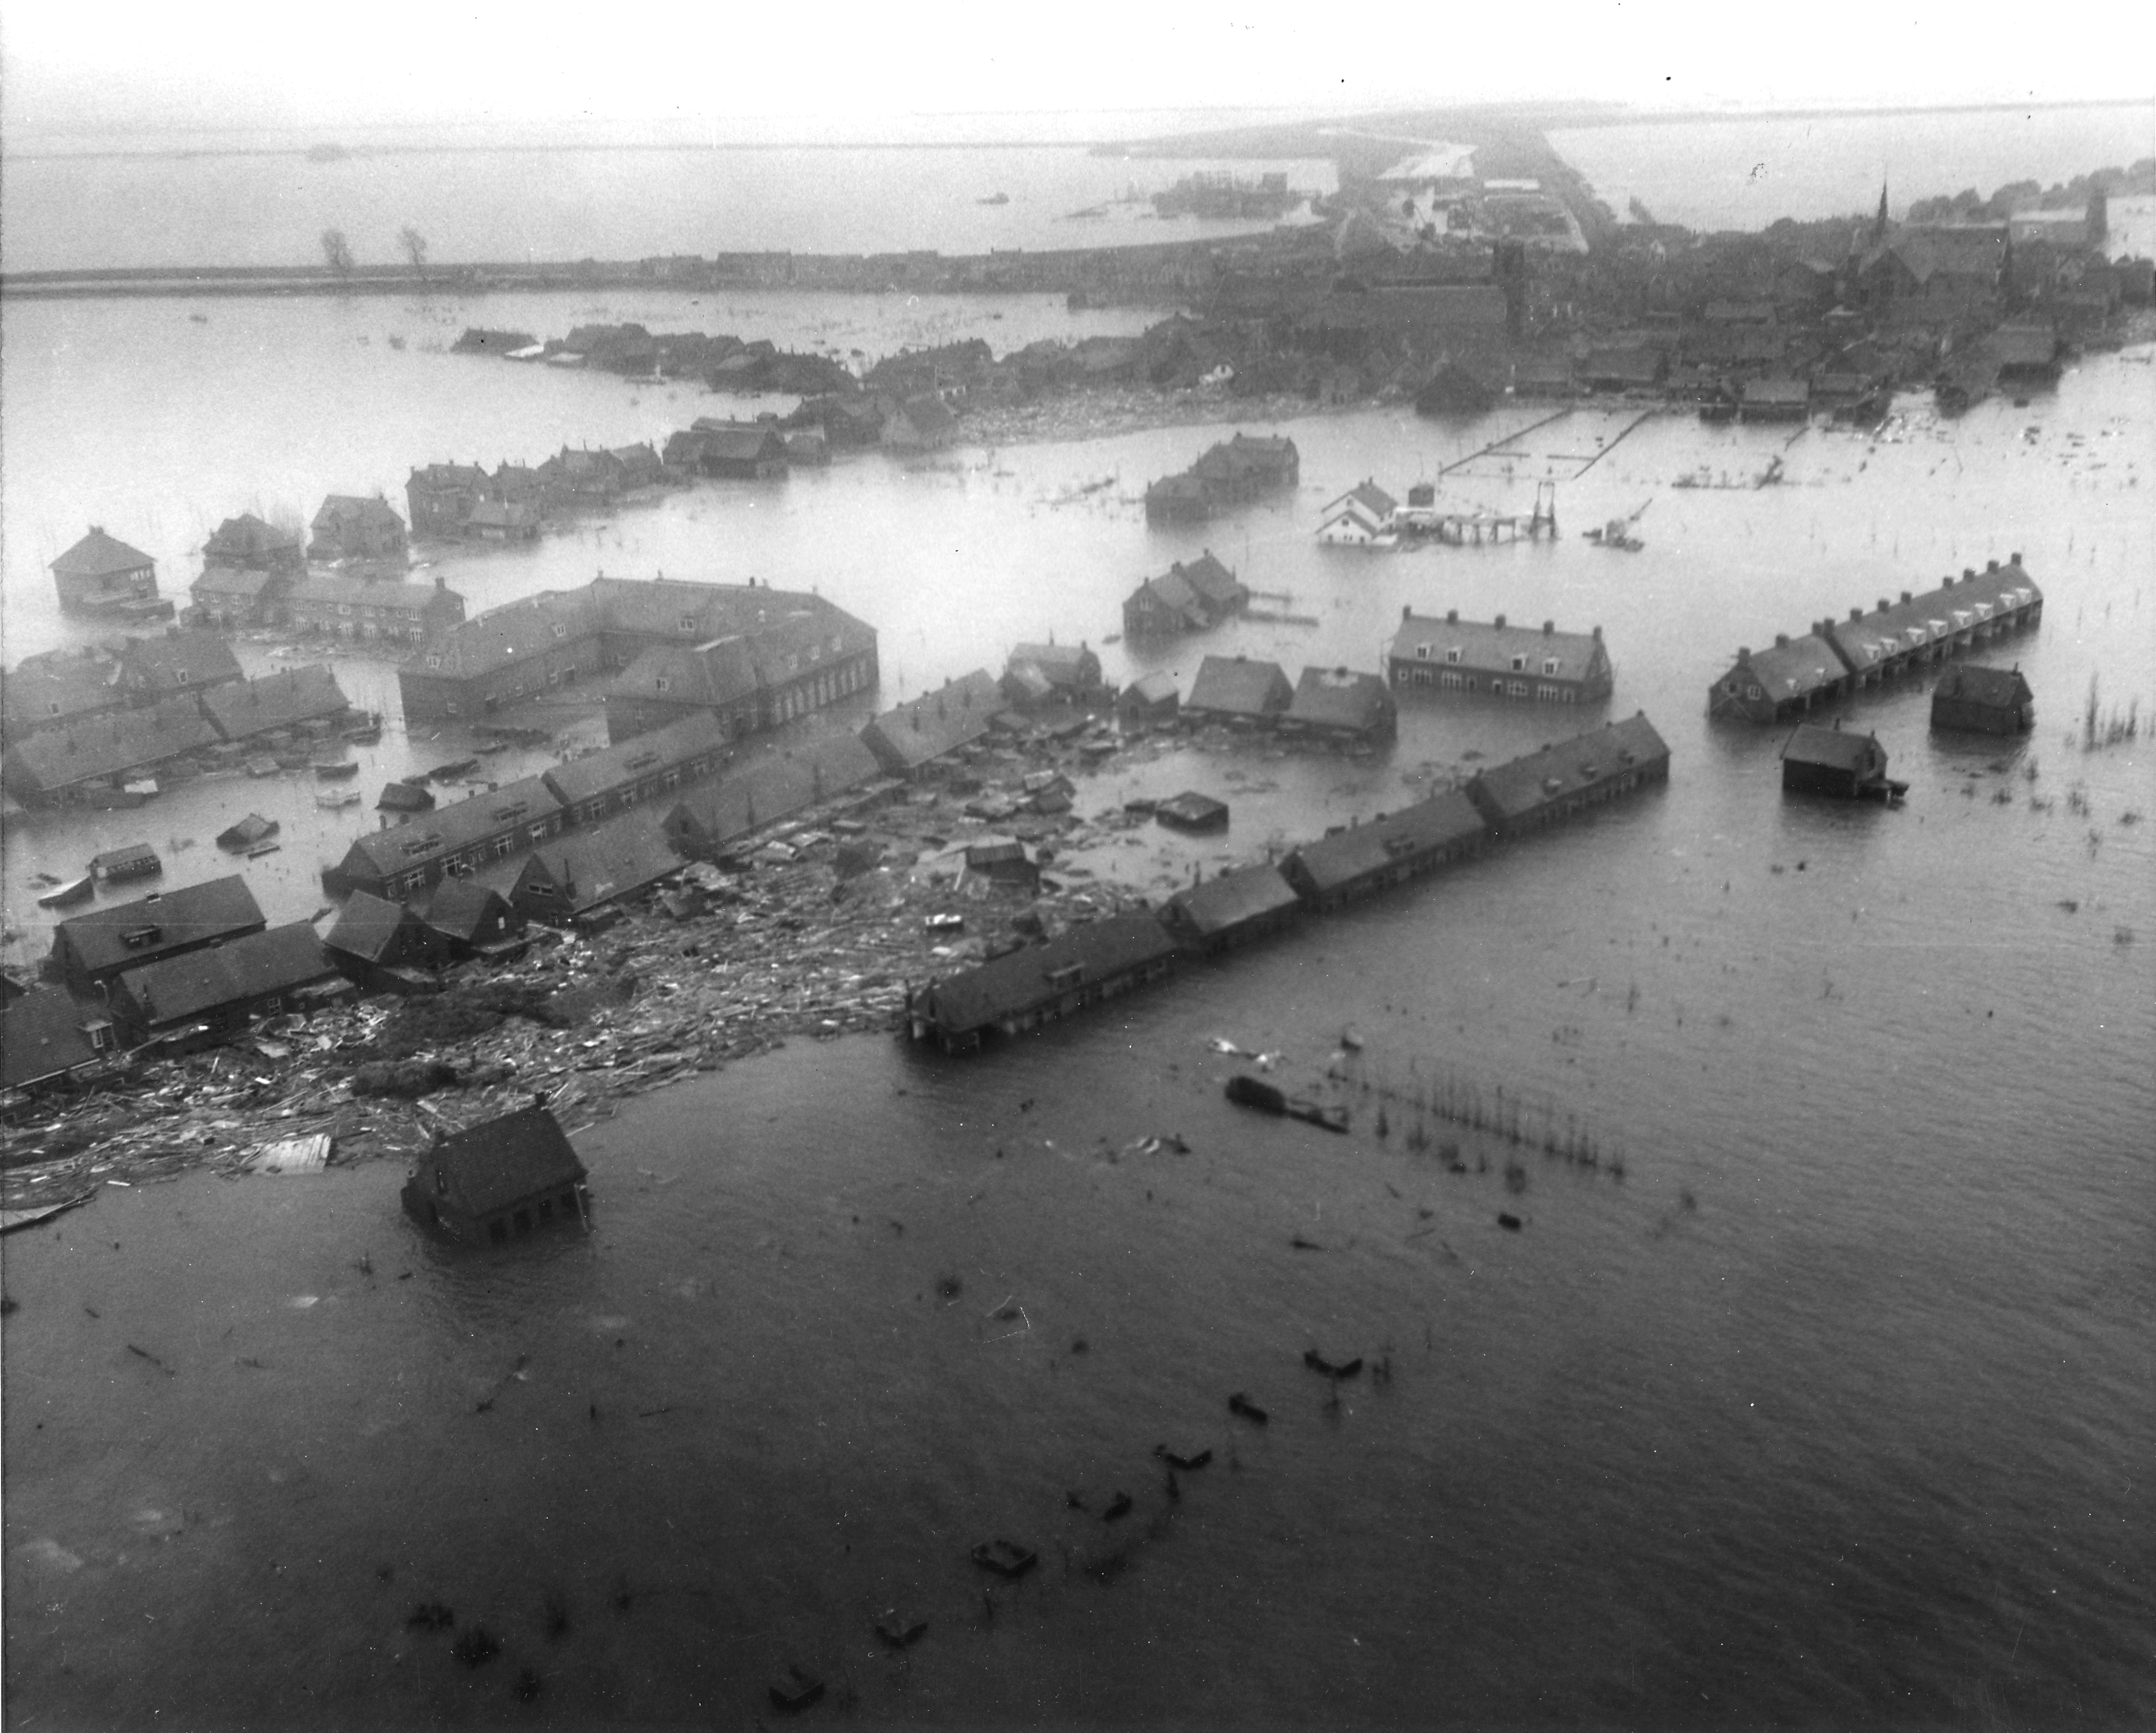
1,800+ people killed
150,000 hectares flooded
9,000 buildings destroyed
Economic loss: 1.5–2 billion guilders
Flooding in the Netherlands, 1953. Source: Wikimedia Commons, public domain.

Slide 4
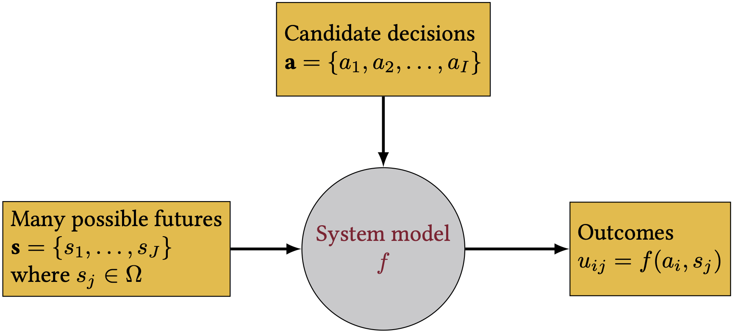
The Dutch government forms the Delta Commission. Their charge: make sure this never happens again.
“How High Should We Build the Dikes?”
Historical approach: build to the height of the highest observed flood.
Problem: there is no upper limit to flood height — every height has a positive exceedance probability.
Higher dikes cost more money to build
Lower dikes mean more expected flood damage
The question: what is the right height?
Review: Our System Dynamics Notation
Figure 1: Notation for our system dynamics. Where does optimization fit?
Notes:
Target: 1:02. Ask: “What should the Commission do?”
Target: 1:05. Pause here. Let the tension sit. “This is fundamentally an optimization problem. And in 1956, a mathematician named van Dantzig figured out how to solve it.”
Target: 1:07. Briefly review the notation diagram. Optimization is about choosing the levers (decision variables) to achieve the best metrics (objective) given the states of the world (scenarios/uncertainties) and the relationships (constraints and system model).

Slide 5
Structure of an Optimization Problem
Every optimization problem has four components:
Decision variables: What can we control?
Objective function: What are we trying to minimize or maximize?
Constraints: What limits our choices?
Scenarios / states of the world: What uncertainties affect the outcome?
Notes:
Target: 1:10. Write these four on the board. We’ll keep coming back to them.

Slide 6
van Dantzig’s Simple Model
Historical Context
Notes:
Target: 1:10. Transition to the formal model. Emphasize that every assumption was shaped by computational constraints.

Slide 7
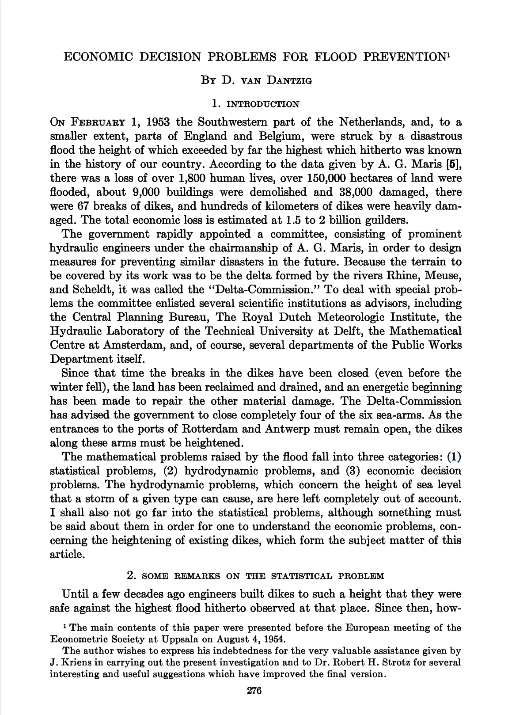
Published in Econometrica, 1956.
Models always trade off realism for tractability — they answer questions and inform decisions, not provide a 1:1 map of the real world.
With no computers available, van Dantzig needed a closed-form solution — so every assumption was chosen to keep the math tractable.
First page of van Dantzig (1956).
Notes:
Target: 1:12. The exponential distribution wasn’t chosen because floods are truly exponential — it was chosen because it yields a tractable integral.

Slide 8
Flood Exceedance Probability

Slide 9
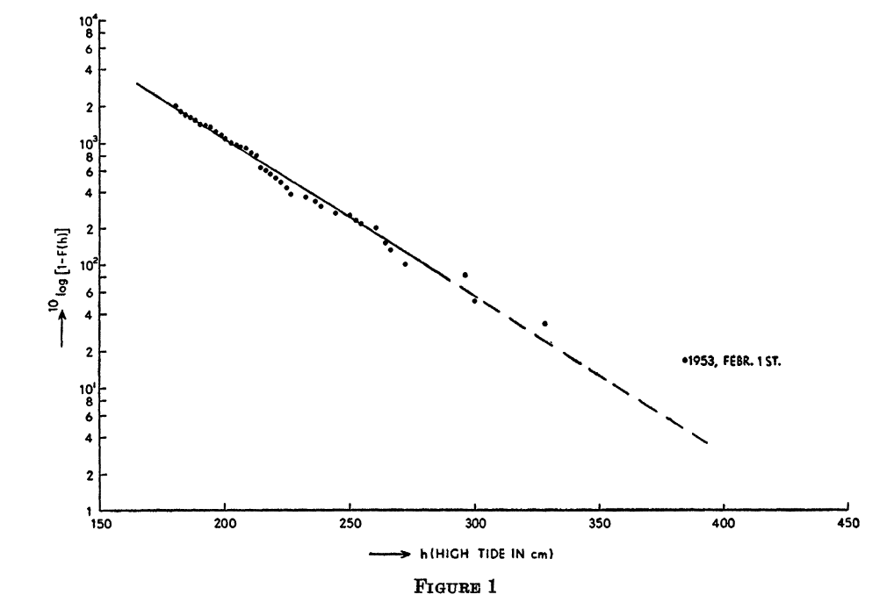
Assumed exponential exceedance probability:
$$p(h)=p_{0} e^{−α(h−H_{0})}$$
$h$ = water height
$H_{0}$ = current dike height
$p_{0}$ = current exceedance probability
$α$ = shape parameter
The straight line on the log plot is the exponential fit.
Why exponential? Because it makes the integral tractable.
van Dantzig’s Figure 1: exceedance probability vs. high tide height at Hook of Holland. Note the 1953 event marked as an outlier. Source: van Dantzig (1956).
Notes:
Target: 1:15. The 1953 event (marked on the figure) falls off the fitted line — it was more extreme than the model predicted. Ask: “What does that tell us about the exponential assumption?”

Slide 10
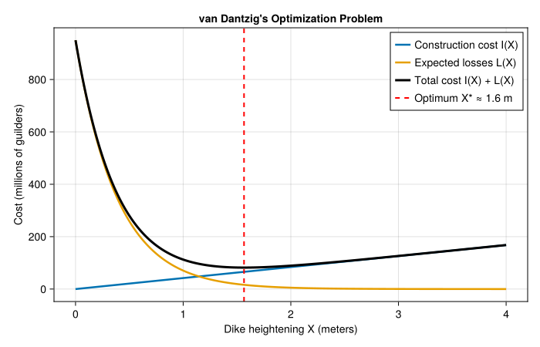
The Loss Model
van Dantzig assumes binary damage: if water exceeds dike height $H$, everything in the polder is lost.
$$S=\left\{\begin{matrix}0 & \text{if }h≤H \\ V & \text{if }h>H\end{matrix}\right.$$
where $V$ is the total value of all goods, buildings, farms, cattle, and industry in the polder.
Building the Cost Function
Construction cost (linear approximation):
$$I(X)=I_{0}+kX$$
Expected annual flood loss (probability $×$ total value at risk):
$$p_{0}⋅V⋅e^{−αX}$$
Present value of ALL future expected losses (discounting!):
$$L(X)=\frac{100 p_{0} V e^{−αX}}{δ}$$
where $δ$ is the interest rate (in percent) — this is NPV, just like Week 5.
The U-Shaped Total Cost
$$\text{Total}(X)=\underset{\text{construction}}{\underset{⏟}{I_{0}+kX}}+\underset{\text{expected losses (NPV)}}{\underset{⏟}{\frac{100 p_{0} V e^{−αX}}{δ}}}$$
Figure 2: The classic trade-off: construction costs rise with dike height, expected losses fall. The optimum balances them. How would the optimum shift if the curves changed shape?
Notes:
Target: 1:17. Students who did Lab 2 (hazard-damage convolution) know that damage is graduated. Ask: “What would change if we used a more realistic damage model?”
Target: 1:20. The 100/δ comes from summing the infinite geometric series of discounted annual losses. This is the same present value calculation from last week.
Target: 1:23. Walk through the figure. Ask: “What happens if V doubles? Which curve shifts?”

Slide 11
The Analytical Solution
Take the derivative, set equal to zero:
$$X^{*}=\frac{1}{α}ln​\left(\frac{100 p_{0} V α}{δ k}\right)$$
Interpretation:
Optimal height increases when value $V$ is high
Optimal height increases when flood probability $p_{0}$ is high
Optimal height decreases when discount rate $δ$ is high
Optimal height decreases when construction cost $k$ is high
Notes:
Target: 1:26. Don’t derive — show the result and focus on interpretation. Ask: “Which of these parameters do we know well? Which are uncertain?”

Slide 12
Adding Realism
The Netherlands is Changing
Two slow processes push the optimal dike height higher:
Wealth growth: the economy grows at rate $γ$ (estimated 1.5–2.5% per year), so $V$ increases over time.
Land subsidence: the Netherlands has been sinking for 9,000 years at rate $ν$ (~0.7 m/century), so effective dike height decreases.
Both compound over centuries-long planning horizons.
The Reduced Interest Rate
With wealth growth, the effective discount rate becomes:
$$δ^{′}=δ−γ$$
van Dantzig estimates $δ≈3.5\text{–}4.5\%$ and $γ≈1.5\text{–}2.5\%$, giving $δ^{′}≈1\text{–}3\%$.
A smaller effective discount rate means future losses matter more — and the optimal dike gets taller.
What happens if $γ≥δ$?
The present value of future losses diverges — there is no finite optimum.
“The Doubtful Constants”
van Dantzig devotes a whole section to parameter uncertainty (Section 6).
Most of his parameters are “rather badly known”:
$α$ and $p_{0}$ — physical constants, improvable with better data
$I_{0}$ and $k$ — engineering estimates
$V$ — determinable from economic data (with difficulty)
$δ$ and $γ$ — “secular” economic quantities, deeply uncertain over centuries
Which of these can we learn? Which are fundamentally unknowable?
We’ll return to this distinction when we study robustness later in the semester.
The “Safe Side” Approach
van Dantzig’s solution to parameter uncertainty:
“The best thing we can do is to ascertain that our solution will hold under the most unfavourable circumstances which must be considered to be realistic.”
Take the highest reasonable $p_{0}$, $V$, $η$ and the lowest reasonable $k$, $δ^{′}$.
This is a minimax strategy — minimize cost under the worst-case parameter values.
The trade-off: minimax will overdesign relative to the expected case. Choosing to err on the side of safety is defensible — but overdesign has real costs.
We’ll return to robustness more formally in Week 8.
The Numerical Result
Notes:
Target: 1:26. van Dantzig spends half the paper relaxing these assumptions.
Target: 1:29.
Target: 1:32. If wealth growth equals the discount rate, the present value of future losses diverges. Connect to discounting debates from Week 5.
Target: 1:35. A 1956 paper grappling with the same uncertainty challenges we discuss today. Flag the connection to Week 8 (robustness and deep uncertainty).
Target: 1:37. He’s doing robust optimization before the term existed.

Slide 13
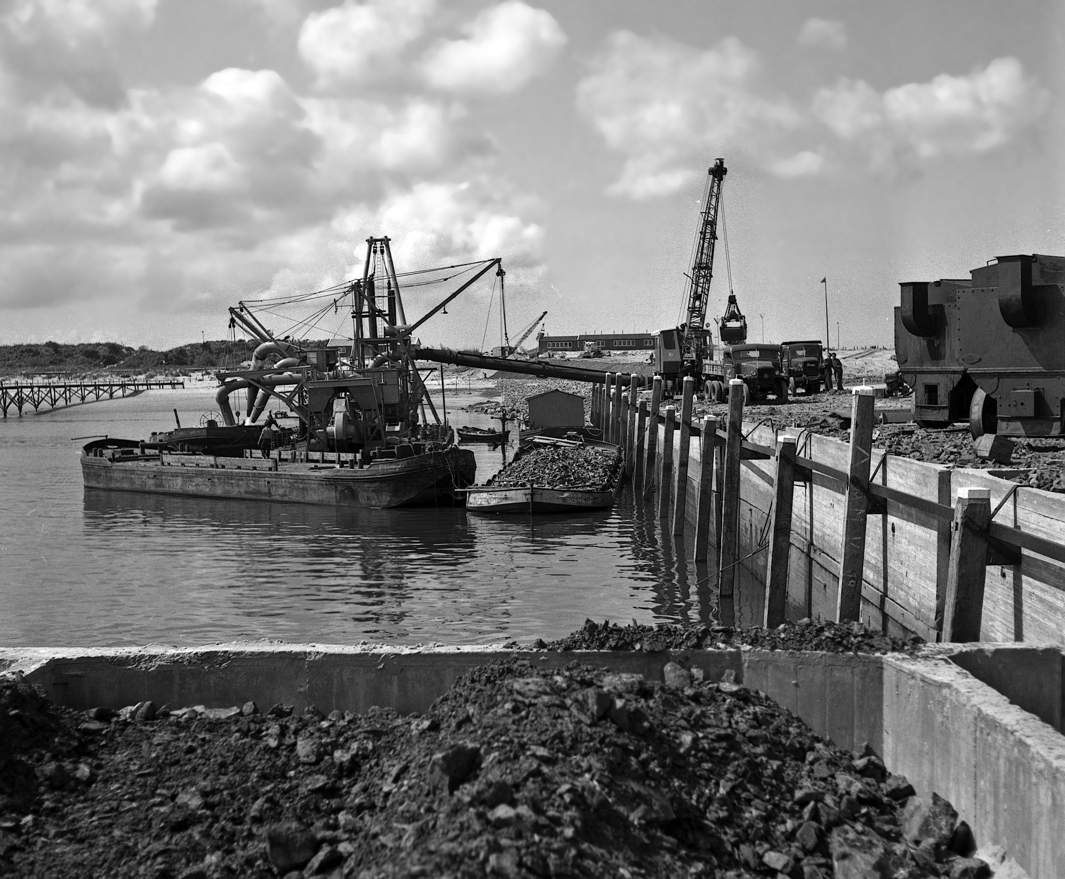
The paper considers additional parameters and processes (wealth growth, land subsidence, safe-side estimates) that shift both curves — pushing the optimum higher.
van Dantzig concludes that a dike height of roughly 6 meters “may be considered as a sufficiently safe height.”
This informed the Delta Commission’s decisions — and ultimately the Delta Works.
The Oosterscheldekering, part of the Delta Works. Source: Wikimedia Commons, CC BY-SA 3.0.
Notes:
Target: 1:39. The Delta Works took 43 years and cost ~$7 billion.

Slide 14
What About Human Lives?
The 1953 flood killed 1,800 people. Material losses were 1.5–2 billion guilders. At ~100,000 guilders per life lost, the economic framing seems inadequate.
van Dantzig’s approach: look at what the state actually spends to save lives in other domains (railway safety, factory regulations) to derive an implicit value.
“It does not make sense to increase the dikes by an extra centimeter to account for the value of human lives.”
But the dikes should be higher than pure material-loss optimization suggests.
Notes:
Target: 1:42. Ask: “Is it ethical to put a dollar value on human life? Is it ethical not to, when making infrastructure decisions?” The value of a statistical life is still debated today.

Slide 15
Optimization and Policy Search
Notation | Meaning | van Dantzig
$x$ | Decision variables | $X$ = dike heightening
$f(x)$ | Objective function | Total cost $I(X)+L(X)$
$g_{j}≤0$ | Constraints | $X≥0$
van Dantzig used optimization to inform an engineering design decision. Let’s formalize the general framework.
Optimization Fundamentals
Every optimization problem has the same mathematical structure:
$$\begin{matrix}\min_{x} & f(x) \\ \text{subject to} & g_{j}(x)≤0, & j=1,…,J \\ & h_{k}(x)=0, & k=1,…,K\end{matrix}$$
Notes:
Target: 1:42. “We’ve just seen one concrete example of using optimization to inform design. Now let’s name the pieces so you can recognize them in any context.”
Target: 1:45. Write the canonical form on the board. “This notation is universal across engineering, economics, and operations research. If you can read this, you can read any optimization paper.” Map each piece to van Dantzig. One variable, one constraint, closed-form objective — the simplest possible case.

Slide 16
Approach | Formulation | Plain English
Expected value | $\min_{x} E[f(x,θ)]$ | Minimize the average outcome
Chance constraint | $Pr[g(x,θ)≤0]≥1−ϵ$ | Meet constraints with high probability
Robust | $\min_{x}\max_{θ}f(x,θ)$ | Minimize the worst case
Stochastic Optimization: How Uncertainty Enters
van Dantzig averaged over flood uncertainty analytically. More generally, when the objective or constraints depend on uncertain quantities $θ$:

Slide 17
van Dantzig used expected value for losses and robust (“safe side”) for parameters — decades before “robust optimization” had a name.
Classes of Optimization Algorithms
The choice of algorithm depends on what structure is available in $f(x)$:
The less structure you can exploit, the more computation you need.
Optimization vs. Policy Search
“Optimization” implies we found THE optimal answer. But it’s only optimal within our model and assumptions.
I prefer the term policy search: using computers to suggest promising alternatives.
van Dantzig’s answer was optimal — in a model with binary damage and exponential floods
In practice, a set of good options to evaluate beats a single “optimal” answer
Notes:
Target: 1:47. Just vocabulary. Students should recognize these terms when they see them in papers. The question for any study is: “how does uncertainty enter the optimization?” Different answers give very different solutions. Connect to Week 8 (robustness).
Target: 1:49. One sentence per row. The organizing principle: “what structure does your problem have?” Other courses cover each technique in depth. Here we need to understand the tradeoffs between them.
Target: 1:55. We’ll use “policy search” for the rest of the course. It changes how we think about and present results.

Slide 18
Evaluating Optimization Claims
Four Key Questions
When someone presents an “optimal” solution:
Decision variables: What levers are we pulling? What was left out?
Objective: What are we optimizing? Whose costs and benefits count? What isn’t monetized?
Constraints: Are these real physical limits or modeling assumptions?
Scenarios: Over what states of the world is this “optimal”? One scenario, a few, or a full representation of uncertainty?
What’s Next
Wednesday: Exam 1 (covers Weeks 1–4)
Friday: Lab 5 — Policy search with ICOW
Coming up in Module 2: sensitivity analysis, value of information, robustness — all about what happens when your model assumptions are wrong
References
Dantzig, D. van. 1956. “Economic Decision Problems for Flood Prevention.” Econometrica 24 (3): 276–87. https://doi.org/10.2307/1911632.
Notes:
Target: 1:58. These four questions apply to van Dantzig, to ICOW, and to any optimization result you’ll encounter.

