Slide 1
Multi-Objective Optimization
Lecture James Doss-Gollin

Slide 2
Today: Two Ideas Combined
We are combining two threads from earlier in the course:
Multiple criteria (from the Values lecture): some things are hard to compare on a single scale.
Optimization / policy search (from the Optimal Decisions lecture): search a decision space for good actions.
Today: search a decision space when several objectives matter, without collapsing them into one number.
MCA vs. MOO
Notes:
Target: 1:05. Frame this as a synthesis week. Connect explicitly to (a) Week 9 values discussion — incommensurability, weighting is itself a value choice — and (b) the optimization framing from BCA. Multi-objective optimization is what you do when those two ideas meet.

Slide 3
Multi-Criteria Analysis
Fixed list of alternatives
Score each on each criterion
Aggregate via weights → ranking
Scoring a given menu
Multi-Objective Optimization
Alternatives generated by search
Objectives kept separate
Output: a set of trade-off solutions
Discovering trade-offs and generating new alternatives
Notes:
Target: 1:08. Crisp distinction: MCA ranks a given list; MOO discovers the list and exposes the trade-offs. HCFCD couldn’t do MOO because their alternatives were discrete projects. House elevation height is a continuous decision — perfect for MOO.

Slide 4
Multiple Conflicting Objectives
$$\min_{a} \{f_{1}(a), f_{2}(a), …, f_{k}(a)\}$$
. . .
Coastal adaptation example:
$f_{1}(a)$: expected flood damages
$f_{2}(a)$: construction cost
Improving $f_{1}$ generally requires accepting worse $f_{2}$.
Notes:
Target: 1:15. ~4 min. Ask: “Another pair of objectives in tension?” e.g. speed of deployment vs. community buy-in; near-term cost vs. long-term resilience.

Slide 5
Dominance and Pareto Optimality
What Does “Better” Mean?
Dominance: Solution $a$ dominates solution $b$ if:
$a$ is at least as good as $b$ on every objective
$a$ is strictly better than $b$ on at least one objective
. . .
If $a$ dominates $b$, there is no reason to choose $b$.
Which solutions dominate?
A vs. B? A is cheaper, B has lower damages → neither dominates.
B vs. C? B is cheaper, C has slightly lower damages → neither dominates.
The Pareto front is {A, B, C}.
Your Turn: Which are Dominated?
Notes:
Target: 1:18. Conceptual core. ~10 min.
Target: 1:21. “At least as good on ALL, strictly better on AT LEAST ONE.” Partial order — many solutions won’t be comparable.
Target: 1:23. Walk through row by row. Make students check both objectives carefully.

Slide 6
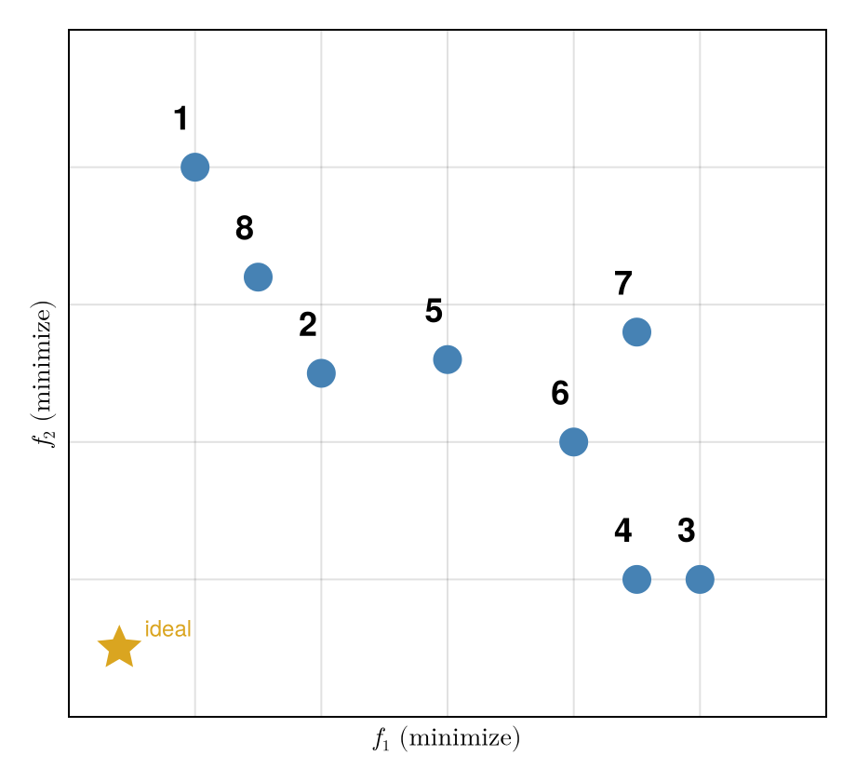
Both objectives are minimized (lower-left is better).
Identify every dominated solution.
The star marks the (infeasible) ideal point.
let points = [ (1.0, 4.0), # 1: front (2.0, 2.5), # 2: front (5.0, 1.0), # 3: front (4.5, 1.0), # 4: front (3.0, 2.6), # 5: dominated by 2 (4.0, 2.0), # 6: front (4.5, 2.8), # 7: dominated by 3 (1.5, 3.2), # 8: front ] labels = ["1", "2", "3", "4", "5", "6", "7", "8"] fig = Figure(; size=(460, 420)) ax = Axis( fig[1, 1]; xlabel=L"f_1 \text{ (minimize)}", ylabel=L"f_2 \text{ (minimize)}", xticksvisible=false, xticklabelsvisible=false, yticksvisible=false, yticklabelsvisible=false, limits=(0, 6, 0, 5), ) scatter!(ax, [0.4], [0.5]; marker=:star5, markersize=28, color=:goldenrod) text!(ax, 0.6, 0.55; text="ideal", fontsize=12, color=:goldenrod) for (i, (x, y)) in enumerate(points) scatter!(ax, [x], [y]; markersize=22, color=:steelblue) text!(ax, x - 0.18, y + 0.22; text=labels[i], fontsize=18, font=:bold) end fig end
Figure 1: Five candidate solutions in two-objective space; both objectives minimized.
Notes:
Target: 1:26. Cold call. Answer: solution 5 is dominated by solution 2 (2 is better on both: 2.0<3.0 and 2.5<3.0). Solutions 1, 2, 3, 4 are mutually non-dominated → they form the Pareto front. Walk through the check explicitly for each candidate.

Slide 7
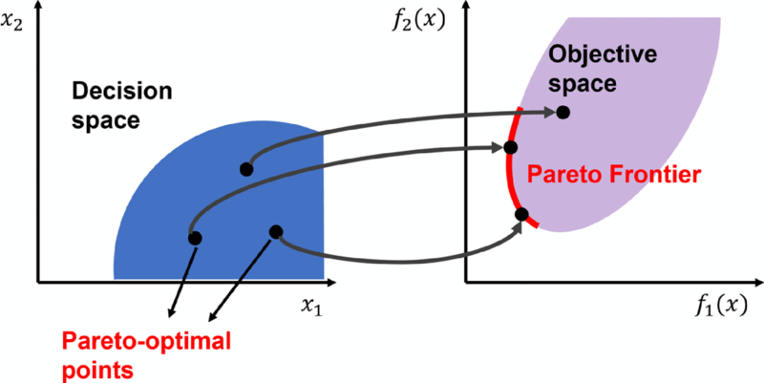
The Pareto Front
Figure 2: A Pareto front in two objectives. Source: Smith et al. (2022)
Notes:
Target: 1:29. Analogy: efficient frontier in portfolio theory. Division of labor: analysts find the front, decision-makers choose from it. More honest than embedding values in weights.

Slide 8
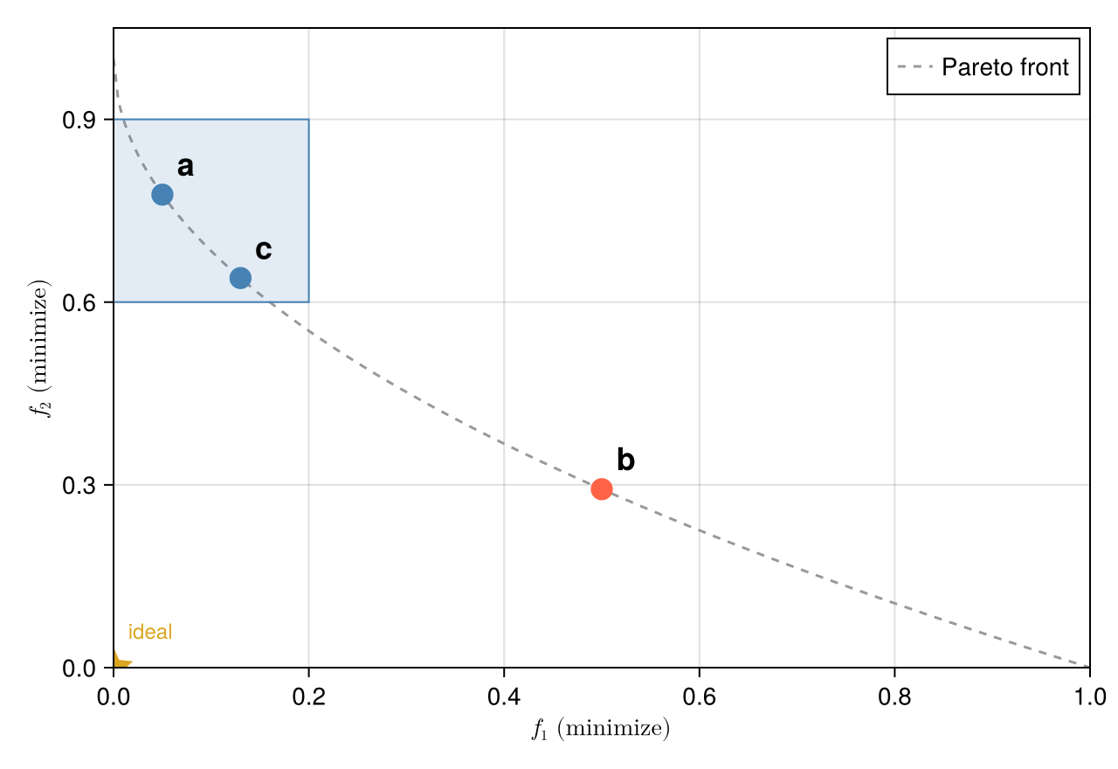
Multi-Objective Evolutionary Algorithms
How MOEAs Work
Maintain a population of candidate solutions that evolves over generations
Selection favors non-dominated solutions
Diversity preservation spreads solutions across the front
Repeat until convergence
. . .
Result: a set of solutions approximating the full trade-off curve, including non-convex regions.
Genetic Algorithm Mechanics
A GA is stochastic search with a population instead of a single point.
Population: $N$ candidate solutions in the decision space
Evaluation: compute objectives for every member
Selection: bias future generations toward better solutions
Variation: produce offspring via crossover (mix two parents) and mutation (perturb)
Replacement: combine parents + offspring, keep the best $N$
Repeat for many generations
. . .
The population is what makes GAs natural for MOO: many trade-off points evolve at once.
ε-Dominance
Why we need it. Plain Pareto dominance has two practical problems:
Diversity. Nothing stops the archive from clustering many near-identical solutions in one region of the front while leaving other regions empty.
Computation. The archive can grow without bound — every slightly-different point survives — and every new candidate must be checked against all of them.
We want a rule that keeps only solutions that differ by amounts the decision-maker actually cares about.
ε-Boxes
Pick a vector $ϵ=(ϵ_{1},…,ϵ_{k})$ — one resolution per objective. Tile objective space with boxes of side $ϵ_{i}$ along axis $i$, and map each solution to the integer coordinates of the box it lands in.
ε-dominance: $a$ ε-dominates $b$ if $a$’s box dominates $b$’s box in the ordinary sense, and the archive keeps at most one solution per box.
Two solutions in the same box are treated as equivalent — keep the one closer to the box’s lower corner
$ϵ_{i}$ encodes the resolution at which the decision-maker cares about differences on objective $i$
Resolutions can differ by objective (e.g., damages in $M, lives in counts)
Archive size is bounded by the number of boxes the front intersects
ε-Dominance: Picture
Figure 3: An $ϵ$-grid with $ϵ_{1}=0.20$, $ϵ_{2}=0.30$. Points $a$ and $c$ both fall in the same box, so the archive keeps only one (whichever is closer to the box’s lower corner). Point $b$ lives in a different box and survives. The star marks the (infeasible) ideal point.
Notes:
Target: 1:31. Students don’t need to implement MOEAs — just understand them well enough to interpret results.
Target: 1:34. Each solution is a “design.” MOEA runs many in parallel and improves them. Diversity mechanism is key — without it, the algorithm collapses to one region.
Target: 1:39. “Hill-climbing with a crowd.” No gradients required. Crossover/mutation = exploration; selection = exploitation.
Target: 1:42. The ε vector is a values parameter: “I do not care about differences smaller than this on objective i.” Smaller ε → finer front, bigger archive, slower convergence. Larger ε → coarser, faster. This grid/box version is what ε-MOEA and Borg actually implement; the key property is “one solution per box.”

Slide 9
A Toy ε-MOEA on ZDT1
ZDT1: A Test Problem
Notes:
Target: 1:43. The next slides build a working ε-MOEA from scratch and animate convergence. Students don’t need to memorize the code — the goal is to see the machinery.

Slide 10
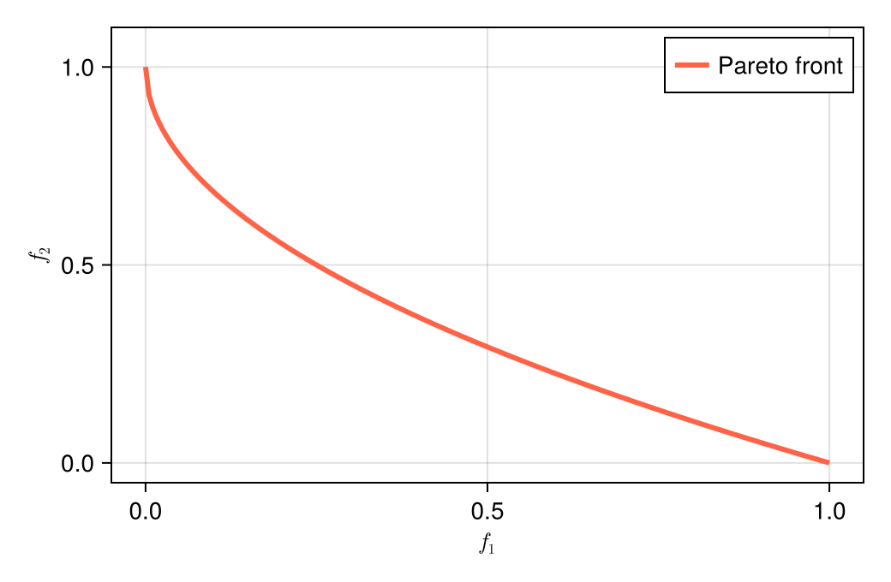
A standard MOO benchmark with two decision variables $x_{1},x_{2}∈[0,1]$ and two objectives (both minimized):
$$\begin{aligned}f_{1}&=x_{1} \\ f_{2}&=g(x_{2})\left(1−\sqrt{f_{1}/g(x_{2})}\right) \\ g(x_{2})&=1+9x_{2}\end{aligned}$$
The analytical Pareto front is $x_{2}=0$, giving $f_{2}=1−\sqrt{f_{1}}$ on $f_{1}∈[0,1]$.
using Random Random.seed!(1) function zdt1(x) f1 = x[1] g = 1 + 9 * x[2] f2 = g * (1 - sqrt(f1 / g)) return [f1, f2] end let fs = 0.0:0.005:1.0 fig = Figure(; size=(520, 340)) ax = Axis(fig[1, 1]; xlabel=L"f_1", ylabel=L"f_2", limits=(-0.05, 1.05, -0.05, 1.1)) lines!(ax, fs, 1 .- sqrt.(fs); color=:tomato, linewidth=3, label="Pareto front") axislegend(ax; position=:rt) fig end
Figure 4: Canonical visualization of ZDT1: the analytical Pareto front in objective space.
Notes:
Target: 1:45. ZDT1 is one of the Zitzler–Deb–Thiele benchmark problems. The front is convex; algorithms have to find the whole thin red curve from (0,1) to (1,0). Off the front, f_2 shoots up.

Slide 11
Mutation
The GA’s source of new points: take a parent vector, add small Gaussian noise, clamp back into the unit box.
mutate(x) = clamp.(x .+ 0.1 .* randn(length(x)), 0, 1)
ε-Dominance in Code
Map each point to its $ϵ$-box, then apply ordinary dominance on the integer box coordinates.
# Integer coordinates of the ε-box a point lands in ebox(f, ε) = floor.(Int, f ./ ε) # a ε-dominates b if a's box dominates b's box function eps_dominates(a, b, ε) ba, bb = ebox(a, ε), ebox(b, ε) return all(ba .<= bb) && any(ba .< bb) end
floor.(Int, f ./ ε) is the entire ε-grid mapping
Dominance on integer tuples is the same comparison from the dominance slides — just at coarser resolution
Archive Update
function update_archive!(archive, cand, ε) cb = ebox(cand.f, ε) drop = Int[] for (i, m) in enumerate(archive) mb = ebox(m.f, ε) if mb == cb # Same box: keep whichever is closer to its lower corner if sum((m.f .- mb .* ε) .^ 2) <= sum((cand.f .- cb .* ε) .^ 2) return else push!(drop, i) end elseif eps_dominates(m.f, cand.f, ε) return # candidate ε-dominated by m elseif eps_dominates(cand.f, m.f, ε) push!(drop, i) # candidate ε-dominates m end end deleteat!(archive, drop) push!(archive, cand) return end
Initialize
Notes:
Target: 1:46. Real MOEAs use polynomial mutation and simulated binary crossover. Gaussian + clamp is the simplest thing that works and makes the mechanism transparent. Step size 0.1 is small enough to refine, large enough to escape local clusters.
Target: 1:48. The trick: ε-dominance reduces to ordinary dominance on rounded coordinates. Two short functions.
Target: 1:50. Three cases: same box → keep the one closer to the corner; existing member dominates candidate → reject; candidate dominates existing → mark for removal. Tie-breaking by corner distance gives clean coverage.

Slide 12
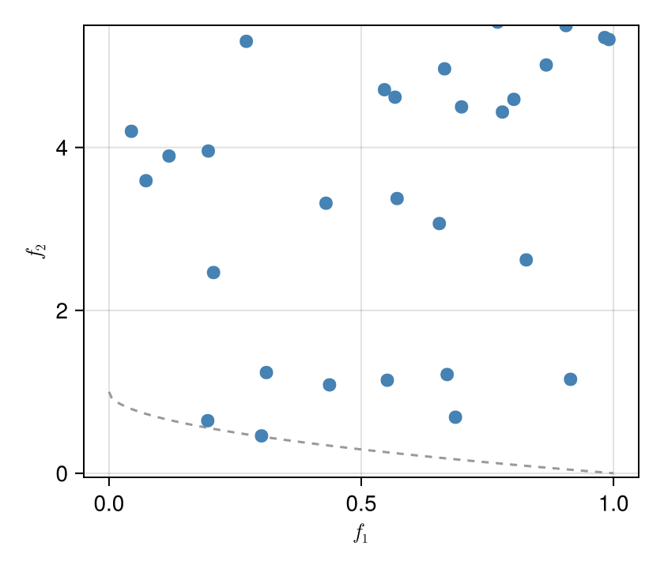
N = 40 ε = [0.05, 0.05] pop = [(x=rand(2), f=zeros(2)) for _ in 1:N] pop = [(x=p.x, f=zdt1(p.x)) for p in pop] archive = eltype(pop)[] for p in pop update_archive!(archive, p, ε) end length(archive)
Figure 5: Initial population (blue) vs. analytical front (dashed).
Notes:
Target: 1:50. 40 random points scattered all over objective space. Archive starts as whatever subset is mutually non-dominated under the ε-grid.

Slide 13
Running the Model
function step!(pop, archive, ε; p_random=0.3) offspring = map(1:length(pop)) do _ x = rand() < p_random ? rand(2) : mutate(rand(pop).x) (x=x, f=zdt1(x)) end for o in offspring update_archive!(archive, o, ε) end # Next generation: half from archive (exploit), half from offspring (explore) half = length(pop) ÷ 2 return vcat( [archive[rand(1:length(archive))] for _ in 1:half], offspring[1:(length(pop) - half)], ) end
gens = 50 # Frame 0: the raw initial random population (before any selection) snapshots = Vector{Vector{Point2f}}() push!(snapshots, [Point2f(p.f...) for p in pop]) # Frames 1..gens: archive after each generation for g in 1:gens global pop = step!(pop, archive, ε) push!(snapshots, [Point2f(m.f...) for m in archive]) end
Watching It Converge
Notes:
Target: 1:52. The mix of (a) parents from archive and (b) parents from current pop, plus (c) occasional fresh random samples, prevents premature collapse and keeps the corners reachable. Saving snapshots lets us animate the run.
Target: 1:55. Random scatter → quick collapse onto the front → progressive filling-in along the curve, including the corners. Nothing in the algorithm knows the analytical front exists — just dominance + mutation + ε-bookkeeping. Real MOEAs (NSGA-II, Borg) add smarter recombination, but the conceptual machinery is identical.

Slide 14
Reading and Using the Pareto Front
What Does Many-Objective Look Like?
Notes:
Target: 1:56. Quick section — 5 min.

Slide 15
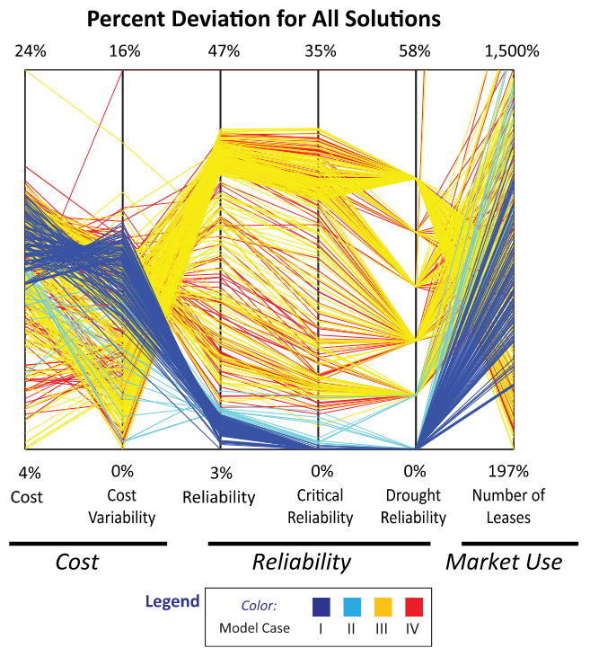
With 2 objectives: a curve.
With 3+ objectives: a surface — impossible to visualize directly.
Parallel axis plots show all objectives simultaneously. Each line = one non-dominated solution.
Figure 6: Parallel axis plot of non-dominated solutions across six objectives. Source: Kasprzyk et al. (2013)
Notes:
Target: 1:58. Each vertical axis is one objective; each colored line is a solution. Solutions good on reliability tend to be worse on cost. Color = model case. Water portfolio problem in the Rio Grande Valley. ~1000 non-dominated solutions across 6 objectives.

Slide 16
Reading a Pareto Front
On a Pareto front plot, each axis is one objective and each point is a non-dominated solution.
. . .
The “knee” of the front:
Region of high curvature — large gains on one objective for small losses on another
Often a practical default if no strong preference exists
Not always present; depends on problem structure
How Many Objectives?
More objectives → richer representation, but real costs:
Computational: exponentially more solutions to cover the front
Conceptual: harder to reason about trade-offs in high dimensions
Communication: harder to show decision-makers
. . .
Rule of thumb: use as few objectives as possible. Combining objectives is often the right call — when the assumptions hold.
Notes:
Target: 1:50. Preview Lab 10: students will generate a Pareto front for the house elevation problem.
Target: 1:52. Counterweight to the motivation. MOO is powerful but not free. Most student projects have 2–3 meaningful objectives at most.

Slide 17
Wrapup
Summary
Why MOO? When objectives are incommensurable, weighting hides value choices. MOO keeps them separate.
Dominance is the comparison rule: better on all, strictly better on one. The non-dominated set is the Pareto front.
MOEAs approximate the front with a population of designs, dominance-based selection, and variation operators. No gradients needed.
$ϵ$-dominance thins the archive to a manageable, decision-relevant resolution.
Division of labor: analysts find the front; decision-makers choose from it.
Looking Ahead
This week:
Wednesday: Madison leads discussion of Yang et al. (2023) — come prepared to discuss objectives, algorithm choice, and how results inform decisions
Friday: Lab 10 — generate and visualize Pareto fronts for the house elevation problem
Friday: Memo 2 due (Evidence & Robustness)
. . .
Week 13 (Monday): Putting it all together — how robustness, scenario discovery, sequential decisions, and multi-objective optimization connect in real projects.
References
Kasprzyk, Joseph R., Shanthi Nataraj, Patrick M. Reed, and Robert J. Lempert. 2013. “Many Objective Robust Decision Making for Complex Environmental Systems Undergoing Change.” Environmental Modelling & Software 42 (April): 55–71. https://doi.org/10.1016/j.envsoft.2012.12.007.
Smith, S., M. Southerby, S. Setiniyaz, R. Apsimon, and G. Burt. 2022. “Multiobjective Optimization and Pareto Front Visualization Techniques Applied to Normal Conducting Rf Accelerating Structures.” Physical Review Accelerators and Beams 25 (6): 062002. https://doi.org/10.1103/PhysRevAccelBeams.25.062002.
Yang, Shengnan, Laddaporn Ruangpan, Arlex Sanchez Torres, and Zoran Vojinovic. 2023. “Multi-Objective Optimisation Framework for Assessment of Trade-Offs Between Benefits and Co-benefits of Nature-based Solutions.” Water Resources Management 37 (6–7): 2325–45. https://doi.org/10.1007/s11269-023-03470-8.
Notes:
Target: 1:53. Recap before Looking Ahead. Emphasize the division of labor — that is the key conceptual takeaway distinguishing MOO from BCA.
Target: 1:53. End class here. Madison leads Wednesday — students should read Yang et al. with attention to: (1) what are the objectives? (2) how is the Pareto front generated and interpreted? (3) how do the authors handle trade-offs with decision-makers?

