Slide 1
Case Studies: Dynamic Adaptive Policy Pathways
Lecture James Doss-Gollin

Slide 2
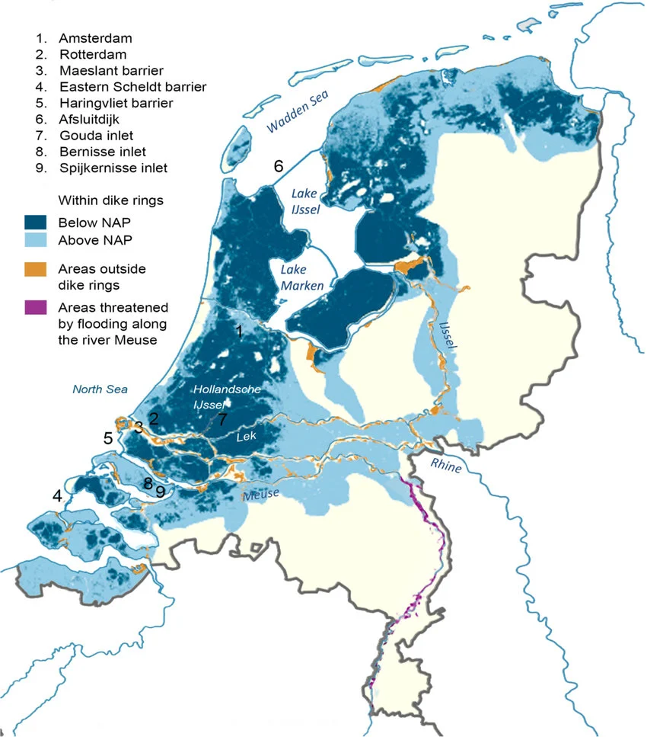
Background and Context
The Netherlands
Figure 1: Flood-prone zones (blue) and key flood defense infrastructure. Source: Haasnoot et al. (2020).
Notes:
Target: 1:00. Part 1: ~10 min.
Target: 1:02. Orient students. Dark blue = below sea level. Light blue = flood-prone from rivers. Note the dike rings and storm surge barriers marked on the map.

Slide 3
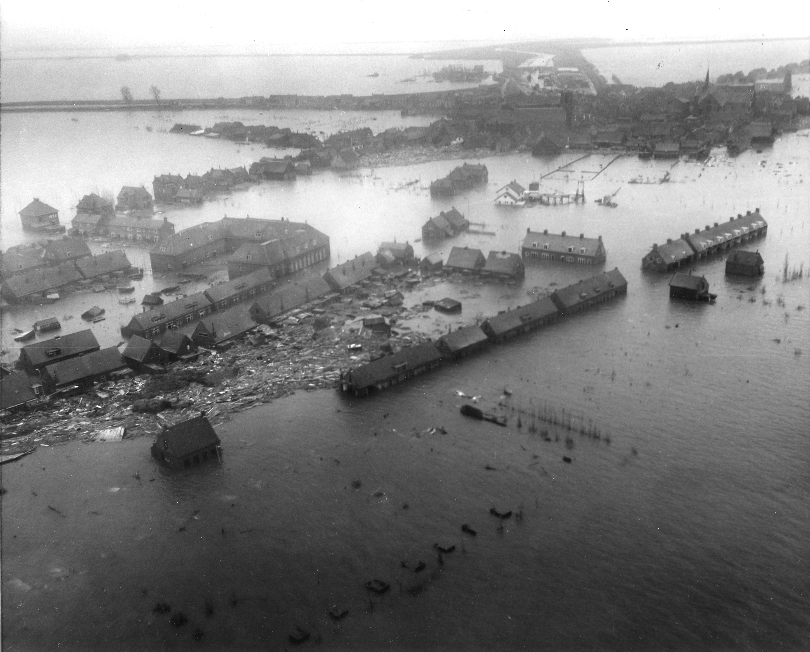
A Long History of Flooding
The Dutch have been fighting water for centuries.
1404, 1421: St. Elizabeth Floods reshape the coastline
1530, 1570: Catastrophic North Sea floods kill tens of thousands
1916: Zuider Zee flood triggers first modern flood protection program
1928-1943: Repeated studies find dikes “seriously defective” — repairs delayed by WWII
. . .
Then came 1953.
February 1, 1953
Figure 2: Aerial view of flooding in the Netherlands, 1953. Source: Wikimedia Commons (public domain).
Notes:
Target: 1:04. The point: 1953 wasn’t a surprise. Warnings went back decades. WWII, competing priorities, and years without major flooding reduced urgency. Source: MIT.
Target: 1:06. Let the image sit. 1,836 dead. 72,000 evacuated. 200,000 hectares flooded. Dikes breached in 150+ locations.

Slide 4
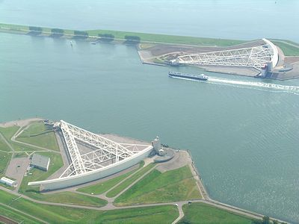
“Never Again”
The 1953 disaster reshaped Dutch politics.
The Delta Commission was formed within weeks
Parliament committed to a 1-in-10,000 year protection standard for critical infrastructure
The result: a 40-year, multi-billion euro construction program
The Delta Works
Figure 3: The Maeslantkering storm surge barrier. Source: Wikimedia Commons / Rens Jacobs (CC BY-SA).
Notes:
Target: 1:08. Failure floods the Randstad (Amsterdam, Rotterdam, The Hague). Political commitment, not just engineering.
Target: 1:09. Maeslantkering = one of the largest moving structures on Earth. 40 years, billions of euros. 1-in-10,000 year design standard.

Slide 5
Think-Pair-Share (90 seconds)
It’s 2026. You’re advising the Dutch government on whether the Delta Works are still adequate.
Using what you’ve learned in this course, what questions would you ask?
Notes:
Target: 1:12. 60s think, 30s pair, cold-call 2-3. Open-ended on purpose — let students generate the concerns from course material. Don’t resolve. Collect answers, then transition to the video.

Slide 6
Room for the River
A Different Kind of Response
The Delta Works said: hold the line.
. . .
Starting in 2006, the Dutch tried something different.
Instead of raising dikes higher, they asked: what if we give the river more room?
Room for the River
https://www.youtube.com/watch?v=xPtRK6wu_tg
Notes:
Target: 1:14.
Target: 1:15. One sentence, then play.
Target: 1:23. 8-min video. No interruption. Pause briefly after.

Slide 7
Current Debates
The Problem with “Predict-Then-Act”
Notes:
Target: 1:23. Part 3: ~12 min.

Slide 8
Traditional approach:
Make best forecast
Design optimal solution
Build it and hope
(is this a straw man? yes.)
Problems:
Brittle: Optimal for one future, fails in others
Divisive: Stakeholders disagree on which forecast to use
Static: Hard to change course as you learn more
Vulnerable: Fails catastrophically when surprised
Notes:
Target: 1:25. The Delta Works = textbook predict-then-act.

Slide 9
Hold the Line vs. Adapt with Nature

Slide 10
Hold the Line
Hard engineering: higher dikes, stronger barriers
Protect existing land use and development
Proven track record, measurable standards
Clear design criteria and accountability
Adapt with Nature
Nature-based solutions, managed retreat
Work with natural processes
Multiple co-benefits (ecosystem services, recreation, equity)
Flexibility across uncertain futures

Slide 11
. . .
Neither is obviously right. Real solutions likely involve both – but the balance depends on values, not just science.
How the Dutch Actually Decided
The Delta Programme faced a choice you’ve seen before:
Notes:
Target: 1:28. The Dutch kept the Delta Works AND added Room for the River. They didn’t choose one side.

Slide 12
For individual structures:
Probabilistic design standards.
1-in-10,000 year return periods.
For long-term strategy:
Scenarios, not probabilities.
Four Delta Scenarios exploring divergent futures.

Slide 13
. . .
They used both — probabilities where they could, scenarios where they couldn’t.
Think-Pair-Share (90 seconds)
Which side of the “Hold the Line vs. Adapt with Nature” debate does the Room for the River video support?
What’s the strongest argument for the OTHER side?
Notes:
Target: 1:31. Four Delta Scenarios (Warm, Rest, Busy, Steam) without probabilities. Individual structures still use probabilistic standards. Both coexist.
Target: 1:34. 60s think, 30s pair, cold-call 2-3. Push students to steelman the side they disagree with.

Slide 14
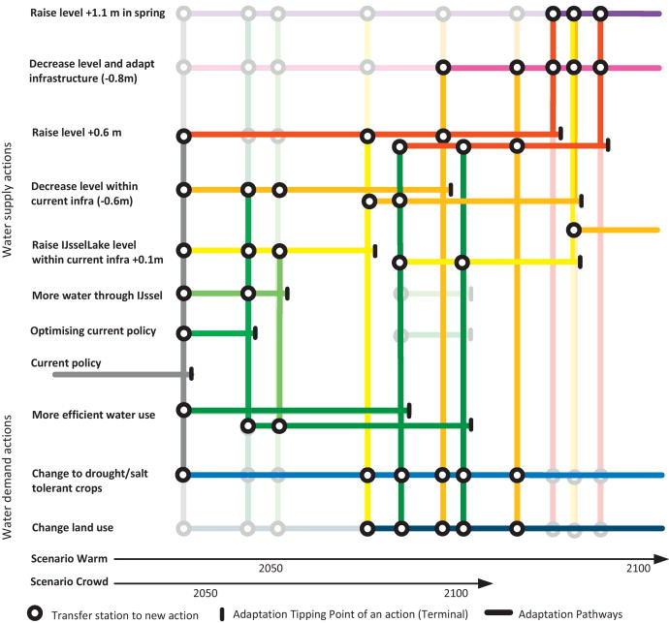
Dynamic Adaptive Policy Pathways
Adaptation Tipping Points
An Adaptation Tipping Point (ATP) is the condition under which a strategy no longer meets its objectives.
Examples:
Storm surge barrier effective up to 2.5m sea-level rise
Current evacuation plan works for population < 150,000
Nature-based solutions sufficient for rainfall < 150 mm/day
. . .
ATPs tell us when we need to adapt, not just what to adapt to.
The Key Insight
There is no single “optimal” plan under deep uncertainty.
. . .
Instead: design pathways — sequences of actions that can be adjusted as we learn.
. . .
A pathway is a sequence of decisions where transitions are triggered by observable conditions.
The Pathway Map
Figure 4: Adaptation pathways map for water management in the Netherlands. Source: Haasnoot et al. (2013).
Notes:
Target: 1:34. Part 4: ~8 min.
Target: 1:37. ATPs bridge scenario discovery (Week 10) and sequential decisions (Week 11). Numbers are illustrative.
Target: 1:39. Triggers must be observable, not predicted.
Target: 1:42. Walk through the figure: x-axis = time. Colored lines = adaptation options. Circles = transfer stations. Vertical bars = ATPs. Bottom rows = two scenarios. The map IS the plan.

Slide 15
Traditional Approach | Adaptive Pathways
Optimize for one scenario | Perform under many scenarios
Static plan | Triggers for adaptation
Single recommendation | Menu of options
Uncertainty as risk | Uncertainty as driver of design
What Makes Pathways Different
Notes:
Target: 1:44. Bottom row is key: uncertainty drives the design, not just the analysis.

Slide 16
Wrap-up and Connecting
Write (60 seconds)
Trace your final project through this pipeline.
Which stages did you use? Which didn’t you need? Where did you spend the most time?
Five Questions for Any Case Study
Decision context: Who decides? What’s at stake? What are the constraints?
System model: What’s captured? What’s left out?
Uncertainty characterization: Deep or well-characterized? How sampled?
Decision framework: Static or adaptive? Single or multi-objective?
Limits: What does this analysis NOT answer?
This Week and Next
Wednesday: Dongwook leads discussion of Steinschneider et al. (2015)
Friday, Apr 17: No lab; you are encouraged to use the time to practice your final presentation
Week 14 (Apr 20-24): Final presentations
References
Haasnoot, Marjolijn, Jan H Kwakkel, Warren E Walker, and Judith ter Maat. 2013. “Dynamic Adaptive Policy Pathways: A Method for Crafting Robust Decisions for a Deeply Uncertain World.” Global Environmental Change 23 (2): 485–98. https://doi.org/10.1016/j.gloenvcha.2012.12.006.
Haasnoot, M., J. Kwadijk, J. van Alphen, et al. 2020. “Adaptation to Uncertain Sea-Level Rise: How Uncertainty in Antarctic Mass-Loss Impacts the Coastal Adaptation Strategy of the Netherlands.” Environmental Research Letters 15 (3): 034007. https://doi.org/10.1088/1748-9326/ab666c.
Steinschneider, Scott, Rachel McCrary, Sungwook Wi, Kevin Mulligan, Linda O Mearns, and Casey M Brown. 2015. “Expanded Decision-Scaling Framework to Select Robust Long-Term Water-System Plans Under Hydroclimatic Uncertainties.” Journal of Water Resources Planning and Management 141 (11). https://doi.org/10.1061/(asce)wr.1943-5452.0000536.
Notes:
Target: 1:44. Part 5: ~6 min.
Target: 1:49. 60s silence. Then cold-call 2-3.
Target: 1:49. Scaffold for Wednesday. Question 5 is the most revealing.

