Slide 1
Downscaling Precipitation based on Air Temperature and Dew Point Temperature
CEVE 543
Samira Hossain

Slide 2
Objective
Downscaling precipitation based on climate variables air temperature and dew point
The choice of air temperature and dew point temperature as predictors is due to their high correlation with precipitation.
Combining K-Nearest Neighbors (KNN) and Principal Component Analysis (PCA) forms the main method

Slide 3
Method :KNN-PCA method
ERA5
Dew point temperature
Sub-setting
-Temporal and spatial sub setting
Preprocessing
-Reshaping to 2D matrix
-Rescaling
-Concatenating
Air temperature
KNN-PCA model
Predicted precipitation
CPC
Precipitation over Texas
Hyperparameter tuning:
-K
-Number of principal component
Mean squared error
minimizing

Slide 4
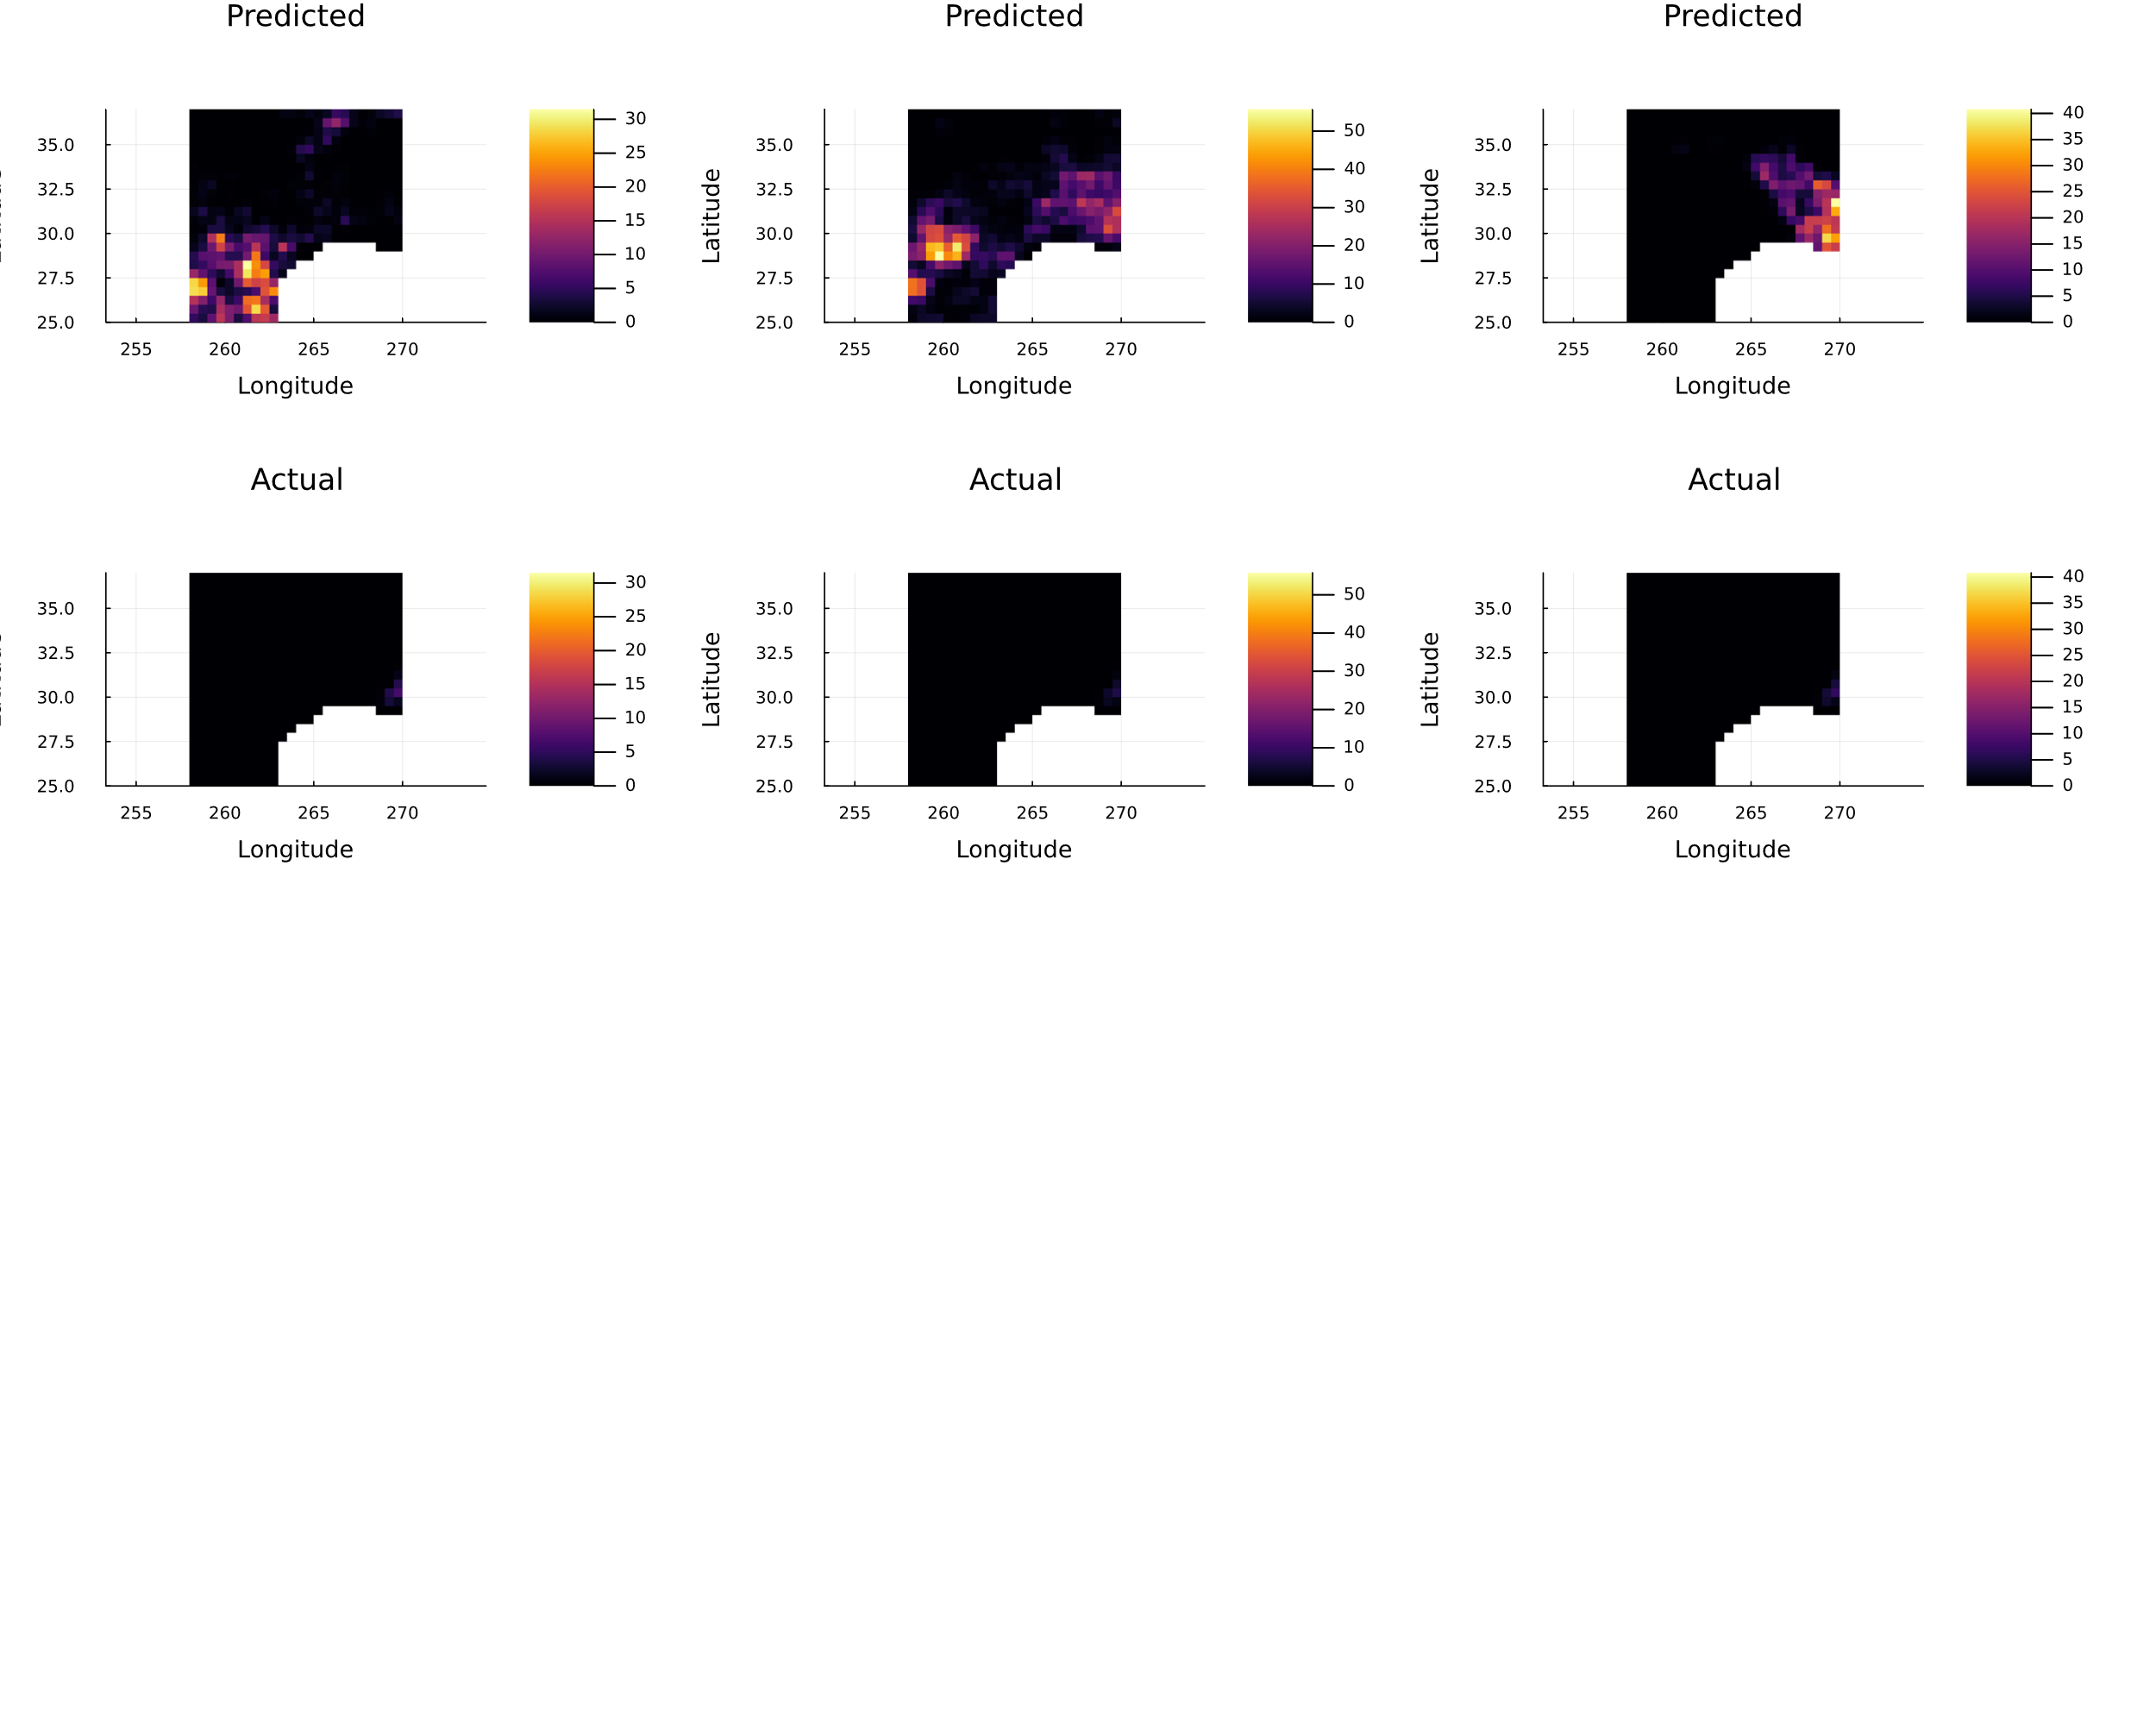
Results
KNN-PCA Method MSE (~60) < Base-line method (Mean Precipitation-based Prediction) MSE (~71)

Slide 5
Conclusion
The KNN-PCA model demonstrates a marked improvement over the baseline mean-based prediction method.
However, the improvement does not seem significantly higher
This could be due to –small training dataset
_ Inadequate hyperparameter selection

