Slide 1
DATA SCIENCE APPLICATION:
Sentiment Analysis & Movie Review
Celestino B. Edaño Jr.
1313915
www.celcs405.tk

Slide 2
Introduction
Sentiment analysis has been rapidly gaining popularity as a method of analyzing subjective human opinions or sentiments for such diverse applications such as predicting trends in the stock market.

Slide 3
Background of the Study
In the real world, businesses and organizations always want to find consumer or public opinions about their products and services. This study aims to provide an overview of the wider public opinion.

Slide 4
Objectives
My objectives are the following:
Gather tweets from Twitter about the movie films.
Perform text normalization and do sentiment analysis on the top 3 grossing movie films (source: Box Office Mojo) for each month of 2016.
Apply machine learning technique such as Naïve Bayes while performing sentiment analysis.
Create a simple movie review website that contains all my gathered information.

Slide 5
Data Structure and Knowledge Representation
Data Frame - used for storing data tables. It is a list of vectors of equal length.
sentiment package - which classifies the emotion of the text.

Slide 6
Software and Programming Language
R Language – programming language to do sentiment analysis.
HTML/CSS/JavaScript/JQuery – programming language to create the movie review website.
Sublime Text 2 – IDE for developing my website.
R Studio – IDE to perform sentiment analysis.
Hostinger – to create my own domain.
Freenom – to run my website.

Slide 7
Algorithms
Naïve Bayes algorithm - a Machine Learning technique to characterize subjective human opinions or sentiments.

Slide 8
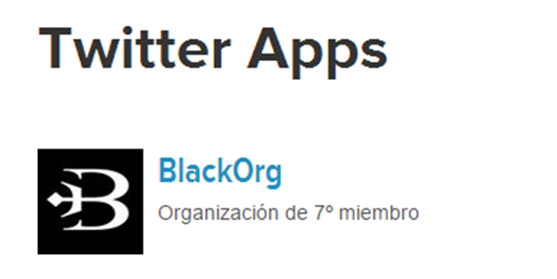
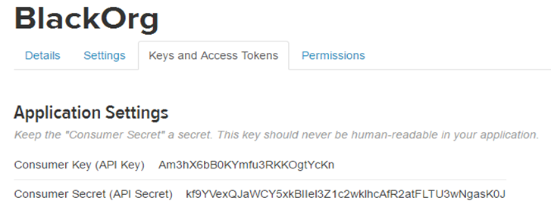
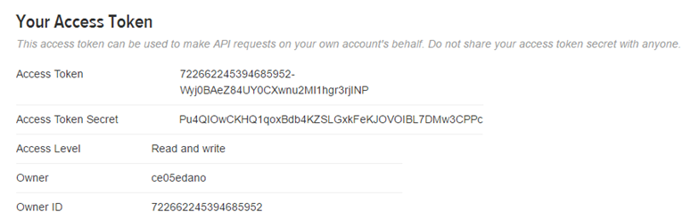
Step 1: Creating my own application at apps.twitter.com
Go to the “Keys and Access Tokens” tab. Copy API Key, API Secret, Access Token, and Access Token Secret

Slide 9
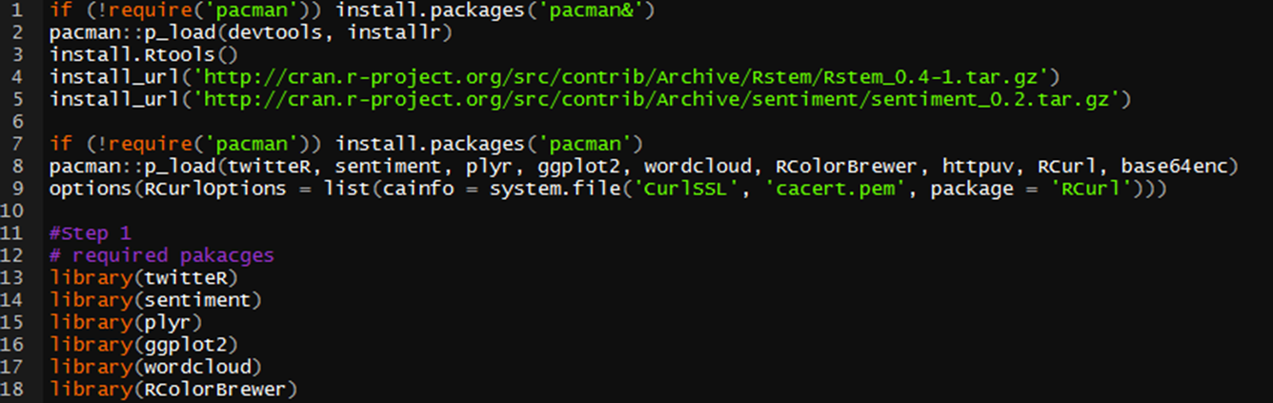
Step 2: Authorize R to access Twitter (Load Twitter authorization libraries)
twitteR: which gives an R interface to the Twitter API
sentiment: classifies the emotions of text
plyr: for splitting text
ggplot2: for plots of the categorized results
wordcloud: creates word clouds of the results
RColorBrewer: color schemes for the plots and wordcloud
httpuv: required for the alternative web authorization process
RCurl: http requests and processing the results returned by a web server

Slide 10
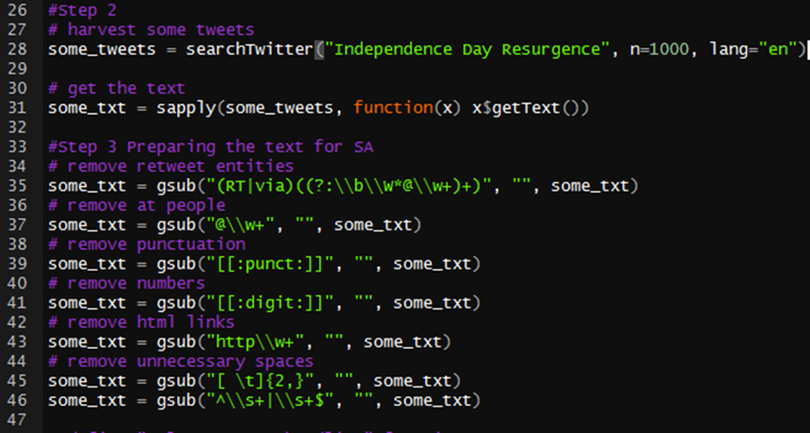
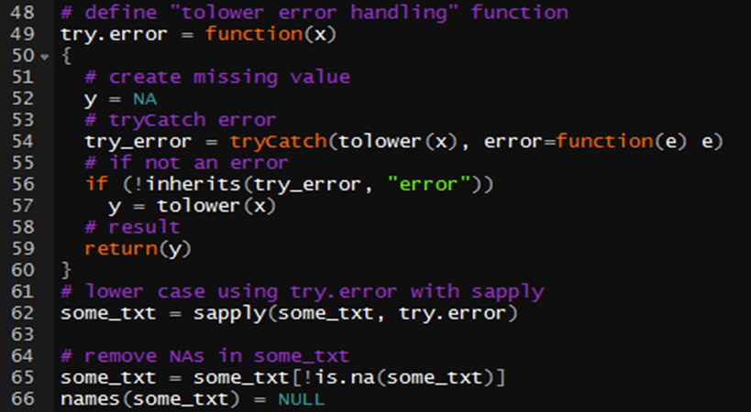
Step 3: Perform a search and do text normalization for each tweets.

Slide 11
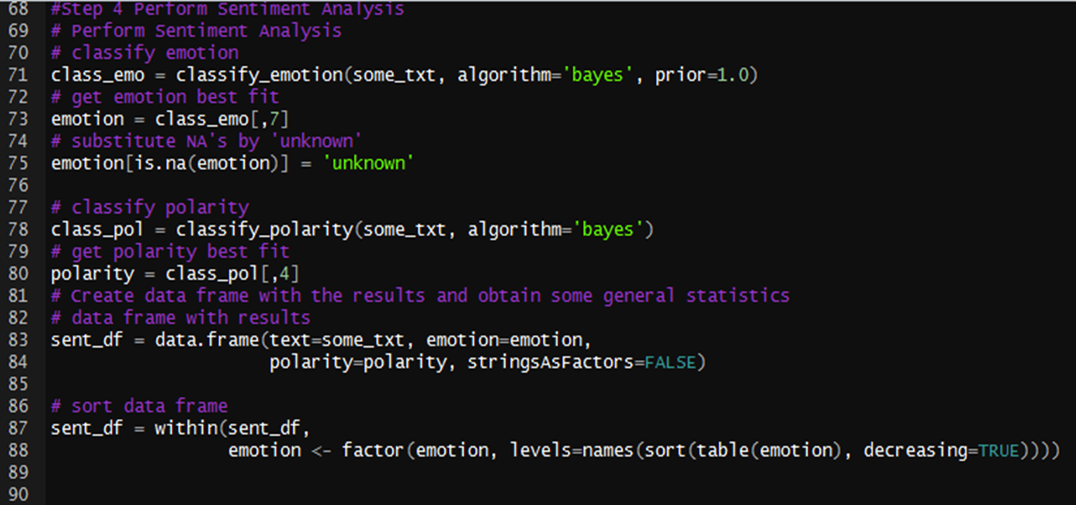
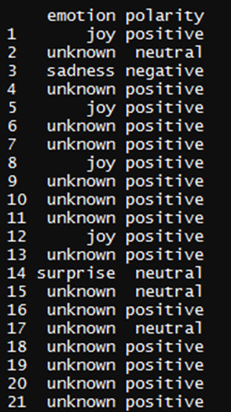
Step 4: Perform Sentiment Analysis

Slide 12
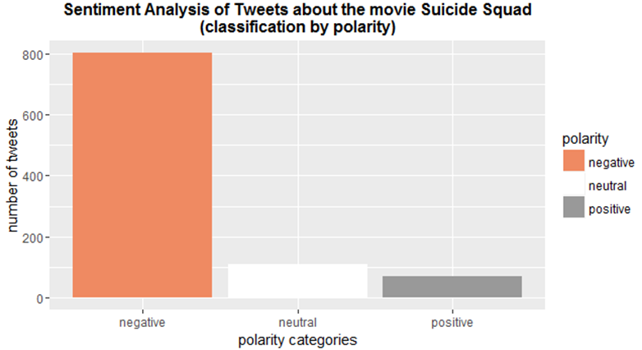
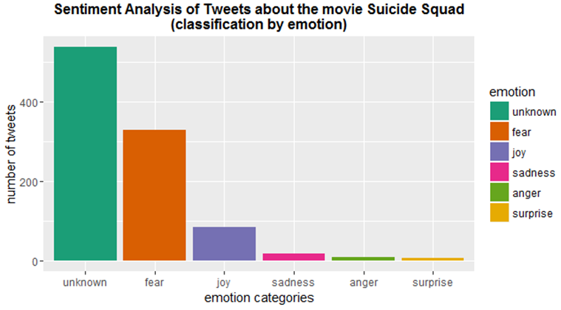
Step 5: Plots the obtained results by polarity and emotion.

Slide 13
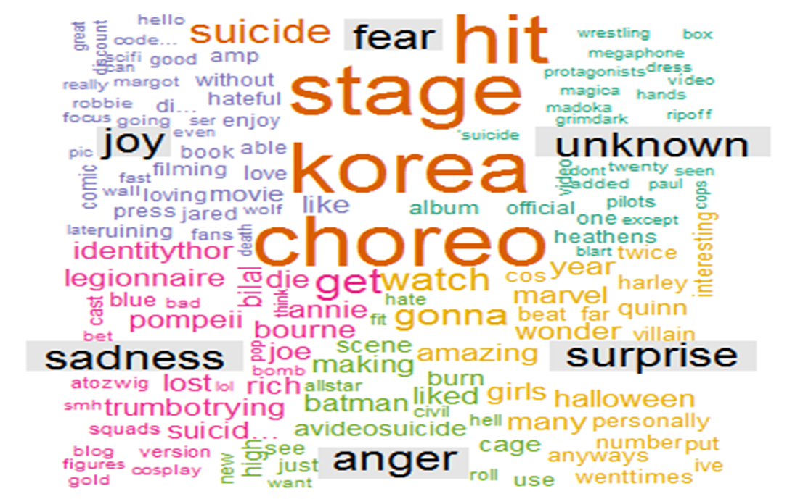
Step 6: Create a word cloud

Slide 14
Relationship to Artificial Intelligence and Machine Learning?
My project Sentiment Analysis or opinion mining is related to Artificial Intelligence because opinion mining is one of the task in Natural Language Processing which is a field of Artificial Intelligence.
It is related to Machine Learning because I used Naïve Bayes algorithm which is a Machine Learning technique.

Slide 15
Conclusion:
With the help of some machine learning technique like Naïve Bayes, Support Vector Machines, etc. doing sentiment analysis is more convenient than before.

Slide 16
Website Demonstration
Please go to:
www.celcs405.tk

