Slide 1
Online News Popularity Classification with R
Celestino B. Edaňo Jr.
1313915

Slide 2
Introduction
In this information era, reading and sharing news have become the center of people’s entertainment lives. With the expansion of the Internet, more and more people enjoys reading and sharing online news articles.

Slide 3
Background of the Study
The number of shares under a news article indicates how popular the news is. Therefore, it would be greatly helpful if we could accurately predict the popularity of news prior to its publication, for social media workers like authors, advertisers, etc.

Slide 4
Objectives
Find the best model to predict the number of shares in social networks (popularity).
Implement four machine learning models (KNN, CART, C5.0, and RF) that we already discussed in our course.

Slide 5
The dataset
Provided by UCI Machine Learning Repository, which is a real data originally acquired and preprocessed by K. Fernandes et al.
Summarizes a heterogeneous set of features about articles published by Mashable in a period of two years.
It has 61 attributes (58 predictive attributes, 2 non-predictive, and 1 goal field) as numerical values, describing different aspects of each article, from a total of 39797 articles.

Slide 6
Models
KNN
CART
C5.0
Random Forest

Slide 7
KNN (k-nearest neighbors)
A non-parametric (make no assumptions about the probability distributions of the variables) model used for classification and regression.

Slide 8
CART (Classification and Regression Trees)
An algorithm that employs decision trees and can be used for a variety of business and scientific applications.

Slide 9
C5.0
A model which is widely used as a decision tree method in machine learning. This type of decision tree model is based on entropy (measure of the randomness in the information being processed) and information gain.
Note: The higher the entropy, the harder it is to draw any conclusions from that information.

Slide 10
Random Forest
One of the best among classification algorithms - able to classify large amounts of data with high accuracy.

Slide 11
Implementation in R

Slide 12
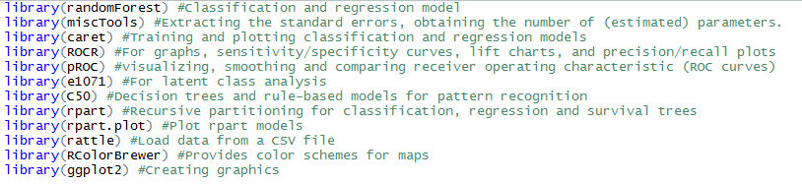
Importing important libraries

Slide 13
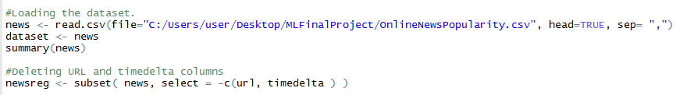
Loading and cleansing the dataset

Slide 14
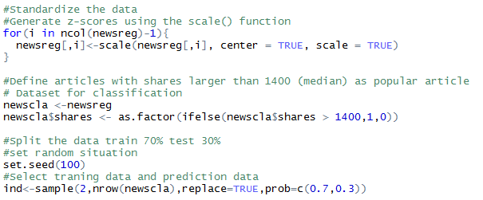
Standardize and split the data into training and testing

Slide 15

Setting the color palette

Slide 16
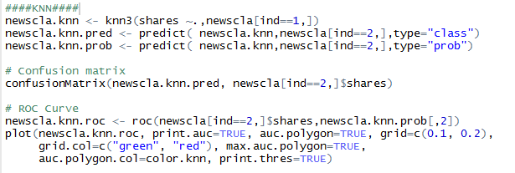
KNN (Generate confusion matrix and roc curve)

Slide 17
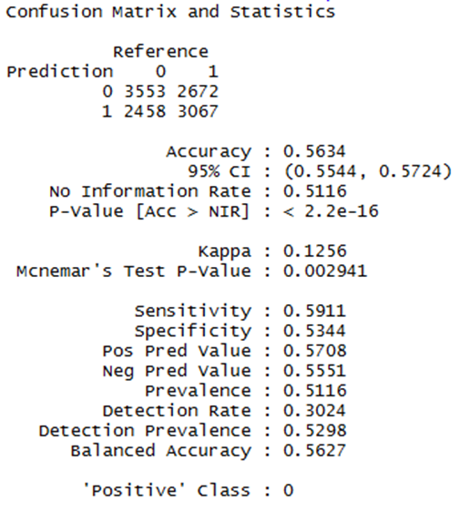
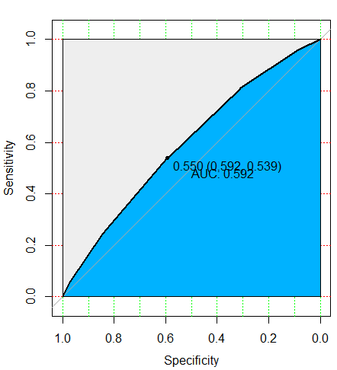
KNN confusion matrix and roc curve result

Slide 18
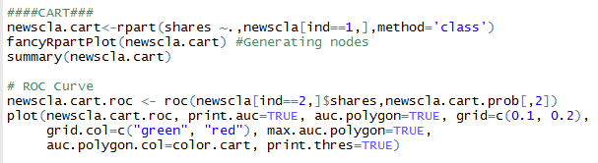
CART (Generate confusion matrix, roc and nodes)

Slide 19
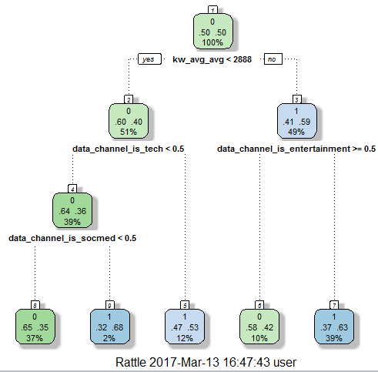
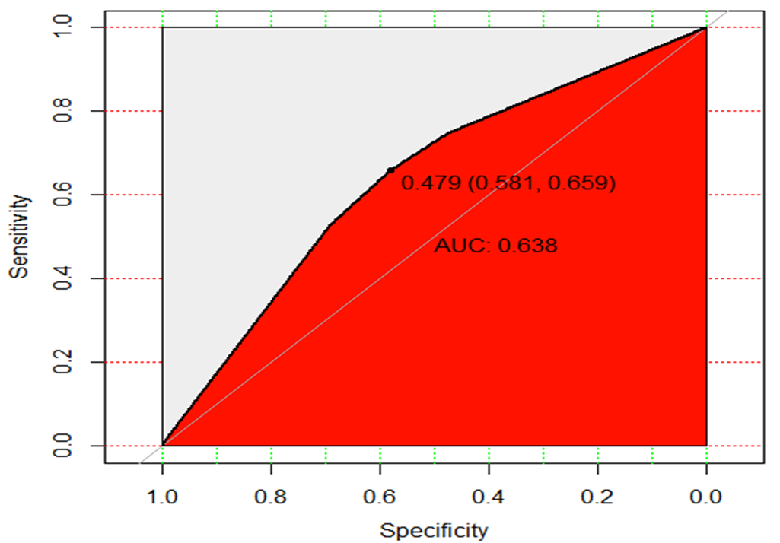
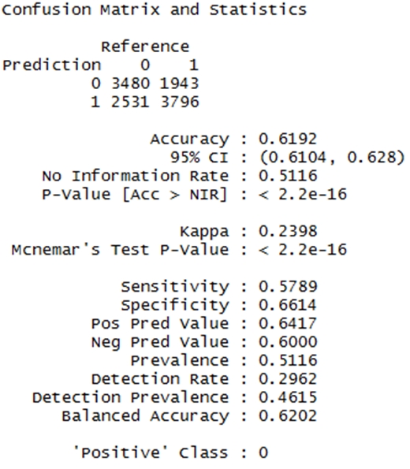
CART confusion matrix, nodes, and roc result

Slide 20
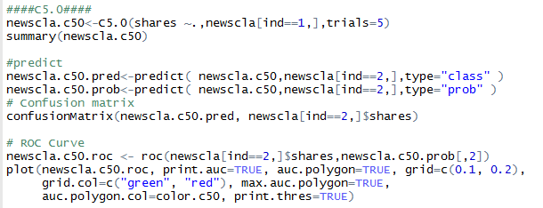
C5.0 (Generate confusion matrix and roc curve)

Slide 21
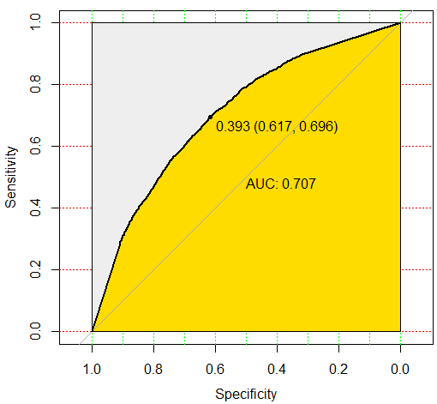
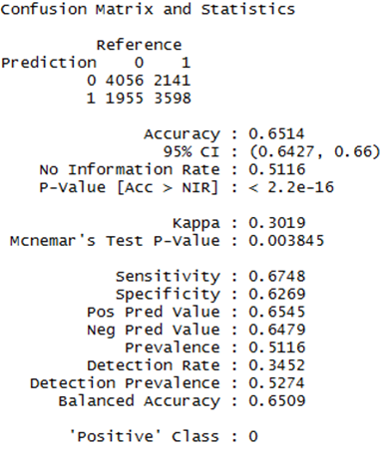
C5.0 confusion matrix and roc curve result

Slide 22

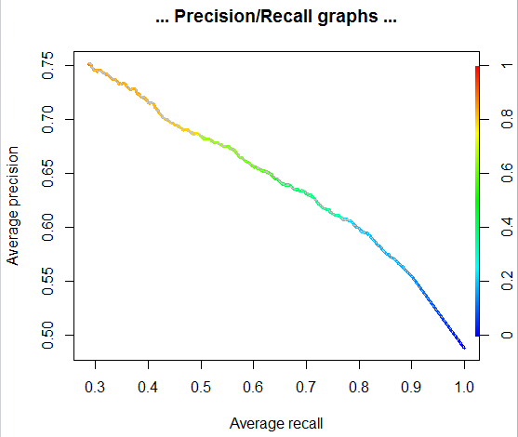
C5.0 precision and recall graph

Slide 23
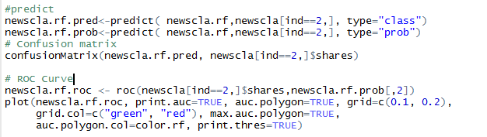
RF (Generate confusion matrix and roc curve)

Slide 24
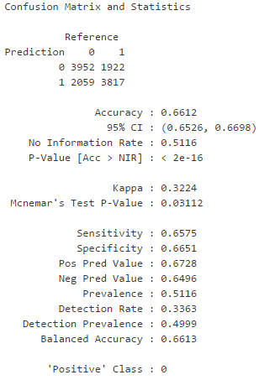
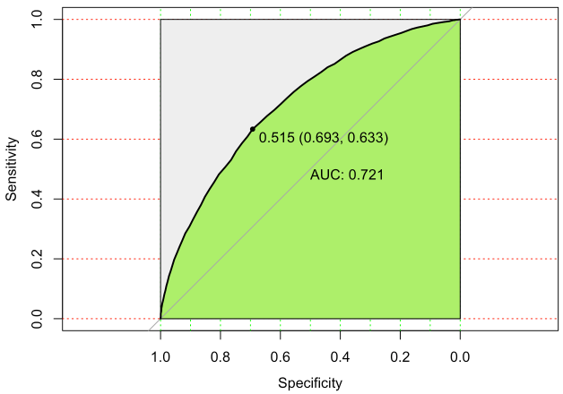
RF confusion matrix and roc curve result

Slide 25
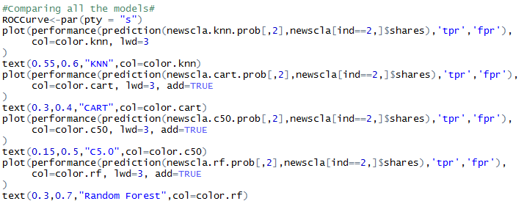
Comparing all models

Slide 26
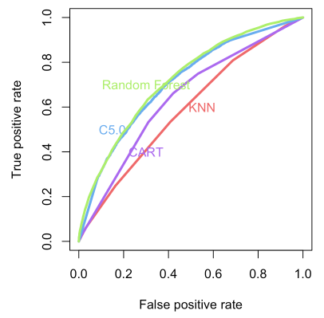
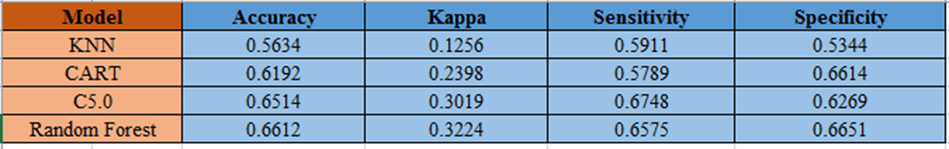
Result
Random Forest is the best model.

Slide 27
How is your project relate to AI and Machine Learning?
My project is related to both AI and Machine Learning because I’m using Machine Learning tools to predict the popularity of online news.

Slide 28
Limitations
Limited memory - my laptop’s RAM is not enough to handle or process big data set. In that case, I can’t do bagging, boosting, and stacking since it requires a lot of memory.
Too long to process – random forest takes hours to return result since my data set is large.
I can’t use GLM , svmRadial models even though my dataset can do both classification and regression tasks.

Slide 29
Summary
For this dataset, Random Forest emerge as the best model to predict the popularity of online news. It is one of the best among classification algorithms which able to classify large amounts of data with high accuracy.

