Slide 1


GIT-HUB
CH-ERRINATH​
T1702
A Quest Global Company

Slide 2
What is GitHub?
GitHub is a web-based platform for version control and collaboration. It allows developers to store and manage their code projects, track changes, and work together with others. GitHub is built on Git, a version control system that helps developers manage code changes in an organized manner.
Key Concepts:
Version Control: GitHub helps manage changes to files, enabling users to go back to previous versions of a project if needed.
Repository (Repo): A storage space on GitHub where a project's files and their revision history are kept.
Commit: A snapshot of changes made to the project. Each commit is identified by a unique ID.
Branch: A separate line of development. This allows developers to work on features independently without affecting the main codebase.
Pull Request: A request to merge changes from one branch into another, typically for review before merging into the main code.
Fork: A copy of a repository that allows you to freely experiment with changes without affecting the original project.

Slide 3

Step-by-Step Guide to Using GitHub
Step 1: Set up a GitHub Account
Go to GitHub: Open your web browser and visit github.com.
Sign Up: Create an account by providing your email, creating a username, and setting a password.
Step 2: Install Git on Your Computer
Download Git: Go to git-scm.com and download the Git software for your operating system (Windows, Mac, Linux).
Install Git: Follow the installation instructions. This will install Git on your local computer so you can interact with GitHub repositories.
Step 3: Create a New Repository (Repo)
Login to GitHub: Log in to your GitHub account.
New Repository: On your GitHub home page, click the "New" button (or "+" symbol), which allows you to create a new repository.

Slide 4
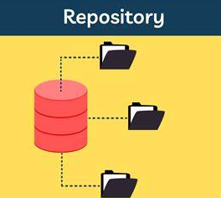
Set Repository Details:
Repository name: Give your repository a name.
Description: Optionally, provide a description of your project.
Public or Private: Choose whether your repository will be visible to others (Public) or kept private (Private).
Create Repository: Click "Create Repository" to set up the repo.
Step 4: Clone a Repository to Your Local Machine
Find the Repo on GitHub: Go to the repository you want to work with.
Clone URL: Copy the Clone URL from the repository's page. You'll find this URL by clicking on the green "Code" button and selecting "HTTPS".
Clone Repo: Open your terminal or Git Bash and run the following command:
Bash
git clone https://github.com/username/repository-name.git
This will download a copy of the repository to your local machine.

Slide 5
Step 5: Make Changes Locally
Navigate to the Repo: Use the terminal or file explorer to go to the folder of your cloned repository.
Make Changes: Edit or add files to the project (for example, write code, update files, etc.).
Check Changes: You can check which files have been modified using the command: git status
Step 6: Commit Your Changes
Stage Changes: Before committing, you need to stage your changes. Use the command: git add .
This stages all modified files. Alternatively, you can stage specific files by replacing the dot with a file name.
Commit Changes: Commit the changes with a meaningful message: git commit -m "Descriptive commit message"
Step 7: Push Changes to GitHub
Push to GitHub: Once you’ve committed the changes, you need to push them to GitHub: git push origin main
This uploads the changes to the main branch of your GitHub repository.
Step 8: Create a Branch and Work on Features
Create a New Branch: It's best practice to work on a separate branch for new features. Create a branch with:
git checkout -b feature-branch

Slide 6
Replace feature-branch with a name relevant to your changes.
Make Changes: Edit your files on the new branch.
Commit and Push: Commit and push the changes to the new branch using the same git commit and git push commands.
Step 9: Create a Pull Request (PR)
Go to GitHub: On the repository page, you will see an option to create a pull request once you’ve pushed your changes.
Create PR: Click "Compare & pull request" to propose merging your feature branch into the main branch. Add a title and description to explain your changes.
Review and Merge: Team members can review the PR, discuss, and then merge the changes if everything looks good.
Step 10: Update Your Local Repository
Pull Changes: If others have made changes to the repository, you can update your local copy with: git pull origin main

Slide 7
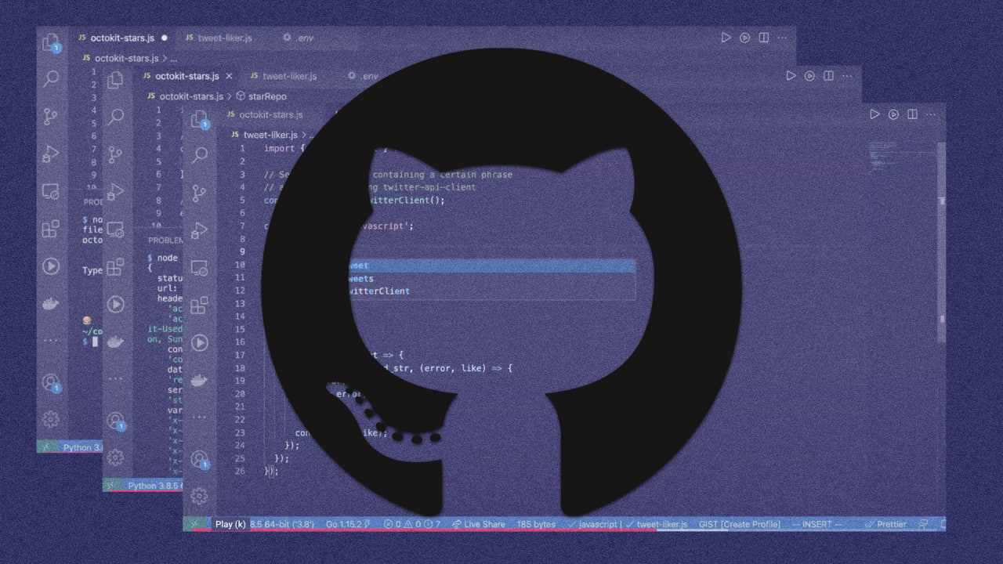
What is GitHub used for?
GitHub allows you to create, store, change, merge, and collaborate on files or code. Any member of a team can access the GitHub repository (think of this as a folder for files) and see the most recent version in real-time. Then, they can make edits or changes that the other collaborators also see. GitHub also lets users make requests of one another and internally discuss the iterations along the way. It’s even been called “a social coding platform” because it invites people to coordinate, share, and collaborate code across distributed and asynchronous environments.

Slide 8
common Git commands
. Starting with Git:
git init
Initialize a new Git repository in your current folder.
git clone <repository-url>
Copy a remote repository to your local machine.
2. Working with Files:
git status
Check the current state of your files (what's been changed, added, etc.).
git add <file>
Stage a specific file to be committed.
git add .
Stage all modified files to be committed.
git commit -m "message"
Save your staged changes with a message describing them.

Slide 9
3. Branching:
git branch
View a list of branches in your repository.
git branch <branch-name>
Create a new branch.
git checkout <branch-name>
Switch to a different branch.
git checkout -b <branch-name>
Create and switch to a new branch at the same time.
git merge <branch-name>
Combine changes from another branch into your current branch.

Slide 10
4. Working with Remote Repositories:
git remote -v
See which remote repositories are linked to your local one.
git remote add <name> <url>
Link a new remote repository to your local one.
git push <remote> <branch>
Send your local changes to a remote repository.
git pull <remote> <branch>
Get the latest changes from a remote repository and merge them into your current branch.
5. Undoing Changes:
git reset <file>
Remove a file from the staging area (but keep the changes in the file).

Slide 11
git reset --hard
Discard all changes and reset everything to the last commit.
git checkout -- <file>
Discard changes in a file, restoring it to the version from the last commit.
6. Stashing Changes:
git stash
Save your uncommitted changes temporarily and revert your working directory.
git stash pop
Apply the most recent stash and remove it from the stash list.
git stash list
View a list of all your stashes.

Slide 12
7. Tagging:
git tag
List all tags in the repository.
git tag <tag-name>
Create a tag at the current commit to mark a specific point in history (e.g., a release).
git push <remote> <tag-name>
Send a tag to a remote repository.

Slide 13
8. Viewing History:
git log
View the commit history with details like author, date, and commit message.
git log --oneline
View a simplified, single-line version of the commit history.
git blame <file>
See who made changes to each line of a file.
9. Configuring Git:
git config --global user.name "Your Name"
Set your name for commits.
git config --global user.email "youremail@example.com"
Set your email for commits.

Slide 14


Thank You

