Slide 1
Week 17

Slide 2
Warm-up (10 minutes)
What are underfitting and overfitting? How do you avoid them?
What is cross validation?
Notes:
Overfitting: Good performance on the training data, but low test accuracy which means poor generliazation to other data. The model is too complex, learning all the patterns of a specific dataset
Ex:
Underfitting: Poor performance on the training data. The model is too simple so it doesn’t capture the patterns in the data leading to low training accuracy and poor generalization to other data
Ex:
Both overfitting and underfitting can lead to poor model performance. But by far the most common problem in applied machine learning is overfitting.
Use a resampling technique to estimate model accuracy – cross validation
It allows you to train and test your model k-times (k-fold cross validation) on different subsets of training data and gives an estimate of the performance of a machine learning model on unseen data
Cross validation allows you to compare different machine learning methods and get a sense of how well they will work in practice
https://elitedatascience.com/overfitting-in-machine-learning

Slide 3
Today's Activities
Warmup (15 mins)
Lingering Presentations (25 mins)
ROC Curve Reading (15 mins)
Ensemble Methods (30 mins)
Break (15 mins)
Random Forest (30 mins)
Group Exercise (50 mins)

Slide 4
Class Memo
To continue in this course, you must have completed 16 of the 17 assignments by January 26th!
Remember, for the whole course, you can miss one assignment, but you must complete all your group projects.

Slide 5
Review Homework

Slide 6

Review Decision Tree Optimizations

Slide 7
ROC Curve Reading
What is an ROC curve? Why is it useful over simply using the true positive and false positive rates?
What is AUC and what does it tell us?

Slide 8
Ensemble Methods
From the DataCamp, what do you know about ensemble methods?
The winners of machine learning competitions with million-dollar prizes almost always use ensemble methods
Ensemble methods – train many different models on the same dataset and aggregate the model predictions into one robust and fault-tolerant model

Slide 9
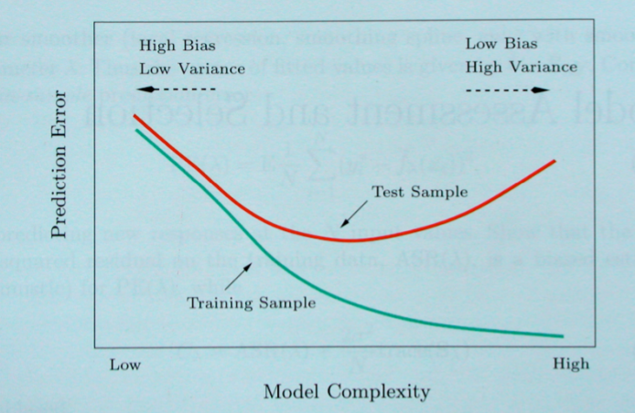
Bias-Variance Tradeoff
Notes:
Hastie, Tibshirani, Friedman “Elements of Statistical Learning” 2001

Slide 10
How do you reduce variance without increasing bias?
Averaging!
But, that begs the question: if we only have one training set where do multiple models come from?

Slide 11
Bootstrapping
Bootstrapping – random sample with replacement.
This method helps understand the bias and variance in a dataset
Basically, this is sampling with replacement, also called resampling
Why would we do this in practice?

Slide 12
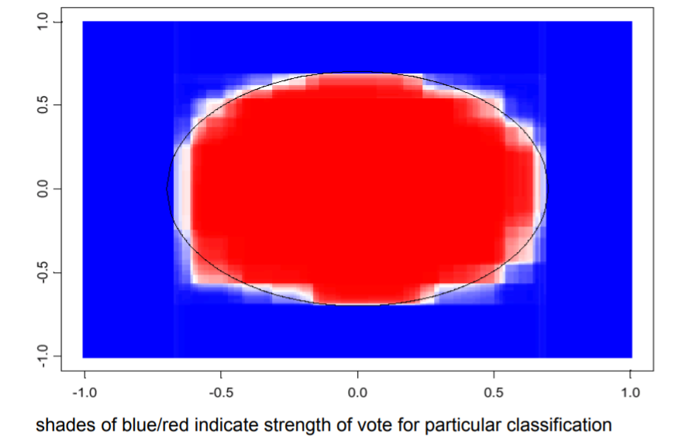
Bagging – bootstrap aggregating
Bagging - A way to decrease the variance of the model by generating additional training data
We take repeated bootstrapped samples, run models, and average them together to reduce variance
Bagging does not typically affect bias
Notes:
http://people.csail.mit.edu/dsontag/courses/ml12/slides/lecture12.pdf

Slide 13
Boosting
Boosting: method for converting rules of thumb and inclinations into rules for prediction
Boosting reduces bias
How? Two steps:
1) Produce a bunch of decently performing models
2) Sort based on a performance function where those with good predictive results are given a higher weight in the final model.
Notes:
Example: works if you hav

Slide 14
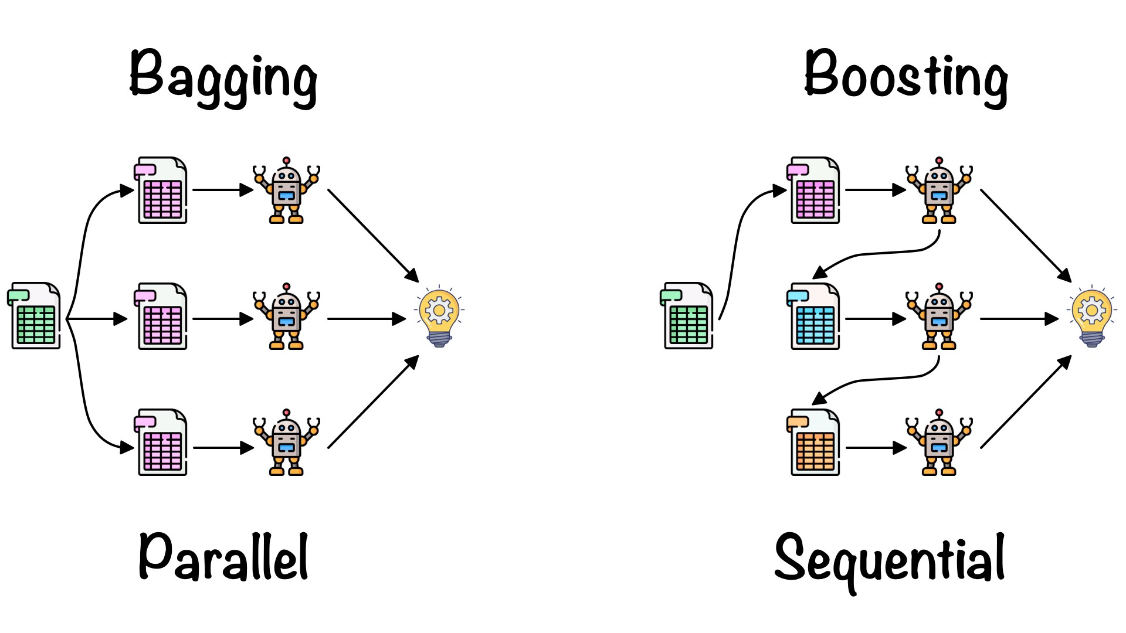
Notes:
https://towardsdatascience.com/ensemble-learning-bagging-boosting-3098079e5422

Slide 15
Break (15 Minutes)
Attendance word:CSSConjurer

Slide 16
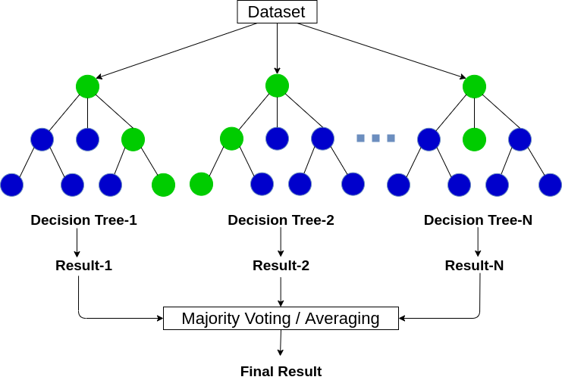
Random Forest
Random forest is a type of ensemble method that runs multiple decision tree algorithms (often several hundred) where each of the trees gets a vote and the result/prediction is determined by those votes
What is this also called?
Bagging
Notes:
https://www.analyticsvidhya.com/blog/2020/05/decision-tree-vs-random-forest-algorithm/

Slide 17
Week 17 Group Exercise
Once you finish and have submitted your exercise in Canvas via a github link, use the remaining time to work on your homework.

