Slide 1
Week 19

Slide 2
Warm-up (10 minutes)
How does backpropagation work? Be as detailed as possible.
What do you remember about PCA?
Notes:
1. Backpropagation takes the error from the output layer and goes back one layer at a time, using the slope formula of the loss function for each of the weights and biases, multiply the slope by the learning rate and subtract from the current weights

Slide 3
Today's Activities
Warmup (15 mins)
Review Homework (15 mins)
Optimizing Neural Networks (15 mins)
Unsupervised Learning (30 mins)
Break (15 mins)
Unsupervised Learning (30 mins)
Group Exercise (60 mins)

Slide 4
Review Homework

Slide 5
Questions from Reading
What is a multilayer perceptron?
Which approach to improving model stability was the most successful for the example in the reading? Why do you think that was?
Notes:
https://machinelearningmastery.com/how-to-improve-neural-network-stability-and-modeling-performance-with-data-scaling/

Slide 6
Unsupervised Learning
Goal: find patterns in unlabeled data
Two main approaches:
Clustering
K-means
Hierarchical
Also, grid-based and density based
Dimensionality Reduction
Linear
Principal component analysis (PCA)
SVD – sparse data
Linear discriminant …
Non-Linear
Isomap embedding
…
Why do you think we bother with unsupervised learning instead of just labeling our data?

Slide 7
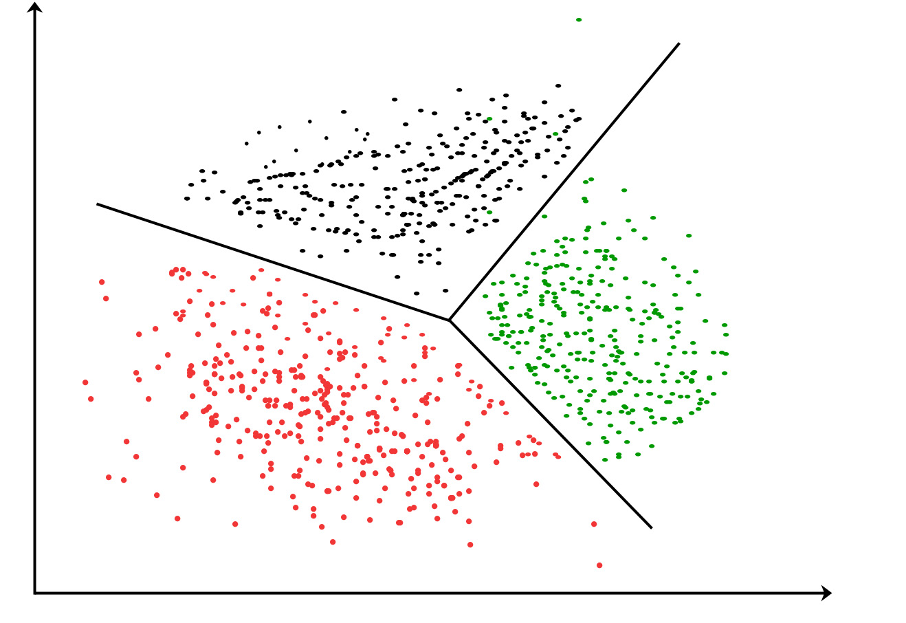
Clustering
Clustering is a process that looks to find inherent groupings in data.
K-means first randomly assigns a mean value for each of the K clusters. Then, all the values are assigned to the closest mean. Finally, the means of those clusters are recalculated based on the actual values, and the process repeats until this mean is closest to the mean of the values in the cluster.
Hierarchical clustering takes a tree-based structure and groups data together based on proximity into repeatedly smaller groups.
Notes:
https://www.geeksforgeeks.org/clustering-in-machine-learning/

Slide 8
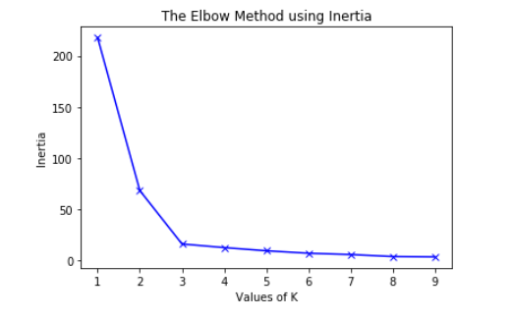
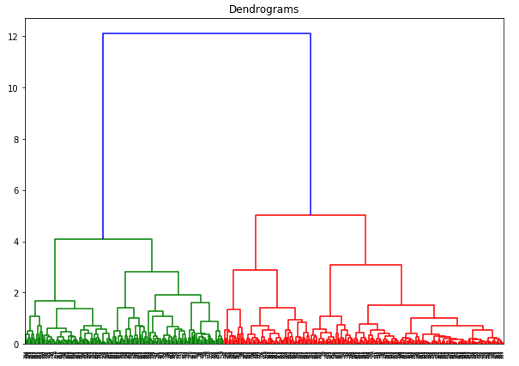
Finding Ideal Number of Clusters
Partitioning (K-Means)
Hierarchical
Measure of inertia
Elbow Method – curve of within-cluster sum of squares (WSS)
Gap Method – Tries to maximize intra-cluster range
Average Silhouette Method – determines how well each value fits in each cluster
Find Maximum distance in dendrogram
This represents the maximum distance (y axis) between clusters
Number of clusters is number of clusters intersected at max distance.
Notes:
Distortion is another method to find the ideal number of clusters

Slide 9
Break (15 Minutes)
Attendance word:CSSConjurer

Slide 10
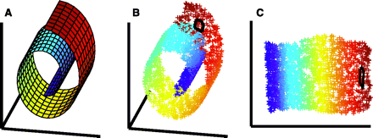
Dimensionality Reduction
Goal is to reduce the dimensions in your dataset
Why? If we have a lot of dimensions the model is more complex, which increases the chance of overfitting
There are linear and non-linear ways of doing this depending on your data
Notes:
https://science.sciencemag.org/content/290/5500/2323/tab-figures-data

Slide 11
Week 19 Group Exercise
Once you finish and have submitted your exercise in Canvas via a github link, use the remaining time to work on your homework.

