Slide 1
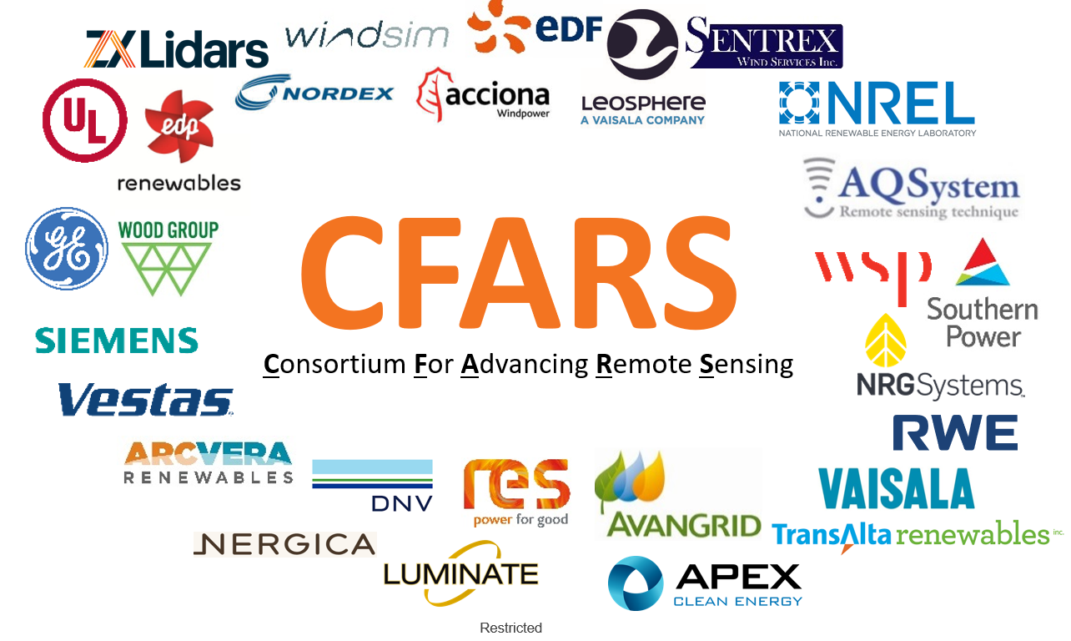
CFARS – Science Working Group Overview
April 13, 2021
Alexandra St. Pé, RWE Renewables
Alexandra.st.pe@rwe.com

Slide 2
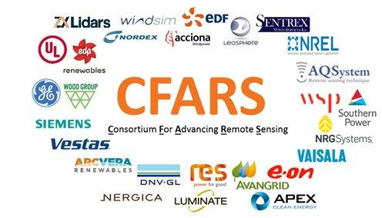

Why Science Working Group Lead?
Support Science subgroups in ensuring results compatible and focused on commercial implementation as final result
Provide perspective on interplay between industry stakeholders
Support the development of best practice approaches for stakeholder collaboration that can be leveraged within any Science subgroup
Support coordination and communication between subgroup leads regarding lessons learned and best practices

Slide 3
CFARS – Science Subgroups’ Collaboration Approach
Address
Challenges
Take
Action
Deliver
Impactful
Results
Science subgroups identify key hurdles to RSD acceptance within given topic area and utilize the CFARS platform to make progress in overcoming them
Science subgroup stakeholders share knowledge and best practices, perform initial benchmarking exercises in an open and collaborative setting
Science subgroups develop opensource science & tools ….
Science subgroups develop best practice stakeholder collaboration frameworks that leverage the advantages of opensource science

Slide 4
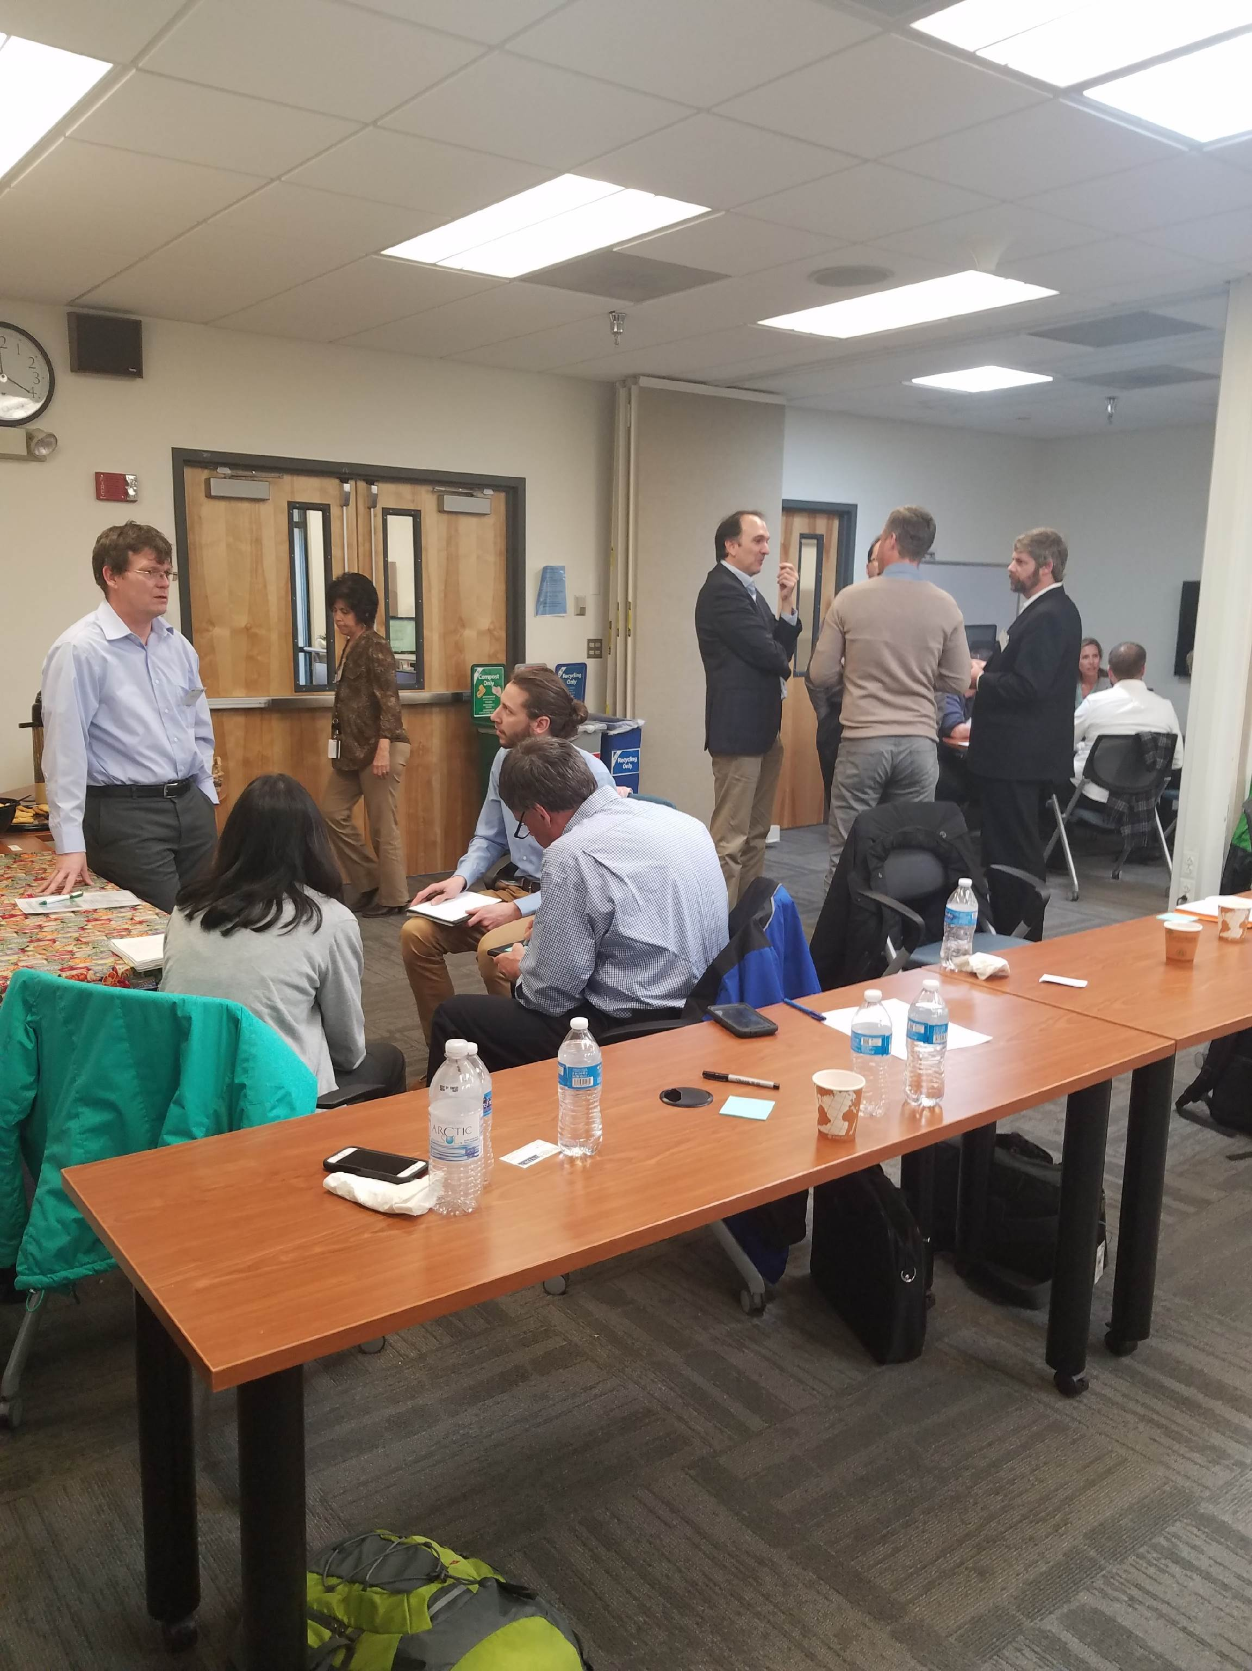
Science Working Group Topic Prioritization
Released in March 2018
RSD Science Topics
Complex Flow Correction
Energy Yield Uncertainty
Power Curves / PPTs
Impact
Site Suitability (TI)
Effort

Slide 5
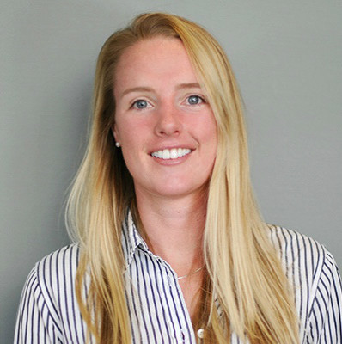

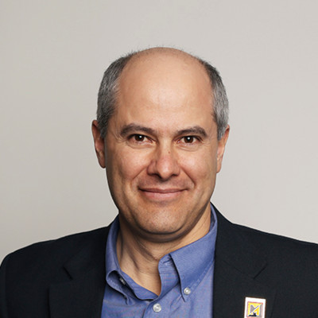
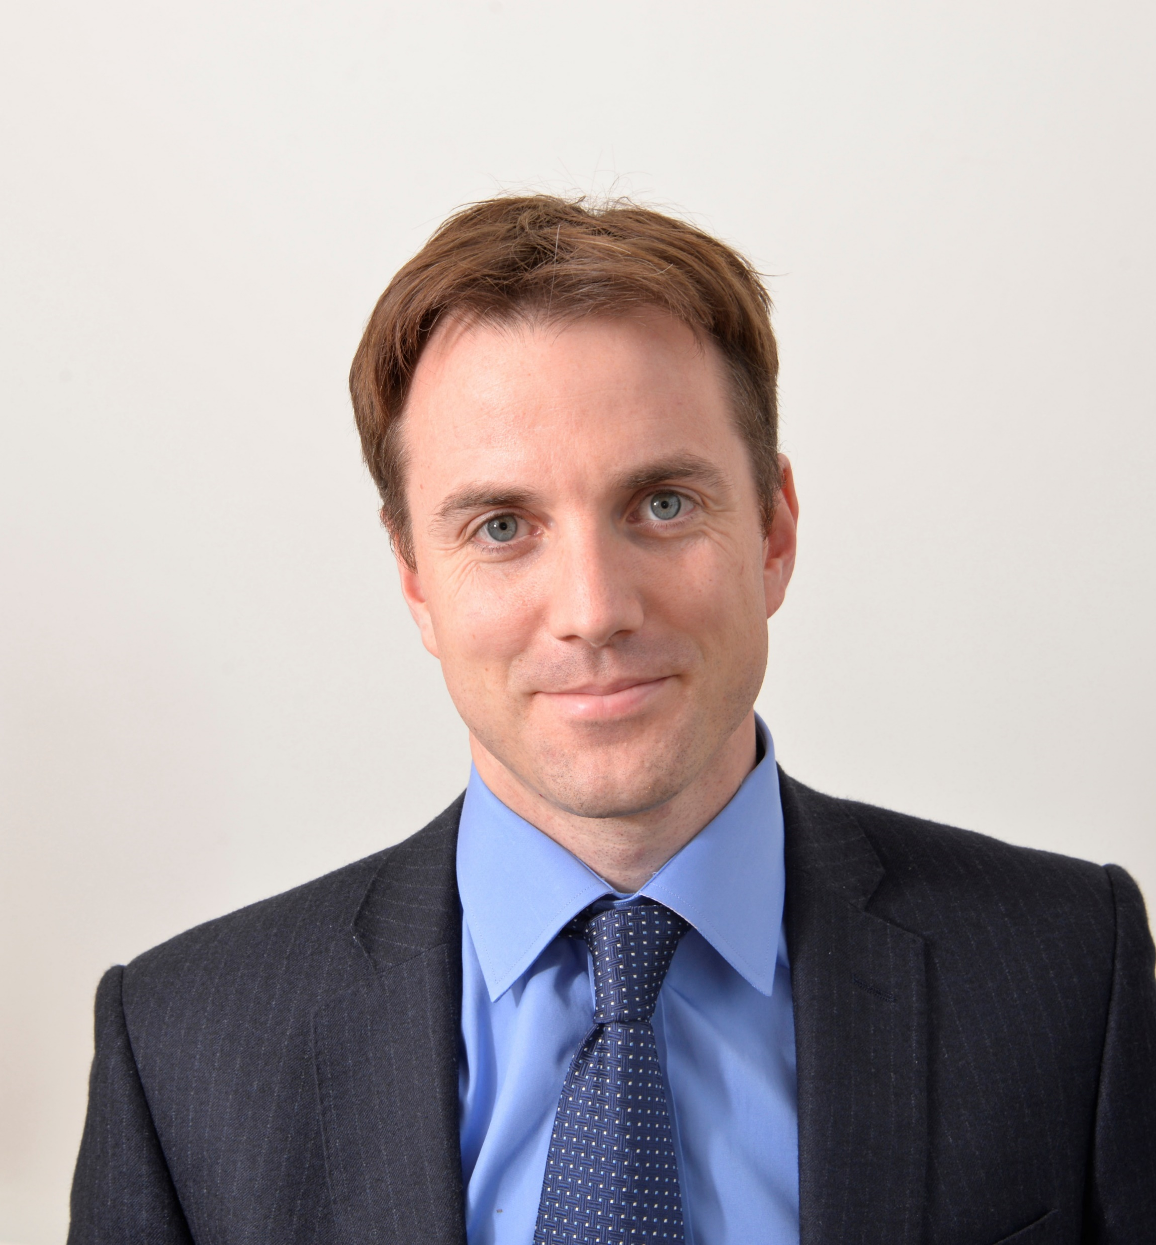
Science Working Group Structure
Subgroup Leads
Site
Suitability
TI Correction
Share X
Modelling Turbine Performance in Real World Wind Conditions”
Complex Flow
Correction
Power Curve Testing
Alexandra Arntsen
NRG Systems
Scott Wylie
ZX Lidars
Dan Bernadett
UL, AWS Truepower
Peter Stuart
RES
Launch Year
2018
2019
2020

Slide 6
Back-Up

Slide 7




CFARS Working Groups
Science Mission
CFARS Mission
Empower the Industry to Achieve
Data-Driven Answers to
Persistent RSD Use Hurdles
Leverage Opensource Science & Tools to Build Consensus & Establish Best Practice Frameworks for Stakeholder collaboration
Solicit input from industry stakeholders to determine CFARS agenda
Amplify findings from Science Group via publications and messaging
Drive consensus on new Best Practices framework collaboration and socialize existing Standards to the broad industry
Widespread Use of Adjusted RSD in Bankable, Stand-Alone, Pre-Construction Assessment
Guidance Mission
Notes:
Summarize Current State of RSD Use
Socialize Best Practice to further de-risk RSD use in pre-construction wind assessment
…???

