Slide 1
CFARS – Machine Learning LiDAR Power Curve Dataset
Matthew Carter
March 13, 2021

Slide 2
Agenda
Machine Learning LiDAR Power Curve Concept Introduction
Dataset Introduction
Example Analysis

Slide 3
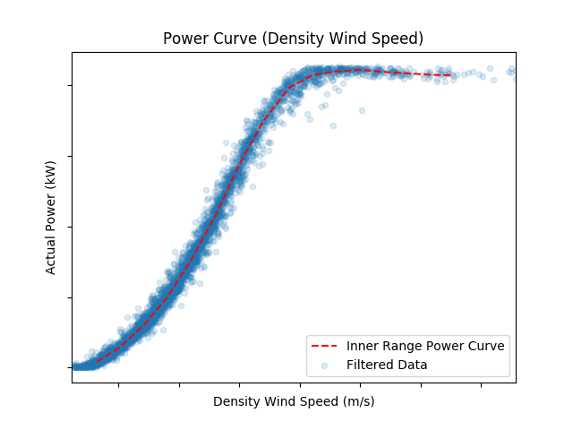
Concept Introduction
Measurement on Site A (Training):
Existing Operational Turbine Model WT100
Site B
Site A
Power Curve
WT100 Power
LiDAR Serial number ABC123
Wind Speed as Measured by ABC123

Slide 4
Concept Introduction
Move LiDAR (same physical device) to site B.
Site B
Site A

Slide 5
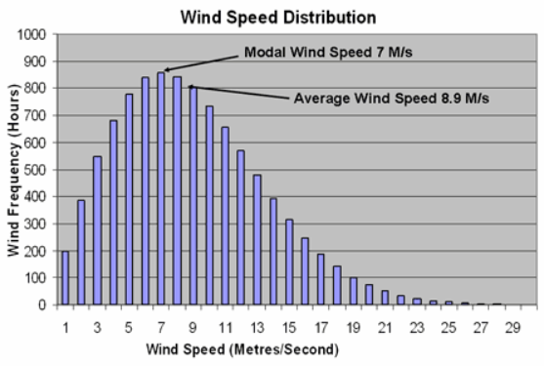
Concept Introduction
Measurement on Site B (Application):
Pre-construction Site for Model WT100
X = planned turbine location
Site B
Site A
X
WT 100 Power
Wind Speed
Measured by ABC123
(on Site B)
Wind Speed
Measured by ABC123
(on Site A)
LiDAR Serial number ABC123
X

Slide 6
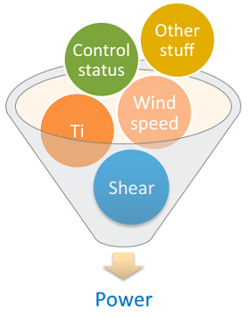
Concept Introduction
This approach would lend itself to advance statistical modelling approaches e.g. machine learning.
This would mean ‘outer range’ considerations would be inherently addressed (as long as training data sufficient).
Traditional Power Cure
Machine Learning
WT 100 Power
Wind Speed
Power Curve Measured by ABC123
(from Site A)

Slide 7
Concept Introduction
No need to reference LiDAR measurement to Anemometer on site.
Provide a highly specified training dataset for machine learning methods (specific turbine model and specific physical LiDAR)
Lower overall yield uncertainty, assist project design and inform turbine selection (lower £/MWh)
RES are open-sourcing a LiDAR power curve dataset designed to trial the proposed methodology.

Slide 8
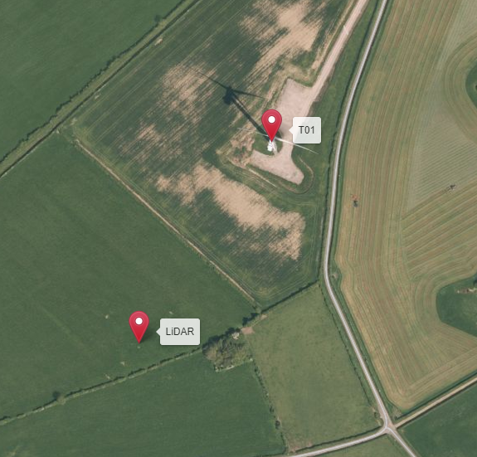
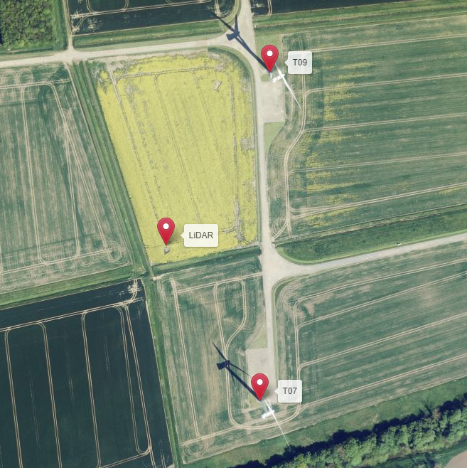
Dataset Introduction
The same ZephIR 300 LiDAR was deployed at two RES operated onshore wind farms in England:
TENG: 2018-11 to 2019-01
WENG: 2018-05 to 2018-10
The turbine model is the same on both sites (2MW rated power, 60m hub height, 80m rotor diameter).
At WENG the LiDAR was close to 2 turbines and so 2 power datasets were acquired.

Slide 9
Dataset Introduction
The LiDAR was measuring at six heights; 92m, 76m, 60m, 44m, 39m, 28m
Data files for both sites contain these fields at the above six heights:
Horizontal Wind Speed
Standard Deviation of Horizontal Wind Speed
Vertical Wind Speed
Turbulence Intensity
Detrended Turbulence Intensity
Wind Direction
Additional Atmospheric conditions are included which were recorded by a met station on the LiDAR:
Temperature
Pressure
Humidity
Raining

Slide 10
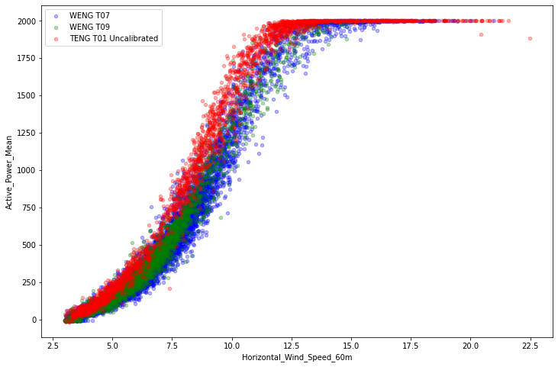
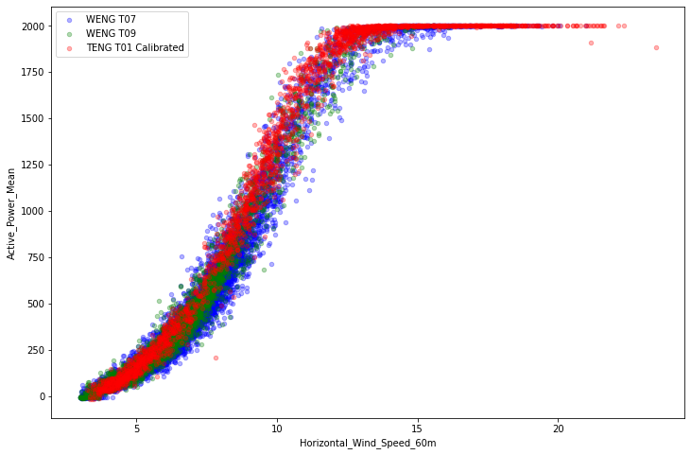
Dataset Introduction
TENG is a complex terrain site. The LiDAR and turbine pair has been subject to a historical mast-based site calibration study.
The site calibration correction are applied to the LiDAR measured horizontal wind speed data in the dataset.

Slide 11
Dataset Introduction
Four .csv files are provided:
WENG_T07.csv power curve dataset for T07 at WENG
WENG_T09.csv power curve dataset for T09 at WENG
TENG_TO1.csv: power curve dataset for T01 at WENG (without site calibration factors applied)
TENG_TO1_cal.csv: power curve dataset for T01 at WENG (with site calibration factors applied)
Each file contains the following 10 minute data:
DateTime
LiDAR measured meteorological signals
Turbine measured active power
All data has already been filtered to remove periods not suitable for power performance measurements, e.g.:
Turbine downtime and curtailments
Waked wind direction sectors
Data Source | Start Date (after filtering) | End Date (after filtering) | Hours of data (after filtering)
TENG_T01 | 2018-11-02 | 2019-01-11 | 277
WENG_T07 | 2018-06-01 | 2018-10-26 | 1205
WENG_T09 | 2018-05-18 | 2018-10-27 | 559

Slide 12
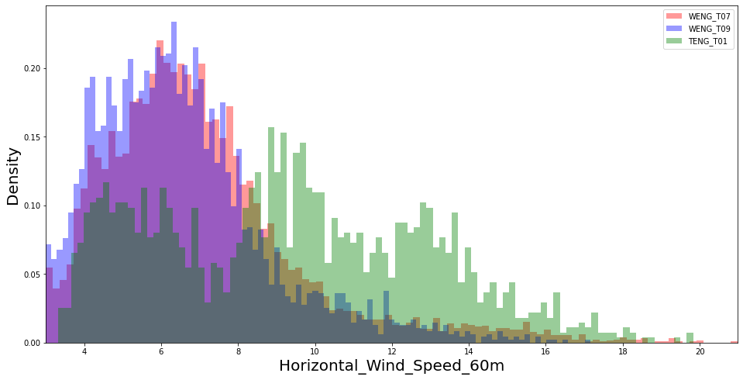
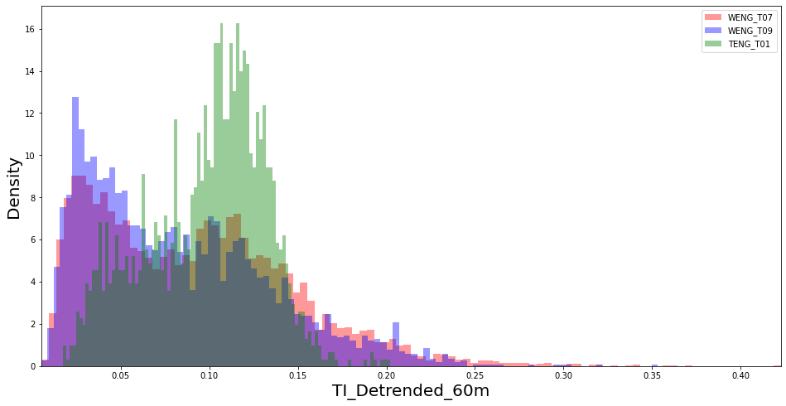
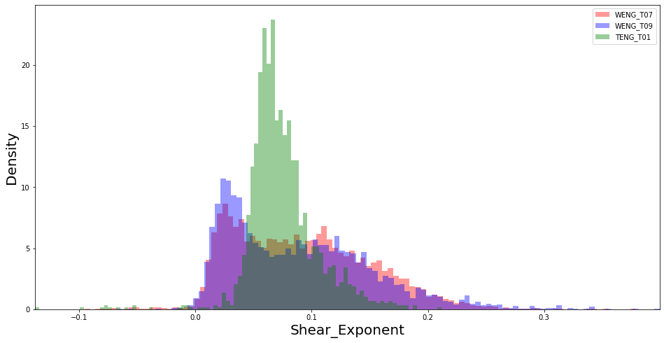
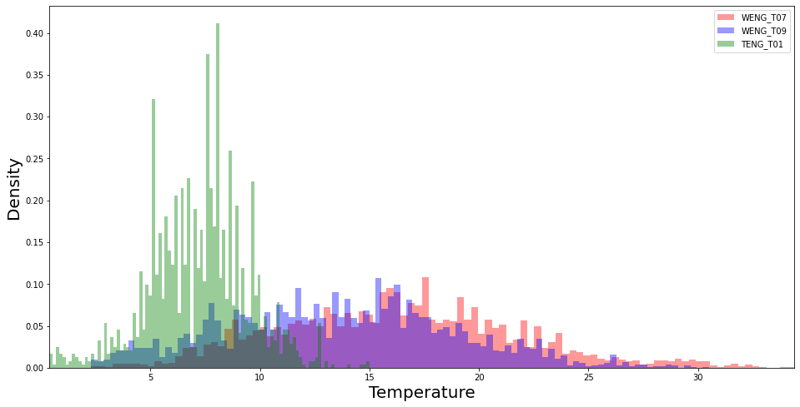
Dataset Introduction
Note that there may be some difference in the prevalent atmospheric conditions in the datasets due to details of the site and measurement periods, e.g.:

Slide 13

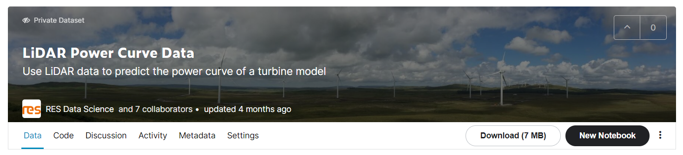
Dataset Introduction
Dataset will be made available through Kaggle
Platform used for hosting datasets and data science competitions
Designed for easy data exploration and documentation
Example scripts will be made available to help get started

Slide 14
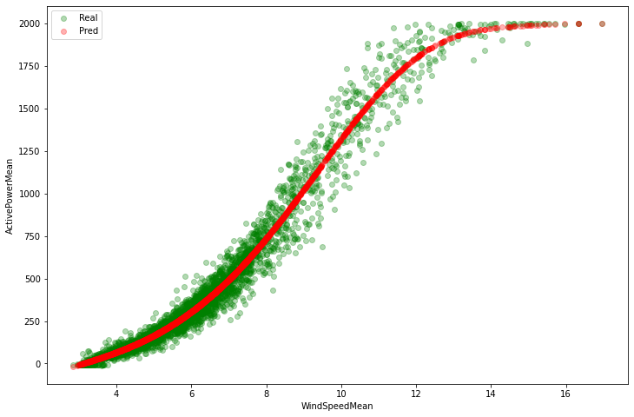
Example Analysis
Using traditional binned power curve as a simple predictive model:
Calculate binned REWS power curve for a training site (e.g. TENGT01)
Use training site binned REWS power curve to make predictions for a test site (e.g. WENGT07) by interpolating the power curve on each 10 minute data point
This traditional approach provides a useful baseline against which to evaluate more advanced statistical modelling techniques such as machine learning.

Slide 15
Example Analysis
RES has trialed various Machine Learning modelling approaches on this data and has found that these approached can perform better than the traditional methods. e.g.:
Model | RMSE (kW)
 | Training | TENG_T01 | TENG_T01 | WENG_T09 | WENG_T07 | WENG_T07 | WENG_T09 | Average
 | Testing | WENG_T07 | WENG_T09 | WENG_T07 | WENG_T09 | TENG_T01 | TENG_T01
Traditional Method |  | 97 | 79 | 81 | 64 | 94 | 97 | 85
RES ML Model |  | 88 | 87 | 30 | 30 | 97 | 97 | 72
Are there any other methods that we can find that are improvements and do better than the traditional methods of binned power curves and power deviations matrices?

Slide 16
Indicative Timeline
CFARS Consultation – April 2021
Release of Kaggle Dataset – May 2021
Participants share results at CFARS – August 2021

Slide 17
Key Questions For Breakout
We want to use the breakout session tomorrow to help define the Kaggle exercise:
Dataset introduction and feedback
How should we do the exercise?
What metrics should be used?
Cross Validation methodology?
Are there any other comparable data sets available that CFARS members could contribute? (i.e. Two sites with same turbine model measured by same LiDAR in same configuration)
Notes:
1 – proposal is data is just the four csvs of 10 minutely data. This is chance to show people around the dataset and Kaggle. Alternative is to include extra metadata such as turbine and LiDAR location.
2 – Proposal is completely open dataset, all four csvs are shared. Participants do complete analysis including metric calculation and model testing themselves. If people want to they can add and share code on the Kaggle site. Alternative would be a more formal Kaggle competition whereby one of the datasets are hidden and participants submit entries to be scored by an competition organisor.
3 – RMSE, MAE, ME are proposed. R^2 could be used? Another suggestion could be binned statistics. Binned by windspeed etc, this is how it was done in the PCWG tool. https://github.com/PCWG/PCWG/blob/master/Share_X_template.xls
4 – 6 splits across the three sites, using the average of the metrics for those splits.
5 – This is what a ‘good’ dataset could look like; turbine model has to be the same, LiDAR model the same and configured to the same height. Dataset cleaned by removing downtime and curtailment and wakes. More than or equal to 180 Hrs of usable data for each site.

Slide 18
Thank You!
Any Questions?

Slide 19
Future Work
Can we get the industry and OEMs interested and involved in this approach? Collaboration / open sourcing findings?
Can we carry out more experiments with different turbine models to keep on testing and improving this method?
Will this become more relevant as rotor size increases?
Can we work towards turbine specific power prediction models and datasets which are available across the industry?

