Slide 1
CFARS - General Meeting
Scientific Sub-Group Update: RSD Use in Complex Flow
March 13, 2021
A. Black, S. Wylie, M. Debnath, A. Lammers, P. Mazoyer, R. Schultz, T. Spalding

Slide 2
CFARS Complex Flow Science Sub-Group: Mission
Support increased use of RSDs in complex terrain.
Show typical complex flow biases for different terrain types
Validate commercially available bias removal methods
Explore limitations in correction technologies, with focus on atmospheric stability, surface roughness, and detached flow.
Evaluate correction uncertainty as a function of site and measurement height.
Demonstrate the value in RSD measurements plus some sort of compensation.
Investigate improved measurement abilities of RSDs in assessment of complex terrain developments.
2020 Focus
CFARS General Meeting, 13th – 15th April 2021

Slide 3
CFARS Complex Flow Science Sub-Group: 2020 Accomplishments
Formation of CFC Scientific sub-group:
7 member initially, spanning multiple disciplines within the wind industry (e.g. RSD OEMs, Developers, Consultants / IE, R&D / Academia)
Oral presentation at 2020 AWEA Wind Resource Assessment - Remote Sensing Special Session.
IEA Task 32 Invited Presentation:
Full presentation available via Zenodo: 10.5281/zenodo.4302363.
CFARS General Meeting, 13th – 15th April 2021

Slide 4
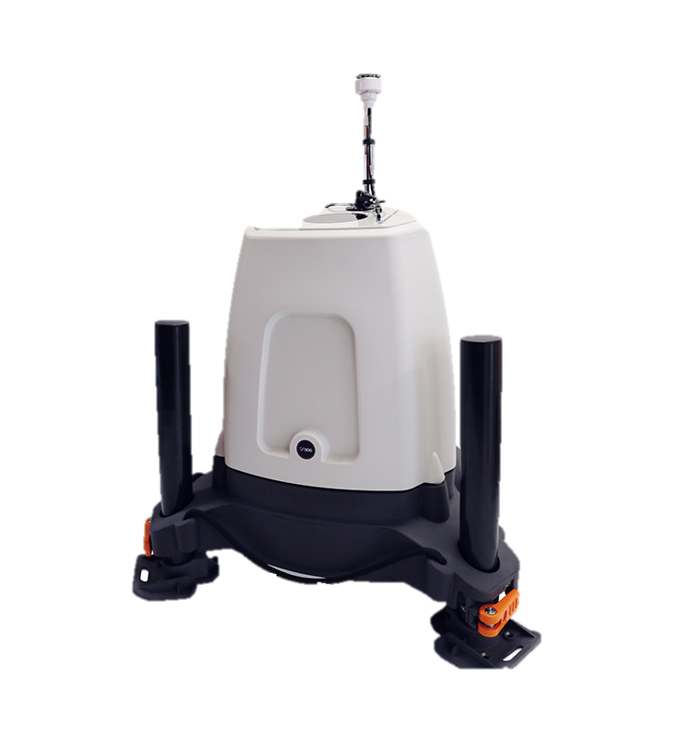
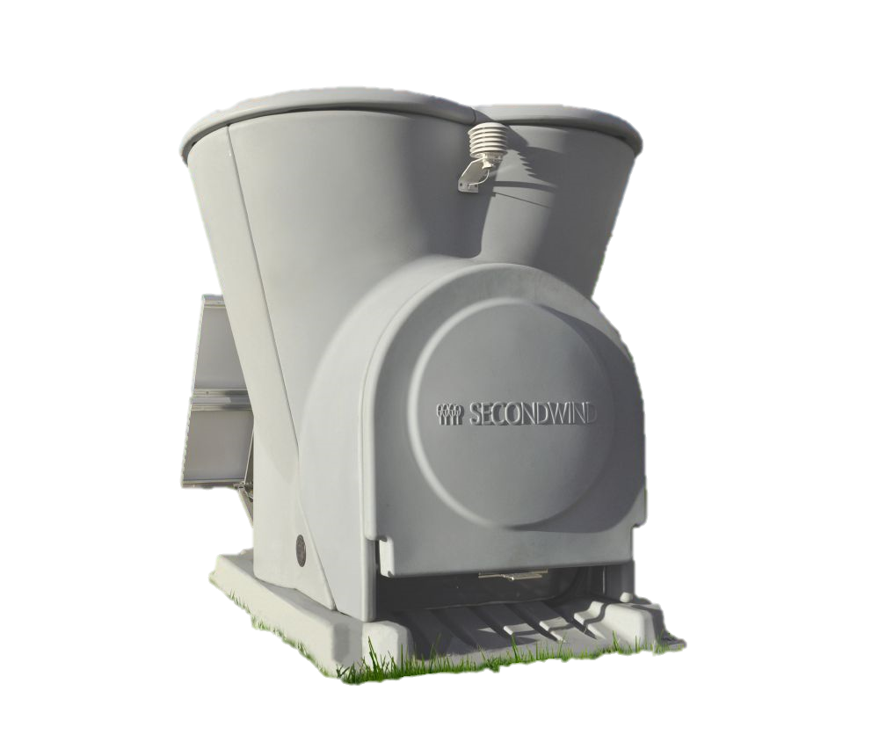

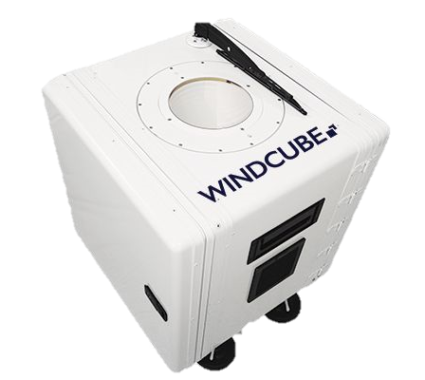
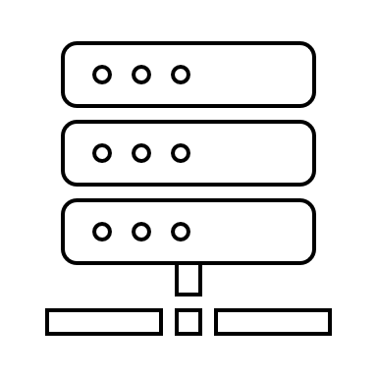
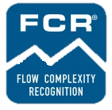


CFARS Complex Flow Science Sub-Group: Summary of 2020 Research
remote sensor
Triton Sonic Wind Profiler
ZX300
WindCube
26 sites
11 sites
6 sites
wind flow model
WindSim
Meteodyn WT
Flow Complexity Recognition
CFARS General Meeting, 13th – 15th April 2021
Notes:
Whilst many different RSDs and CFC techniques exits, the studied surveyed and summarised focus on three systems (triton soda, ZX300 lidar and the WindCube)

Slide 5
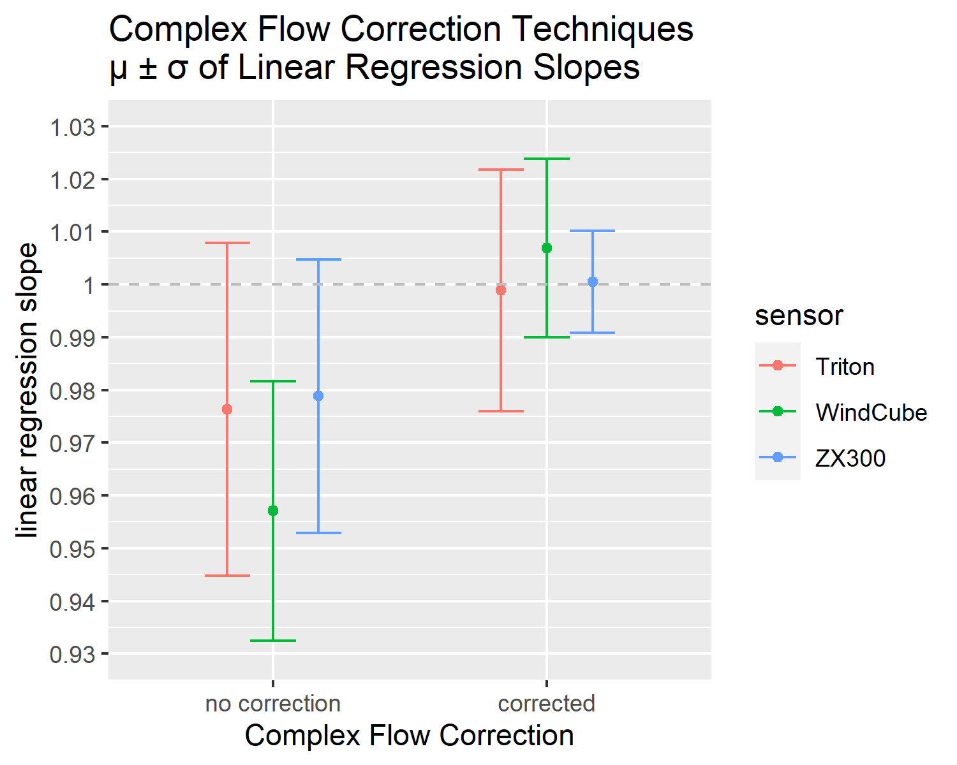
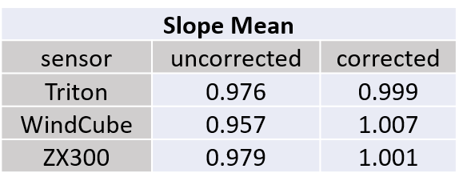
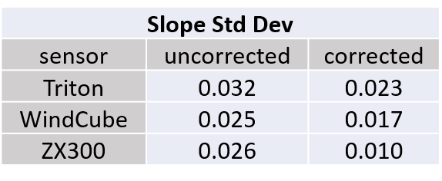
CFARS Complex Flow Science Sub-Group: Summary of 2020 Research
The average slopes for all three techniques are within ±1% of unity
The standard deviations of the slopes are reduced in all three techniques:
CFARS General Meeting, 13th – 15th April 2021
Notes:
Existing performance of RSDs in simple terrain is good across the board, this shouldn’t be called into question after commercial exposure these systems have had.
We’ve taken that one step further and demonstrated that with a well thought out, transparent methodology, excellent performance can be achieved from RSDs in complex terrain when compared to the current industry accepted that is seen as the gold standard.
Whilst these results have been streamlined to produce a top level summary, the data underpinning these statistics covers a variety of terrain types, vegetation coverages and environmental conditions (typical to those found in wind farm development).
There are other methods available and other remote sensing devices, too, and as a group we encourage all those with experience and / or evidence to demonstrate this participate in this group to showcase this and help increase industry acceptance and momentum for use of RSDs in complex flow situations.

Slide 6
CFARS Complex Flow Science Sub-Group: Impacts of 2020 Research
Big impact.
Better results for existing techniques than generally known.
Pushing forward acceptance of CFC techniques.
Broad activity in industry from RSD OEMs, CFD companies, IEs.
New momentum for RSD use on complex sites from developers.
CFARS General Meeting, 13th – 15th April 2021
Notes:
At this stage a qualitative assessment of the impacts have been big, with lots of interest in the results and a level of surprise as to what has been done already, no only from the OEMs.

Slide 7
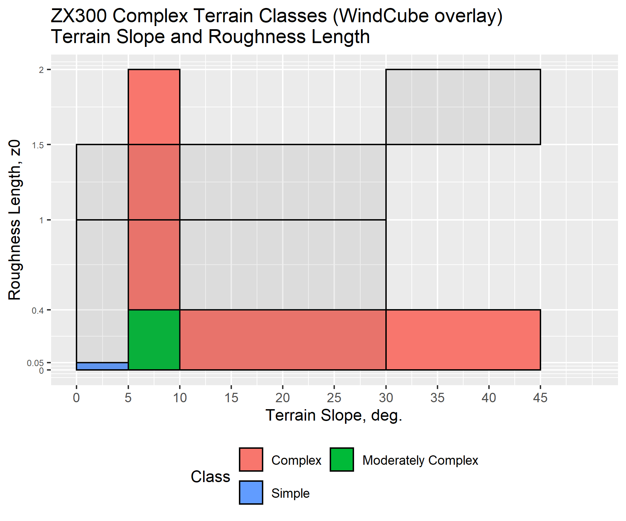
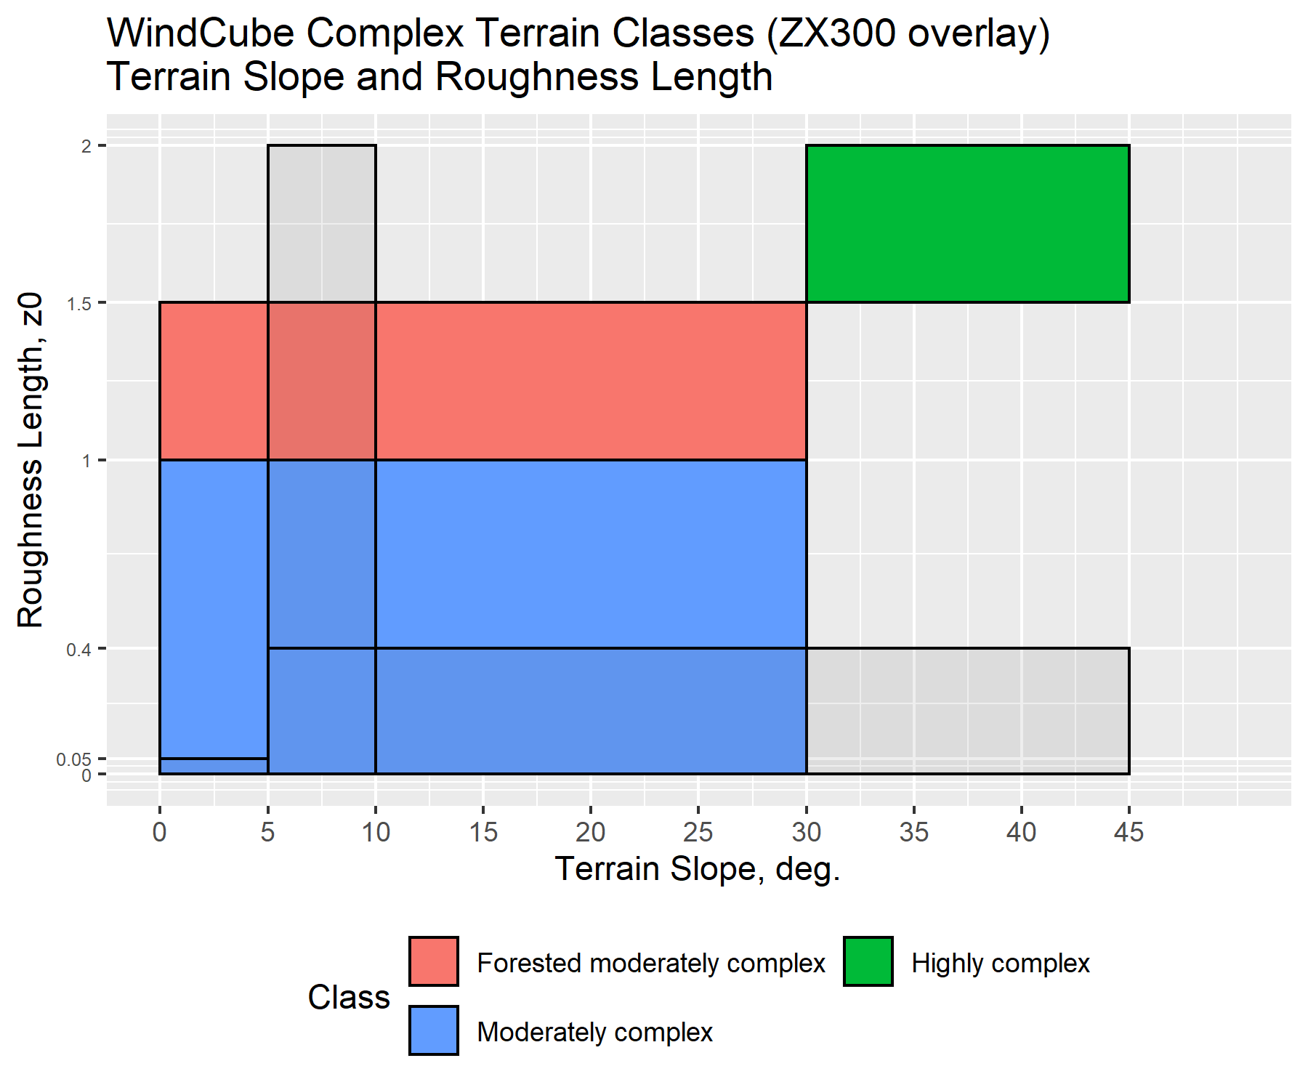
CFARS Complex Flow Science Sub-Group: 2021 Scientific Focus – Terrain Definitions
These terrain categorizations do not cover the same parameter space.
Each OEM / developer / modeler (etc.) has a different method to classify terrain.
There is a need for a generalized method to classify terrain complexity.
CFARS General Meeting, 13th – 15th April 2021
Notes:
Variables Used in Classifying Terrain:
Roughness Length (RIX)
Slope of terrain (degrees)
Standard deviation of elevation (meters)
Terrain Ruggedness Index (TRI)
Forest Canopy Height (meters)
Purposes:
Determining whether CFC is necessary
Setting expectations for CFC performance
Determining where to site RSD to avoid extreme terrain where CFD codes would have limitations

Slide 8
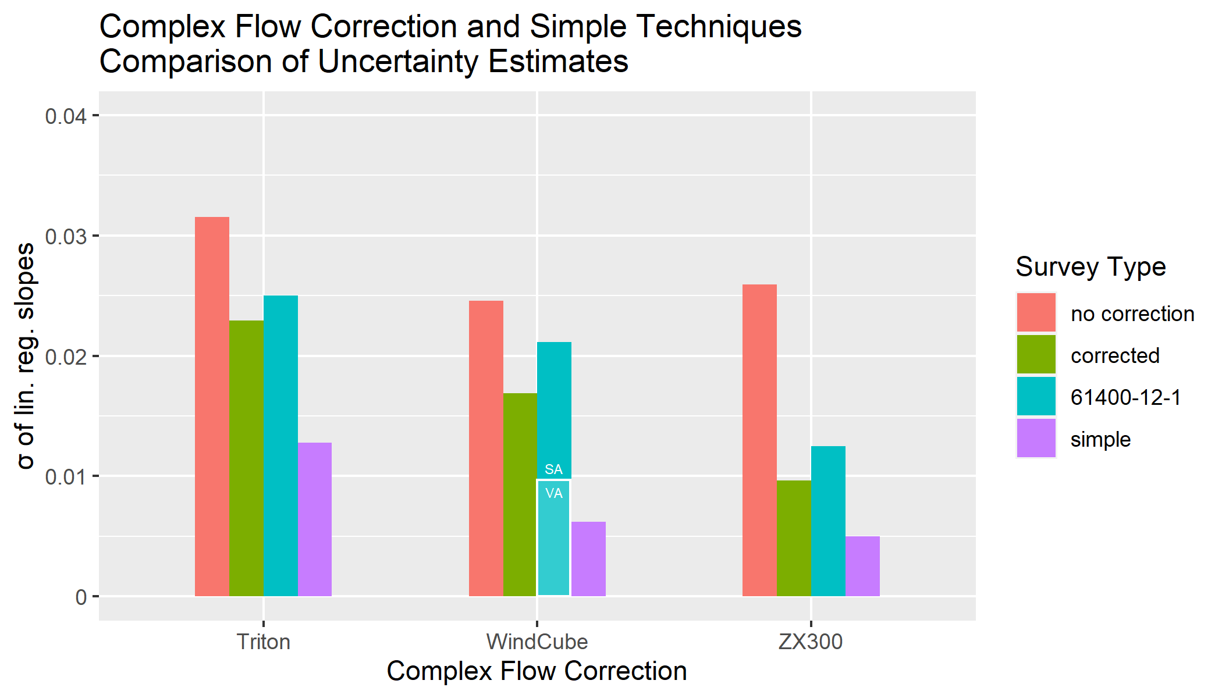
CFARS Complex Flow Science Sub-Group: 2021 Science Focus – Uncertainty Assessment of CFC
For all three techniques, the uncertainty estimate of the CFC-corrected sites is in between the uncertainty estimates of the 61400-12 and the repeatability tests
How to take these uncertainties and refine them to truly reflect what’s being measured?
CFARS General Meeting, 13th – 15th April 2021

Slide 9
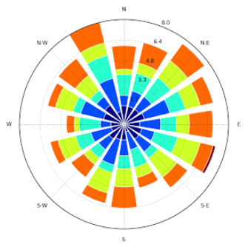
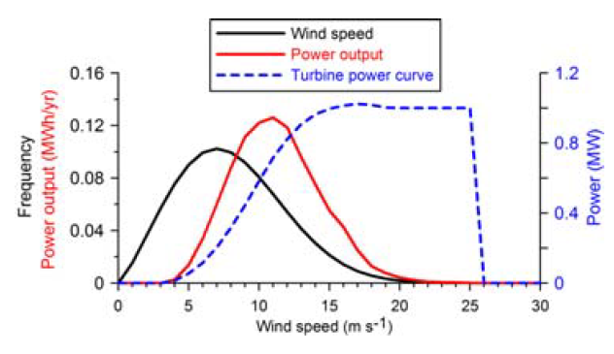
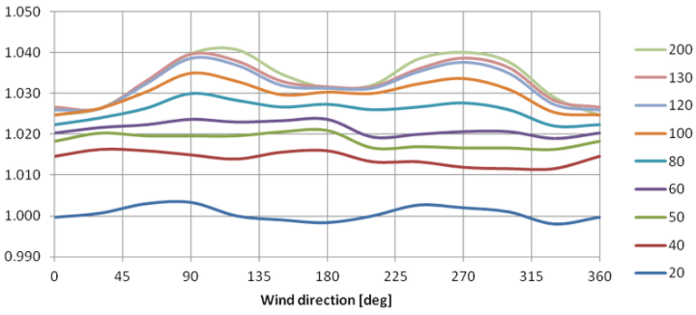
CFARS Complex Flow Science Sub-Group: 2021 Scientific Focus – Data Driven Approach
Use the data and combined with accepted analysis techniques, produce a robust and fair uncertainty assessment of RSD use in complex flow.
CFARS General Meeting, 13th – 15th April 2021

Slide 10
CFARS Complex Flow Science Sub-Group: 2021 Roadmap Focus – RSD CFC Assessment Framework
Siting
Measurements
Modelling
Verification
Currently (wrongly?) we have a linear view of RSD use in complex flow, in reality this is more circular.
Each section has a set of questions that can be addressed by the data driven approach.
CFARS General Meeting, 13th – 15th April 2021

Slide 11
CFARS Complex Flow Science Sub-Group: 2021 Roadmap Focus – RSD CFC Assessment Framework
Siting
Measurements
Bankable Wind Data
Modelling
Take this knowledge and experience, combine it with the work being done in other sub-groups to produce bankable wind data.
CFARS General Meeting, 13th – 15th April 2021

Slide 12
CFARS Complex Flow Science Sub-Group: Summary
All the commercially-available CFC techniques show good skill in eliminating wind speed biases from RSDs when compared to collocated masts.
CFC techniques have been validated at sites with a wide range of terrains, encompassing those found at typical development sites.
Uncertainties particular to complex terrain in the RSDs, the anemometers, and the CFC techniques are quantifiable, and are comparable to the uncertainties of RSDs in flat terrain, across various uncertainty metrics.
Plan for 2021 is to tackle terrain classification and uncertainty through a data driven approach.
To join the sub-group reach out to Scott (scott.wylie@zxlidars.com).
Next Complex Flow sub-Group meeting W/C: 26th April 2021.
CFARS General Meeting, 13th – 15th April 2021

Slide 13
Thank you, any questions?

