Slide 1


Guidance Group
Andrew Hastings Black
April 13, 2021

Slide 2
Mission: Accelerate Acceptance of RSDs for Wind Energy Use Cases
Clearly identify areas of improvement for acceptance of RSD; recommend areas for improvements RSD method improvement to Science WG
Amplify findings from Science Group via open-source documents and publications; drive consensus on new Best Practices
Socialize existing Standards and Best Practices to the broad industry: investors, IEs, OEMs, and developers

Slide 3




Acceleration of Acceptance in Action
*Guidance Group dormant*
Guidance Group 2019 Industry Survey
Creation of Science Sub-groups focused on key survey Use Cases
Results from Science Sub-groups, white papers, publications, etc

Slide 4



Acceleration of Acceptance in Action
Guidance Group 2019 Industry Survey
Creation of Science Sub-groups focused on key survey Use Cases
Results from Science Sub-groups, white papers, publications, etc
*Guidance Group reactivated*
Guidance Group Amplification of Science Results
Website, GitHub repo, open Best Practices
Consensus RSD acceptance for more Use Cases

Slide 5
Acceleration of Acceptance in Action
Guidance Group 2019 Industry Survey
Creation of Science Sub-groups focused on key survey Use Cases
Results from Science Sub-groups, white papers, publications, etc
REPEAT AS NECESSARY
*Guidance Group reactivated*
Guidance Group Amplification of Science Results
Website, GitHub repo, open Best Practices
Consensus RSD acceptance for more Use Cases

Slide 6
Guidance Group Principles
Scientific results by themselves do not drive change quickly
Industry segments working alone do not drive change efficiently
Competing companies in the same segments need collaborative forums to build trust in order to drive changes that benefit all parties
This not only for the benefit of today’s wind energy industry : by collaborating and publishing Best Practices, we lower barriers to entry for new companies + new investors, accelerating wind energy development

Slide 7
Guidance Group 2021 Roadmap
Three key tasks:
#1: Disseminate Site Suitability White Paper(s) Best Practice Framework
#2: Develop CFARS Website + Repo as hub of RSD Best Practices
#3: Engage with Turbine OEM, IE, and Investor communities

Slide 8
#1: Site Suitability White Papers
The RSD TI findings and proposed Best Practice Framework for Adjusted RSD TI need to be shared widely and put into use to gain acceptance
CFARS is not a standards body … but the Best Practices proposed do not require us to be
The Best Practices do require broad understanding about how developers, RSD OEMs, IEs, and Turbine OEMs work together to understand and minimize uncertainties in Adjusted RSD TI Site Suitability analysis
Key Guidance 2021 Ask: Broad industry review and input on the Best Practice Framework for Adjusted RSD TI proposal. That means you!

Slide 9
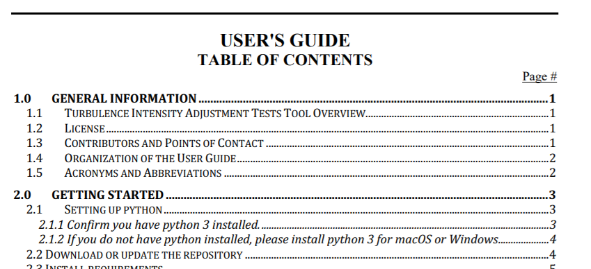
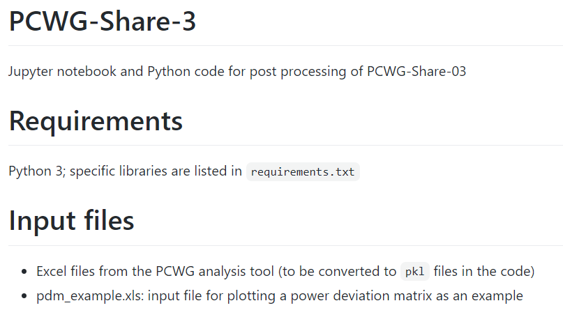
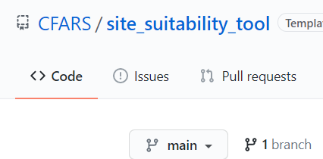
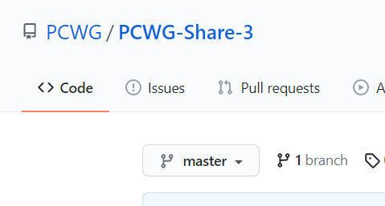
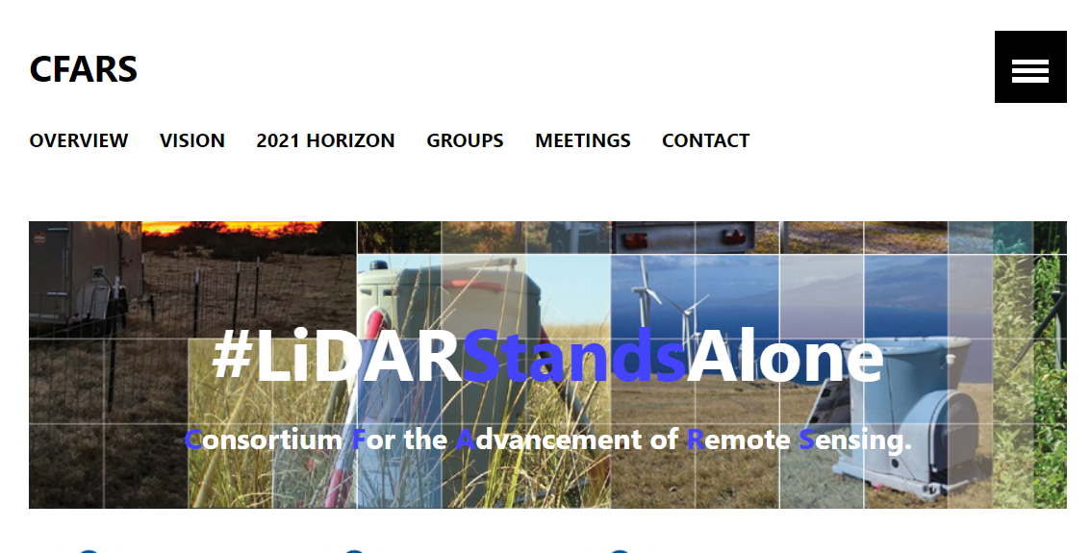
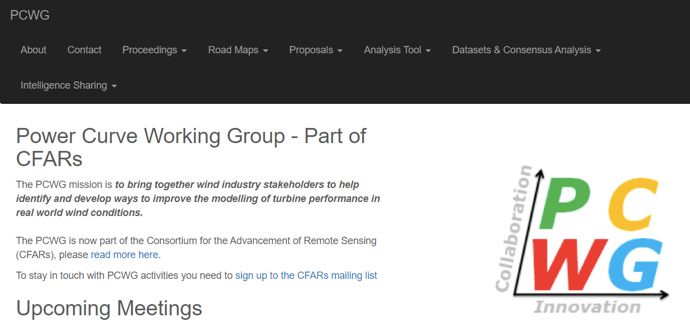
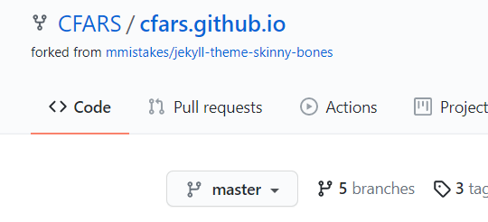
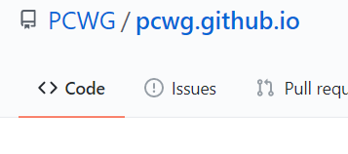
#2: Open Source + Website Resources
Tools
Websites

Slide 10
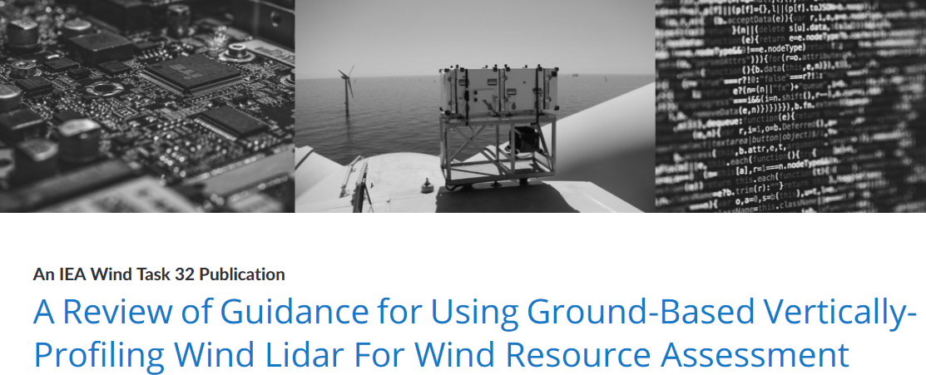
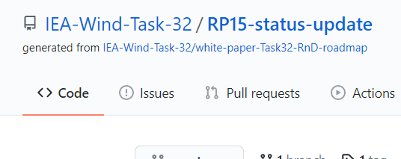
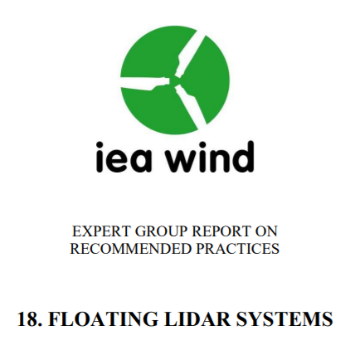
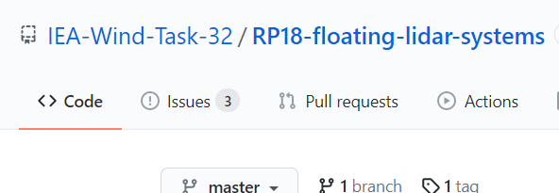
#2: Open Source + Website Resources
We are in good company using open source tools to promote Best Practices: IEA Task 32
We are in close coordination with IEA, IEC, and NREL

Slide 11
#2: CFARS Website Content
Hub of references to the “Ecosystem of RSD Use Cases”
Special focus on CFARS + PCWG output
Promotion of milestones and events by CFARS, IEA, and IEC
Website uses a Markdown template and is published via GitHub
Easy to generate new content, easy to collaborate
No web design knowledge required

Slide 12
#2: Ecosystem of RSD Use Cases
Wind Resource Assessment
Onshore
Energy Yield Assessments
Site Suitability
Site Calibration
Complex Flow
Offshore
Energy Yield Assessment
IEC 61400-15
Power Performance
Power Curves
Vertical Profiling
Nacelle Mounted
Power Performance Testing
Vertical Profiling
Nacelle Mounted
Complex Flow
Offshore
IEC 61400-12
CFARS
PCWG
IEA Task 32
IE Guidelines
TR6
Class NK
MEASNET
IEC 61400-50
CarbonTrust
CFARS website will contain an Executive Summary and links for the above standards

Slide 13

#3: Engagement with Community
Energy per annum: $6 trillion
New investors and new companies are entering the marketplace: global energy expenditures are shifting from fossil fuel to renewables
By collecting and publishing RSD Standards and Best Practices in simple language, to a wide audience, we can ensure that new entrants understand and leverage them from the start
Renewables per annum: $300 billion

Slide 14
#3: Engagement with Community
Joint statements/articles on Standards from different industry segments and competitors send a powerful message to the broad finance and OEM community that remote sensing devices are mature and reliable
Wind is leveraging several technology trends simultaneously:
Lidar, machine learning, computational fluid dynamics, & open source science
It’s sexy
Key Guidance 2021 Ask: Participation from IEs in drafting and reviewing Standards and Best Practices Executive Summaries

Slide 15
Summary
Guidance Group is back in action….
We need Guidance Group participants to:
Co-author and review “Ecosystem of RSD Use Cases” Executive Summaries
Conscious acceleration of “Best Practice Framework for Adjusted RSD TI” through wide industry engagement
Contribute and review webpage layout, formatting, etc.
Guidance Group Meeting #1:
Thursday, April 29, 2021 9:00 – 10:30 AM MST
Please email andrew.hastingsblack@vaisala.com to contribute!

