Slide 1
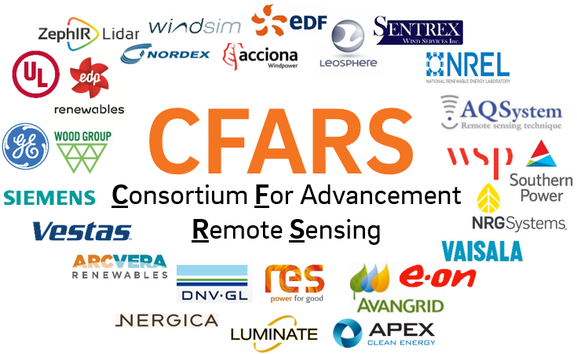
CFARS - Science Working Group Update
March 06, 2019
Alexandra St. Pé, E.ON
(Alexandra.St.-Pe@eon.com)

Slide 2
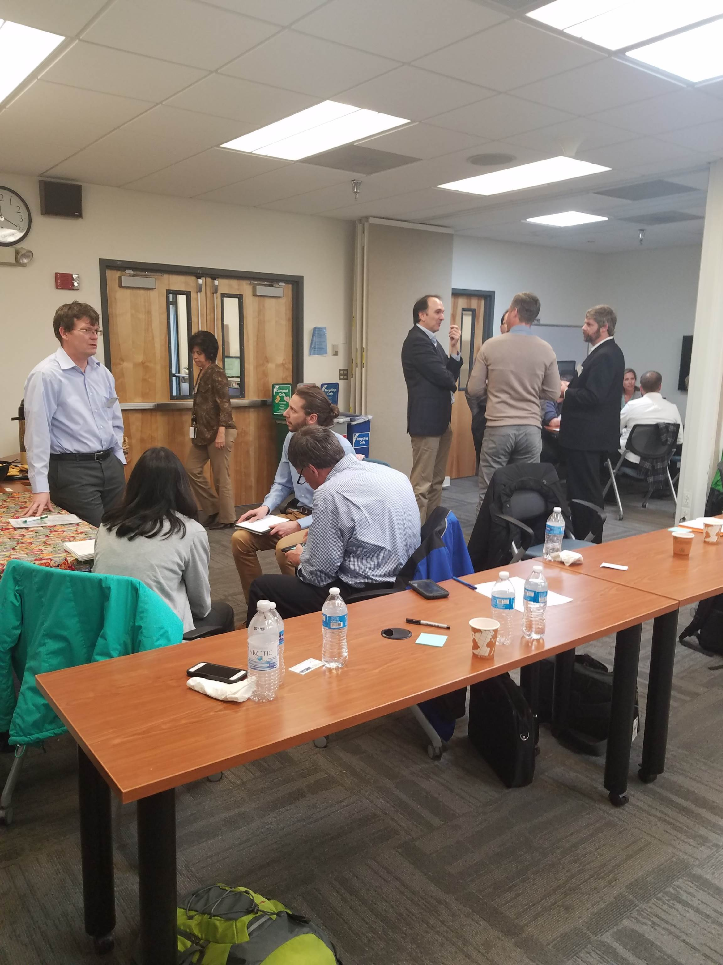
Science WG Topic Prioritization
March 2018
Complex Flow Correction
Uncertainty/ Energy Evaluation
Power Curves / PPTs
Impact
Site Suitability (TI & Shear)
Effort
Mission - Provide data-driven answers to key RSD science questions and support the development pragmatic solutions to hurdles that hinder the acceptance of RSD use
Notes:
The mission of this WG overall is to provide ….
We met here in boulder last year around this time and really began to iron out the details of what we want to accomplish as WG and science topic prioritization.
And to help organize our brainstorm we borrowed the PCWG trademarked Effort vs. Impact plot.
Complex flow correction was identified as priority topic. We know one fundamental assumption of RSD wind retrievals is that the flow over the volume it scans/samples is homogenous. This assumption breaks down in complex flow, where curved flow introduces inhomogeneity between the RSD beams. We identified CFC as a high impact and medium effort topic.
Next up is SS – specifically focused on TI and shear. We know the volume measurement of an RSD yields a slightly different TI thus biased TI compared to cup and understanding the best way to use RSD TI for load assessment will be key. Also, we know the shear assessment may be more comprehensive using RSD vs. cup so what is the bset way to take advantage of the additional RL measurements provided from RSD. This group was though to have med impact and med effort.
PC/ PPT group. Really focused one expanding our database and knowledge of RSD power curves strengths and weaknesses and the uncertainties recom in the 12-1 edition 2 and forming a view of measures that could be done to reduce such uncertainty. This group is now crossing into the realm of power data so while we have med impact we have a bit greater effort than the others.
Finally, the Uncertainty and energy evaluation group. Often times RSD data use in and EPE is caveated with a statement about increased uncertainty. And I think the initial idea for this group is to tease out what that actually means and how to fairly account for this uncertainty in and EPE – to build consensus in the method.

Slide 3
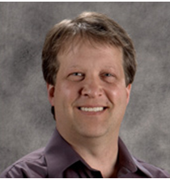
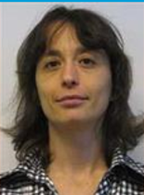
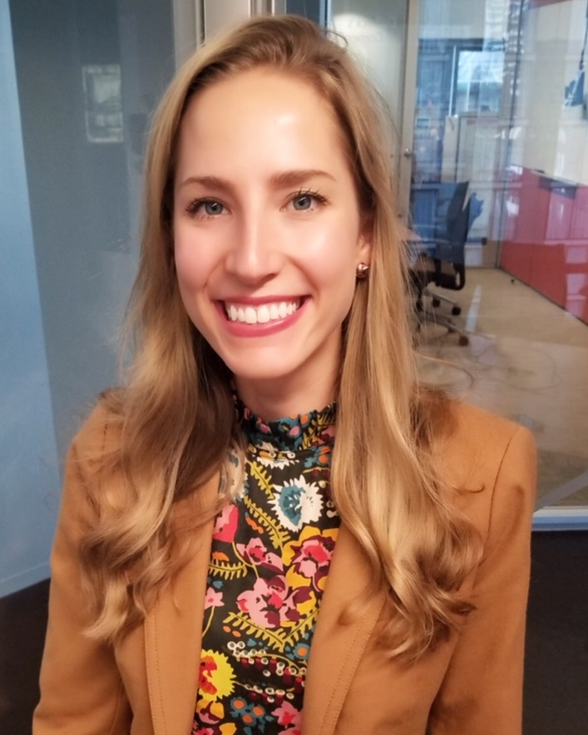

Science WG – Subgroups & Leads
Science
Working Group
Complex Flow
Correction (CFC)
Niels Lawhite
(Niels.lawhite@vaisala.com)
Power
Curves / PPTs
Site
Suitability (SS)
Uncertainty/
Energy Evaluation
Reesa Dexter
(Reesa.dexter@dnvgl.com)
Alexandra St. Pé
(Alexandra.st.-Pe@eon.com)
Volunteer
welcomed!

Slide 4
CFARS - Science CFC Subgroup
Complex Flow Correction
March 06, 2019
Niels LaWhite, Vaisala
(Niels.LaWhite@Vaisala.com)

Slide 5
Complex Flow Correction - Bias Correction for Complex Terrain
Bias is caused by inhomogeneity between RSD beams, i.e. curved flow
RSD wind reconstruction math assumes the wind vector is constant between beams
Curvature induced bias is a well known, major issue – large bias, high uncertainty
Forward scanning RSD – bias induced by changes in horizontal wind direction
Upward facing RSD – bias induced by changes in vertical wind direction, e.g. hilltop/ridge
Characteristics for ground based RSD in complex terrain
Flow over hilltop leads to low bias (underprediction of wind speeds)
Varies with wind direction AND measurement height
Roughly independent of technology, beam configuration, and tilt angle
Bias can be corrected if flow curvature is known – commercial products are available
CFD based models predict flow curvature over terrain, no real-time data necessary
FCR (Windcube) uses real-time data to estimate and correct bias
Complex Flow Correction (CFC) is very important for RSD use in complex terrain!

Slide 6
CFARS Science CFC Subgroup
Support increased use of RSD in complex terrain
Show typical flow curvature biases for different terrains
Validate commercially available bias correction methods
Explore limitations in correction technology – stability, high roughness, detached flow
Evaluate correction uncertainty as a function of site and measurement height
Demonstrate the value in correcting RSD measurements
Subgroup Status
Project kick-off (skype/zoom meeting) in roughly 2 weeks
Roadmap will be decided based on survey results (+new ideas!)
Validation study, uncertainty analysis, comparison of commercial correction offerings, or white paper on theory with terrain type / bias classification.
Interested? We are looking for participants! (contact: Niels.LaWhite@Vaisala.com)

Slide 7
CFARS – Science Subgroup:
Site Suitability
March 06, 2019
Alexandra St. Pé, E.ON
(Alexandra.St.-Pe@eon.com)

Slide 8
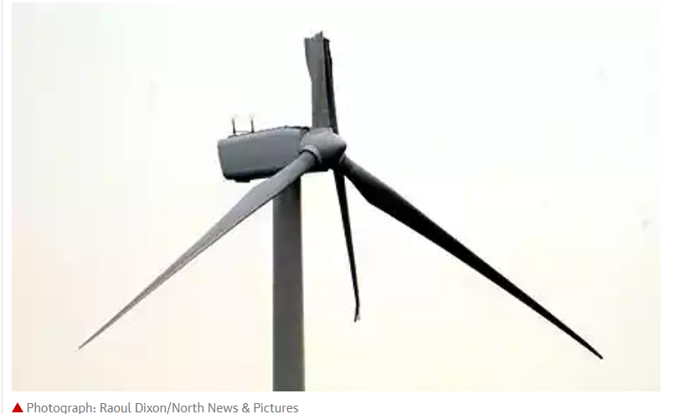
Science WG - Site Suitability Subgroup
Focus → Turbulence Intensity
Turbulent wind produces excessive turbine loads and fatigue
Reduction in turbine performance and yield
Increase O&M costs
Decrease turbine lifespan
IEC 61400-1 → standard wind turbine
classification defined by wind speed & TI
Accurate measurement of TI is mandatory as variation between turbine and wind classes are small
TI bias → load assessment error
Load assessment error → decrease turbine lifespan
Increase O&M costs
Decrease turbine lifespan

Slide 9
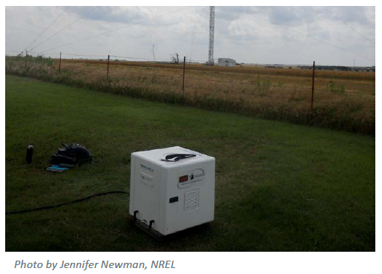
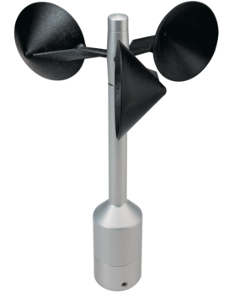
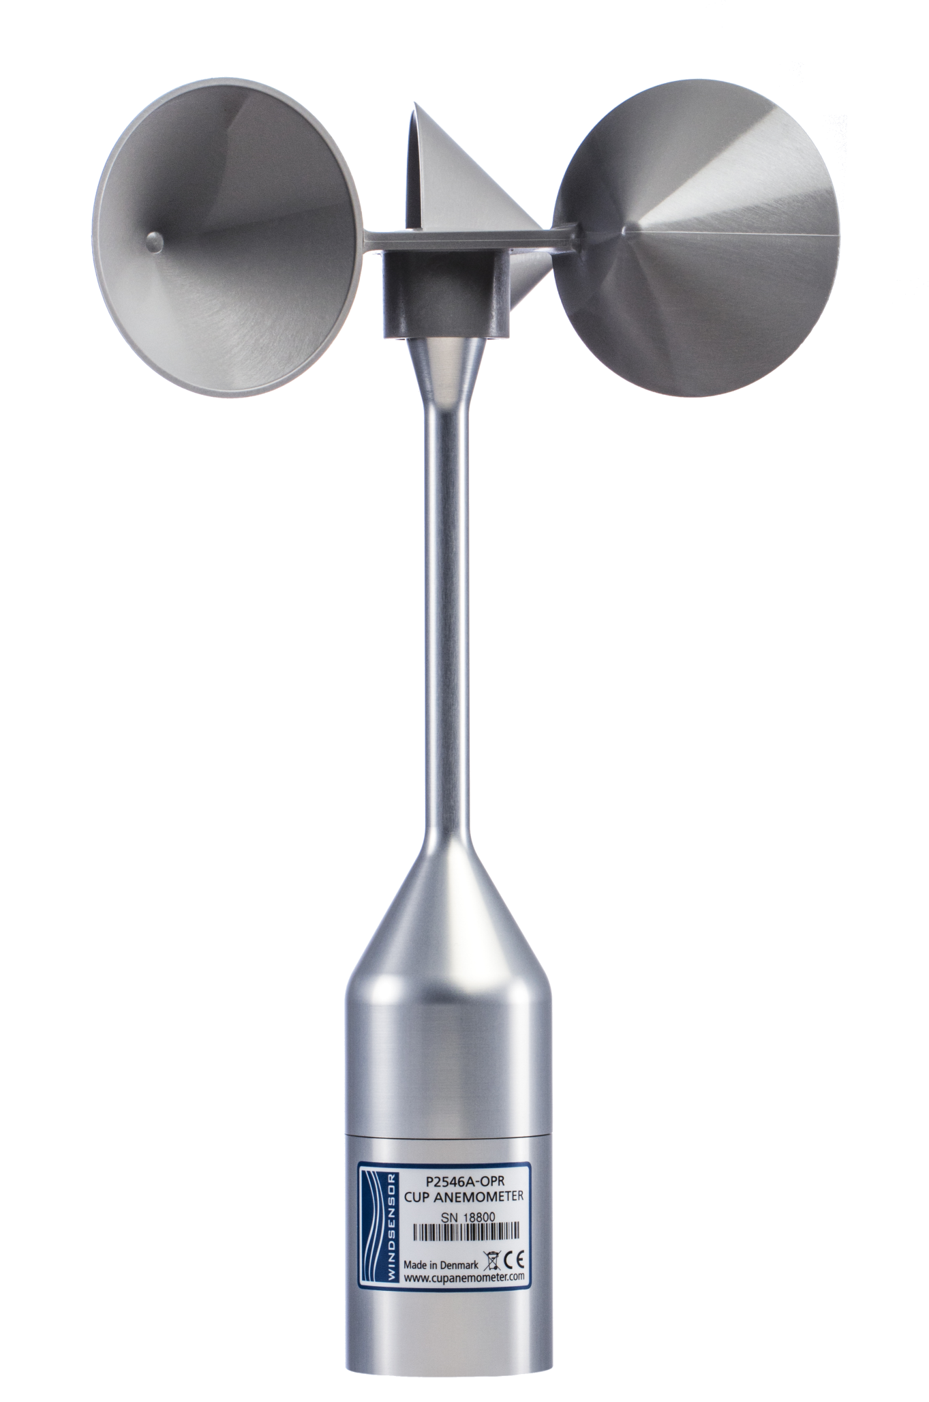
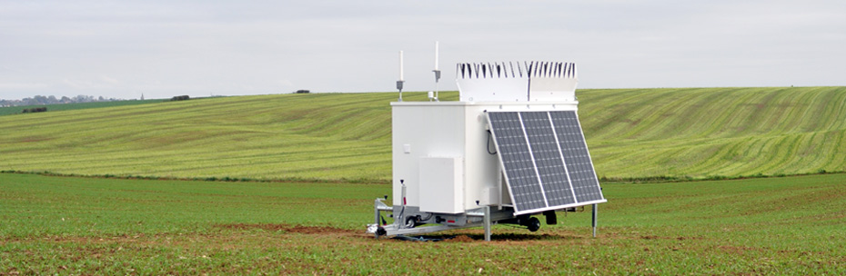
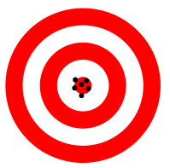


Science WG - Site Suitability Subgroup
2018 Milestone Activities → Defining Deliverables & First Results
1
Phase 1 Analysis: TI Bias Benchmarking – Q1 2019
- Organizations compare average TI bias between their own collocated, concurrent, datasets:
Raw and Corrected RSD TI vs. Reference Anemometer TI
Reference Anemometer TI vs. “Other” Anemometer TI
&
vs.
&
Raw/Corrected RSD TI
Reference Anemometer TI
Reference Anemometer TI
“Other” Anemometer
2
Phase 2 Analysis: RSD TI Correction Method Evaluation– Q3 2019
Organizations perform round robin tests of RSD TI correction methods accuracy and precision on their own collocated, concurrent, datasets:
Raw and Corrected RSD TI vs. Reference Anemometer TI (truth)
&
Corrected RSD TI
Reference
Anemometer TI
High Precision & High Accuracy
3
Baseline Best Practice RSD TI Correction Methods – Q1 2020
Develop and align on baseline best practice RSD TI correction method(s) for site suitability and PPTs assessment

Slide 10
CFARS - Science Subgroup:
Uncertainty/ Energy Evaluation
March 06, 2019
Reesa Dexter, DNV GL
(Reesa.dexter@dnvgl.com)

Slide 11
Thank you. Questions?
(Alexandra.st.-pe@eon.com)

Slide 12
Extra Slides

