Slide 1
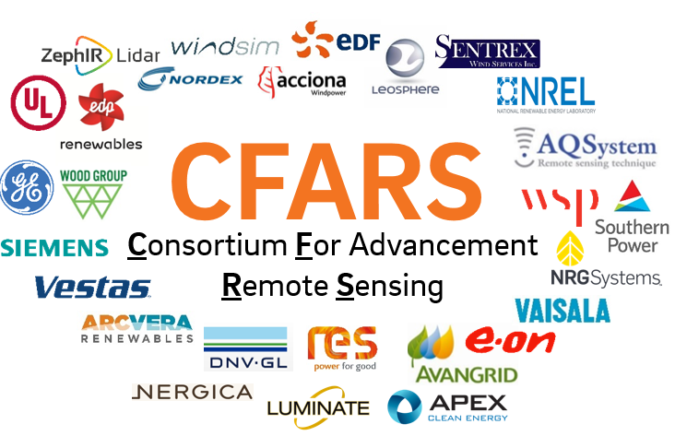
STATUS KEY PLANNING APPROVED DEVELOPMENT LAUNCH
2018 - Q3 |  |  | 2018 – Q4 |  |  | 2019 - Q1 |  |  | 2019 – Q2 |  |  | 2019 – Q3 |  |  | 2019 – Q4 |  |  | 2020 – Q1 |  |  | 2020 – Q1
JUL | AUG | SEPT | OCT | NOV | DEC | JAN | FEB | MAR | APR | MAY | JUN | JUL | AUG | SEPT | OCT | NOV | DEC | JAN | FEB | MAR | APR | MAY | JUN
Dataset Preparation
Phase 1 Analysis: TI Bias Benchmarking
Phase 2 Analysis: RSD TI Correction Method Evaluation
Baseline Best Practice RSD TI Correction Methods
Brainstorm on near-term group deliverables
Submission of Dataset Summary Stats Tables
Develop Dataset Summary Stats Template
Develop Python Opensource Tool For Calculation & Tool Guideline
Testing
Submission of Results
Summarize Results – White Paper
Develop Python Opensource Tool For Calculation & Tool Guideline
Testing
Submission of Results
Summarize Results – White Paper
Define & Align on Document Scope
Develop Document
Draft Document Released to internal CFARS for Feedback
Document Public Dissemination
CFARS Site Suitability Subgroup - Roadmap

Slide 2
Aligning Key Objectives
CFARS Site Suitability Subgroup
IEA Task 32 TI/Loads
Benchmark RSD vs. Anemometer TI Bias
Enhance Knowledge Transfer
Establish Consensus on Achievable & Acceptable RSD TI Accuracy for Specific Purposes
Evaluate the Accuracy and Precision of “in-house” RSD TI Correction Methods
Provide Data-driven De facto Best Practice Methods for RSD TI Correction

