Slide 1
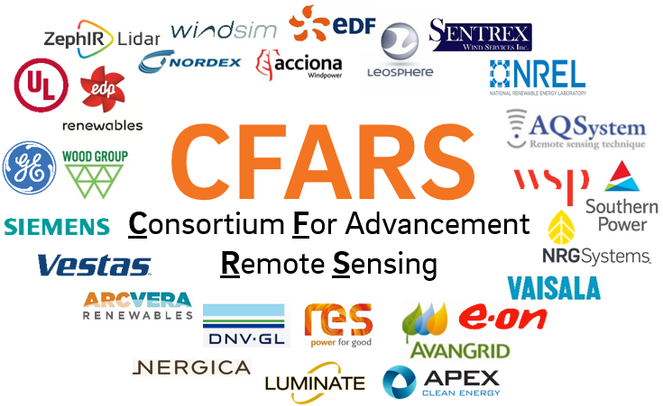
CFARS – Science WGs Overview
Site Suitability Subgroup
June 26, 2019
Alexandra St. Pé, E.ON

Slide 2
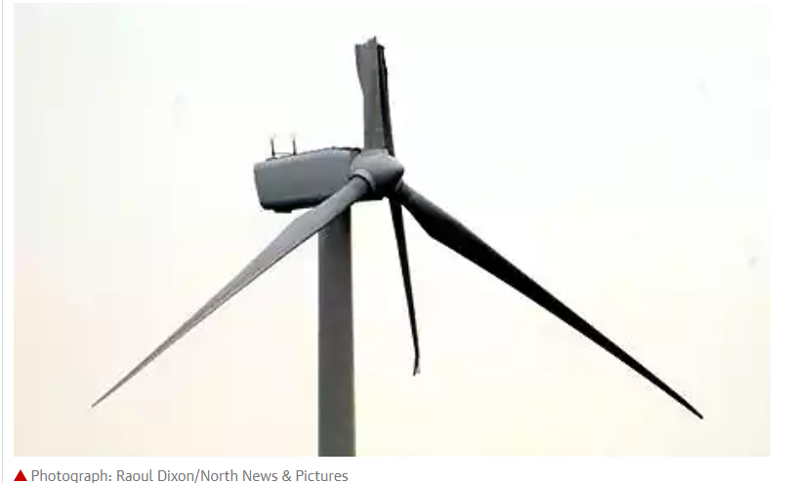
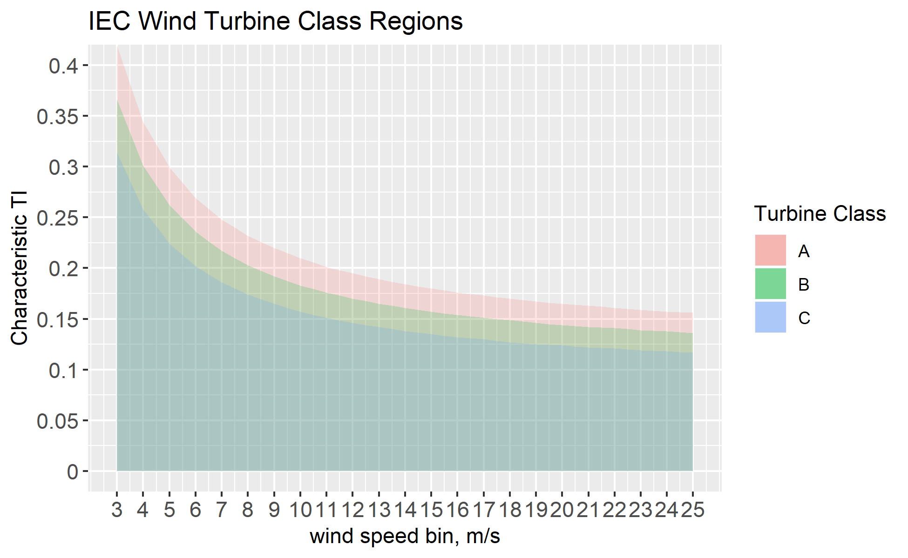
Science WG - Site Suitability (SS) Subgroup
Mission → Build consensus on data-driven answers to key RSD science questions that hinder acceptance of RSD use for site suitability assessment
Focus → Turbulence Intensity
Turbulent wind produces excessive turbine loads and fatigue
Reduction in turbine performance and yield
Increase O&M costs & decrease turbine lifespan
IEC 61400-1 → standard wind turbine
classification defined by wind speed & TI
Accurate measurement of TI is mandatory as variation between turbine and wind classes are small
TI bias → load assessment error

Slide 3
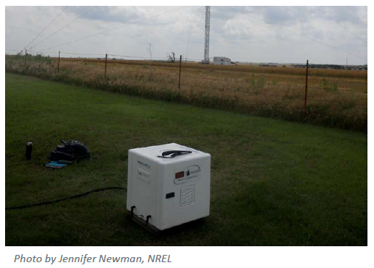
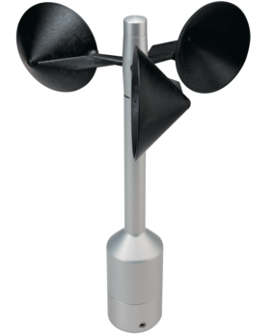
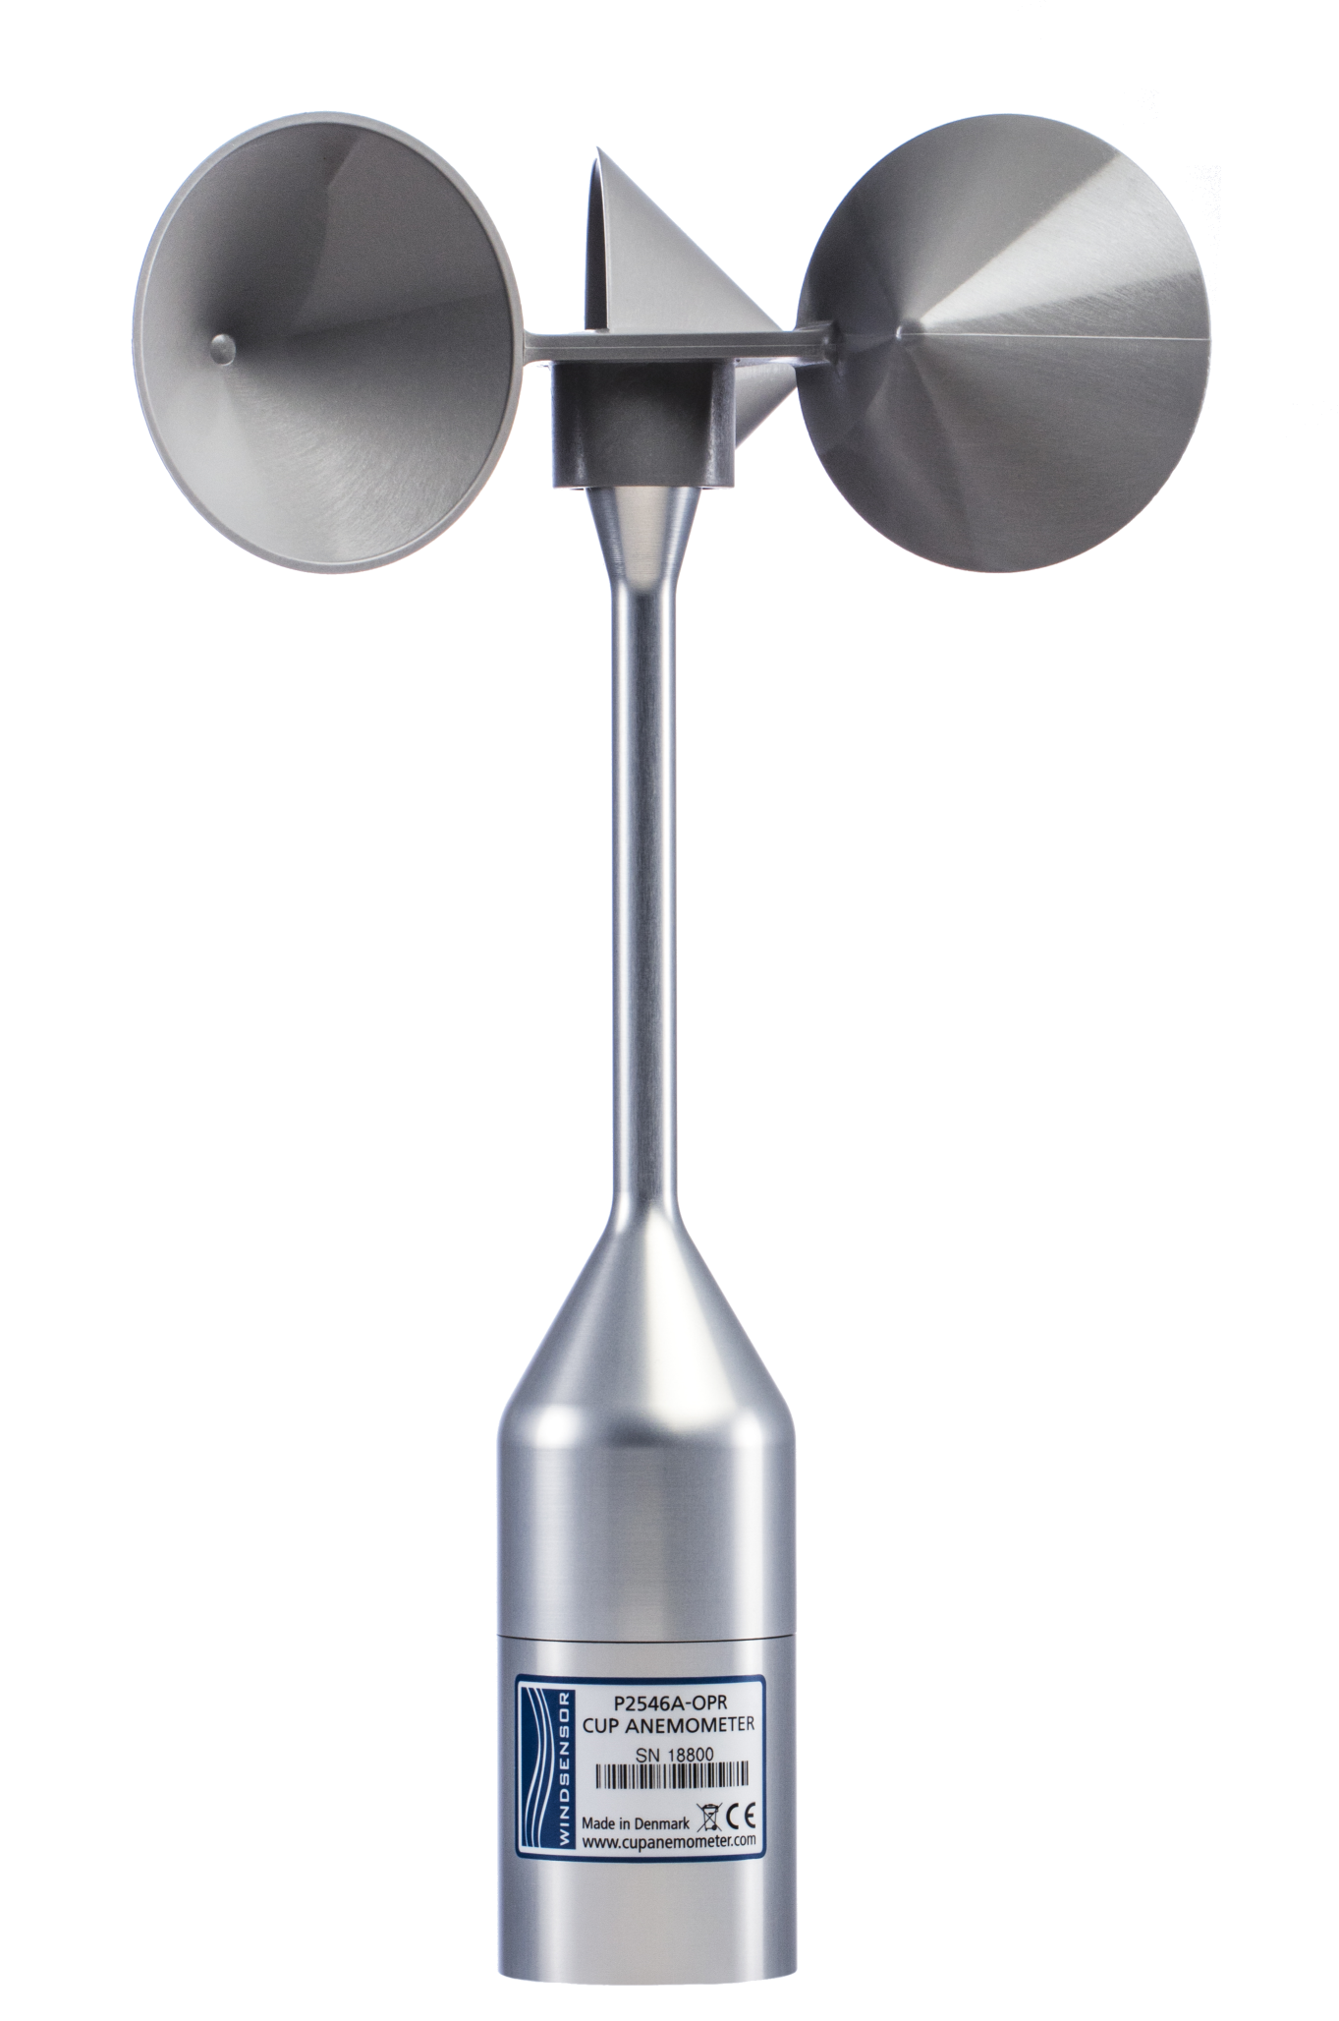
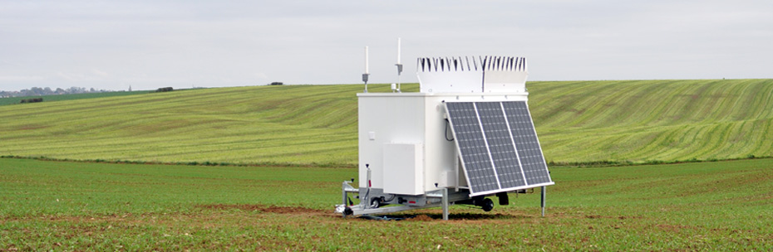
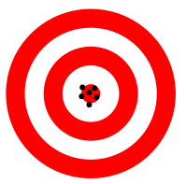


Science WG - Site Suitability Subgroup
2018 Milestone Activities → Defining Deliverables & First Results
2019 - 2020 Activities → Analysis & Final Deliverables
1
Phase 1 Analysis: TI Error Benchmarking – Q3 2018 - Q2 2019
- Organizations compare average TI error between their own collocated, concurrent, datasets:
Raw and Corrected RSD TI vs. Reference Anemometer TI
Reference Anemometer TI vs. “Other” Anemometer TI
Group results to be presented @ WindEurope Friday, June 28th 9AM-11AM “Using Lidar to Reduce Uncertainty”
&
vs.
&
Raw/Corrected RSD TI
Reference Anemometer TI
Reference Anemometer TI
“Other” Anemometer
2
Phase 2 Analysis: RSD TI Correction Method Evaluation– Q3/Q4 2019
Organizations perform round robin tests of RSD TI correction methods accuracy and precision on their own collocated, concurrent, datasets:
Raw and Corrected RSD TI vs. Reference Anemometer TI (truth)
&
Corrected RSD TI
Reference
Anemometer TI
High Precision & High Accuracy
3
Baseline Best Practice RSD TI Correction Methods – Q2 2020
Develop and align on baseline best practice RSD TI correction method(s) for site suitability and PPTs assessment

