Slide 1
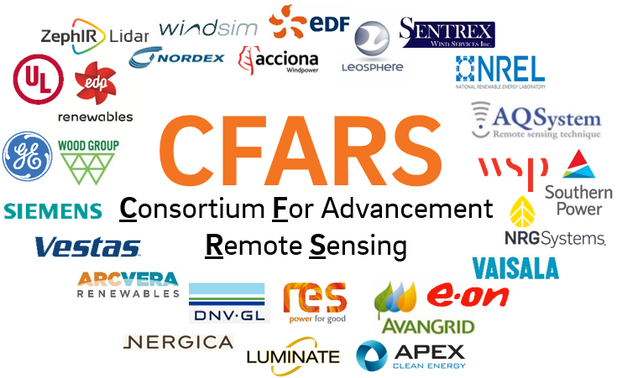
CFARS – Survey Overview
June 25, 2019
Jeff Fine, RES
John Wang, Wood
Matthew Meyer, E.On

Slide 2
CFARS Survey Committee
Create a credible/unbiased baseline for onshore vertical profiling RSD use and acceptability
Understand current perceived limitation/boundaries for commercial use of RSD
Probe RSD users about common area of knowledge vs diverging practices
What is now understood vs what needs to be understood better
Provide some directions/area of focus for the Science and Guidance Tract

Slide 3
CFARS Survey Objectives
Create a credible/unbiased baseline for onshore vertical profiling RSD use and acceptability
Understand current perceived limitation/boundaries for commercial use of RSD
Probe RSD users about common area of knowledge vs diverging practices
What is now understood vs what needs to be understood better
Provide some directions/area of focus for the Science and Guidance Tract

Slide 4
CFARS Survey Roadmap
Survey Opened
November 2018
Focused Group
Feb/March 2019
Survey Closed
April 2019
Early Result
Long From Report
Short Form Report
June 2019
July 2019
September 2019
Wind Europe
CFARS quarterly update
Long form survey released to the participant
AWEA wind resource conference Washington

Slide 5

CFARS Survey Methodology
Limited to RSD for onshore application
Anonymized Survey – Submitted via Survey Monkey
Participants broken down by activity fields
1 point of contact per company
Divided in sections representing key industry challenges
Sections defined by a representative subgroup
Also includes an option deployment history table

Slide 6

Survey Structure
Part 2 - RSD Deployment History Table
Part 1 - RSD Questions
1. General Perspective
2. Campaign Design
3. Installation/ Deployment
4. RSD Operation
5. RSD Validation
6. RSD Data Processing for EYA
7. RSD Data for LT Wind Assessment
8. RSD Data for Wind Flow Modeling
9. RSD Data Consideration for Site Suitability
10. RSD During WF Operation & PPT
11. RSD Measurement Uncertainty
12. RSD Maintenance
13. Other / Misc.
1. General Information
2. Climate Type
3. Air Quality Impacts on Data Recovery
4. Success – How Data is Used
5. Failure – Reasons for Data not being Used
Some Fact on the Survey
145 questions
5 hours to complete
Still got representative level of participation…. Tx!

Slide 7
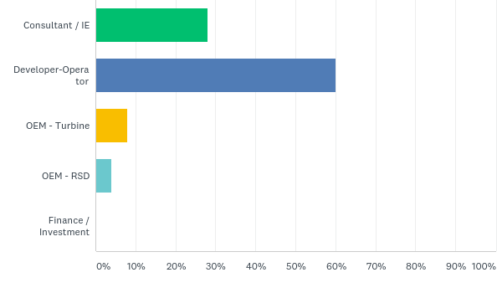
Participant List
Section 0: Choose your stakeholder category association
Answered: 25 Skipped: 0
7 independent companies
15 independent companies
2 independent companies
1 company

Slide 8
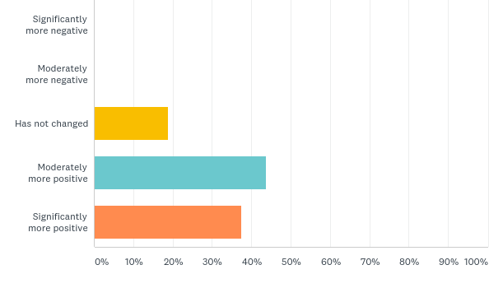
Interesting findings per section
Section 1: How has your perception of RSD value changed over the last 5 years? (Choose one)

Slide 9
Interesting findings per section
Section 2: Do you use remote sensing on all your sites. If yes/no why or why not?
Answer | Answers
Yes | 2 | Most cost efficient way to de-risk a wind project
Most | 7 | Why not: Terrain complexity/low hub height
No | 2 | Too Expensive

Slide 10
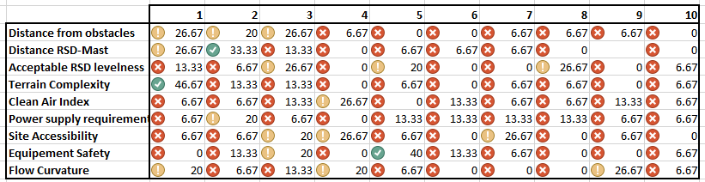
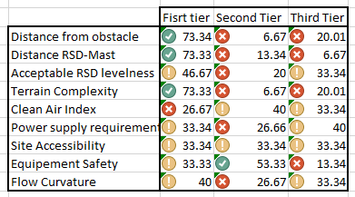
Interesting findings per section
Section 3: What is most important consideration when siting an RSD
Complex flow is clearly #1 criteria
Interesting to find out topics like clean air index is secondary issue

Slide 11
Interesting findings per section
Section 4: How often do you plan your regular maintenance?
Answer | Number of participants answers
6 month to 1 year | 7
Quarterly | 2
As needed | 4

Slide 12
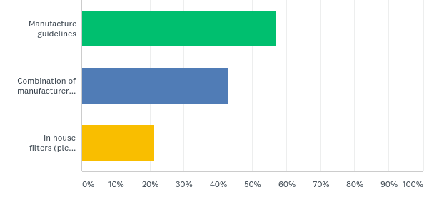
Interesting findings per section
Section 5: What filters/flags do you use to clean RSD data for validation?

Slide 13
Interesting findings per section
Section 5: Do you apply a correction factor to RES following validation with a mast?
Answer | Number of participants answers
Yes | 4
No | 8

Slide 14
Interesting findings per section
Section 5: What filters/flags do you use to clean RSD data for validation?
Combination in house + manufacturer

Slide 15
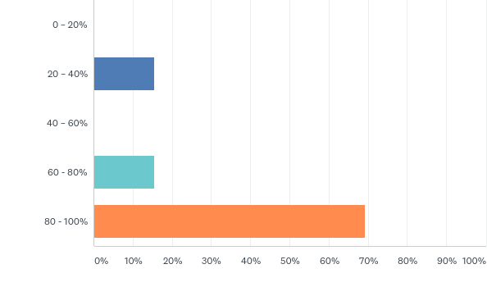
Interesting findings per section
Section 5: What percentage of your RSDs pass a 3rd party validation?

Slide 16
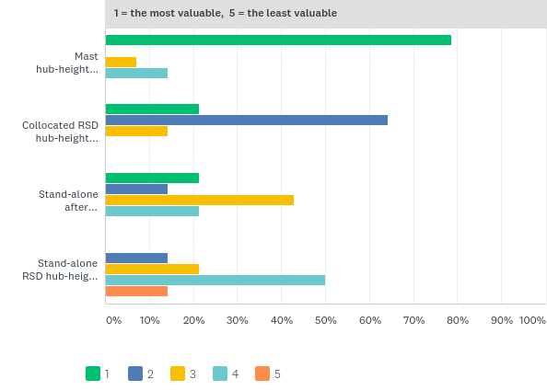
Interesting findings per section
Section 7: Rate the following according to their value:
Mast at Hub Height
Collocated RSD and mast at Hub Height
Stand alone RSD @ HH after collocation
Stand alone RSD @ HH no collocation

Slide 17
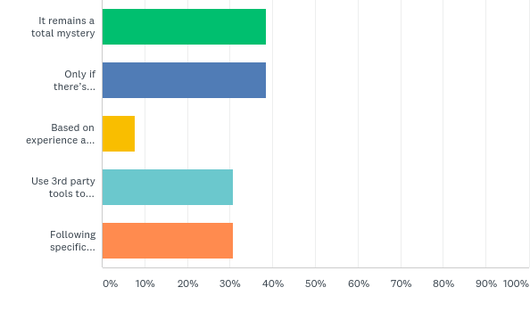
Interesting findings per section
Section 8: How do you know how to perform flow curvature correction on RSD wind speed data? (Check all that apply)

Slide 18
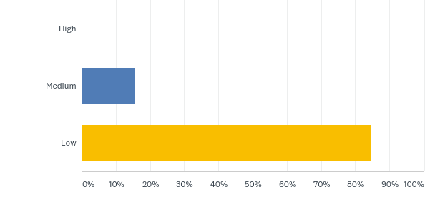
Section 9: How much confidence do you have that an OEM would only use RSD data for a site suitability report?
Interesting findings per section

Slide 19
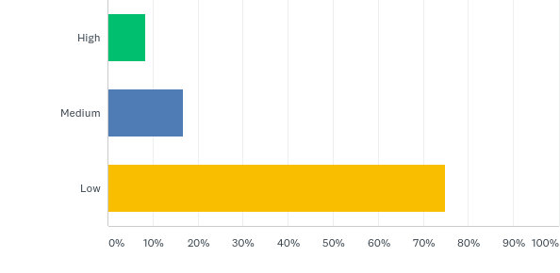
Section 9: How much confidence do you have that a consultant would only use RSD data for a production estimate?
Interesting findings per section

Slide 20
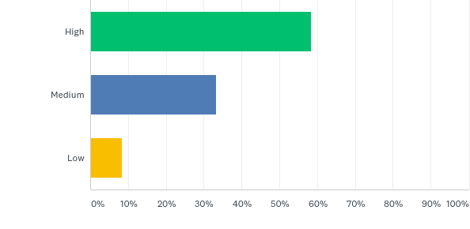
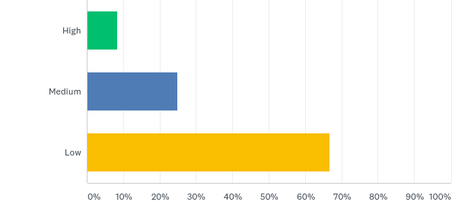
Section 9: How confident are you in using RSD shear/TI information above mast level to support site suitability assessment?
Interesting findings per section
SHEAR
TI

Slide 21
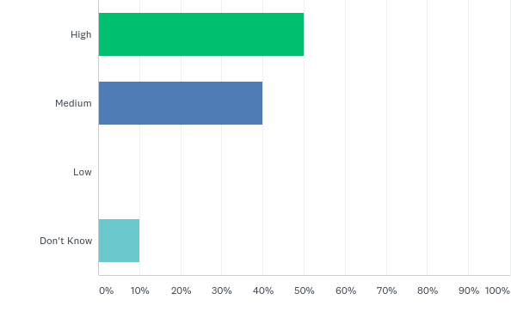
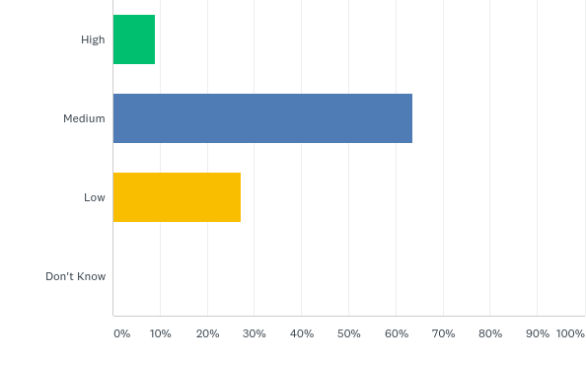
Section 13: How did you perceive the uncertainty in RSD measurement in 2013 vs 2019?
Interesting findings per section
2013
2019

Slide 22
CFARS Early findings
Confidence in RSD significantly increased in the last 5 years
Still a large spread in perception RSD applicability for site suitability and resource assessment
Stand alone LiDAR (without mast) still perceived as the golden standard
Key area of focus for science tract:
TI measurement from RSD
Complex flow characterization and correction

