Slide 1
WRF-bPlume tutorial
Sudheer R Bhimireddy
UTSA (2015-2020)
email: fhl598@my.utsa.edu

Slide 2
Installing WRF-bPlume
Get the latest link from the WRF-bPlume website (Link to be added here) or GitHub (https://github.com/sudheer-wrf/wrf-bplume)
Follow usual WRF-ARW compiling steps
(https://www2.mmm.ucar.edu/wrf/OnLineTutorial/compilation_tutorial.php)
Compile WRF in Large-eddy simulation mode
A successful compilation for idealized cases will result in ideal.exe and wrf.exe executables in the main/ directory
Start building cases using the test case available within WRF build
For a quick CBL case, use /test/em_les/ present in the main WRF directory
Key files modified for WRF-bPlume are present in Registry/ and dyn_em/ directories

Slide 3
Useful WRF-ARW links
Technical guide
https://opensky.ucar.edu/islandora/object/opensky:2898
WRF Dynamics guide
https://www2.mmm.ucar.edu/wrf/users/docs/wrf-dyn.html
User guide
https://www2.mmm.ucar.edu/wrf/users/docs/user_guide_v4/v4.0/contents.html
Tutorials page
https://www2.mmm.ucar.edu/wrf/users/supports/tutorial.html
Best Practices
https://www2.mmm.ucar.edu/wrf/users/namelist_best_prac_wrf.html

Slide 4
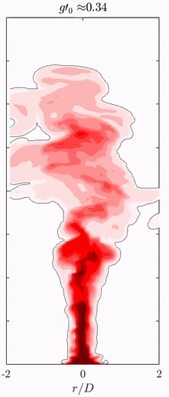
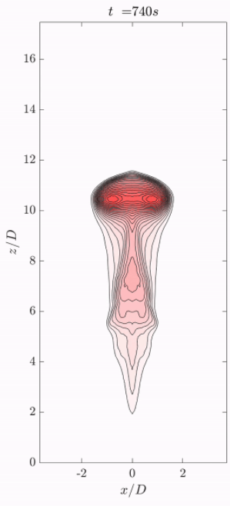
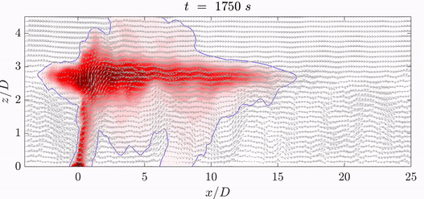
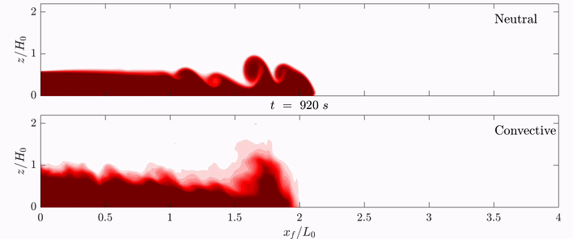
Type of flows to simulate using WRF-bPlume
Axisymmetric plumes
Thermal plumes
Buoyant bubbles
Buoyant gas plumes
Density currents

Slide 5
New in WRF-bPlume
New variables added in WRF-bPlume are:
tke_heat_flux_hot – additional heat flux at the source location
heat_flux_wait_mins – Minutes from simulation start to release the plume
heat_flux_run_mins – Minutes from plume start to turn off the plume source
density_current – Flag to simulate lock-exchange density current
lock_length – density current lock length
lock_height – density current lock height
lock_mixture – density current lock fluid mixing ratio
axisymmetric_plume – flag to simulate axisymmetric plume at the center of the bottom boundary
plume_gas_constant – Gas constant of plume material
plume_surface_flux – Surface flux of plume mixing ratio
source_dia – Plume source diameter

Slide 6
Files modified for WRF-bPlume
For WRF-bPlume following files are modified based on the default WRF-ARW framework (v 4.0.3):
/Registry/Registry.EM_COMMON
/dyn_em/module_big_step_utilities.F
/dyn_em/module_diffusion_em.F
/dyn_em/module_em.F
/dyn_em/module_initialize_ideal.F
/dyn_em/solve_em.F
/share/wrf_timeseries.F

Slide 7
Setting Simulation times
&time_control
run_days = 0,
run_hours = 2,
run_minutes = 0,
run_seconds = 0,
start_year = 0001,
start_month = 01,
start_day = 01,
start_hour = 00,
start_minute = 00,
start_second = 00,
end_year = 0001,
end_month = 01,
end_day = 01,
end_hour = 04,
end_minute = 00,
end_second = 00,
history_interval_m = 00,
history_interval_s = 10,
frames_per_outfile = 90,
restart = .false.,
restart_interval_m = 15,
io_form_history = 2
io_form_restart = 2
io_form_input = 2
io_form_boundary = 2
iofields_filename = "myoutfields.txt"
WRF stops running when either run_* or end_* condition is fulfilled
WRF writes the output for each domain.
Minimum time step to write is 1s
Restart runs are half-completed runs
The start time must match the time information in restart file (wrfrst_d01_*.nc)

Slide 8
Contents of myoutfields.txt
Useful in reducing the WRFOUT file size
Many of the default variables written by WRF are unimportant for ideal cases
-:h:0:LU_INDEX,DZS,VAR_SSO,NEST_POS,FNM,FNP,RDNW,RDN,DNW,DN,CFN,CFN1,RDX,RDY,RESM
-:h:0:ZETATOP,CF1,CF2,CF3,ITIMESTEP,XTIME,SHDMAX,SHDMIN,SNOALB,TSLB
-:h:0:SMOIS,SH2O,SEAICE,XICEM,SFROFF
-:h:0:UDROFF,IVGTYP,ISLTYP,VEGFRA,ACSNOM,SNOW,SNOWH,CANWAT,COSZEN,LAI,VAR
-:h:0:MAPFAC_M,MAPFAC_U,MAPFAC_V,MAPFAC_MX,MAPFAC_MY,MAPFAC_UX,MAPFAC_UY
-:h:0:MAPFAC_VX,MF_VX_INV,MAPFAC_VY
-:h:0:F,E,SINALPHA,COSALPHA,TISO,MAX_MSTFX,MAX_MSTFY,RAINC,RAINSH,RAINNC
-:h:0:SNOWNC,GRAUPELNC,HAILNC,SWDOWN
-:h:0:OLR,CLAT,ALBBCK,EMISS,NOAHRES,TMN,SNOWC,SR,C1H,C2H,C1F,C2F,C3H,C4H,C3F,C4F,PCB,PC
-:h:0:LANDMASK,LAKEMASK
-:h:0:HFX_FORCE_TEND,LH_FORCE_TEND,TSK_FORCE_TEND,HFX_FORCE,LH_FORCE,TSK_FORCE
-:h:0:ZS,SSTSK,GLW,SWNORM
-:h:0:ISEEDARR_SPPT,ISEEDARR_SKEBS,ISEEDARR_RAND_PERTURB,ISEEDARRAY_SPP_CONV
-:h:0:ISEEDARRAY_SPP_PBL,ISEEDARRAY_SPP_LSM,THIS_IS_AN_IDEAL_RUN
-:h:0:SAVE_TOPO_FROM_REAL,TLP,SST_INPUT
-:h:0:CLDFRA,ALBEDO,ZNU,ZNW
-:h:0:Q2,T2,TH2,U10,V10,GRDFLX,ACGRDFLX,HGT,P_STRAT,XLAT_U,XLONG_U,XLAT_V,XLONG_V
+:h:0:PBLH,ACHFX,ACLHF,SST
Anything that is required in addition to usual WRF output variables can be added to stream0 using a +:h:0: command

Slide 9
Setting Simulation domain
&domains
time_step = 0,
time_step_fract_num = 1,
time_step_fract_den = 6,
max_dom = 1,
s_we = 1,
e_we = 201,
s_sn = 1,
e_sn = 201,
s_vert = 1,
e_vert = 301,
dx = 20,
dy = 20,
ztop = 3000,
grid_id = 1,
parent_id = 0,
i_parent_start = 0,
j_parent_start = 0,
parent_grid_ratio = 1,
parent_time_step_ratio = 1,
feedback = 0,
smooth_option = 0
Fractional timesteps are written as numerator and denominator (here, dt =1/6 sec)
Indices within WRF code starts at 1 rather than 0

Slide 10
Setting Simulation physics
For Large-eddy simulations, no need to use PBL or Cummulus schemes.
mp_physics is the key that invokes which microphysics variables are to be considered
Buoyant gas in bPlume model is part of such schemes
&physics
mp_physics = 0,
ra_lw_physics = 0,
ra_sw_physics = 0,
radt = 0,
sf_sfclay_physics = 1,
sf_surface_physics = 0,
bl_pbl_physics = 0,
bldt = 0,
cu_physics = 0,
cudt = 0,
isfflx = 2,
ideal_xland = 1,
num_soil_layers = 5,
mp_physics = 0 tells WRF to resolve only water vapor ratios and plume mixing ratios

Slide 11
Setting Simulation dynamics
Dynamics module is the place where all the plume related inputs are given
&dynamics
hybrid_opt = 0,
rk_ord = 3,
diff_opt = 2,
km_opt = 2,
damp_opt = 0,
zdamp = 200.,
dampcoef = 0.2,
khdif = 1.,
kvdif = 1.,
c_s = 0.18
c_k = 0.10
mix_isotropic = 1
smdiv = 0.1,
emdiv = 0.01,
epssm = 0.1,
.
.
.
/
Tells which sub-grid scale model is to be used

Slide 12
Setting Simulation dynamics
&dynamics
tke_heat_flux = 0.24,
tke_heat_flux_hot = 0.24,
heat_flux_len = 1.,
heat_flux_wait_mins = 35.,
heat_flux_run_mins = 180.,
density_current = 0.,
axisymmetric_plume = 1.,
lock_length = 100.,
lock_height = 50.,
lock_mixture = 0.0,
plume_gas_constant = 488.92,
plume_surface_flux = -10.,(g/kg m/s)
source_dia = 400.,
time_step_sound = 6,
pert_coriolis = .false.,
use_theta_m = 1,
sfs_opt = 1,
m_opt = 1,
tke_drag_coefficient = 0.005,
top_lid = .false.,
/
Used to control the heat-flux at plume source
Total source heat-flux = sum of both heat_flux*
As long as it is 0, heat_flux_len will have no effect
Tells when to start releasing the plume and how long to keep the source ”ON”
Minutes are calculated from the simulation start time (not the restart time)
Plume source details
-ve for buoyant gas and +ve for dense gas
Trigger to turn Coriolis balance on/off

Slide 13
Setting boundary conditions
For LES runs, periodic in horizontal boundary condition is used
&bdy_control
periodic_x = .true.,
symmetric_xs = .false.,
symmetric_xe = .false.,
open_xs = .false.,
open_xe = .false.,
periodic_y = .true.,
symmetric_ys = .false.,
symmetric_ye = .false.,
open_ys = .false.,
open_ye = .false.,
/

Slide 14
Setting initial conditions
For LES runs, initial sounding profiles are required as initial conditions
These are given through input_sounding file in the same directory
First line gives the temperature and moisture mixing ratio at the surface level (1000 corresponds to pressure)
1000.00 305.00 14.00
25.00 300.00 10.00 10.00 0.00
75.00 300.00 10.00 10.00 0.00
125.00 300.00 10.00 10.00 0.00
175.00 300.00 10.00 10.00 0.00
225.00 300.00 10.00 10.00 0.00
275.00 300.00 10.00 10.00 0.00
325.00 300.00 10.00 10.00 0.00
375.00 300.00 10.00 10.00 0.00
Required inputs are temperature, moisture, U and V wind components
This example has no mean wind
1725.00 300.00 10.00 10.00 0.00
1975.00 302.43 10.00 10.00 0.00
2025.00 305.63 4.00 10.00 0.00
2075.00 308.05 4.00 10.00 0.00
2125.00 308.20 4.00 10.00 0.00
2175.00 308.35 4.00 10.00 0.00
2225.00 308.50 4.00 10.00 0.00

Slide 15
Setting Convective Boundary Cases
For practice with CBL runs, a good place to start - /Build_WRF/WRF-4.0.3/test/em_les/
Initialize domain with surface heat-flux and soundings
Run until boundary layer develops
Write restart files
Restart the simulation and start releasing the plume using heat_flux_wait_mins

Slide 16
Setting Simulation times – Plume + CBL
&time_control
run_days = 0,
run_hours = 2,
run_minutes = 0,
run_seconds = 0,
start_year = 0001,
start_month = 01,
start_day = 01,
start_hour = 02,
start_minute = 00,
start_second = 00,
end_year = 0001,
end_month = 01,
end_day = 01,
end_hour = 04,
end_minute = 00,
end_second = 00,
history_interval_m = 00,
history_interval_s = 10,
frames_per_outfile = 90,
restart = .true.,
restart_interval_m = 15,
io_form_history = 2
io_form_restart = 2
io_form_input = 2
io_form_boundary = 2
iofields_filename = "myoutfields.txt"
This is a restart run.
Lets say, CBL simulation took 2 hr to build and we have WRF restart files written every 15min.
So now we want to start the plume, so start_hour is set to 2 and make sure respective wrfrst_d01_* file is available in the same folder

Slide 17
Writing high-frequency data
High-frequency (HF) data = data written at every timestep
By default, WRF does not write any HF data
Only way to get HF data is through tslist input
For LES cases, grid indices are required
#-----------------------------------------------#
# 24 characters for name | pfx | I | J |
#-----------------------------------------------#
center001 c0001 150 50
left0001 i0001 151 50
left0002 i0002 152 50
left0003 i0003 153 50
left0004 i0004 154 50
left0005 i0005 155 50
Ny = 100
Nx = 300

Slide 18
Reading WRFOUT data
WRF writes its output in NetCDF format
Easiest and quickest way to read WRFOUT files is to use ‘ncl’ scripts
Alternative way is to use netcdf reader present in MATLAB
* I use ncl script to write Eulerian data as a 1d array in csv files, then use MATLAB to read csv and build mat files
Reading High-frequency data
WRF writes high-frequency data as ASCII files or log files
Any ASCII reader should work to read the high-frequency data

Slide 19
Reading WRFOUT data
MATLAB script to read Eulerian data written by WRF
% Specify domain size and output frequency used when writing the WRFOUT files
nt = 90;
nz = 700;
nx = 45;
ny = 45;
% Read T
data1 = csvread('LES_3D_T_NBL_7km_HFX_150_case3_1.csv',1,0);
data1 = reshape(data1,[nx ny nz nt]);
data = data1;
% If reading more than 1 csv written from WRFOUT files, concatenate time dimension
%data = cat(4,data1,data2,data3,data4,data5,data6);
clear data1 data2 data3 data4 data5 data6
save(strcat('NBL_3D_T_F',HFX,'.mat'),'data','-v7.3');

Slide 20
Reading High-frequency data
MATLAB script to read high-frequency files written by WRF
% Specify directory where all the high-frequency files are stored
Files_directory = './Instantaneous/';
fileslist = dir(Files_directory);
nFiles = size(fileslist,1);
for iFile = 3:nFiles % Check this, usually on Stampede system, actual files start from 3rd index
filename = fileslist(iFile).name;
fileData = strcat(Files_directory,filename);
temp0 = importdata(fileData);
totalRows = size(temp0,1); k = 1;
for kk = 2:totalRows
temp1 = temp0{kk,1};
temp2 = strsplit(temp1,' ');
j = 1;
for i = 2:size(temp2,2)
data(k,j) = str2double(temp2{1,i});
j = j + 1;
end
k = k + 1;
end
saveFile = strcat('./Instantaneous_MAT_Files/',filename,'.mat');
save(saveFile,'data');
clear data
end

