Slide 1
HDFS8800
Research Methods Class 1
Charles Geier, Ph.D.

Slide 2
Today’s Agenda
Syllabus
Introductions
Break: 10-15 minutes
Causal inference and experiments
The Core Model

Slide 3
Syllabus
A focus on causal inference
Readings
Assignments
Homework
Measure review
Draft proposal
Mock panel reviewer
Final grant proposal
R markdown .html and .pdf

Slide 4
Practical Orientation
What does it mean to be a doctoral student receiving a PhD?
What does it mean to be a “scientist”
Science, it’s a living…

Slide 5
Philosophical Orientation
Kant: our minds play an active role in organizing sensory experiences, meaning knowledge is shaped by internal mental structures rather than being a direct reflection of reality.
Transcendental idealism
Kant recognizes an external reality but emphasizes that perception is filtered through subjective mental processes, requiring scientists to reconcile subjectivity with objectivity.
Science, as envisioned by Kant, uses reason and empirical observation to seek universal truths beyond individual perspectives.
Notes:
https://plato.stanford.edu/entries/kant-science/#Psyc

Slide 6
Quantitative research supports Kantian ideals by using systematic, numerical data to observe and investigate phenomena.
The validity of quantitative research depends on its ability to objectively measure and analyze phenomena, adhering to Kant’s principles of reason and observation.

Slide 7
Social constructionism challenges the notion that observations are purely objective, arguing that interpretation is shaped by cultural and social contexts.
Objectivity is shaped by social processes, including power structures, language, and cultural norms, rather than being an inherent or universal quality.

Slide 8
Acknowledging social critiques does not mean abandoning quantitative research in favor of qualitative methods.
Social critique can help identify biases and enhance scientific practices, leading to improved methodologies.
Incorporating cultural exploration and diverse perspectives can address biases and improve the pursuit of knowledge.
Expanding on the ecological model, integrating power dynamics into person-context studies can deepen scientific insights.

Slide 9
Consider
Social critique doesn’t mean that we must all adopt qualitative research
We can integrate social critique as a form of “bias” and seek ways to do science better
Cultural exploration, how privilege leads to bias, the science of oppression and power, openness, critiques by diverse voices, leading to better forms of ‘truthy stuff’
In some ways this is an extension of ecological model, we are quite comfort with primacy of context, can we have a science of person-context transactions that integrates power

Slide 10
Example
https://www.ncbi.nlm.nih.gov/pmc/articles/PMC6904516/
Real-world example of a meaningful integration of social critique into a Kantian type of study
Notes:
Main Points Summary
Objective:
Investigates the role of the Superwoman Schema (SWS) in moderating the relationship between racial discrimination and allostatic load among African American women aged 30–50.
Explores whether SWS dimensions (e.g., emotion suppression, strength) mitigate or exacerbate the health impacts of racial discrimination.
Background:
Racial Discrimination: A chronic psychosocial stressor linked to physiological dysregulation (allostatic load).
Superwoman Schema (SWS): A cultural framework reflecting coping styles like suppressing emotions, presenting strength, and nurturing others, potentially protecting or harming health.
Key Findings:
Protective Dimensions: Presenting strength and suppressing emotions reduced the negative health impacts of racial discrimination.
Harmful Dimensions: Intense motivation to succeed and obligation to help others heightened health risks.
Associations were curvilinear, highlighting the complexity of stressor-severity effects.
Mechanisms:
Chronic racial discrimination activates cognitive and emotional schemas, influencing biological responses via pathways like HPA-axis dysregulation and inflammation.
Coping strategies and their deployment depend on the severity and chronicity of stressors.
Implications:
Research should incorporate non-linear models to better capture the dynamics of racial discrimination and health outcomes.
Culturally tailored frameworks like SWS offer insights into how systemic stress impacts health inequities.
Limitations:
Cross-sectional design precludes causal inferences.
Findings are specific to U.S.-born African American women and not generalizable to other populations.

Slide 11
This class
90% of this class is “meat and potatoes”…Kant
Learning and eventually mastering the fundamentals – this takes time, patience

Slide 12
Science! (the Kantian Kind)
Some goals of science
Describes the world around us
What is normative, how many people…
Do adolescents and parents argue more than children and their parents?
Valid description
Investigate the cause
Is there a causal relationship from A→B
Do masks prevent COVID?
Does Echinacea prevent colds?
Does bad parenting cause antisocial behavior?
Do low resource communities promote crime?
Is parent-youth conflict bad for youth development?

Slide 13
Research for Causal Inference
Predictor
Outcome
Predictor
The treatment
Independent variable
X
The cause
Exogenous variable
The Outcome
Dependent variable
Y
The effect
Endogenous variable

Slide 14
Effect
Counterfactual model
The “what if” question
What if I hadn’t dated Jimmy these past two years
What if I had taken Vitamin C for that cold?
We never know! Except in the movies…
Miracle on 24th street
Sliding doors
Ground hog day
http://www.youtube.com/watch?v=JA5s-Uh6q8s

Slide 15
Three Requirements for Causal inference
Covariance
Cause precedes effect
Rule out competing explanations
Notes:
Be careful of confounding factors – correlations!

Slide 16
Experimental Design
Two central tasks
Creating a high quality but necessarily imperfect source of counterfactual inference
Understanding how this source differs from the treatment condition

Slide 17
Experiment
We manipulate the presumed cause and observe and outcome afterward
We see if variation in the cause is related to variation in the effect
We use methods in the experiment to reduce the plausibility of other explanations for the effect

Slide 18
A Video:
http://www.ted.com/talks/ben_goldacre_battling_bad_science.html

Slide 19
Experiment
Manipulating something is a particularly valuable way to exert control in design, it is paradigmatic in understanding the validity of non-experimental research.
We don’t always have to do it and sometimes it is unethical
Randomize to smoke cigarettes? Eat badly? Be maltreated?
What causes a disease
Case-control examinations
Who did the crime?
Detective work, patterns

Slide 20
Causal Description and Explanation
We can determine through an experiment that x causes y.
This does not tell us “why”
Once a novel and important causal relationship is discovered, the bulk of basic scientific effort turns toward explaining why and how it happens and under what conditions it happens
Decomposing the cause and effect and identifying mechanisms and pathways
Examining conditions under which effects manifest

Slide 21
At the end of the day
Every quantitative study can be decomposed into
Direct effect
Indirect (mediating) effect
Interaction (moderating) effect
Determining the nature and describing the stuff that goes into the above (measurement, construct validity)
e.g., what is COVID? what is parent child conflict?, what a parent? What is a person?

Slide 22
Generic Model

Slide 23
Translational Research Paradigm
Why do we do research?
Where does our research fit in the community of social/behavioral scientists?
Where do your interests fit?

Slide 24
Translational Science
Bench
Bedside
Practice
To improve human health, scientific discoveries must be translated into practical applications. Translational research involves moving knowledge and discovery gained from the basic sciences to its application in clinical and community settings. This concept is often summarized by the phrases "bench-to-bedside" and "bedside-to-community" research.

Slide 25
Translational Research
Basic Research |  | Clinical Investigation Clinical Trials |  | Practice in the Community
Type 1
Type 2
https://ncats.nih.gov/about/about-translational-science/spectrum
Notes:
Given this information, the goal is to understand these processes and ultimately intervene to promote the positive outcomes for youth in these communities.
Type 1 translation research
Type 1 translation research is concerned with getting ideas and evidence from the laboratory into policy and practice.
Type 2 translation research
Type 2 translation research examines what is needed to apply in everyday life what has been learned from experiments in real life settings.

Slide 26
What do researchers know?
A very Kantian idea!!!!
http://matt.might.net/articles/phd-school-in-pictures/

Slide 27
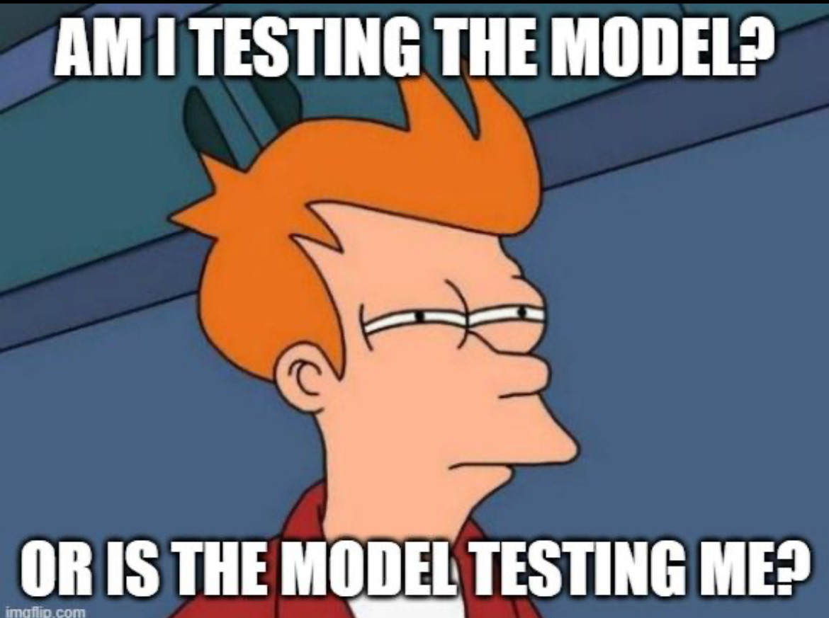
Your model/Research Questions
Just get through the class, this is not the time or place to get fancy. Don’t make extra work for yourself that won’t have value downstream
You are not ready to capitalize on the concepts to get your master’s or thesis proposal done unless you are in 2nd or 3rd year.
Find a simple paper you like or are interested in and just tweak the idea a little bit.
Use existing articles as models and templates to organize yourself.
Seep and immerse yourself in the underlying structure of the validity of an inference, that is what matters

Slide 28
Great Research Questions
Narrow, narrow your focus
Specific populations
Specific outcomes
Specific time periods
Specific domains of assessment
Can complete data collection in 4-5 years for a budget of 3 million

