Slide 1

Save the Children
Team 8

Slide 2
The Challenge
team 8
Two main objectives:
Increase revenue from sponsorship money.
Get more people fundraising for Save the Children.
Our goals:
Make sponsoring opportunities easy and enjoyable.
Make fundraising for Save the Children more fun.

Slide 3
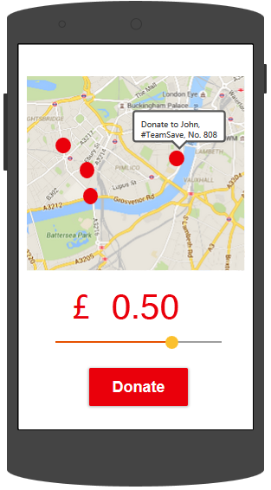
Race-Day Donations
Team 8
Participants running for Save the Children can share their location.
Spectators can look up where all the fundraisers are on the course.
Spectators can choose to donate small amounts as fundraisers run past.
Push notifications are sent to wearables, to encourage runners to keep going.

Slide 4
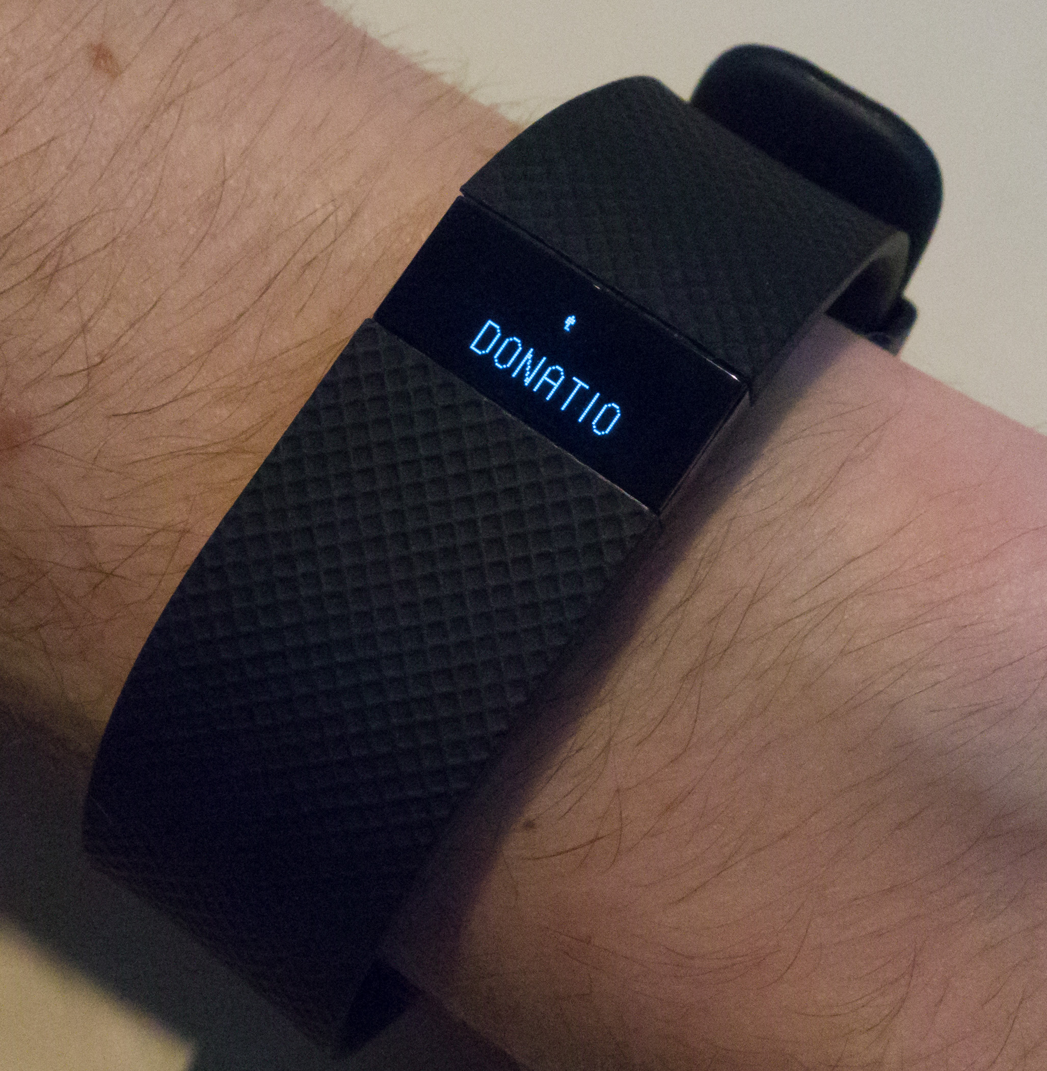
Now for a demonstration…
Team 8

Slide 5
Pre-Race Motivation
TEAM 8
Runners face long, difficult training periods.
Our app allows friends and family to see training progress, and set challenges for extra sponsorship money.
We would also allow the user to set goals for their training, and receive notifications on wearable devices when these are met.
Good interface to social media applications.

Slide 6
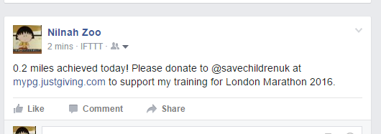

Social media integration
Team 8

