Slide 1

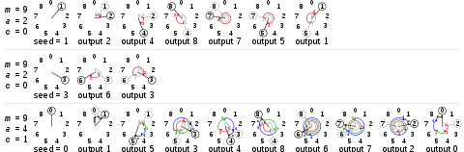
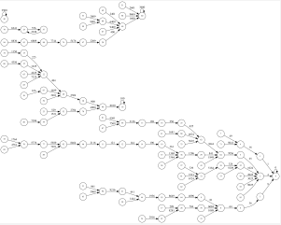
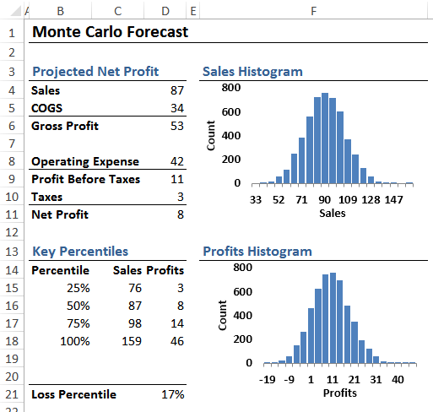
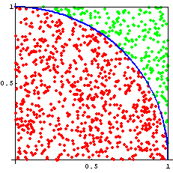
PRNG Algorithms
William Godfrey, Michael Mederos, Ian Staton and Chris Williams
Monte Carlo
Methods
Monte Carlo simulations are used to view any scenario as a system, one where you can model the probability of different outcomes in a computerized, mathematical way which allows people to account for risks and uncertainty in quantitative analysis and decision making. Since its introduction during World War II, Monte Carlo simulations have been being used to model several physical, as well as, conceptual systems. Monte Carlo simulations have found their way into use in virtually every professional field ranging from business related areas like finance, project management, and marketing to more science-oriented careers like engineering, transportation and computer science.
Middle-Square Method: Brief explanation of what it does, and what the parallelizing it should improve
Linear Congruential Generator : Brief explanation of what it does, and what the parallelizing it should improve
Threefry: Brief explanation of what it does, and what the parallelizing it should improve
Linear Congruential Generation
Middle-Square Method
Findings
The results of the testing of our methods mentioned above. Placeholder image to the left that I assume is replaced by graphs of our findings displaying the serial vs parallelized versions of each method. The graphs can focus on two main criteria for solving the MCS problems; a comparison between the speed and accuracy of the two. By increasing one, are we giving up any of the other.
MiddleSquare Serial | MiddleSquare Parallel | LCG | ThreeFry Serial | ThreeFry Parallel
Standard Deviation is 31.12 percent of the range | Standard Deviation is 32.33 percent of the range | Standard Deviation is 26.53 percent of the range | Standard Deviation is 29.59 percent of the range | Standard Deviation is 29.93 percent of the range
The minimum value is 1.46 standard deviations away from the mean | The minimum value is 1.49 standard deviations away from the mean | The minimum value is 1.91 standard deviations away from the mean | The minimum value is 2.12 standard deviations away from the mean | The minimum value is 1.82 standard deviations away from the mean
The maximum value is 1.75 standard deviations away from the mean | The maximum value is 1.60 standard deviations away from the mean | The maximum value is 1.86 standard deviations away from the mean | The maximum value is 1.25 standard deviations away from the mean | The maximum value is 1.53 standard deviations away from the mean
Monte Carlo Forecast in economics used for projecting business profits
Monte Carlo in mathematics used for evaluating the value of pi
The goal of our project is to evaluate the usefulness of various pseudo-random number generators for Monte Carlo experimentation. Many PRNGs, while useful for a wide variety of applications, are flawed in their ability to evenly distribute their results across a given range. These problems are especially exacerbated in seeded PRNGs. Many efficient and well-distributed algorithms exist, but some of these can be computationally expensive. We would like to explore how parallelization may help some less-desirable PRNG algorithms to meet the needs of Monte Carlo experimentation for a number of different problems, or how it might even hinder them further.
Conclusion and Future Work
Synopsis of the work that has been done and a brief breakdown of the our findings. Why or why not something worked while comparing serial to parallelized versions of testing.
Were the findings that we recorded expected to be seen at the end? Are we happy with the results? What could be changed for future iterations?
Space to the right is reserved for appropriate visuals we can add once this section is completed.
References
Will Kenton – https://www.incestopedia.com/terms/m/montecarlosimulation.asp
Optimization Of the Time-dependent Traveling Salesman Problem with Monte Carlo Methods
J Bentner-G Bauer-G Obermair-I Morgenstern-J Schneider –
https/://www.ncbi.nlm.nhi.gov/pubmed/115580476
Monte Carlo Simulation
Michael Asbury - https://www.nasa.gov/centers/ivv/jstar/monte_carlo.html Vol 1. 1978

