Slide 1

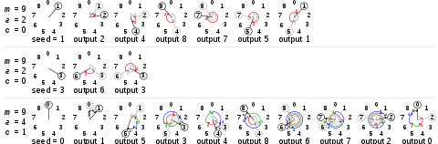
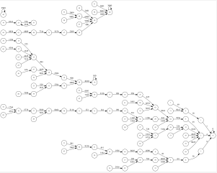
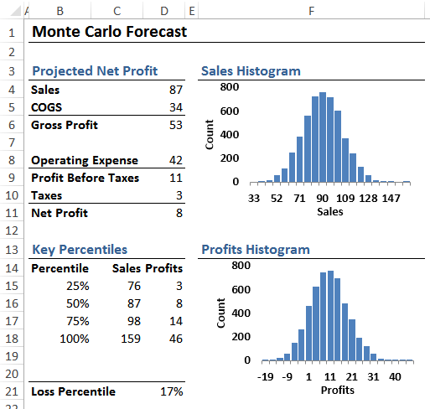
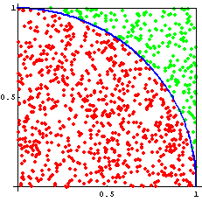
PRNG Algorithms
William Godfrey, Michael Mederos, Ian Staton and Chris Williams
Monte Carlo
Methods
Linear Congruential Generation
Monte Carlo simulations are used to view any scenario as a system, one where you can model the probability of different outcomes in a computerized, mathematical way which allows people to account for risks and uncertainty in quantitative analysis and decision making. Since its introduction during World War II, Monte Carlo simulations have been being used to model several physical, as well as, conceptual systems. Monte Carlo simulations have found their way into use in virtually every professional field ranging from business related areas like finance, project management, and marketing to more science-oriented careers like engineering, transportation and computer science.
For the purposes of our experimentation, we selected and parallelized three Pseudo-Random Number Generation algorithms with varying applications and restrictions. Our intention is to explore the benefits and drawbacks of applying parallelism to pseudo-random number generation, with focus on generating a useful series of numbers for Monte Carlo simulations. Our three methods are as follows;
Middle-Square Method: Purportedly first developed by one Brother Edvin between 1240 and 1250. No practical application in computing. Numbers are generated by squaring an evenly-digited number and then taking the middle digits of the result. Predictable, and prone to falling into small periods. Little benefit from parallelization.
Linear Congruential Generator : One of the best known PRNGs that many implementations currently in use are based off of. Method involves sequential generation by multiplying the last value given by an incrementing value, and performing a modulus operation. Generally improves through parallelization, but primarily through scheduling the overall task to different nodes, rather than any internal parallelization.
Threefry: Threefry is a PRNG that is designed for parallelization. The process of generating a number involves performing a calculation on a base value that corresponds to an incrementing value which can be tracked globally. Parallelizing simply involves incrementing this counter, since the calculations depend on the value of the counter. Threefry benefits appreciably from parallelization.
Middle-Square Method
Findings
At this stage, we have gathered results to analyze the standard deviation of numbers generated by each PRNG. While these results are by no means conclusive, they do offer some insight in to the quality of each of these PRNGs. For example, when considering the middle-square method, the minimum and maximum values are relatively close to the mean, which means that in general, the value generated by this algorithm tend to have a less even spread than, for example, LCG, which has a much greater spread.
MiddleSquare Serial | MiddleSquare Parallel | LCG | ThreeFry Serial | ThreeFry Parallel
Standard Deviation is 31.12 percent of the range | Standard Deviation is 32.33 percent of the range | Standard Deviation is 26.53 percent of the range | Standard Deviation is 29.59 percent of the range | Standard Deviation is 29.93 percent of the range
The minimum value is 1.46 standard deviations away from the mean | The minimum value is 1.49 standard deviations away from the mean | The minimum value is 1.91 standard deviations away from the mean | The minimum value is 2.12 standard deviations away from the mean | The minimum value is 1.82 standard deviations away from the mean
The maximum value is 1.75 standard deviations away from the mean | The maximum value is 1.60 standard deviations away from the mean | The maximum value is 1.86 standard deviations away from the mean | The maximum value is 1.25 standard deviations away from the mean | The maximum value is 1.53 standard deviations away from the mean
Monte Carlo Forecast in economics used for projecting business profits
Monte Carlo in mathematics used for evaluating the value of pi
The goal of our project is to evaluate the usefulness of various pseudo-random number generators for Monte Carlo experimentation. Many PRNGs, while useful for a wide variety of applications, are flawed in their ability to evenly distribute their results across a given range. These problems are especially exacerbated in seeded PRNGs. Many efficient and well-distributed algorithms exist, but some of these can be computationally expensive. We would like to explore how parallelization may help some less-desirable PRNG algorithms to meet the needs of Monte Carlo experimentation for a number of different problems, or how it might even hinder them further.
Conclusion and Future Work
Much of our work in this project up to this point has been correctly implementing our PRNG algorithms and establishing our guidelines for testing their usefulness. In the process of attempting to parallelize these PRNGs, we have found that since many of these algorithms employ sequential generation, truly ‘parallelizing’ these calculations is less possible, in favor of giving each process a seed based off of the user-provided seed.
Our next steps will be to run a full suite of tests for each of these algorithms for timing and accuracy based off of the Monte Carlo algorithms we have selected.
References
Will Kenton – https://www.incestopedia.com/terms/m/montecarlosimulation.asp
Optimization Of the Time-dependent Traveling Salesman Problem with Monte Carlo Methods
J Bentner-G Bauer-G Obermair-I Morgenstern-J Schneider –
https/://www.ncbi.nlm.nhi.gov/pubmed/115580476
Monte Carlo Simulation
Michael Asbury - https://www.nasa.gov/centers/ivv/jstar/monte_carlo.html Vol 1. 1978
Middle Square Method: https://en.wikipedia.org/wiki/Middle-square_method

