Slide 1
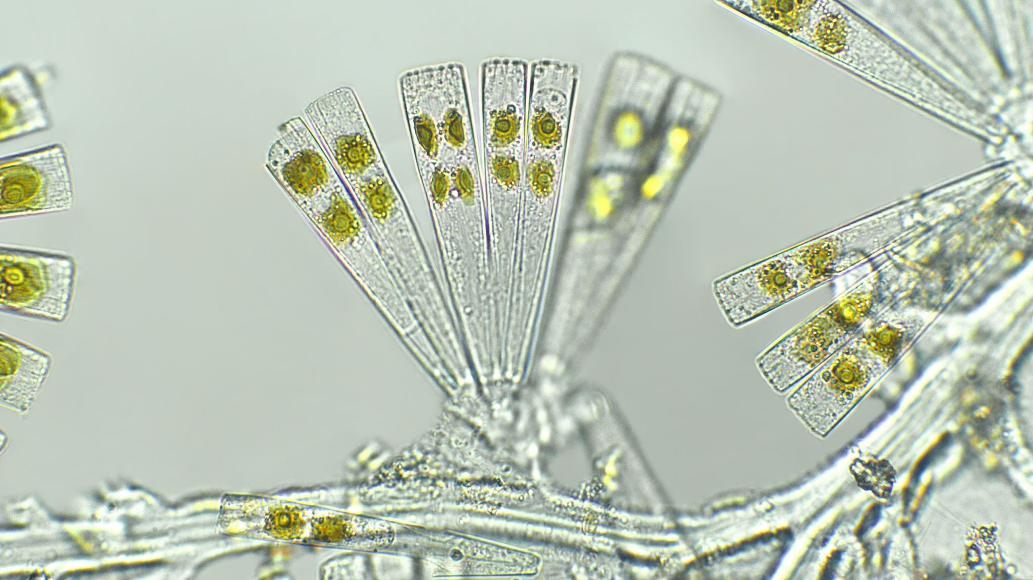
Lake Metabolism

Slide 2
NEP = GPP - R
0.15 mg/L O₂ = GPP – 0.08 mg/L O₂
0.15 + 0.08 mg/L O₂ = GPP
0.23 mg/L O₂ = GPP

Slide 3
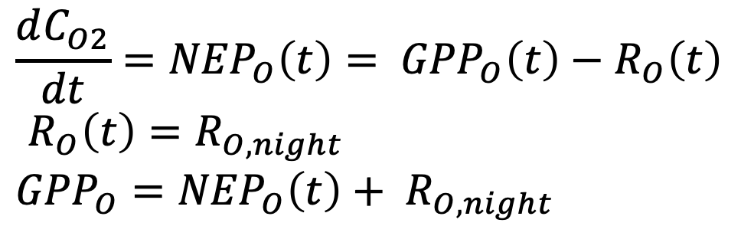
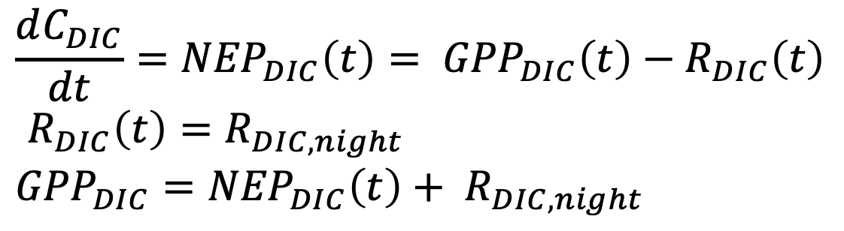
Diel Gas approaches (book keeping)
$$\frac{dC_{O2}}{dt}={NEP}_{O}\left(t\right)= {GPP}_{O}\left(t\right)−R_{O}\left(t\right)$$
$R_{O}\left(t\right)=R_{O,night}$
$${GPP}_{O}={NEP}_{O}\left(t\right)+ R_{O,night}$$
High frequency Oxygen Data
$$\frac{dC_{DIC}}{dt}={NEP}_{DIC}\left(t\right)= {GPP}_{DIC}\left(t\right)−R_{DIC}\left(t\right)$$
$R_{DIC}\left(t\right)=R_{DIC,night}$
$${GPP}_{DIC}={NEP}_{DIC}\left(t\right)+ R_{DIC,night}$$
High frequency Carbon Data

Slide 4
But…we aren’t measuring O₂ or DIC
Estimate DIC from: pH, alkalinity, and temperature
AquaEnv: an Aquatic modelling Environment in R integrated development toolbox for aquatic chemical model generation focused (ocean) acidification and CO2 air-water exchange
CAUTION: Potential for high error in DIC estimated from pH and Alkalinity (see Golub et al. 2017)

Slide 5
Relevant Citations
Staehr, P. A., Bade, D., Van de Bogert, M. C., Koch, G. R., Williamson, C., Hanson, P., ... & Kratz, T. (2010). Lake metabolism and the diel oxygen technique: state of the science. Limnology and Oceanography: Methods, 8(11), 628-644.
Peeters, F., Atamanchuk, D., Tengberg, A., Encinas-Fernández, J., & Hofmann, H. (2016). Lake metabolism: Comparison of lake metabolic rates estimated from a diel CO2-and the common diel O2-technique. PloS one, 11(12), e0168393.
Golub, M., Desai, A. R., McKinley, G. A., Remucal, C. K., & Stanley, E. H. (2017). Large uncertainty in estimating pCO2 from carbonate equilibria in lakes. Journal of Geophysical Research: Biogeosciences, 122(11), 2909-2924.

Slide 6
Analyze Sensor Data
https://github.com/CFL-UWMadison/ASW

