Slide 1
Higgs Production
final report
Group 7
106022219 Wen Chieh Wu
106022231 Hsin Yu Wu
2021/06/16
Notes:
We are group 7 and today's topic is our final presentation of this course. Our topic is ML on higgs production. I'm 吳芯瑀 and my group member is wjj.

Slide 2

Outline
Recap
Model architecture
Results
Summary
Reference
Notes:
first, I'll review on our preliminary report. It will shows physics and data structure. And next is model architecture and results, we try DNN and decision tree in this case. We will take focus on decision tree model. Finally, it is the summary and reference.

Slide 3
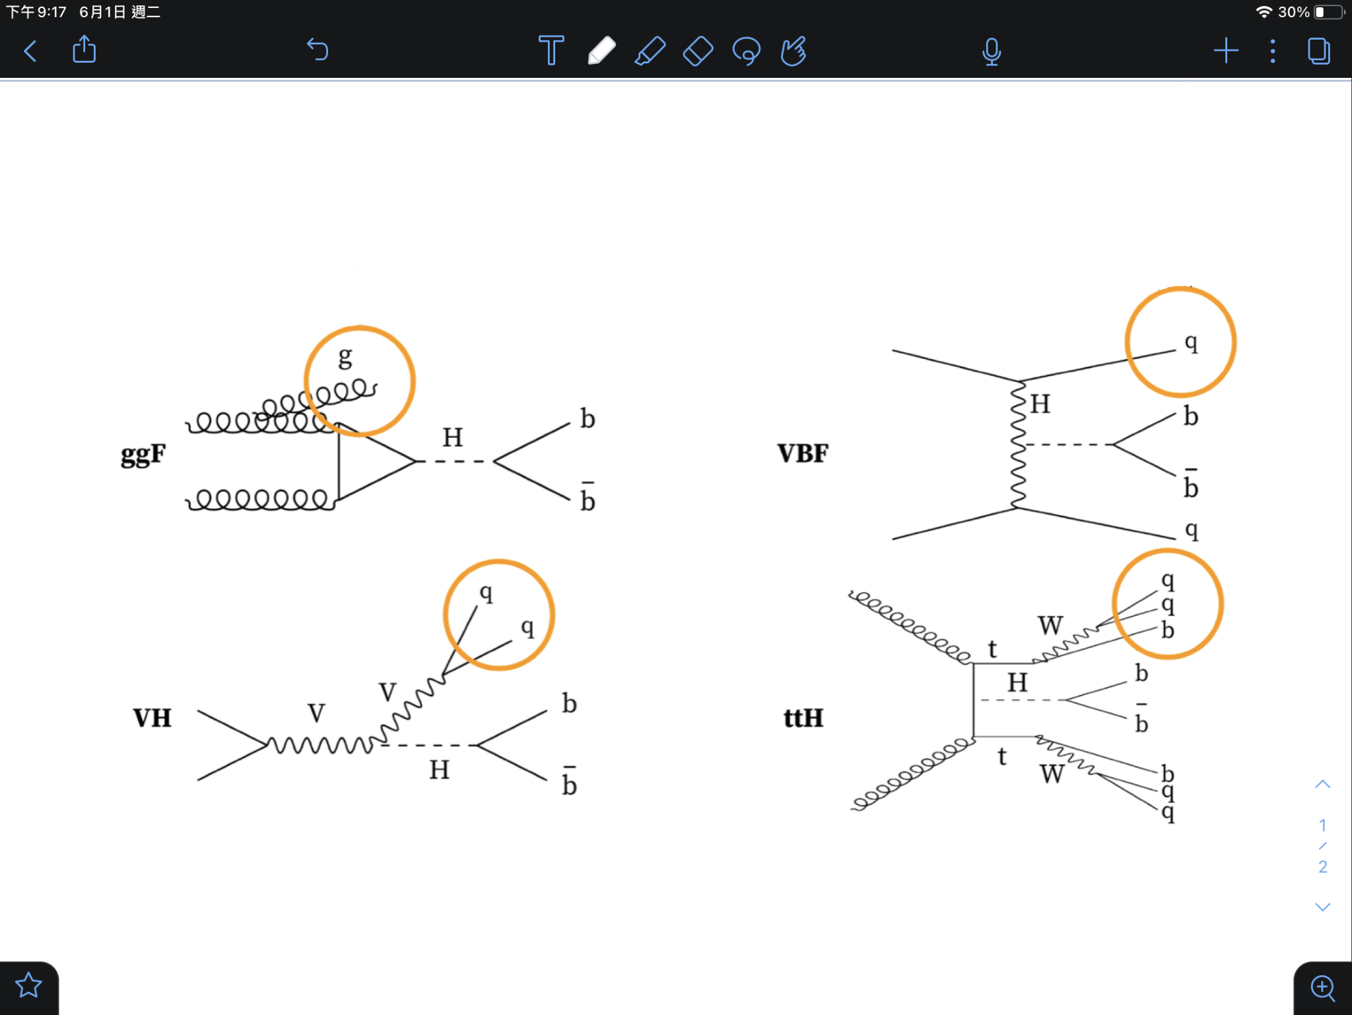
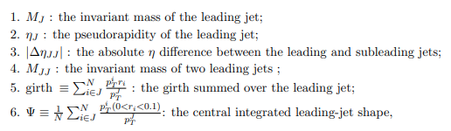
Recap
Physics and data
Four decay mode
Data Structure:
High Level Features
Low Level Features
Jet Images
Purpose: To classify each of them.
arXiv:2009.05930
Notes:
Start from physics behind the data, we can see that they are produce from 4 different modes, as figures show. Since it was discovered, we have to find the technique to distinguish them.
If gg → H could be clearly separated from the other Higgs production modes, the sensitivity to BSM would be enhanced.
We have three major groups of data which are Low Level Features,High Level Features and jet image.
We take focus on High level features to train the model.
High level features include invariant mass of leading jet, non-leading jet and two leading jet, the pseudorapidity, eta difference,
pseudorapidity: Describe the direction of particle motion, and the angle of the incident particle beam
(BsM)
The low level feature is a more primitive physical quantity that contains the momentum, the direction of particle motion (the angle with the incident particle beam)
Then the high level feature is obtained by taking the low level feature and doing the calculation.
The third part of data is leading non-Higgs jet images. Images show the eta and phi of jets.

Slide 4
Data architecture
DNN
structure | 6 hidden layer with 256, 128, 64, 32, 16, 8 nodes; activation function: ReLU activation function of output layer: softmax
optimizer | adam
loss function | cross entropy
batchsize | 512
epoch | 50
Notes:
In DNN model part, we use all high level features to train the model. The first hidden layer consists of 256 nodes and decrease in follow up layers. Activation function of six hidden layer is ReLU. Our optimizer is adam and loss function is cross entropy.
softmax: multi-classification

Slide 5
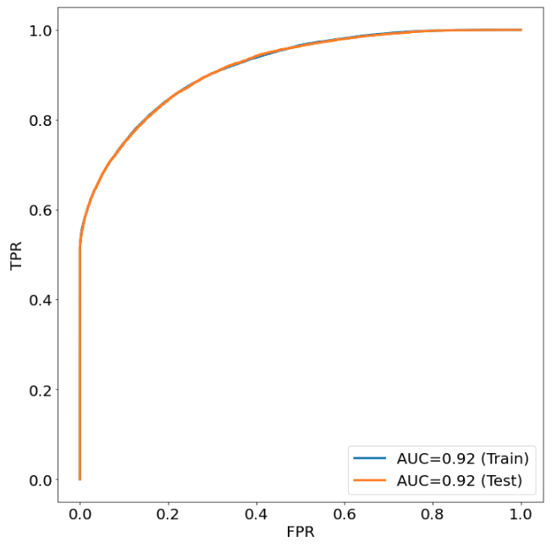
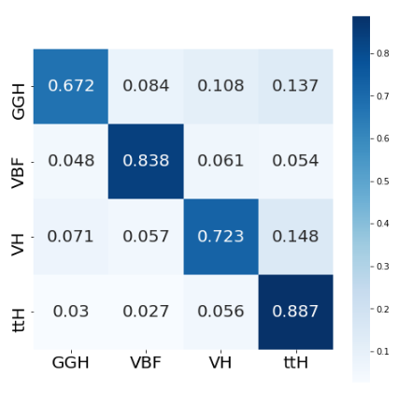
Results
DNN
ROC curve
Confusion matrix
Test accuracy: 0.7801
Notes:
Here is our result.
We made the ROC curve and confusion matrix. It is useful to present the effectiveness of the methods using the ROC curves. Our AUC value is 0.92. See the figure right hand side, the horizontal axis is real label and vertical axis is prediction. We can see VBF, VH, ttH have better results while GGH only get 0.672. Besides, our total test accuracy is 0.78. Since we don't so much about the model, we just try different function and get this the best result. it still has to be improved.
Next part 鄔玟潔 will show the detail of the decision tree and get the summary.

Slide 6

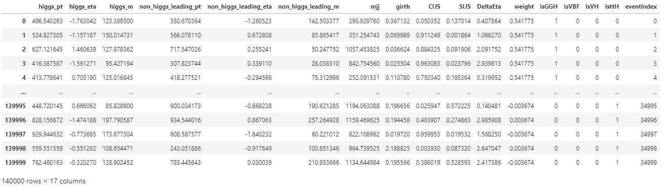
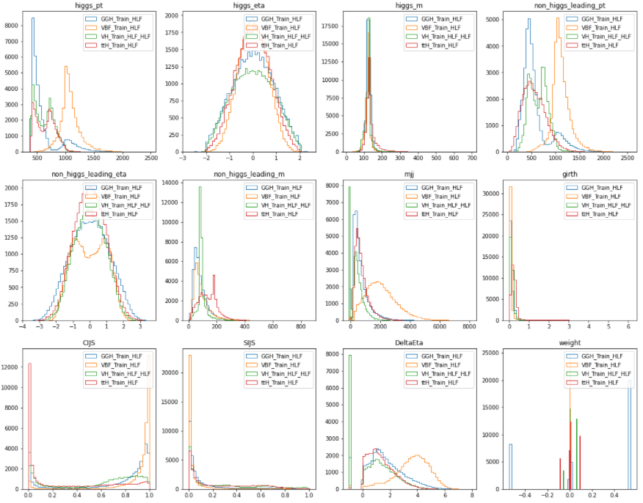
Feature exploration
high level features data
Notes:
In the last report, we mentioned that :
We can observe that the distribution range of same features which can be distinguished into different categories
so maybe we can use decision tree to identify each production modes

Slide 7
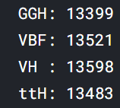
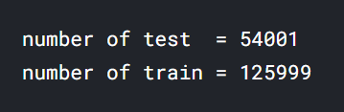
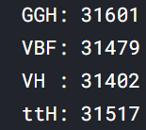
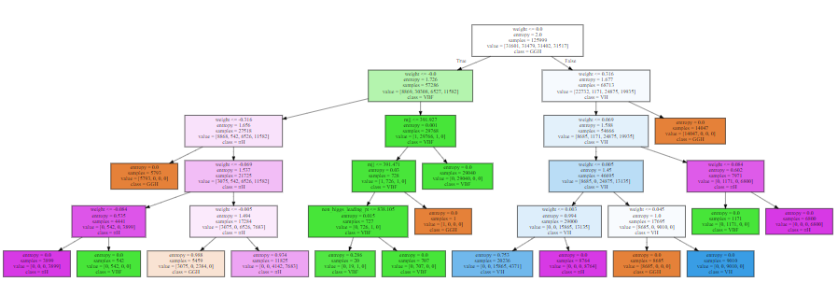
Decision tree
High level feature
Notes:
so now,
我們在paper中發現有使用類似決策樹的改良版,課堂上也曾教過決策樹，因此我們一開始先從最簡單的版本開始
Base on we found a modified version of a similar decision tree in the paper, and we have also taught a simple version of the decision tree in class. So we start with the simplest version at first.
決策樹的優點
決策樹在資料探勘領域中，是非常受歡迎的一種分類方法，原因是其可用簡單規則將欲分析的資料進行分類，而且不需要經過龐大的運算
Decision trees are a very popular classification method in the field of data exploration because they can classify the data to be analyzed by simple rules and do not require extensive computation.
適合用在哪裡
But When there are too many categories to be analyzed, the error rate may increase significantly.
Before deciding to use a decision tree,we need to evaluate our own data
can’t have too many label ,and also Sample distribution should be balanced
在資料處理方面，我們重新將test data 和 train data 混合後，重新以3:7的比例分配
並且檢查分配後的資料中,所有label是足夠均勻的
In terms of data processing, we re-mixed the test data and train data and re-allocated them in a ratio of 3 to 7.
And check that all labels are uniform enough in both test data and train data.

Slide 8
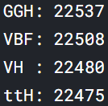

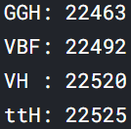
High level feature
Notes:
so now,
我們在paper中發現有使用類似決策樹的改良版,課堂上也曾教過決策樹，因此我們一開始先從最簡單的版本開始
Base on we found a modified version of a similar decision tree in the paper, and we have also taught a simple version of the decision tree in class. So we start with the simplest version at first.
決策樹的優點
決策樹在資料探勘領域中，是非常受歡迎的一種分類方法，原因是其可用簡單規則將欲分析的資料進行分類，而且不需要經過龐大的運算Decision trees are a very popular classification method in the field of data exploration because they can classify the data to be analyzed by simple rules and do not require extensive computation.
適合用在哪裡
But When there are too many categories to be analyzed, the error rate may increase significantly.
Before deciding to use a decision tree,we need to evaluate our own data
can’t have too many label ,and also Sample distribution should be balanced
在資料處理方面，我們重新將test data 和 train data 混合後，重新以3:7的比例分配
並且檢查分配後的資料中,所有label是足夠均勻的
In terms of data processing, we re-mixed the test data and train data and re-allocated them in a ratio of 3 to 7.
And check that all labels are uniform enough in both test data and train data.

Slide 9
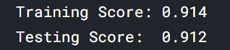
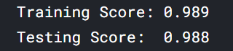

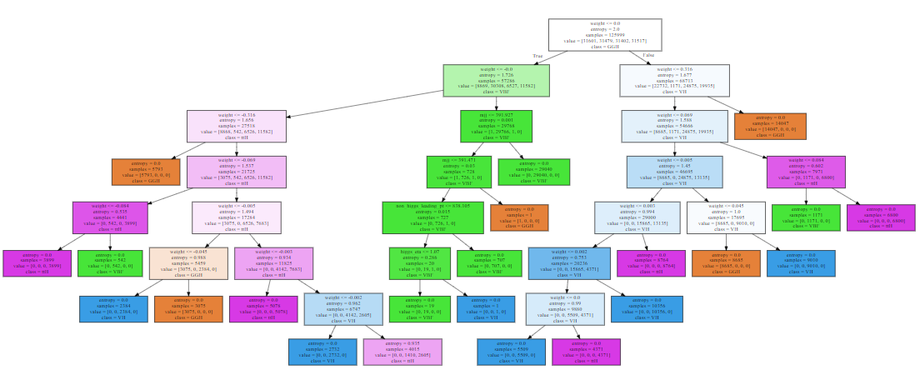
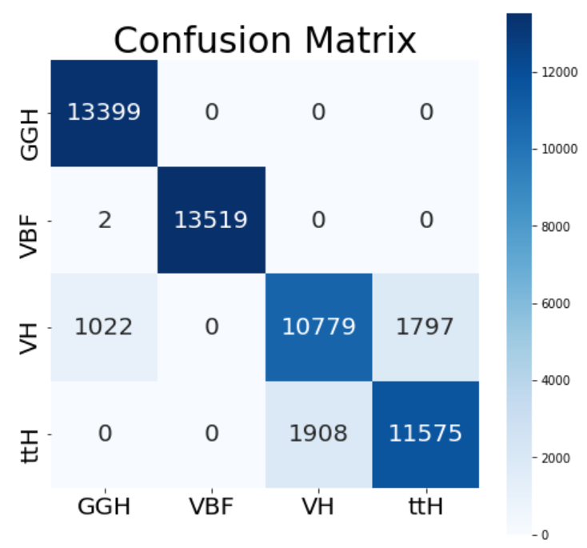
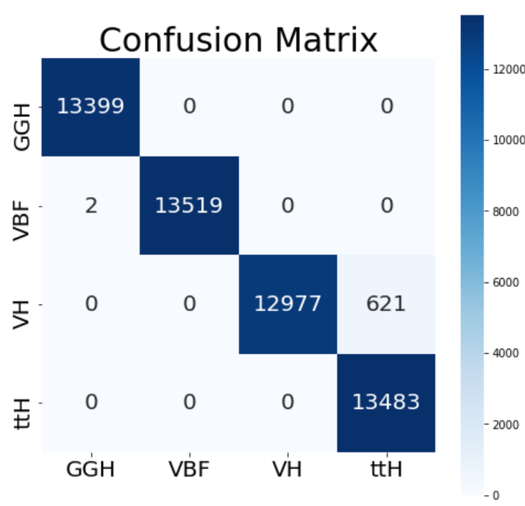
Decision tree
Notes:
我們發現當決策樹的層樹到達7~9層時，其準確度就已經非常高,可以到98%
除了將VH 誤判為ttH
整體而言 看起來似乎有很好的分類功能
We found that the accuracy of the decision tree is already very high when it reaches 5 levels, which can reach 91%.
Except for misclassifying VH as ttH, it seems to have a good classification function overall.

Slide 10
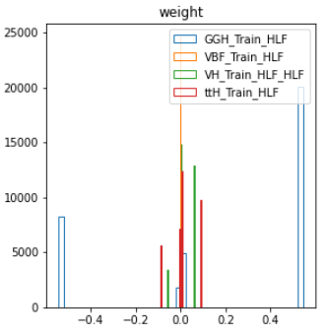


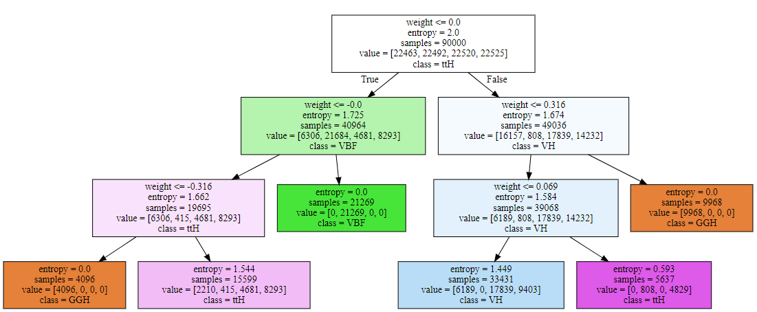
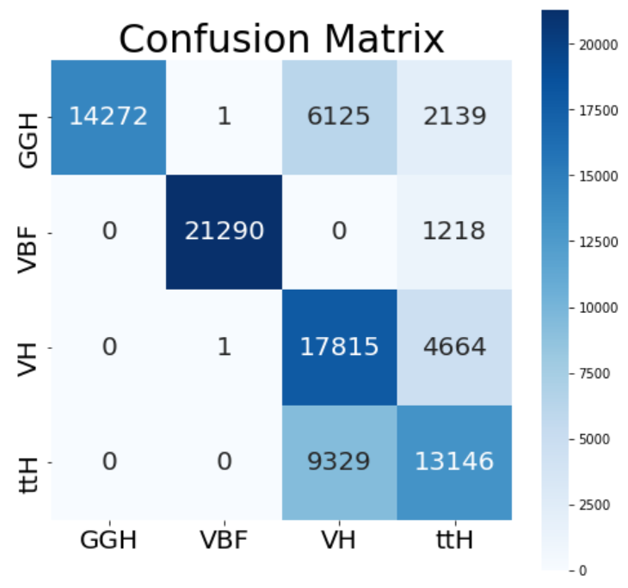
max_depth = 7
Decision tree
max_depth = 3
weight
weight
weight
weight
weight
Notes:
這次我們重新把數據 test,train 對半分
因為想看看再train的data數量沒那麼多時，會不會造成精確度快速下降
此時如果層樹還是7層,準確度依然在90%以上
This time, we re-divided the data test and train in half.
Because we want to see if the number of data in the train is not so much,whether it will cause a rapid decrease in accuracy or not
At this time, if the layer tree is still 7 layers, the accuracy will still above 90%.
而且即使決策樹只有3層，也已經讓準確度達到73%
And even though the decision tree has only 3 levels, it is already 73% accurate.
從混淆矩陣中，我們可以看到誤判出現在:
把GGH ,VBF 看成 VH (綠) 把GGH ,VBF, VH 看成ttH (紅)
From the confusion matrix, we can see that the misjudgment appears in:
We will see GGH ,VBF as VH (which Circle with a green line)
We will see GGH ,VBF, VH as ttH (which Circle with a red line)
從三層決策樹中 可以發現 她只考慮了一個feature (weight)
From the three-level decision tree, we can find that it only considers one feature (which is weight)
indeed,We can see that cause its difficulty in judging VH and ttH
because the distribution of weight for two label is interlaced in the middle.

Slide 11
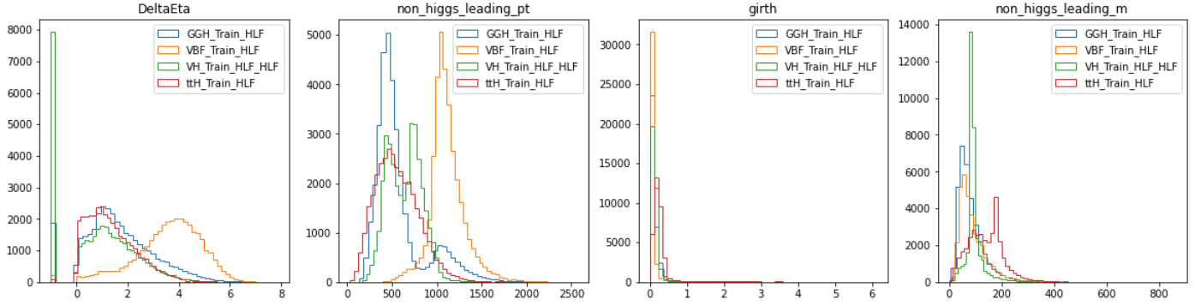
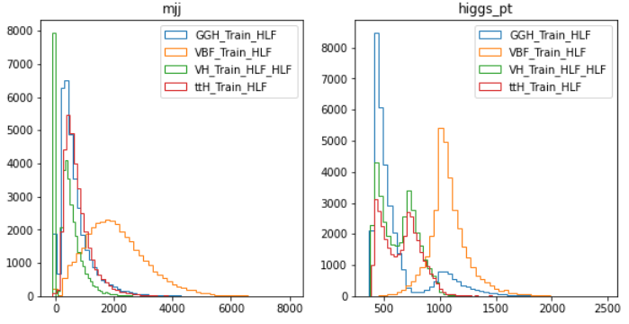

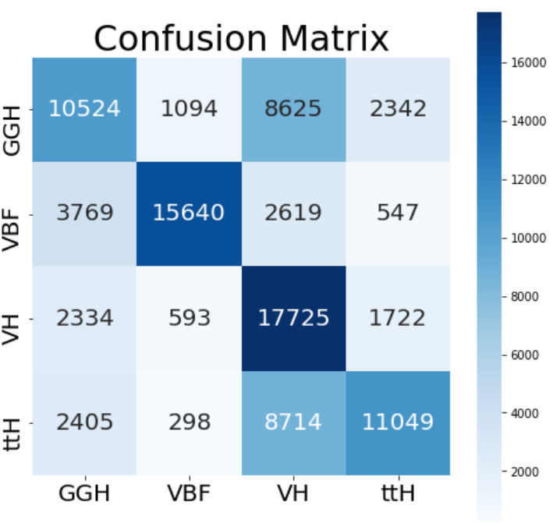
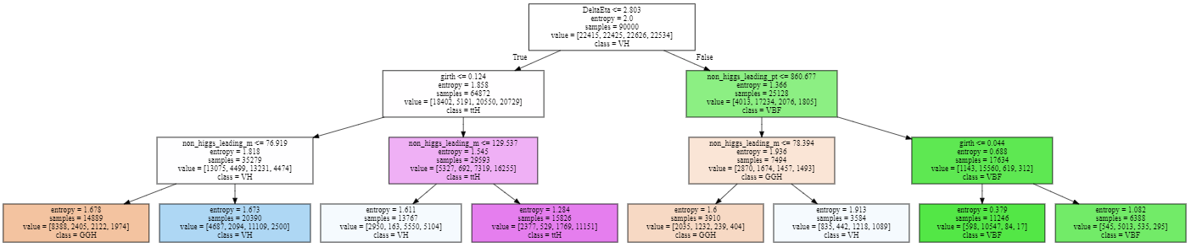
Decision tree
max_depth = 3
DeltaEta
girth
non higg leading pt
non higg leading m
girth
non higg leading m
non higg leading m
Notes:
在一樣是將test,train資料對分的情況下
現在我們在把weight拿掉
可以發現同樣是三層,決策樹的準確度降低了
但也可以觀察到除了weight 之外,還有哪些feature可以有效的降低data的entropy
In the same case of splitting test and train data
Now we take away the weight
We can find that the accuracy of the decision tree is reduced for the same three levels.
However, we can also observe what other features can effectively reduce the entropy of data besides weight
在這裡我們可以發現'DeltaEta' , 'non_higgs_leading_pt' , 'girth' , 'non_higgs_leading_m',被優先選取以區分資料
當我們再將決策樹多增加一層時，則會多出'mjj' , 'higgs_pt'
Here we can find 'Delta Eta' , 'non_higgs_leading_pt' , 'girth' , 'non_higgs_leading_m', are selected first to differentiate the data
(點一下)When we add one more level to the decision tree, 'mjj' , 'higgs_pt' will be added.
這些feature和當初 我們觀察high level feature 時，覺得可能有用的feature 大多吻合
These features match most of the features that we thought might be useful when we first looked at high level features

Slide 12
Summary
Use High level features to train model.
Train decision tree model and DNN model.
We can get accuracy 0.91 and 0.78 on decision tree model and DNN model
Decision tree model are a way to help us categorize
We can also use its classification details to get an initial understanding of a whole set of data.
Notes:
compare with DNN model, decision tree we made get better result. (?

Slide 13
Reference
1. Chung, Y. L., Hsu, S. C., & Nachman, B. (2020). Disentangling Boosted Higgs Boson Production Modes with Machine Learning. arXiv preprint arXiv:2009.05930.
2. Becker, K., Caola, F., Massironi, A., Mistlberger, B., Monni, P. F., Chen, X., ... & Wever, C. (2020). Precise predictions for boosted Higgs production. arXiv preprint arXiv:2005.07762.
3. Lin, J., Freytsis, M., Moult, I., & Nachman, B. (2018). Boosting H→ bb with machine learning. Journal of High Energy Physics, 2018(10), 1-25.
4. eta: https://en.wikipedia.org/wiki/Pseudorapidity
5. higgs boson: https://en.wikipedia.org/wiki/Higgs_boson

Slide 14
end

Slide 15
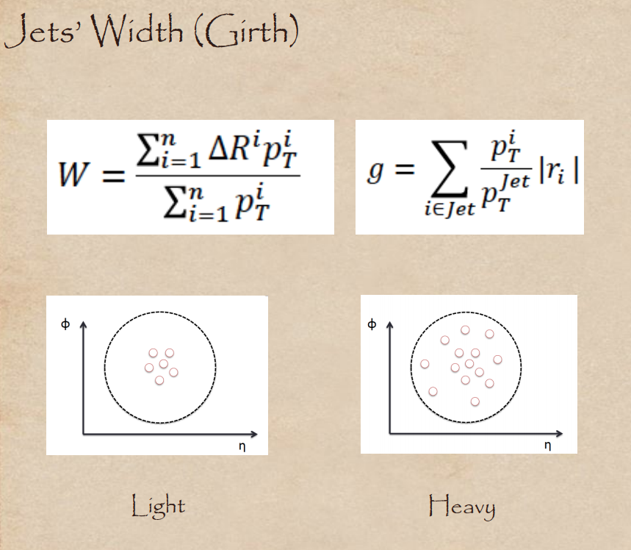
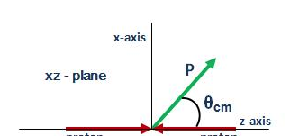
Backup
Notes:
jet shape which probes the radial distribution
η=−ln [(tan(θ /2)]
Besides, transversal momentum, pT , is calculated from transversal Energy, delivered on calorimeters.
https://indico.cern.ch/event/170556/contributions/1430595/attachments/211988/297161/pic2012_duchovni.pdf

