Slide 1

Token Taxonomy Framework (TTF)
Moving Tokens Forward
1.0

Slide 2
Introduction
What its for:
Educate – take a step back and CLEARLY define a token in non-technical and cross industry terms. Using real world, everyday analogies so ANYONE can understand them using properties and behaviors to describe and define them.
Establish a common set of terms and definitions that can be used by business and technical participants to speak the same language
Create - implementation neutral token definitions (artifacts) with clear requirements that developers can follow, and standards validate following a composition framework
Define meta-data using the TTF syntax and grammar to be able to generate visual representations of classifications, used by modelling tools to view and create token definitions mapped to the taxonomy and can also support taxonomy to implementation or source code mapping
It is NOT:
Blockchain specific
A legal framework – but a common ground
Complete or comprehensive – requires and encourages collaboration

Slide 3
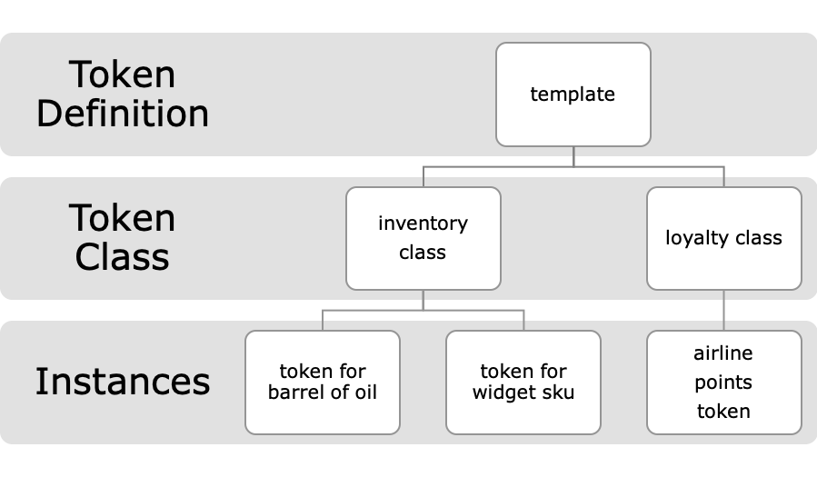
Definitions and Artifacts
The framework establishes a set of definitions for tokens like template, class and instance.
An instance belongs to a class which is created from a template
Artifacts are definitions of a token part or complete token definition, template
The framework consists of the base set of artifacts and any new artifact contributed

Slide 4

Base Token Types & Symbols
Interchangeable having the same value with other tokens of the same class
${ τ}_{Ϝ}$ - Fungible
〖 𝜏〗_Ϝ - Fungible
Physical money
Loyalty points
Different values and should not be interchangeable.
$τ_{Ν}$- Non-fungible
𝜏_Ν- Non-fungible
Property title
Art token
- Theater ticket – non-fungible base – Play name, show date + classes of non-fungible tokens for theater sections.
- Artifact group of tokens owned by other tokens and represent them as a single token.
${ τ}_{Ν}$($τ_{Ϝ}$)
${ τ}_{Ϝ}$($τ_{Ν}$) - Hybrids

Slide 5
Taxonomy – Properties, Behaviors and Controls
Tokens are comprised of properties and behaviors that are interacted with using standard control messages
All Tokens will have a common set of base token properties and a collection of non-behavior related properties
Tokens differentiate themselves based on their behaviors, which in turn create new properties that are bound to them
The Taxonomy simply defines these behaviors and the properties that make up a token. Most behaviors are already known, the taxonomy just defines them in a standard way and organizes them.
Controls are actions defined as messages that are verb-based descriptions used to invoke a behavior and represent token properties/state

Slide 6

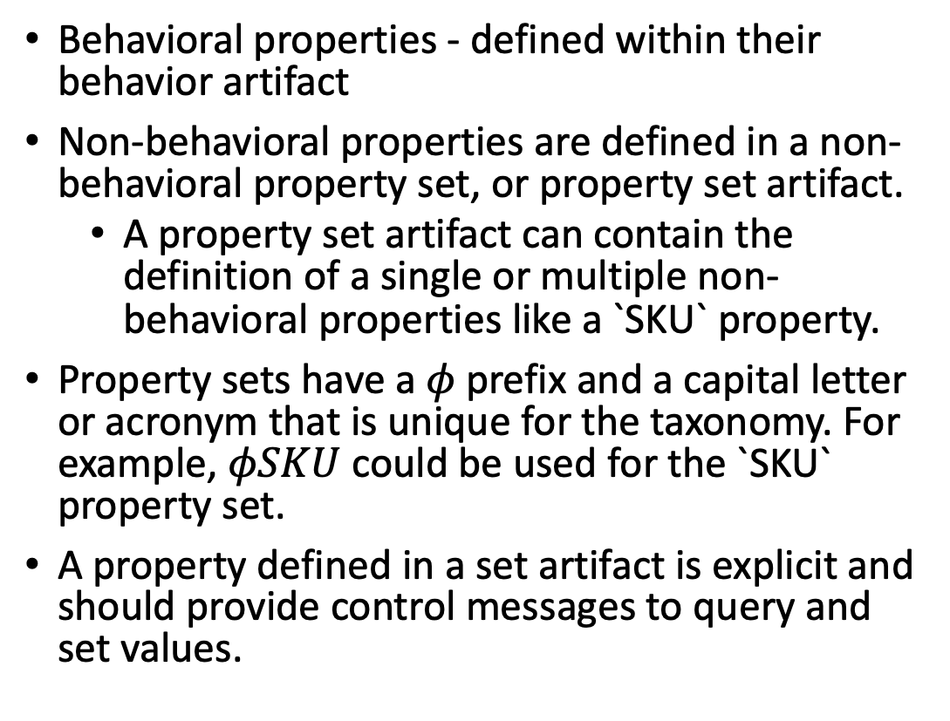
Properties
Behavioral properties - defined within their behavior artifact
Non-behavioral properties are defined in a non-behavioral property set, or property set artifact.
A property set artifact can contain the definition of a single or multiple non-behavioral properties like a `SKU` property.
Property sets have a $φ$prefix and a capital letter or acronym that is unique for the taxonomy. For example, $φSKU$ could be used for the `SKU` property set.
A property defined in a set artifact is explicit and should provide control messages to query and set values.

Slide 7
Behavior Artifact Definitions
Behavior – describes a capability or restriction. For example, a token can be capable of being subdivided, be restricted to a single owner or be non-transferable
Property – a property or data element that is bound to the token to one of its behaviors. In the above, a sub-dividable token will have a decimals property with a number representing the decimal places supported.
$ Token – Decimals = 2 ($.43 or $1.43)
Oil Token - Decimals = 0 (you cannot own a fraction)
Control - a message, usually named with a verb if it is an action that is used to invoke a behavior or a noun if it represents state. For example, a transferable token will have a TransferRequest message and a non-transferable one will not. The TransferRequest action message contains the fields/properties used in the action like From, To and Amount.
Control messages are standardized and a link to their source is a property of the definition.
TokenId:
To:
Quantity:
TransferRequest
D
TransferResponse
TokenId:
Receipt
From:
To:
Quantity Transfered
ReceiptId

Slide 8
Common Behaviors
$t$ - Transferable
𝑡 - Transferable
~t- Non-transferable
$d$ - Sub-dividable or ~$d$ - Whole
𝑑 - Sub-dividable or ~𝑑 - Whole
$m$ - Mint-able
𝑚 - Mint-able
$r$ - Role Support
𝑟 - Role Support
Restriction of preventing a change of ownership from the initial issued owner. A vote token for an election or an airline ticket are examples.
Decimal places a token can be subdivided into.
Ability to issue new tokens of the class. Creating a new property deed or adding money to the overall supply.
$b$ - Burnable
𝑏 - Burnable
$s$ - Singleton
𝑠 - Singleton
There can only be a quantity of one, where the token class represents the only instrument. Like a piece of fine art.
Ability to have roles defined within the class to allow or prevent certain actions.
Ability to remove tokens from the supply. A token representing a barrel of oil that gets burned when it is refined is a good example.
Ability to transfer ownership of the token. Basic fungible behavior when using cash money, but also applies to non-fungible tokens.

Slide 9
Taxonomy Artifacts and Groups
Once a behavior, its properties and controls are defined, they are bundled together into an Artifact
A Behavior Artifact has the following properties:
Common Name – a generic name that can clearly represent the behavior
A Symbol - should be a unique acronym, for example $nt$ is the symbol for non-transferable
A Symbol - should be a unique acronym, for example 𝑛𝑡 is the symbol for non-transferable
Behavior Groups are a collection of artifacts to form higher level artifact. These have a common name and symbol with an additive symbol group or compound symbol with links to the behaviors it includes.
Internal or External – where external is linked with a contract
$$m$$
𝑚
MintRequest
MintFrom
MintFromRequest
MintResponse
Mint
MintFromResponse
$$SC$$
𝑆𝐶
t
m
r
$$t$$
𝑡
TransferRequest
TransferFrom
TransferFromRequest
TransferResponse
Transfer
TransferFromResponse
$$r$$
𝑟
TransferRequest
RemoveRoleMemeber
RemoveRoleMemeberFromRequest
AddRoleMemeberResponse
AddRoleMemeber
TRemoveRoleMemeberFromResponse

Slide 10
Tokens
Tokens are then classified using the taxonomy artifacts (base, artifacts and groups) that define a whole token.
Some behaviors only apply to a token's class, like delegable (g) and can influence behaviors added to the definition of the token like transfer and burn.
A Token is like an artifact group, except a Token is considered a complete template, ready to implement.
Token Templates can represent a branch on a tree and have the following properties:
Common name – a generic name that is easily understood and best if a real-world name is used. I.e. Ticket, Receipt, Title, Coin, License, etc.
Compound formula of symbols for its base type, behaviors, behavior-groups and property-sets.
Descriptions, aliases, analogies, business use cases and interaction diagrams, etc.
Node or Leaves – a more specific, usually a vertical industry token definition of this type. i.e. a Concert Ticket, Theme Park Ticket and Movie Ticket would be nodes on the same branch, but an airline ticket would be on a different one.
Nodes on the same branch differ primarily on the property-sets they add to the branch definition.

Slide 11
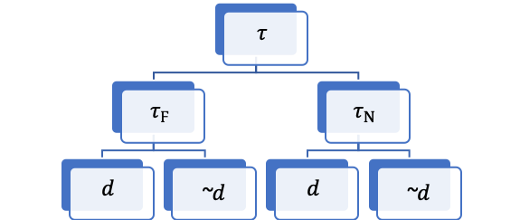
Classification and Hierarchy
Tokens begin at a common root named Base - $τ$
Tokens begin at a common root named Base - 𝜏
Base has 2 initial branches: Fungible ${ τ}_{Ϝ}$ and Non-Fungible $τ_{Ν}$. More top-level branches can be added
Base has 2 initial branches: Fungible 〖 𝜏〗_Ϝ and Non-Fungible 𝜏_Ν. More top-level branches can be added
A new branch is created from a parent branch when it is added but does not represent a complete token. For example, non-transferable would represent a branch on non-fungible, but would not be a branch on fungible.
Some artifacts and artifact groups can apply to both Fungible and Non-Fungible branches, like Transferable. These are represented as branches on each of these branches with a dotted line to the branch or some other visual indicator that it is not a duplicate and can provide navigation to its other location(s).

Slide 12
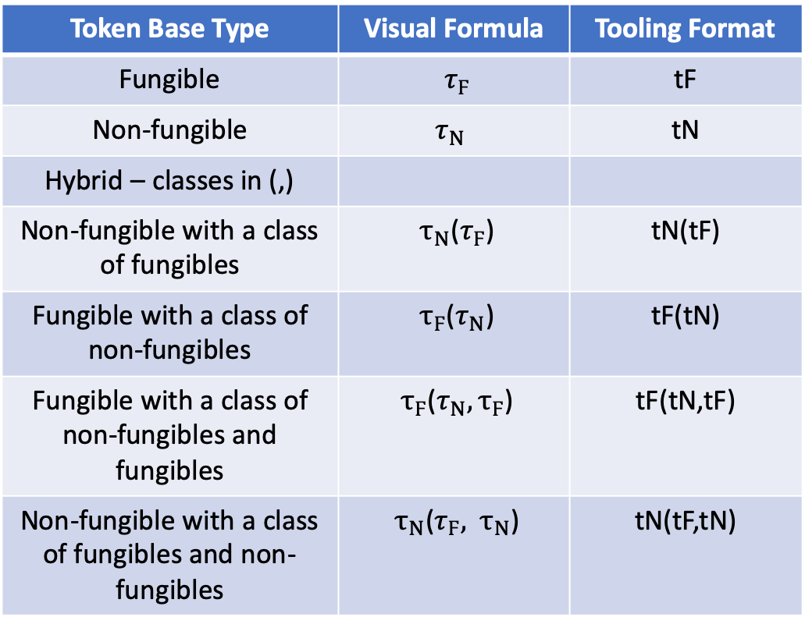
Taxonomy Grammar
Token Base Type | Visual Formula | Tooling Format
Fungible | ${ τ}_{Ϝ}$ | tF
Non-fungible | $$τ_{Ν}$$ | tN
Hybrid – classes in (,)
Non-fungible with a class of fungibles | ${ τ}_{Ν}$($τ_{Ϝ}$) | tN(tF)
Fungible with a class of non-fungibles | ${ τ}_{Ϝ}$($τ_{Ν}$) | tF(tN)
Fungible with a class of non-fungibles and fungibles | ${ τ}_{Ϝ}$($τ_{Ν},τ_{Ϝ}$) | tF(tN,tF)
Non-fungible with a class of fungibles and non-fungibles | ${ τ}_{Ν}$($τ_{Ϝ},$ ${ τ}_{Ν}$) | tN(tF,tN)
Grammar defines how to construct a token or behavior group formula that is recorded as metadata in the artifact for the respective token, behavior or group.
The grammar has a visual representation and one for tooling that does not include presentation characters for italics, Greek, super or subscript, etc.
Token definitions start with the token base type followed by the behaviors and if needed wrapped by non-behavioral property sets.

Slide 13
Taxonomy Grammar
Behavior: single italic lower-case letter or letters that are unique
Behavior Group: upper-case letter or letters that are unique with behavior formula encased in {,} Supply Control: SC{m,b,r}
Whole Token Formulas start with the base token type, followed by a collection of behaviors and groups in {,}
Property Sets used to create a node or leaf from a base formula are added by [] the formula and + the set(s) using braces if there a multiple sets required.
$Vote$ = $τ_{Ν}\{\sim t, S\}$ (Non-fungible: non-transferable & suspendable) (implicit ~d)
𝑉𝑜𝑡𝑒 = 𝜏_Ν {~𝑡, 𝑆} (Non-fungible: non-transferable & suspendable) (implicit ~d)
$Theater Ticket$ = $τ_{Ν}(τ_{Ϝ})\{e,t\}$ (Hybrid: expire-able & transferable)
𝑇ℎ𝑒𝑎𝑡𝑒𝑟 𝑇𝑖𝑐𝑘𝑒𝑡 = 𝜏_Ν (𝜏_Ϝ){𝑒,𝑡} (Hybrid: expire-able & transferable)
$Physical Cash =$ $τ_{Ϝ}\{d,SC\}$ (Fungible: sub-dividable & Supply Control)
𝑃ℎ𝑦𝑠𝑖𝑐𝑎𝑙 𝐶𝑎𝑠ℎ = 𝜏_Ϝ {𝑑,𝑆𝐶} (Fungible: sub-dividable & Supply Control)
$Barrel of Oil$ = $τ_{Ϝ}\{$~d,$g, SC\}$ (Fungible: whole, delegable & Supply Control)
𝐵𝑎𝑟𝑟𝑒𝑙 𝑜𝑓 𝑂𝑖𝑙 = 𝜏_Ϝ {~d,𝑔, 𝑆𝐶} (Fungible: whole, delegable & Supply Control)
$Inventory Item$ = [$τ_{Ϝ}${~d$,g, SC\}+φSKU]$ (Fungible: whole, delegable & Supply Control and a SKU property)
Inventory Item = [𝜏_Ϝ{~d,𝑔, 𝑆𝐶}+𝜙𝑆𝐾𝑈] (Fungible: whole, delegable & Supply Control and a SKU property)
Tokens

Slide 14
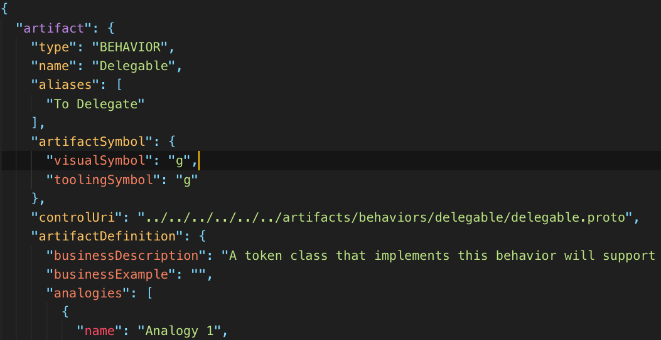
Taxonomy Artifacts
Written in common language so anyone can understand the artifact description and what it does.
Metadata for: (hidden from users)
Tokens
Behavior
Behavior Groups
Property Sets
Artifact Files are place in the same folder under the artifact type and contains:
HTML Primary Definition and metadata
Proto File (optional, needed for behaviors)
Markdown to host supporting information like sequence diagrams, etc.
Artifacts are primarily defined using the same file format comprised of common language formatted in HTML with taxonomy metadata.
Additional files can also be used to improve the quality of the artifact definition.

Slide 15
Artifact Hierarchical File Structure
Taxonomy Framework Repo stores artifacts in folder structures by base type, behaviors, behavior-groups, property-sets and tokens.
artifacts
base
fungible
non-fungible
behaviors
mintable
behavior-groups
token-templates
burnable
...
supply-control
...
LogToken
property-sets
SKU
...

Slide 16
Contract Interfaces
Network A
Loan Contract
financeable
A Taxonomy Definition represents the token messaging interface and contains the taxonomy identifiers for its root and the standard behavior artifacts and groups it has as well as a collection of custom behaviors.
Tokens provide implementation specific responses to standard definition requests
External Behaviors provide standard contract interfaces across platforms and consortiums
Property
Title
Network B

Slide 17




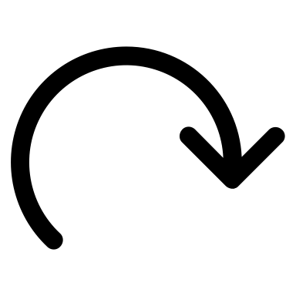
Workshop Process
Describe Token Business and Function
A la Carte behaviors and groups
Missing a behavior or Group?
Complete taxonomy formula definition
Submit Pull Request
Select a Token Base Type
TTF
no
Y
Create New Artifact
Y

Slide 18
Tooling with Artifacts and Metadata
behaviors
mint
Ethereum
Fabric
burn
…
Open Zeppelin
Chaincode Source
Corda
Kotlin Source
DAML
DAML Source
Artifact metadata can be mapped to implementation types
Map to source code
Map to implementation
Map for taxonomy behavior or property-set to platform specific code. (Solidity, Chaincode, Kotlin, DAML)
Map for taxonomy token definition to specific implementation. (complete open source, commercial solution, etc.)
token-templates
tF{~d,SC}
Ethereum
Fabric
[tN{~d,s}]+phM
…
Open Zeppelin
IBM Product
Corda
3rd Party Solution
DAML
Packaged Solution

Slide 19

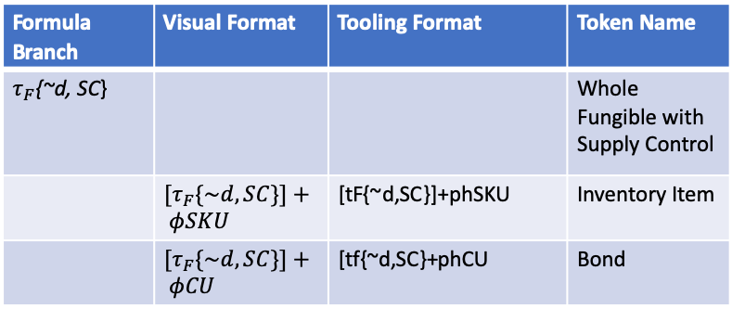
Token Node/Leaf & Implementation Maps
Formula Branch | Visual Format | Tooling Format | Token Name
$τ_{F}${~d, SC} |  |  | Whole Fungible with Supply Control
 | ${[τ}_{F}\{\sim d,SC\}]+ φSKU$ | [tF{~d,SC}]+phSKU | Inventory Item
 | ${[τ}_{F}\{\sim d,SC\}]+ φCU$ | [tf{~d,SC}+phCU | Bond
A Token Node or Leaf represents an end-point or destination in classification hierarchy.
A generic taxonomy formula can represent a node or a branch. It becomes a branch if there are nodes with the same formula but with added non-behavior property sets. For example, you can have multiple $τ_{F}${~d, SC} or Whole Fungible Token with Supply Control type of tokens like an Inventory Item or a Bond. Where the the Inventory Item has a property-set added for a SKU and the Bond adds the CUSIP set.
Nodes from a branch surround the base formula with [] and + $φSKU$ or phSKU.
When using multiple property sets, they should be placed in (,).
and can then have implementation maps.
Implementation Map have the following properties:
Supported Blockchain/Ledger Platform(s): i.e. TTI 2.0, Ethereum or Hyperledger Fabric or Corda, etc.
Standard Name
Description
Certifications and Reviews
Link to technical implementation – GitHub, marketplace, etc.

Slide 20
Classification Hierarchy Example
base $τ$
base 𝜏
fungible $τ_{Ϝ}$
fungible 𝜏_Ϝ
non-fungible $τ_{Ν}$
non-fungible 𝜏_Ν
fixed quantity
whole ~d
sub-dividable $d$
sub-dividable 𝑑
variable quantity
variable quantity
fixed quantity
SKU
Stock
Bond
ICO
Fiat Currency
Loyalty
sub-dividable $d$
sub-dividable 𝑑
whole ~d
non-transferable
singleton
vote
composites
transferable
deed
title

Slide 21
Example – Fungible with Supply Control
Hierarchy | Design | Behaviors
$$τ_{Ϝ}\{\sim d,SC\}$$
𝜏_Ϝ {~𝑑,𝑆𝐶}
OwnerId: Name: Symbol:
Quantity:
Decimals:
~d
Decimals: 0
$$SC$$
𝑆𝐶
$$m$$
𝑚
$$b$$
𝑏
$$τ$$
𝜏
$$r$$
𝑟
$SC$ - Supply Control
𝑆𝐶 - Supply Control
$F$ - Financeable
𝐹 - Financeable
$C$ – Custodial
𝐶 – Custodial
$SW$ - Swappable
𝑆𝑊 - Swappable
$$τ$$
𝜏
$$τ_{Ϝ}$$
𝜏_Ϝ
$$d$$
𝑑
~$d$
~𝑑
$$τ_{Ν}$$
𝜏_Ν
$$d$$
𝑑
~$d$
~𝑑
Behavior
Groups
$t$ - Transferable
𝑡 - Transferable
~t - Non-transferable
$d$ - Sub-dividable
𝑑 - Sub-dividable
$s$ - Singleton
𝑠 - Singleton
$m$ - Mint-able
𝑚 - Mint-able
$r$ - Role Support
𝑟 - Role Support
$b$ - Burnable
𝑏 - Burnable
Behaviors

Slide 22
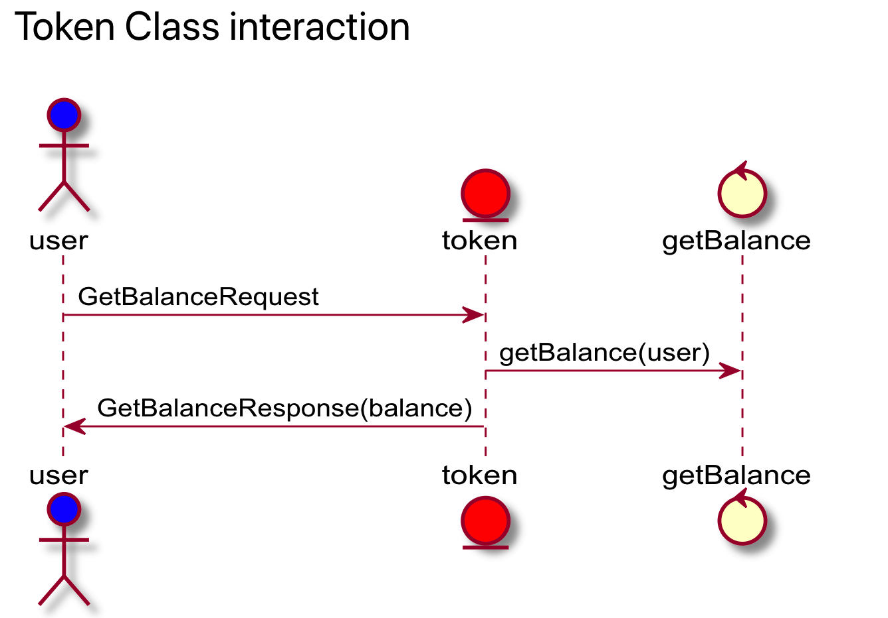
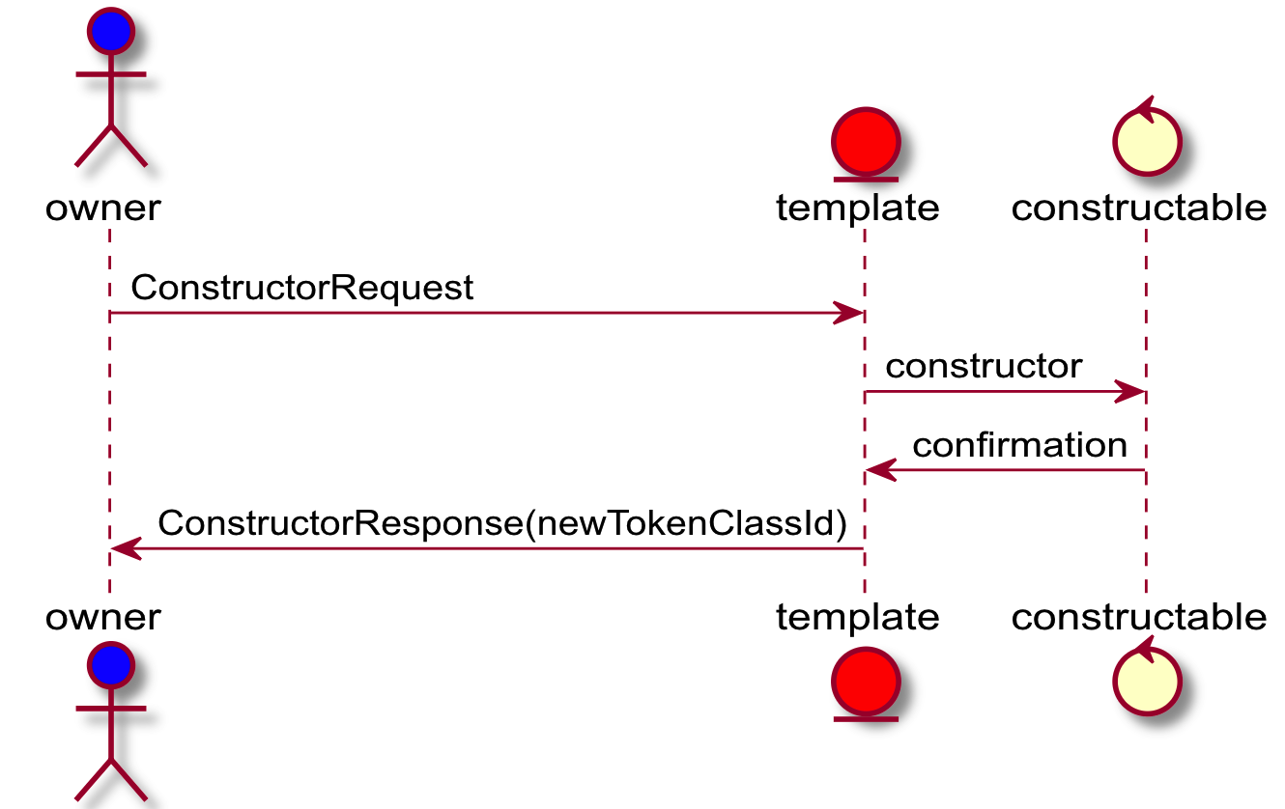
Interaction Sequences
Create Token

Slide 23
Interaction Models
${[τ}_{Ϝ}\{\sim d,SC\}$]+$φSKU$
〖[𝜏〗_Ϝ {~𝑑,𝑆𝐶}]+𝜙𝑆𝐾𝑈
OwnerId: Name: Symbol:
Quantity:
Decimals:
~d
Decimals: 0
$$SC$$
𝑆𝐶
$$m$$
𝑚
$$b$$
𝑏
$$τ$$
𝜏
$$r$$
𝑟
$$τ$$
𝜏
$$φSKU$$
𝜙𝑆𝐾𝑈
Behavior | Control | Properties
Constructable | Constructor | Name, Symbol, Decimals = 0
Mintable | MintRequest | Quantity = 100
Base | GetBalanceRequest
SKU Property-Set | GetSKURequest

