Slide 1
Token Taxonomy Process
Moving Tokens Forward

Slide 2
Token Taxonomy Initiative - Mission
Create and publish standard taxonomy framework (TTF) with a backing repository to educate, navigate, discover and create new framework components or token definitions.
Also, educate and facilitate teams wanting to use the framework, a TTF Workshop, to contribute components or define an existing or new token definition. The taxonomy will serve as common ground for terms and definitions for business, legal, regulatory and developers to collaborate.

Slide 3
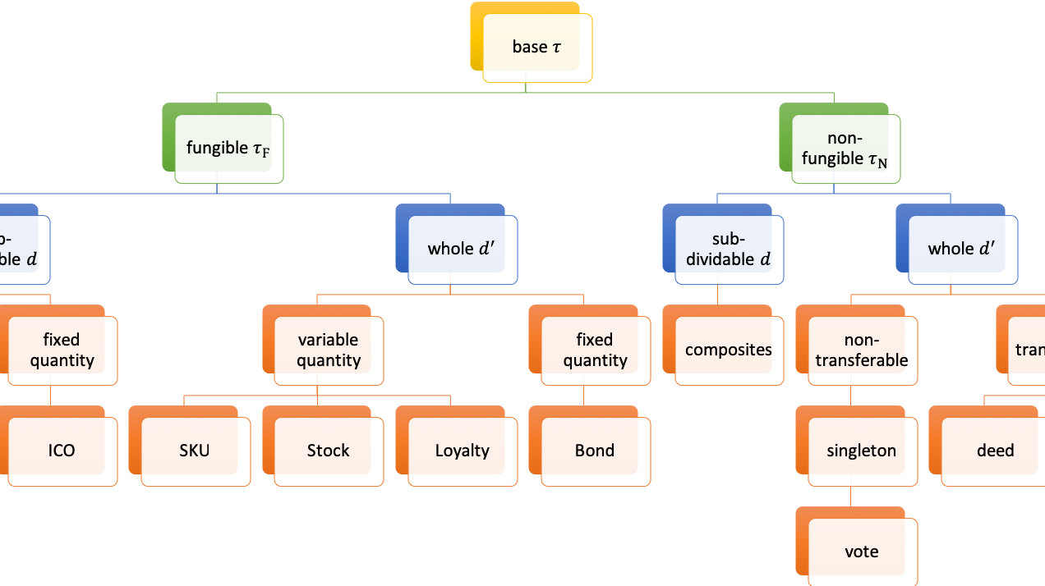
Token Taxonomy Initiative
What we will do:
Refine and expand on the base taxonomy framework
Resolve any issues with existing framework
Add any missed, non-exceptional, base items or combinations
Standardize artifact templates - format, metadata and GitHub structure
Create artifacts for the base taxonomy as both samples and a starting point
Base Token, Fungible, Non-Fungible and Hybrid
Base behaviors and groups
A small set of sample token definitions
Populate a parking lot list for not created but known artifacts
List of behaviors, behavior groups and tokens the group can identify
Comments and potential interested parties that could define
Establish a roadmap on what and how standardization can be certified, we don’t need to even know what we will standardize on to start.
What we will NOT do:
Define vertical specific or existing token implementation definitions
Bleed blockchain implementation specific restrictions or proprietary non-open capabilities

Slide 4
Token Taxonomy Initiative
Complete the Taxonomy Framework
Maintain GitHub:
Base Taxonomy artifacts
Artifact library of behaviors, groups, sets and control message descriptions
GitHub Library for Token Definitions
Destination for definitions, links to the base libraries, source or 3rd party implantations. (maps)
Special Interest Groups & Vendors compose token definitions
Contribute new or update behaviors that are not proprietary
Submit Token Artifacts to GitHub via pull request
Open Issues:
Compliance based on base message conformance
Testing?
Publish map examples

Slide 5






TTI Process
Energy
Insurance
Healthcare
Banking
Media &
Entertainment
Capital Markets
Supply Chain
Workshop
TTI Publishes the TTF
Vendors and Special Interest Groups begin defining and contributing through workshops
TTI approves pull requests from workshops with new or updated artifacts.
TTI Pull
Request
TTF
Maps
Source Repos
Implementations
Legal/Reg Frameworks

Slide 6
Workback Plan
April 24 – May 15th: Preview release of the TTF
May 16th: Face-to-Face Workshop
May 31st: Workshop Preview release of TTF
June – September: Train the trainer and broad workshop contribution requests that are controlled merges by TTI.
October TTF 1.0 Release.
Monthly cadence post release for reviews of workshop improvements and feature requests for 2.0.

Slide 7
April 24 – May 15th: Preview release of the TTF
Core preview members, lead by technical contributors to:
Symbol, Grammar and Formula improvements
Artifact formats: HTML, MD, PPTX, proto, etc.
Core Metadata for artifacts: inline HTML attributes and JSON? Or just JSON or other?
Extensible metadata practices
Metadata considerations for artifact file types
Informed by use for tooling, SDKs, extensions, etc.
Control Message Descriptions
Maps to code, implementations, etc.
SDK/Object Model?
Demos?

Slide 8
May 16th, 2019
2 Events – Location TBD in NYC.
Morning public session for educating and recruiting new members about the TTF and workshops.
Afternoon Session for the preview participants.

Slide 9
May 16th Face to Face
Switching contributor focus from technical to business.
Active workshop teams refining and improving core artifact definitions, examples and analogies.
Train the trainer and workshop BOM development and refinement.

Slide 10
May 16-31st
Business Focused artifact refinement and workshop development
Technical contributors engage as needed and to make suggested metadata and syntax updates.

Slide 11
June-September
Business Driven Workshops with:
Existing token implementors in industries
Special Interest groups
Consulting members or systems integrators leading workshops as an offering
Technical team fills in gaps
Approval of artifacts

Slide 12
Next Steps – Preview Release
Use of GitHub, once migrated this week to post issues for discussion:
Metadata requirements: schema, API model, extensible, not too much
Metadata technology: XML, JSON, Proto
Schema for artifacts and maps
Tooling and capturing Workshop data
Example extension via API
Will be posted with initial seed questions for discussion and email sent to the team to chime in.

