Slide 1
Taxonomy Workshop Overview
Moving Tokens Forward

Slide 2
Taxonomy Workshop
Guided workshop that provides an overview of the taxonomy for business people to get started.
Sessions following the Overview:
High Level Business definition of the targeted token to apply the taxonomy
Decompose the token
Identify base token type and additional non-behavioral properties
Identify taxonomy behaviors already defined that will be included
Describe a behavior that has no match already defined in the taxonomy framework
Create a taxonomy artifact for any new behaviors found and repeat
Complete the token definition by creating an artifact for it.
Submit for review to be included in the framework.

Slide 3
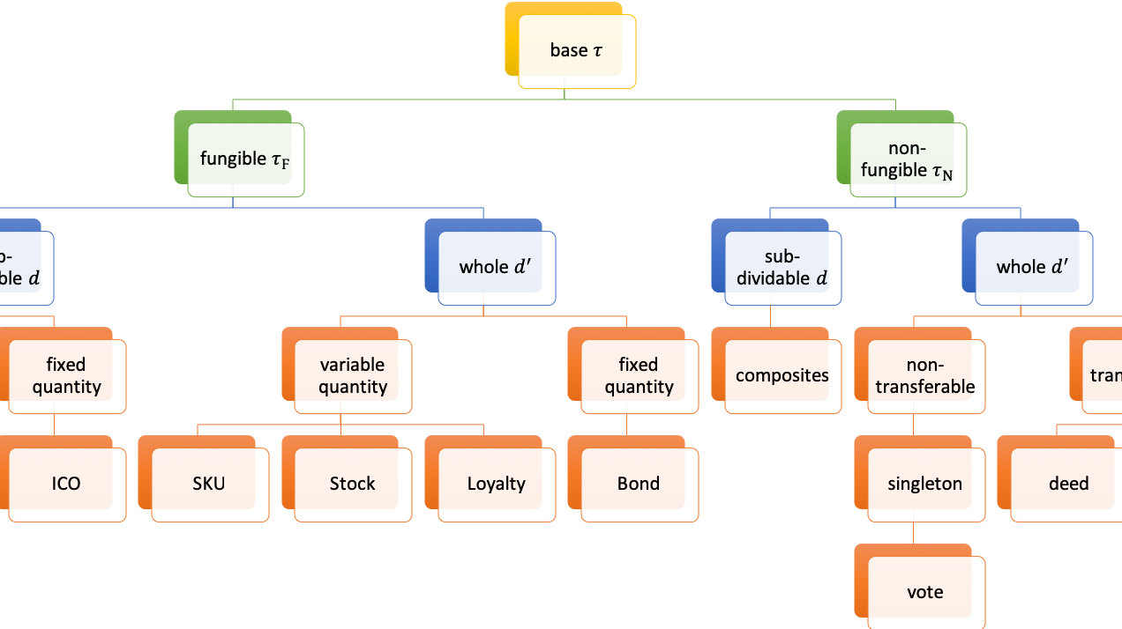
Workshop Fundamentals
Educate the group to establish a baseline understanding before any discussions about the actual token.
Keep the focus on describing the properties and behaviors and rein in any talk about implementation.
Read out loud any artifacts to the group to ensure clarity of definitions
Decomposition requires discipline because it initially requires more work
Assume any behavior the group is describing is probably a behavior group that needs decomposition.

Slide 4
Lessons Learned…so far
Technical participants with exposure to blockchain bring a lot of baggage.
Frequently jump to implementation or introduce a particular ledger feature or restriction that isn’t helpful.
Gently reinforce the workshop is not about implementation and needs to be agnostic from any implementation.
Behaviors are usually groups when first described.
Decomposition takes longer and requires more work initially, stress the value on the back end.
Value of decomposition is easy to understand when the group re-uses a behavior from the framework.

Slide 5
Workshop Outputs
Taxonomy artifacts
Behaviors and Behavior Groups should be contributed back to the framework.
Formatting the artifacts following the template is important for acceptance into the framework.
Submission is a pull request.
Complete Token definition submission is optional but encouraged. Some organizations may want to keep their definition private.

Slide 6
Improve the Taxonomy Framework
Identify gaps in the base framework and help shore up definitions.
Identify metadata gaps that may be needed for future tooling.
Extend the workshop into branded offerings in your organization or for delivery with customers.
Contributions back to the framework are vital.

Slide 7





Workshop Process
Describe Token Business and Function
A la Carte behaviors and groups
Missing a behavior or Group?
Complete taxonomy formula definition
Submit Pull Request
Select a Token Base Type
TTF
no
Y
Create New Artifact
Y

