Slide 1

Token Taxonomy Framework (TTF)
Moving Tokens Forward
1.0

Slide 2
















April 2019 Token Taxonomy Initiative was born…
Microsoft contributed TTF to seed the TTI
Platform Neutrality
Standards and Interoperability
Consistency in terms, definitions and concepts
Then…
Notes:
Accenture, Banco Santander, Blockchain Research Institute, Clearmatics, ConsenSys, Digital Asset, EY, IBM, ING, Intel, J.P. Morgan, Komgo, Microsoft, R3, and Web3 Labs

Slide 3
Introduction
What its for:
Educate – take a step back and CLEARLY define a token in non-technical and cross industry terms. Using real world, everyday analogies so ANYONE can understand them using properties and behaviors to describe and define them.
Establish a common set of terms and definitions that can be used by business and technical participants to speak the same language
Create - implementation neutral token definitions (artifacts) with clear requirements that developers can follow, and standards validate following a composition framework
Define meta-data using the TTF syntax and grammar to be able to generate visual representations of classifications, used by modelling tools to view and create token definitions mapped to the taxonomy and can also support taxonomy to implementation or source code mapping
It is NOT:
Blockchain specific
A legal framework – but a common ground
Complete or comprehensive – requires and encourages collaboration

Slide 4
High Level Terms
Loyalty
Definition
Airline
Loyalty
Class
Hotel
Loyalty
Class
Airline Points
Hotel Points
Inventory
Definition
Inventory
Class
Barrel of Oil
Token
Formula
Formula
Template
Definition
Class
Instance
The framework establishes a set of terms for tokens like template formula, definition, class and instance
Token Template = Formula + Definition
An instance belongs to a class which is created from a template
Artifacts are definitions of a token part or complete token definition, template
The framework consists of the base set of artifacts and any new artifact contributed

Slide 5

Baking with Artifacts, Templates & Instances
A Token Class is like a Cake, it is baked from a recipe, i.e. a Template
A slice of this cake is like a Token Instance
A cake is made of ingredients like milk, flour, sugar, etc.
The cake recipe specifies how much of each ingredient to use, when and how long to bake it.
In the TTF:
Ingredients are Artifacts
Recipe is a Template
A Cake is the Class made from the Template
A slice is an instance of the Class

Slide 6
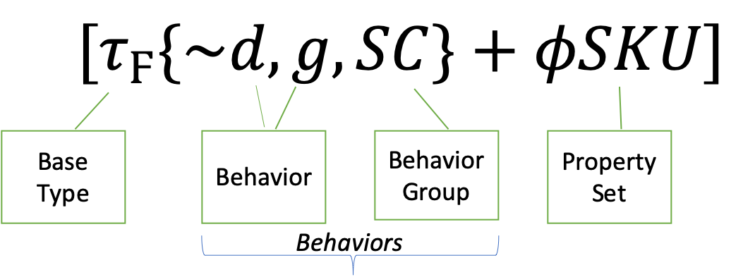
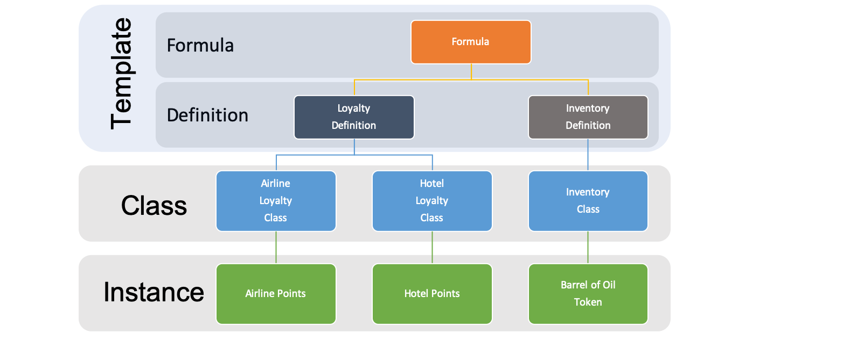
Template Formula
Collection of components from the TTF
Represented by a Formula of Symbols
Symbols link to individual artifacts
Formulas are used to classify templates

Slide 7
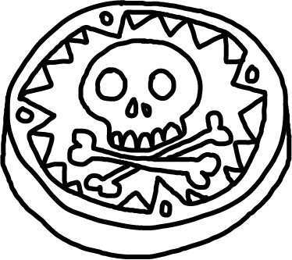
Template Definition, Class & Instance
A Template Definition is based off and paired with a Formula, providing details to complete the Template.
A Token Class is a deployed implementation of a Template to a blockchain.
A Token Instance is a token of a class that you can own and control.
Token Definition
Token Class A
Token Class B
Token Class C
Blockchain 1
Blockchain 2
Blockchain 3

Slide 8
Categories: Base Token, Property Sets, Behaviors & Behavior Groups
Tokens are comprised of properties and behaviors that are interacted with using standard control messages
All Tokens will have a common set of base token properties including simple name/value pair generic properties.
Tokens differentiate themselves based on their behaviors and property sets.
The Taxonomy defines behaviors and properties that are the building blocks of tokens. Some behaviors are already known, the taxonomy just defines them in a standard way and organizes them.
Controls are actions described as messages that are used to invoke a behavior and represent properties.

Slide 9
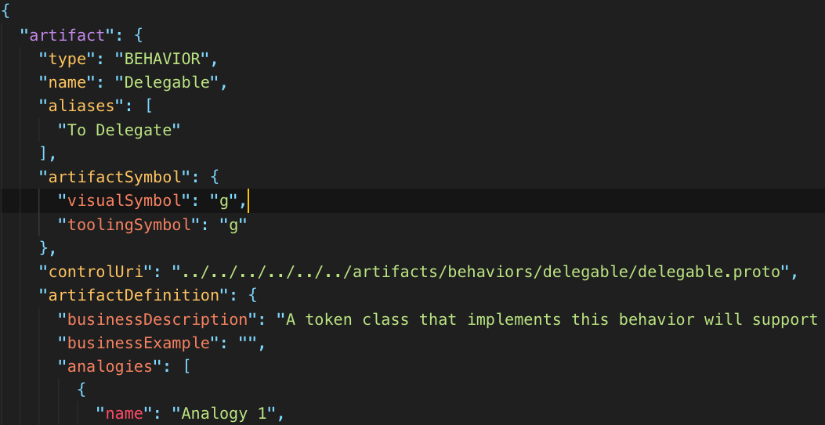
Artifacts
Written in common language so anyone can understand the artifact description and what it does.
Metadata for: (hidden from users)
Tokens
Behavior
Behavior Groups
Property Sets
Token Templates
An artifact is a collection of files placed in a single folder based on the artifact type.
GitHub based
Artifact Categories using File System Folder/Directory structure
Extensible
ArtifactSymbol contains a formula symbol as well as a unique identifier or id which is used to reference the artifact.

Slide 10

Base Token Types & Symbols
Interchangeable having the same value with other tokens of the same class
$τ_{Ϝ}$ Common Fungible
$τ_{Ϝ^{′}}$Unique Fungible
𝜏_Ϝ Common Fungible
𝜏_(Ϝ^′ ) Unique Fungible
Physical money – $τ_{Ϝ^{′}}$
Physical money – 𝜏_(Ϝ^′ )
Loyalty points - $τ_{Ϝ}$
Loyalty points - 𝜏_Ϝ
Different values and should not be interchangeable.
$τ_{Ν}$ Non-fungible
$τ_{Ν^{′}}$ Unique Non-fungible
𝜏_Ν Non-fungible
𝜏_(Ν^′ ) Unique Non-fungible
Property title
Art token
- Theater ticket – non-fungible base – Play name, show date + classes of non-fungible tokens for theater sections.
- Artifact group of tokens owned by other tokens and represent them as a single token.
${ τ}_{Ν}$($τ_{Ϝ}$)
${ τ}_{Ϝ}$($τ_{Ν}$) Hybrids
Notes:
There are currently two kinds of fungible tokens, common, sometimes called account or balance tokens, and unique, or UTXO (unspent transaction output). This distinction might seem subtle, but is important when considering how fungible tokens can be traced and what properties they can have.
Common fungible tokens share a single set of properties, are not distinct from one another and balances are recorded in a central place. These tokens are simply represented as a balance or quanitity attributed to an owners address where all the balances are recorded on the same balance sheet. This balance sheet is distributed, so its not 'centralized' but rather simplified. Common tokens have the advantage of easily sharing a common value like a "SKU" where the change in the value is immediately reflected for all tokens. Like money in a bank account is represented as a balance. Common tokens cannot be individually traced, only their balances between accounts can.
A common fungible token is identified by **&tau;<sub>F</sub>**.
Unique fungible tokens have their own identities and can be individually traced. Each unique token can carry unique properties that cannot be changed in one place and cascade to all and their balances must be summed. These are like bank notes, paper bills and metal coins, they are interchangable but have unique properties like a serial number.
A unique fungible token is identified by **&tau;<sub>F'</sub>**

Slide 11

Classification
A Token Classification has 5 Variables:
Token Type: Fungible or Non-Fungible – the fundamental difference between token types.
Token Unit: Fractional, Whole or Singleton – Quantity and subdivision restrictions.
Value Type: Intrinsic or Reference – the asset type the token represents.
Representation Type: Common or Unique – how balances and property value settings are stored.
Template Type: Single or Hybrid – does the token have any child tokens.

Slide 12

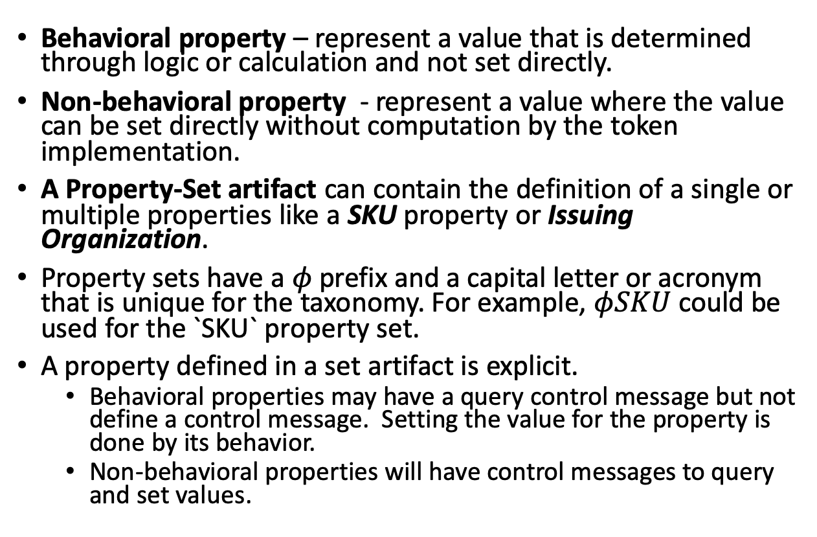
Properties
Behavioral property – represent a value that is determined through logic or calculation and not set directly.
Non-behavioral property - represent a value where the value can be set directly without computation by the token implementation.
A Property-Set artifact can contain the definition of a single or multiple properties like a SKU property or Issuing Organization.
Property sets have a $φ$prefix and a capital letter or acronym that is unique for the taxonomy. For example, $φSKU$ could be used for the `SKU` property set.
A property defined in a set artifact is explicit.
Behavioral properties may have a query control message but not define a control message. Setting the value for the property is done by its behavior.
Non-behavioral properties will have control messages to query and set values.

Slide 13
Behaviors
Behavior – describes a capability or restriction. I.e. Transferable or Non-transferable.
Behavior Property – a property or data element that is required for a behavior. I.e. Sub-dividable requires a decimals property.
D
Notes:
For example, a token can be capable of being subdivided, be restricted to a single owner or be non-transferable
For example, a sub-dividable token must have a decimals property with a number representing the decimal places supported.
$ Token – Decimals = 2 ($.43 or $1.43)
Oil Token - Decimals = 0 (you cannot own a fraction)

Slide 14
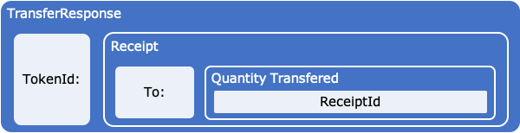
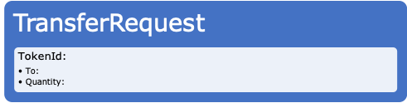
Control Messages
Property-Sets and Behaviors have Control Messages that describe how to get or set the property or invoke a behavior.
Messages usually named starting with a verb like Get or Add
Control messages are paired together with a Request and a Response.
Request messages describe what property to get or behavior to invoke along with any parameters needed for the Control. For example, a TransferRequest message will need to have To and Amount parameters to successfully invoke the Transferable behavior.
A Response message describes what the Requestor is expecting in return from their response. I.e. a receipt, query result, etc.

Slide 15
Common Behaviors
$t$ - Transferable
𝑡 - Transferable
~t- Non-transferable
$d$ - Sub-dividable or ~$d$ - Whole
𝑑 - Sub-dividable or ~𝑑 - Whole
$m$ - Mint-able
𝑚 - Mint-able
$r$ - Role Support
𝑟 - Role Support
Restriction of preventing a change of ownership from the initial issued owner. A vote token for an election or an airline ticket are examples.
Decimal places a token can be subdivided into.
Ability to issue new tokens of the class. Creating a new property deed or adding money to the overall supply.
$b$ - Burnable
𝑏 - Burnable
Ability to have roles defined within the class to allow or prevent certain actions.
Ability to remove tokens from the supply. A token representing a barrel of oil that gets burned when it is refined is a good example.
Ability to transfer ownership of the token. Basic fungible behavior when using cash money, but also applies to non-fungible tokens.
$s$ - Singleton
𝑠 - Singleton
There can only be a quantity of one, where the token class represents the only instrument. Like a piece of fine art.

Slide 16
Behavior Groups
Behavior Groups are a collection behaviors that are frequently used together.
Encourages Decomposition of lowest level behaviors being defined and combined for maximum re-use.
$$b$$
𝑏
BurnRequest
BurnFrom
BurnFromRequest
BurnResponse
Burn
BurnFromResponse
$$SC$$
𝑆𝐶
b
m
r
$$m$$
𝑚
MintRequest
MintFrom
MintFromRequest
MintResponse
Mint
MintFromResponse
$$r$$
𝑟
AddRoleMemberRequest
RemoveRoleMember
RemoveRoleMemeberFromRequest
AddRoleMemeberResponse
AddRoleMember
RemoveRoleMemeberFromResponse

Slide 17
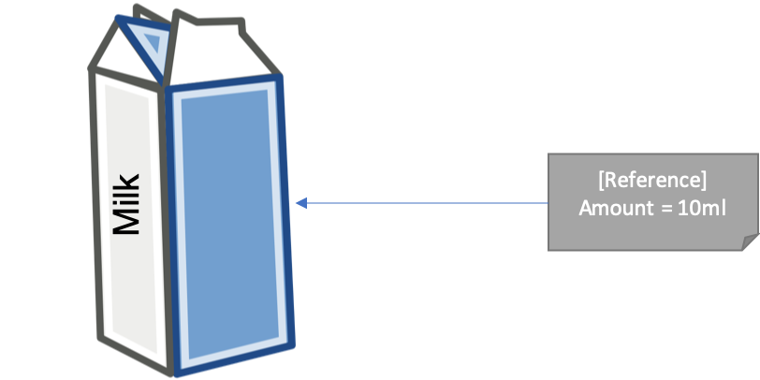
Artifact Reference
An Artifact is an ingredient, like milk or flour, and has a placeholder for the amount needed of the ingredient, but not the actual value.
An Artifact Reference is where the value is set for the Artifact’s use.

Slide 18
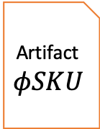
Template Formula Setting Context for Artifacts working together
Artifacts are composed into a formula using references.
Grammar rules will provide the first level of component compatibility.
Formulas represent a branch on the Taxonomy Hierarchy Tree.
Reference
Template Artifact
Artifact $φSKU$

Slide 19
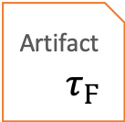




Template Definition Filling in the details…
Individual Taxonomy Artifacts are defined in relative isolation to facilitate reuse.
A single artifact may list a dependency on another artifact but leave details like property values or settings as TBD.
When artifacts are composed together into a Definition, the TDB values can be specified, setting values can be set or recommended for these artifacts in the context of the template.
A Token Template is where Definition is a paired with its Formula
The Definition Id is the also the Token Template and Token Specification Id.
Formula
Definition
reference - $τ_{Ϝ}$
reference - 𝜏_Ϝ
reference - ~d
reference - g
settings
decimals = 0
transferable & burnable
reference - SC
role = minters
apply to mintable
reference - $φ$SKU
reference - 𝜙SKU
15 characters long, starting with a capital letter T
Artifact
$$\sim d$$
Artifact $τ_{Ϝ}$
Artifact
$$g$$
References
Artifact
$$SC$$
Artifact
$$φSKU$$
Reference Values

Slide 20



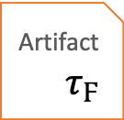


Token Specification
A token template is the combination of its formula + definition.
From a template definition a specification is generated.
The TTF generates the specification upon request from the Template Definition Id
Token
Specification
Definition
reference - $τ_{Ϝ}$
reference - 𝜏_Ϝ
reference - ~d
reference - g
settings
decimals = 0
transferable & burnable
reference - SC
role = minters
apply to mintable
reference - $φ$SKU
reference - 𝜙SKU
15 characters long, starting with a capital letter T
Artifact
$$\sim d$$
Artifact $τ_{Ϝ}$
Artifact
$$g$$
References
Artifact
$$SC$$
Artifact
$$φSKU$$
Reference Values

Slide 21
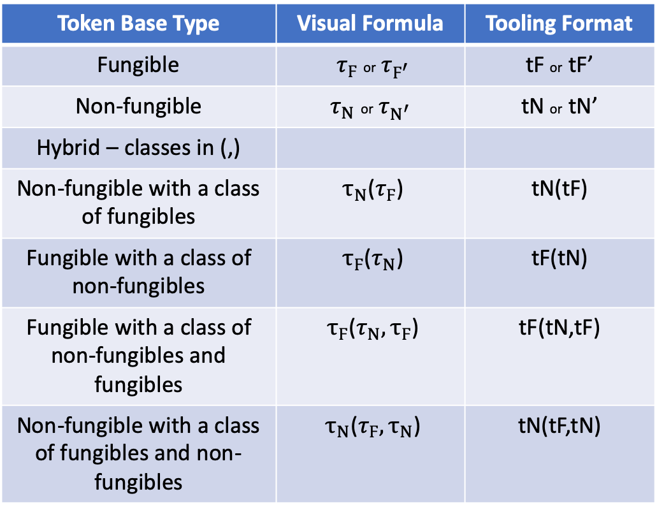
Taxonomy Grammar
Token Base Type | Visual Formula | Tooling Format
Fungible | ${ τ}_{Ϝ}$ or $τ_{Ϝ^{′}}$ | tF or tF’
Non-fungible | $τ_{Ν}$ or $τ_{Ν^{′}}$ | tN or tN’
Hybrid – classes in (,)
Non-fungible with a class of fungibles | ${ τ}_{Ν}$($τ_{Ϝ}$) | tN(tF)
Fungible with a class of non-fungibles | ${ τ}_{Ϝ}$($τ_{Ν}$) | tF(tN)
Fungible with a class of non-fungibles and fungibles | ${ τ}_{Ϝ}$($τ_{Ν},τ_{Ϝ}$) | tF(tN,tF)
Non-fungible with a class of fungibles and non-fungibles | ${ τ}_{Ν}$($τ_{Ϝ}{, τ}_{Ν}$) | tN(tF,tN)
Grammar defines how to construct a token or behavior group formula that is recorded as metadata in the artifact for the respective token, behavior or group.
The grammar has a visual and tooling format where the tooling does not include presentation characters for italics, Greek, super or subscript, etc.

Slide 22
Taxonomy Grammar
Behavior: single italic lower-case letter or letters that are unique
Behavior Group: upper-case letter or letters that are unique with behavior formula encased in {,} Supply Control: SC{m,b,r}
Whole Token Formulas start with the base token type, followed by a collection of behaviors and groups in {,}
Property Sets used to create a node or leaf from a base formula are added by wrapping the the formula in brackets [] and then adding + the property-set(s) using braces if there a multiple sets required.
Hybrid children with formulas are grouped within []: i.e. [tN{s,~t}(tF{~d,SC}]
$τ_{Ν}\{\sim t, S\}$ (Non-fungible: non-transferable & suspendable) (implicit ~d)
𝜏_Ν {~𝑡, 𝑆} (Non-fungible: non-transferable & suspendable) (implicit ~d)
$τ_{Ν}(τ_{Ϝ})\{e,t\}$ (Hybrid: expire-able & transferable)
𝜏_Ν (𝜏_Ϝ){𝑒,𝑡} (Hybrid: expire-able & transferable)
$τ_{Ϝ}\{d,SC\}$ (Fungible: sub-dividable & Supply Control)
𝜏_Ϝ {𝑑,𝑆𝐶} (Fungible: sub-dividable & Supply Control)
$τ_{Ϝ}\{$~d,$g, SC\}$ (Fungible: whole, delegable & Supply Control)
𝜏_Ϝ {~d,𝑔, 𝑆𝐶} (Fungible: whole, delegable & Supply Control)
[$τ_{Ϝ}${~d$,g, SC\}+φSKU]$ (Fungible: whole, delegable & Supply Control and a SKU property)
[𝜏_Ϝ{~d,𝑔, 𝑆𝐶}+𝜙𝑆𝐾𝑈] (Fungible: whole, delegable & Supply Control and a SKU property)
Formulas

Slide 23
Behavior grammar/rules
Some behaviors can apply to a token's class, like delegable (g) and can influence behaviors added to the definition of the token like transfer and burn.
Some behaviors have a natural opposite or a need to indicate a lack or disabled behavior. These will have the same symbol, where the opposite is indicated by a prefix of ~.
Some behaviors are incompatible with others.
Some behaviors are implicit based on the base token. I.e. transferable, is implicit for fungible tokens.

Slide 24

Branch Classification
Common root Base - $τ$
Classification views:
3 branches: Fungible ${ τ}_{Ϝ}$ and Non-Fungible $τ_{Ν}$ and Hybrid
Branches and views can be created using Template formulas like Fractional Fungibles, Whole Fungibles, Fractional Non-Fungibles or Singletons, etc.
Branch views are created from template references and behaviors.
Template Formulas are branches
A Definition is a node or leaf
Token Template = Formula + Definition
base $τ$
base 𝜏
fungible $τ_{Ϝ}$
fungible 𝜏_Ϝ
fixed quantity
whole
~d
fractional
$$d$$
fractional
𝑑
variable quantity
variable quantity
SKU
Stock
ICO
Fiat Currency
Loyalty
hybrid

Slide 25

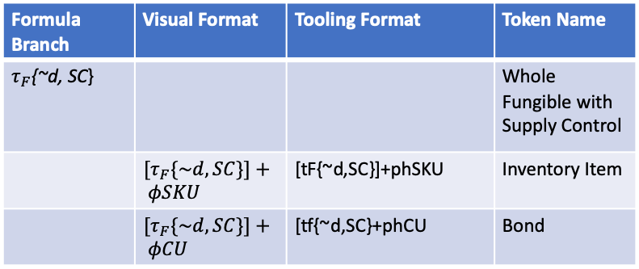
Classification Hierarchy
Formula Branch | Visual Format | Tooling Format | Token Name
$τ_{F}${~d, SC} |  |  | Whole Fungible with Supply Control
 | ${[τ}_{F}\{\sim d,SC\}]+ φSKU$ | [tF{~d,SC}]+phSKU | Inventory Item
 | ${[τ}_{F}\{\sim d,SC\}]+ φCU$ | [tf{~d,SC}+phCU | Bond
A Token Node or Leaf represents an end-point or destination in classification hierarchy.
A TTF Template Formula represents a branch, which can reference another branch to reuse and add to its formula.
For example, you can have multiple template that share the same base formula $τ_{F}${~d, SC} or Whole Fungible Token with Supply Control, but differ based on the property-sets they require. These would be different branches each referring to the same parent.
A Template Definition is a Leaf or Node on the branch for the formula it is based from.
Fractional Fungible
Supply Control
Inventory Item Token
Whole Fungible
Fractional Non-Fungible
Singleton
Barrel of Oil
Branches - Formulas
Node - Definition

Slide 26
Token Template = Formula + Definition
A Token Template Formula is a Branch
Definitions based off a Formula are leaf or nodes suppling the values for each Artifact Reference in the Formula.
Node
Formula
Formula
Artifact b
Artifact c
Artifact a
Template Definition: Bring it all together
(a) Instance
Quantity = 3
(b) Instance
Enabled = false
(c) Instance
Color = Blue
Size = Small
References

Slide 27
Token Template
Definitions must have a Formula
Formulas can be the source of many different definitions
Multiple definitions using the same template should have significantly different Artifact Reference values
$τ_{Ν}\{\sim t, S\}$ (Non-fungible: non-transferable & suspendable) (implicit ~d)
𝜏_Ν {~𝑡, 𝑆} (Non-fungible: non-transferable & suspendable) (implicit ~d)
$τ_{Ν}(τ_{Ϝ})\{e,t\}$ (Hybrid: expire-able & transferable)
𝜏_Ν (𝜏_Ϝ){𝑒,𝑡} (Hybrid: expire-able & transferable)
$τ_{Ϝ^{′}}\{d,SC\}$ (Fungible: sub-dividable & Supply Control)
𝜏_(Ϝ^′ ) {𝑑,𝑆𝐶} (Fungible: sub-dividable & Supply Control)
$τ_{Ϝ}\{$~d,$g, SC\}$ (Fungible: whole, delegable & Supply Control)
𝜏_Ϝ {~d,𝑔, 𝑆𝐶} (Fungible: whole, delegable & Supply Control)
[$τ_{Ϝ}${~d$,g, SC\}+φSKU]$ (Fungible: whole, delegable & Supply Control and a SKU property)
[𝜏_Ϝ{~d,𝑔, 𝑆𝐶}+𝜙𝑆𝐾𝑈] (Fungible: whole, delegable & Supply Control and a SKU property)
$$Vote$$
𝑉𝑜𝑡𝑒
$$Theater Ticket$$
𝑇ℎ𝑒𝑎𝑡𝑒𝑟 𝑇𝑖𝑐𝑘𝑒𝑡
$$Physical Cash$$
𝑃ℎ𝑦𝑠𝑖𝑐𝑎𝑙 𝐶𝑎𝑠ℎ
$$Barrel of Oil$$
𝐵𝑎𝑟𝑟𝑒𝑙 𝑜𝑓 𝑂𝑖𝑙
$$Inventory Item$$
Inventory Item
Templates
Definitions

Slide 28
Artifact Hierarchical File Structure
Taxonomy Framework Repo stores artifacts in folder structures by base type, behaviors, behavior-groups, property-sets and tokens.
Version specific folders contain all the artifact files for that version. Latest always contains the latest version regardless of version number.
artifacts
base
fungible
non-fungible
behaviors
mintable
behavior-groups
token-templates
burnable
...
supply-control
...
property-sets
SKU
...
latest
1.0
latest
2.0
1.0.1
formulas
definitions
Invoice
Stable Coin
specifications

Slide 29
Tooling with Artifacts and Metadata
behaviors
mint
Ethereum
Fabric
burn
…
Open Zeppelin
Chaincode Source
Corda
Kotlin Source
DAML
DAML Source
Artifact metadata supports mapping to:
Source code
Finished implementation
Resource (i.e. regulatory framework or guidance)
Map for taxonomy behavior or property-set to platform specific code. (Solidity, Chaincode, Kotlin, DAML)
Map for token template to a specific implementation. (complete open source, commercial solution, etc.)
Which Map entry to use can be specified in an Artifact Reference
definitions
Document
Ethereum
Fabric
Bond
…
Open Zeppelin
IBM Product
Corda
3rd Party Solution
DAML
Packaged Solution

Slide 30
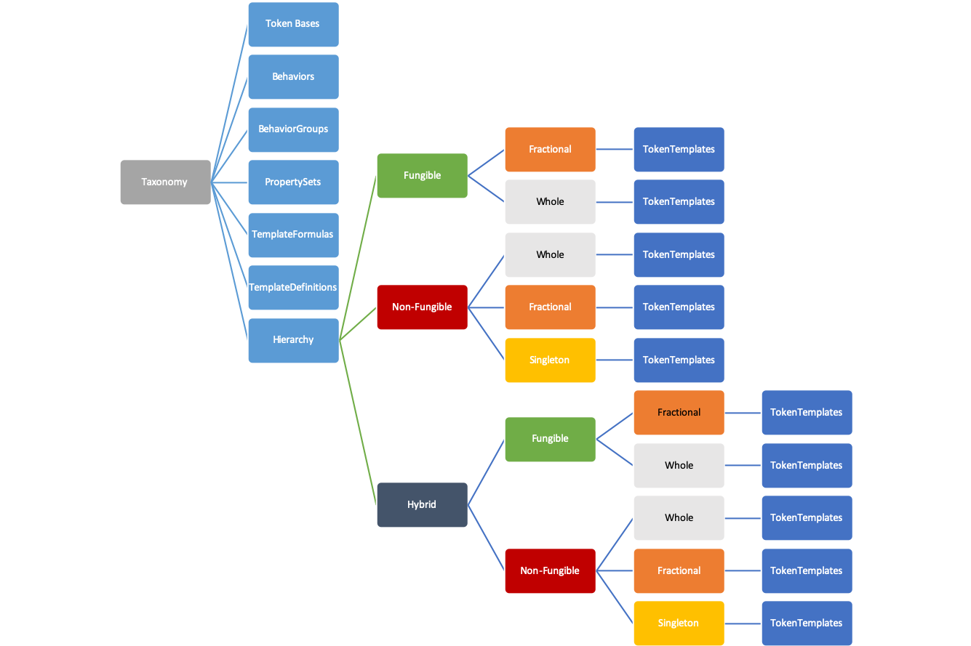
Taxonomy Model
The Taxonomy is represented as a structured model with all the artifacts in the TTF
From these tools can build design palates as well as visual representations of the artifacts

Slide 31
Contract Interfaces
Network A
Loan Contract
A Template Formula represents the logical token interface.
Internal behaviors apply only to the token itself and are self invoking.
External Behaviors provide standard contract interfaces across platforms and consortiums. These behaviors are often “end point” properties invoked by an external contract or token.
financeable
Property
Title
Network B

Slide 32
Classification Hierarchy Example
base $τ$
base 𝜏
fungible $τ_{Ϝ}$
fungible 𝜏_Ϝ
non-fungible $τ_{Ν}$
non-fungible 𝜏_Ν
fixed quantity
whole
~d
fractional
$$d$$
fractional
𝑑
variable quantity
variable quantity
fixed quantity
SKU
Stock
Bond
ICO
Fiat Currency
Loyalty
fractional
$d$
fractional
𝑑
singleton
s
non-transferable
vote
composites
transferable
deed
title
Whole
~d
hybrid

Slide 33
Example – Fungible with Supply Control
Hierarchy | Design | Behaviors & Properties
$$τ_{Ϝ}\{\sim d,SC\}$$
𝜏_Ϝ {~𝑑,𝑆𝐶}
OwnerId: Name: Symbol:
Quantity:
Decimals:
~d
Decimals: 0
$$SC$$
𝑆𝐶
$$m$$
𝑚
$$b$$
𝑏
$$τ$$
𝜏
$$r$$
𝑟
$SC$ - Supply Control
𝑆𝐶 - Supply Control
$F$ - Financeable
𝐹 - Financeable
$C$ – Custodial
𝐶 – Custodial
$SW$ - Swappable
𝑆𝑊 - Swappable
tokens
fungible
non-fungible
hybrid
Behavior
Groups
$t$ - Transferable
𝑡 - Transferable
~t - Non-transferable
$d$ - Sub-dividable
𝑑 - Sub-dividable
$s$ - Singleton
𝑠 - Singleton
$m$ - Mint-able
𝑚 - Mint-able
$r$ - Role Support
𝑟 - Role Support
$b$ - Burnable
𝑏 - Burnable
Behaviors

Slide 34




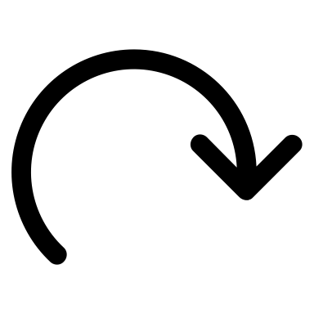
Workshop Process
Describe Token Business and Function
A la Carte behaviors and groups
Missing a behavior or Group?
Complete taxonomy formula definition
Submit Pull Request
Select a Token Base Type
The TTF is designed for collaboration and extension:
TTF initially has only the most common generic artifacts.
Workshops will contribute most artifacts and token templates.
Subject matter experts in vertical businesses or innovation will define and contribute artifacts in their area of expertise.
Those artifacts are then available for reuse and refinement by all.
TTF
no
Y
Create New Artifact
Y

Slide 35
Where does the TTF end & implementation begin?
The TTF has extensions, called a Map, allowing each artifact to reference code, implementation or reference materials that are external to the TTF.
For example, you may have a reference for a Token Template Definition that maps to:
Complete source code for a platform and language (i.e. HLF/Chaincode/Go - > url)
A finished solution or implementation (i.e. a link to a website or marketplace offering)
Regulatory guidance (i.e. link to a regulatory agency report)
TTF
Artifacts
Template
Map
External Reference
Your Extension
Notes:
s

Slide 36
Questions
http://tokentaxonomy.org

Slide 37
Taxonomy Object Model
TTF uses GitHub as the backend for storing artifacts.
Developers can consume the GitHub natively and create artifacts manually.
The Taxonomy Object Model provides a programmable middle extension for navigating the taxonomy and create/update/delete artifacts.
This allows for any application to create a presentation, Web, Mobile or Office experience using the model for general and business users.
Because it stores the data as formatted text, JSON, Proto3 and MD, git hub tracks changes and provides the collaboration tools to facilitate the workshop process.

Slide 38
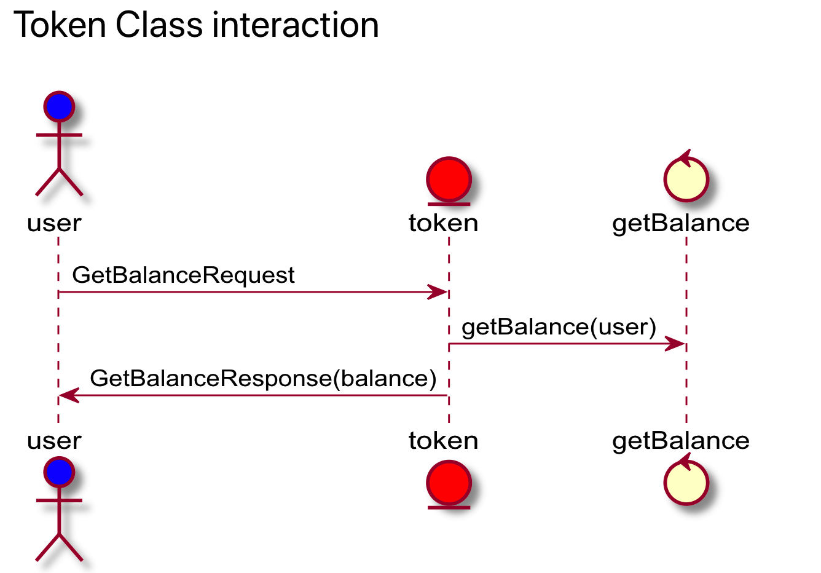
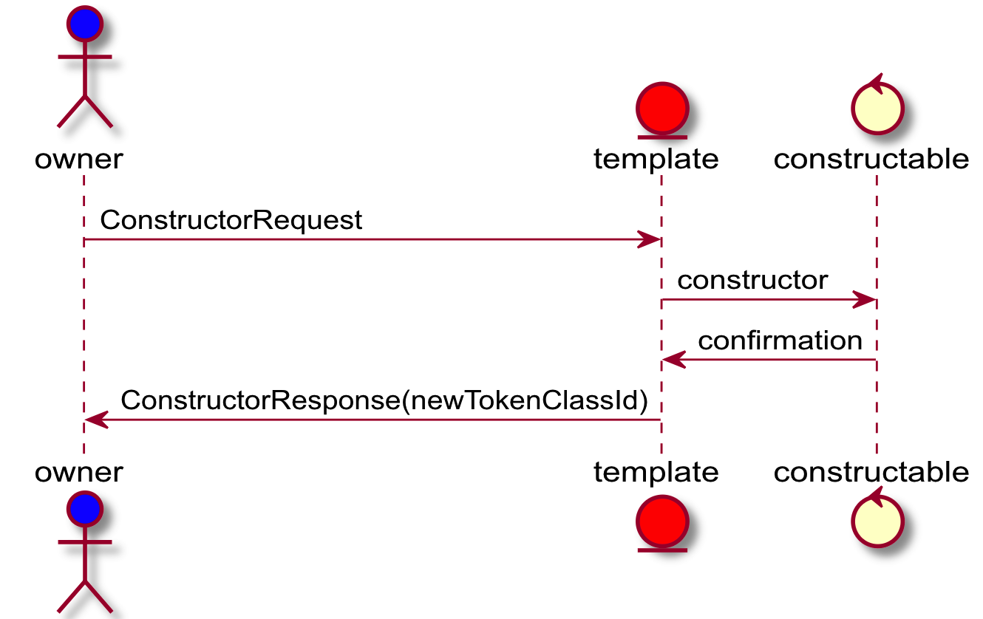
Interaction Sequences
Create Token

Slide 39
Interaction Models
${[τ}_{Ϝ}\{\sim d,SC\}$]+$φSKU$
〖[𝜏〗_Ϝ {~𝑑,𝑆𝐶}]+𝜙𝑆𝐾𝑈
OwnerId: Name: Symbol:
Quantity:
Decimals:
~d
Decimals: 0
$$SC$$
𝑆𝐶
$$m$$
𝑚
$$b$$
𝑏
$$τ$$
𝜏
$$r$$
𝑟
$$τ$$
𝜏
$$φSKU$$
𝜙𝑆𝐾𝑈
Behavior | Control | Properties
Constructable | Constructor | Name, Symbol, Decimals = 0
Mintable | MintRequest | Quantity = 100
Base | GetBalanceRequest
SKU Property-Set | GetSKURequest

Slide 40
Template
Loyalty
Definition
Airline
Loyalty
Class
Hotel
Loyalty
Class
Airline Points
Hotel Points
Inventory
Definition
Inventory
Class
Barrel of Oil
Token
Template - Branch
Taxonomy
Hierarchy
Token Bases
Behaviors
BehaviorGroups
PropertySets
TemplateFormulas
TemplateDefinitions
Hybrid
Fungible
TokenTemplates
Fungible
Fractional
TokenTemplates
Whole
TokenTemplates
Non-Fungible
Whole
TokenTemplates
Fractional
TokenTemplates
Singleton
Fractional
TokenTemplates
Whole
TokenTemplates
Non-Fungible
Whole
TokenTemplates
Fractional
TokenTemplates
Singleton
TokenTemplates
Definition - Node
Class
Instance

