Slide 1

Token Taxonomy Framework (TTF)
Moving Tokens Forward
1.0

Slide 2
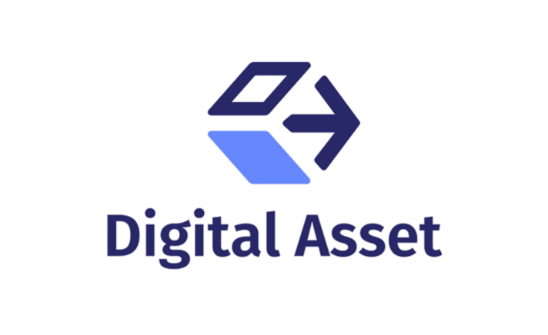





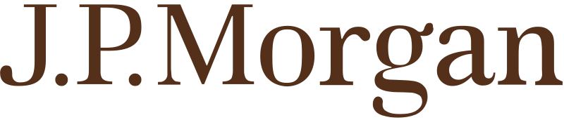







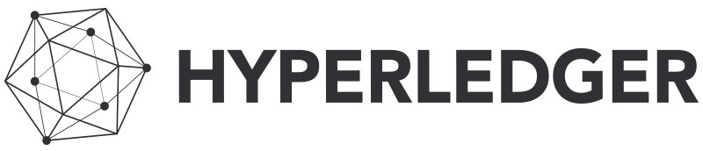


April 2019 Token Taxonomy Initiative was born…
Microsoft contributed TTF to seed the TTI
Platform Neutrality
Standards and Interoperability
Consistency in terms, definitions and concepts
Then…
Notes:
Accenture, Banco Santander, Blockchain Research Institute, Clearmatics, ConsenSys, Digital Asset, EY, IBM, ING, Intel, J.P. Morgan, Komgo, Microsoft, R3, and Web3 Labs

Slide 3
Introduction
What its for:
Educate – take a step back and CLEARLY define a token in non-technical and cross industry way.
Create - implementation neutral token with clear requirements that developers can follow, and standards validate.
It is NOT:
Blockchain specific
A legal framework – but a common ground
Complete or comprehensive – requires and encourages collaboration
Establish - a common terminology and definitions so business and technical participants can speak the same language
Extend - to other frameworks and standards organization for code, implementations, regulator & legal guidance, etc.

Slide 4
Terminology
Loyalty
Definition
Airline
Loyalty
Class
Hotel
Loyalty
Class
Airline Points
Hotel Points
Inventory
Definition
Inventory
Class
Barrel of Oil
Token
Formula
Formula
Template
Definition
Class
Instance
A Template is a token definition that can be standardized.
Token Template has 2 parts: a Formula and Definition
A class is an implementation of a template, the TTF does NOT define the class, which is platform specific.
An instance is a unit of ownership in a token class, like what you would have in your crypto-wallet: Bitcoin, Ether, etc.

Slide 5

Simple Composition Framework
A Token Class is like a Cake, it is baked from a recipe, i.e. a Template
A slice of this cake is like a Token Instance
A cake is made of ingredients like milk, flour, sugar, etc. these are Artifacts
The cake recipe specifies how much of each ingredient to use, when and how long to bake it.
In the TTF:
Ingredients are Artifacts
Recipe is a Template
A Cake is the Class made from the Template
A slice is an instance of the Class

Slide 6
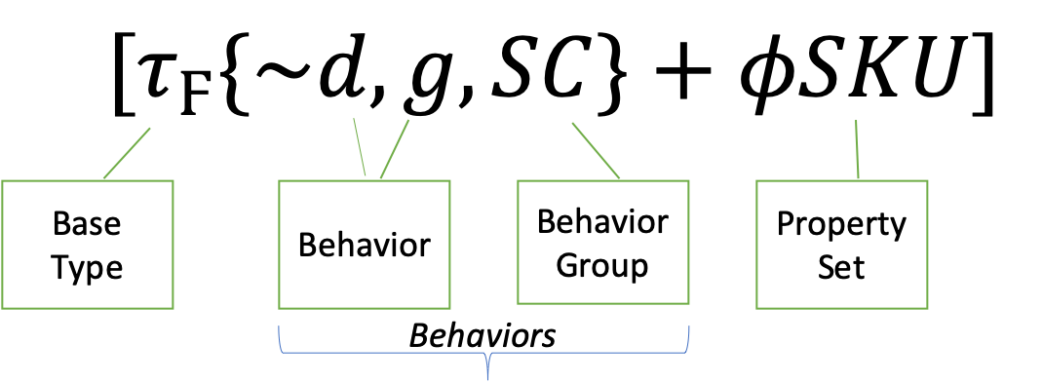
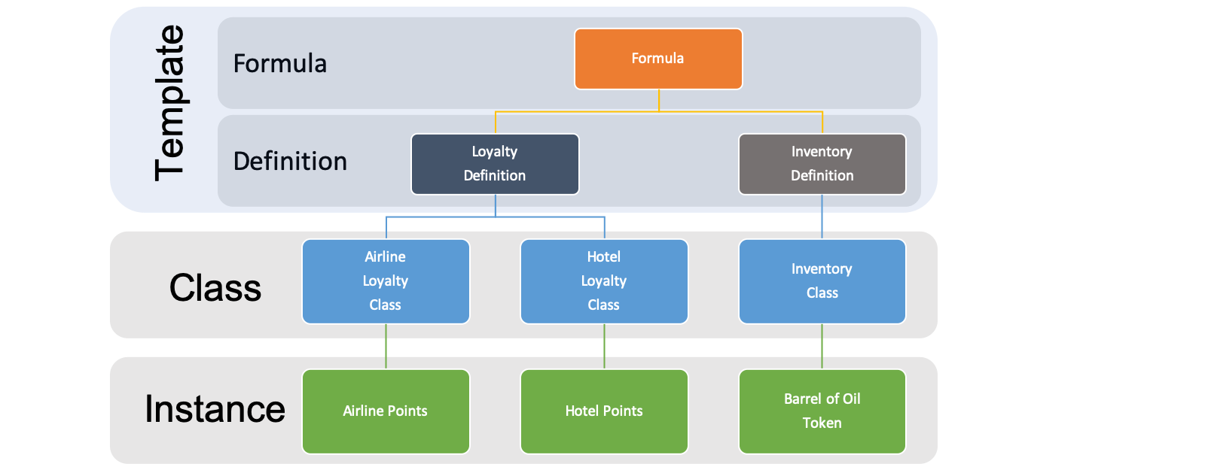
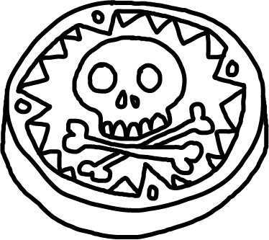
Template Definition, Class & Instance
A Template Definition is based off and paired with a Formula, providing details to complete the Template.
A Token Class is a deployed implementation of a Template to a blockchain.
A Token Instance is a token of a class that you can own and control.
Token Definition
Token Class A
Token Class B
Token Class C
Blockchain 1
Blockchain 2
Blockchain 3

Slide 7
Categories: Base Token, Property Sets, Behaviors & Behavior Groups
Tokens are comprised of properties and behaviors that are interacted with using standard control messages
All Tokens will have a common set of base token properties including simple name/value pair generic properties.
Tokens differentiate themselves based on their behaviors and property sets.
The Taxonomy defines behaviors and properties that are the building blocks of tokens. Some behaviors are already known, the taxonomy just defines them in a standard way and organizes them.
Controls are actions described as messages that are used to invoke a behavior and represent properties.

Slide 8
Artifacts
Artifacts are the decomposed parts, or ingredients, that are used to define a token template.
Grouped together by Token Bases, Behaviors, Behavior Groups and Property-Sets.
Common metadata
Extensible: enhance existing artifacts or create new ones to contribute

Slide 9

Base Token Types & Symbols
Interchangeable having the same value with other tokens of the same class
${ τ}_{Ϝ}$ - Fungible
〖 𝜏〗_Ϝ - Fungible
Physical money
Loyalty points
Different values and should not be interchangeable.
$τ_{Ν}$- Non-fungible
𝜏_Ν- Non-fungible
Property title
Art token
- Theater ticket – non-fungible base – Play name, show date + classes of non-fungible tokens for theater sections.
- Artifact group of tokens owned by other tokens and represent them as a single token.
${ τ}_{Ν}$($τ_{Ϝ}$)
${ τ}_{Ϝ}$($τ_{Ν}$) - Hybrids

Slide 10


Properties
Behavioral property – represent a value that is determined through logic or calculation and not set directly.
Non-behavioral property - represent a value where the value can be set directly without computation by the token implementation.
A Property-Set artifact - can contain the definition of a single or multiple properties like a SKU property or Issuing Organization.

Slide 11
Behaviors
Behavior – describes a capability or restriction. I.e. Transferable or Non-transferable.
Behavior Property – a property or data element that is required for a behavior. I.e. Sub-dividable requires a decimals property.
D
Notes:
For example, a token can be capable of being subdivided, be restricted to a single owner or be non-transferable
For example, a sub-dividable token must have a decimals property with a number representing the decimal places supported.
$ Token – Decimals = 2 ($.43 or $1.43)
Oil Token - Decimals = 0 (you cannot own a fraction)

Slide 12
Common Behaviors
$t$ - Transferable
𝑡 - Transferable
~t- Non-transferable
$d$ - Divisible or ~$d$ – Indivisible/Whole
𝑑 - Divisible or ~𝑑 – Indivisible/Whole
$m$ - Mint-able
𝑚 - Mint-able
$r$ - Role Support
𝑟 - Role Support
Restriction of preventing a change of ownership from the initial issued owner. A vote token for an election or an airline ticket are examples.
Decimal places a token can be subdivided into.
Ability to issue new tokens of the class. Creating a new property deed or adding money to the overall supply.
$b$ - Burnable
𝑏 - Burnable
Ability to have roles defined within the class to allow or prevent certain actions.
Ability to remove tokens from the supply. A token representing a barrel of oil that gets burned when it is refined is a good example.
Ability to transfer ownership of the token. Basic fungible behavior when using cash money, but also applies to non-fungible tokens.
$s$ - Singleton
𝑠 - Singleton
There can only be a quantity of one, where the token class represents the only instrument. Like a piece of fine art.

Slide 13
Behavior Groups
Behavior Groups are a collection behaviors that are frequently used together.
Encourages Decomposition of lowest level behaviors being defined and combined for maximum re-use.
$$b$$
𝑏
BurnRequest
BurnFrom
BurnFromRequest
BurnResponse
Burn
BurnFromResponse
$$SC$$
𝑆𝐶
b
m
r
$$m$$
𝑚
MintRequest
MintFrom
MintFromRequest
MintResponse
Mint
MintFromResponse
$$r$$
𝑟
AddRoleMemberRequest
RemoveRoleMember
RemoveRoleMemeberFromRequest
AddRoleMemeberResponse
AddRoleMember
RemoveRoleMemeberFromResponse

Slide 14



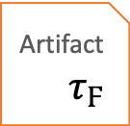


Token Specification
A token template is the combination of its formula + definition.
From a template definition a specification is generated.
The TTF generates the specification upon request from the Template Definition Id
Token
Specification
Definition
reference - $τ_{Ϝ}$
reference - 𝜏_Ϝ
reference - ~d
reference - g
settings
decimals = 0
transferable & burnable
reference - SC
role = minters
apply to mintable
reference - $φ$SKU
reference - 𝜙SKU
15 characters long, starting with a capital letter T
Artifact
$$\sim d$$
Artifact $τ_{Ϝ}$
Artifact
$$g$$
References
Artifact
$$SC$$
Artifact
$$φSKU$$
Reference Values

Slide 15

Classification
Common root Base - $τ$
Classification views:
3 branches: Fungible ${ τ}_{Ϝ}$ and Non-Fungible $τ_{Ν}$ and Hybrid
Branches and views can be created using Template formulas like Fractional Fungibles, Whole Fungibles, Fractional Non-Fungibles or Singletons, etc.
Branch views are created from template references and behaviors.
Template Formulas are branches
A Definition is a node or leaf
TokenTemplate = Formula + Definition
base $τ$
base 𝜏
fungible $τ_{Ϝ}$
fungible 𝜏_Ϝ
fixed quantity
whole
~d
fractional
$$d$$
fractional
𝑑
variable quantity
variable quantity
SKU
Stock
ICO
Fiat Currency
Loyalty
hybrid

Slide 16
Token Template
Definitions must have a Formula
Formulas can be the source of many different definitions
Multiple definitions using the same template should have significantly different Artifact Reference values
$τ_{Ν}\{\sim t, p\}$ (Non-fungible: non-transferable & pausable) (implicit ~d)
𝜏_Ν {~𝑡, 𝑝} (Non-fungible: non-transferable & pausable) (implicit ~d)
$τ_{Ν}(τ_{Ϝ})\{e,t\}$ (Hybrid: expire-able & transferable)
𝜏_Ν (𝜏_Ϝ){𝑒,𝑡} (Hybrid: expire-able & transferable)
$τ_{Ϝ}\{d,SC\}$ (Fungible: sub-dividable & Supply Control)
𝜏_Ϝ {𝑑,𝑆𝐶} (Fungible: sub-dividable & Supply Control)
$τ_{Ϝ}\{$~d,$g, SC\}$ (Fungible: whole, delegable & Supply Control)
𝜏_Ϝ {~d,𝑔, 𝑆𝐶} (Fungible: whole, delegable & Supply Control)
[$τ_{Ϝ}${~d$,g, SC\}+φSKU]$ (Fungible: whole, delegable & Supply Control and a SKU property)
[𝜏_Ϝ{~d,𝑔, 𝑆𝐶}+𝜙𝑆𝐾𝑈] (Fungible: whole, delegable & Supply Control and a SKU property)
$$Vote$$
𝑉𝑜𝑡𝑒
$$Theater Ticket$$
𝑇ℎ𝑒𝑎𝑡𝑒𝑟 𝑇𝑖𝑐𝑘𝑒𝑡
$$Physical Cash$$
𝑃ℎ𝑦𝑠𝑖𝑐𝑎𝑙 𝐶𝑎𝑠ℎ
$$Barrel of Oil$$
𝐵𝑎𝑟𝑟𝑒𝑙 𝑜𝑓 𝑂𝑖𝑙
$$Inventory Item$$
Inventory Item
Templates
Definitions

Slide 17
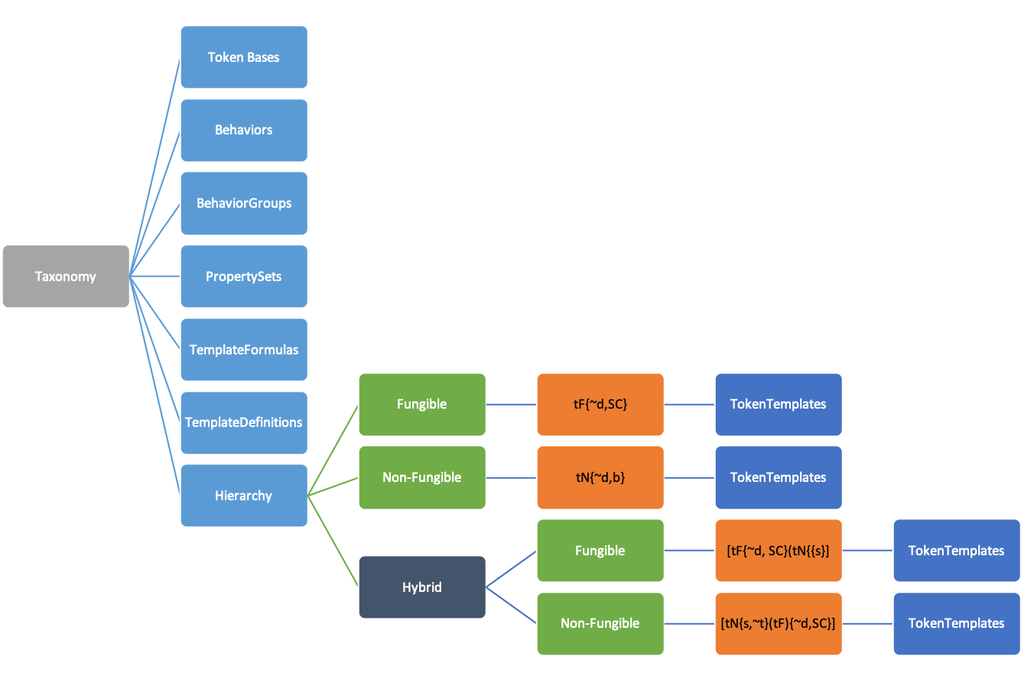
Taxonomy Model
The Taxonomy is represented as a structured model with all the artifacts in the TTF
From these tools can build design palates as well as visual representations of the artifacts

Slide 18
Contract Interfaces
Network A
Loan Contract
A Template Formula represents the logical token interface.
Internal behaviors apply only to the token itself and are self invoking.
External Behaviors provide standard contract interfaces across platforms and consortiums. These behaviors are often “end point” properties invoked by an external contract or token.
financeable
Property
Title
Network B

Slide 19
Classification Hierarchy Example
base $τ$
base 𝜏
fungible $τ_{Ϝ}$
fungible 𝜏_Ϝ
non-fungible $τ_{Ν}$
non-fungible 𝜏_Ν
fixed quantity
whole
~d
fractional
$$d$$
fractional
𝑑
variable quantity
variable quantity
fixed quantity
SKU
Stock
Bond
ICO
Fiat Currency
Loyalty
fractional
$d$
fractional
𝑑
singleton
s
non-transferable
vote
composites
transferable
deed
title
Whole
~d
hybrid

Slide 20
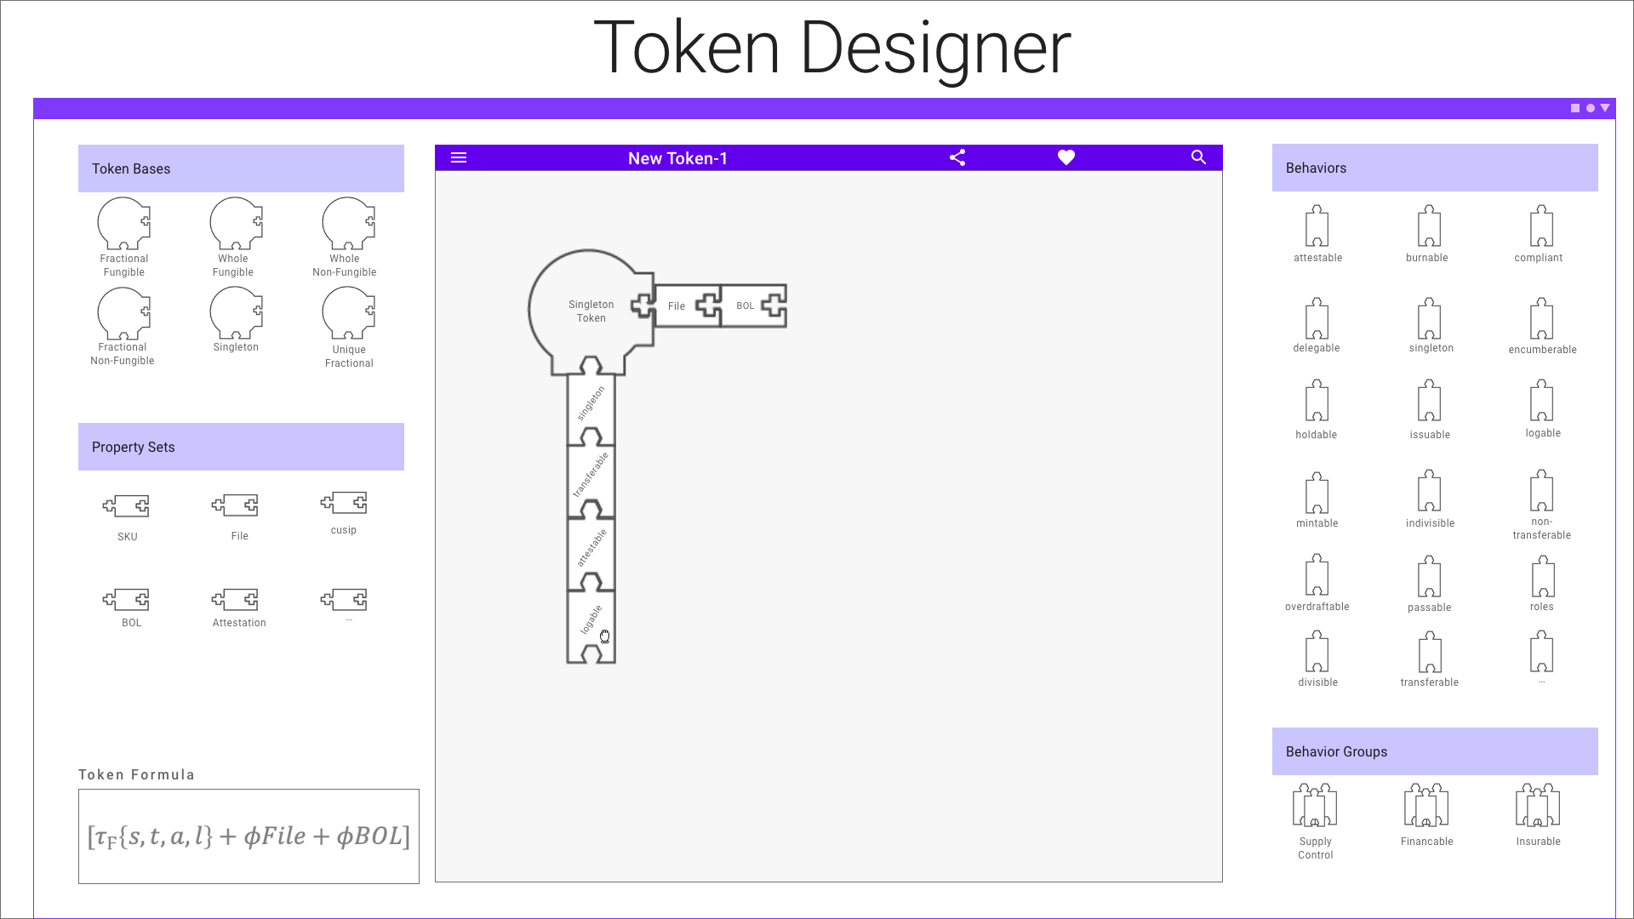
Example

Slide 21




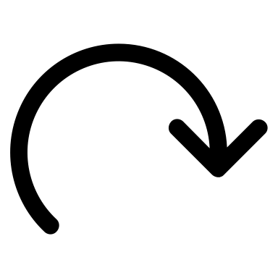
Workshop Process
Describe Token Business and Function
A la Carte behaviors and groups
Missing a behavior or Group?
Complete taxonomy formula definition
Submit Pull Request
Select a Token Base Type
The TTF is designed for collaboration and extension:
TTF initially has only the most common generic artifacts.
Workshops will contribute most artifacts and token templates.
Subject matter experts in vertical businesses or innovation will define and contribute artifacts in their area of expertise.
Those artifacts are then available for reuse and refinement by all.
TTF
no
Y
Create New Artifact
Y

Slide 22
Questions
http://tokentaxonomy.org

