Slide 1
Token Taxonomy Framework (TTF)
Moving Tokens Forward
Notes:
The Token Taxonomy Framework bridges the gap between blockchain developers, line of business executives and legal/regulators allowing them to work together to model existing and define new business models and networks based on Tokens. The blockchain space alone makes it difficult to establish common ground, but when adding Tokens to the mix they find themselves speaking completely different languages. The framework’s purpose IS:
- Educate – take a step back and CLEARLY define a token in non-technical and cross industry terms. Using real world, everyday analogies so ANYONE can understand them using properties and behaviors to describe and define them.
- Define a common set of concepts and terms that can be used by business, technical and regulatory participants to speak the same language.
- Produce token definitions that have clear and understood requirements that are implementation neutral for developers to follow and standards to validate.
- Establish a base Token Classification Hierarchy (TCH) driven by metadata that is simple to understand and navigate for anyone interested in learning and discovering Tokens and underlying implementations.
- Tooling meta-data using the TTF syntax to be able to generate visual representations of classifications and modelling tools to view and create token definitions mapped to the taxonomy.
- Neutral to programming language and blockchain, distributed ledger or other distributed medium where tokens reside.
- Open and collaborative workshops to accelerate the creation of powerful vertical industry applications and innovation for platforms, start-ups and enterprises.
- Standard artifacts and control message definitions mapped to the taxonomy that are implementation neutral and provide base components and controls that consortia, startups, platforms or regulators can use to work together.
- Encourage differentiation and vertical specialization while maintaining an interoperable base.
- Sandbox environment for legal and regulatory requirement discovery and input
- Used in taxonomy workshops for defining existing or new tokens which results in a contribution back to the framework to organically grow and expand across industries for maximum re-use.
It is **NOT**:
- Specific to the Ethereum family but applies to any shared medium.
- A Legal framework - but does establish common ground.
- A Regulatory framework - also creates common ground.
- Complete or comprehensive
This paper does not provide a backgrounder on Tokens and their function, but rather introduces taxonomy and classifications as a composition framework for creating or documenting existing token definitions.
See the [Token Hall](https://medium.com/tokenhall) for a backgrounder for business and technical audiences.

Slide 2
What is it?
Educate – take a step back and CLEARLY define a token in non-technical and cross industry terms. Using real world, everyday analogies so ANYONE can understand them using properties and behaviors to describe and define them.
Establish a common set of terms and definitions that can be used by business and technical participants to speak the same language
Create - implementation agnostic token definitions with clear requirements that developers can follow, and standards validate
Define meta-data using TTF syntax to be able to generate visual representations and extensions supporting tools and mappings to solutions, implementations and source code
it is NOT:
Blockchain specific
A legal framework – although it does create common ground
Complete or comprehensive – requires and encourages collaboration

Slide 3
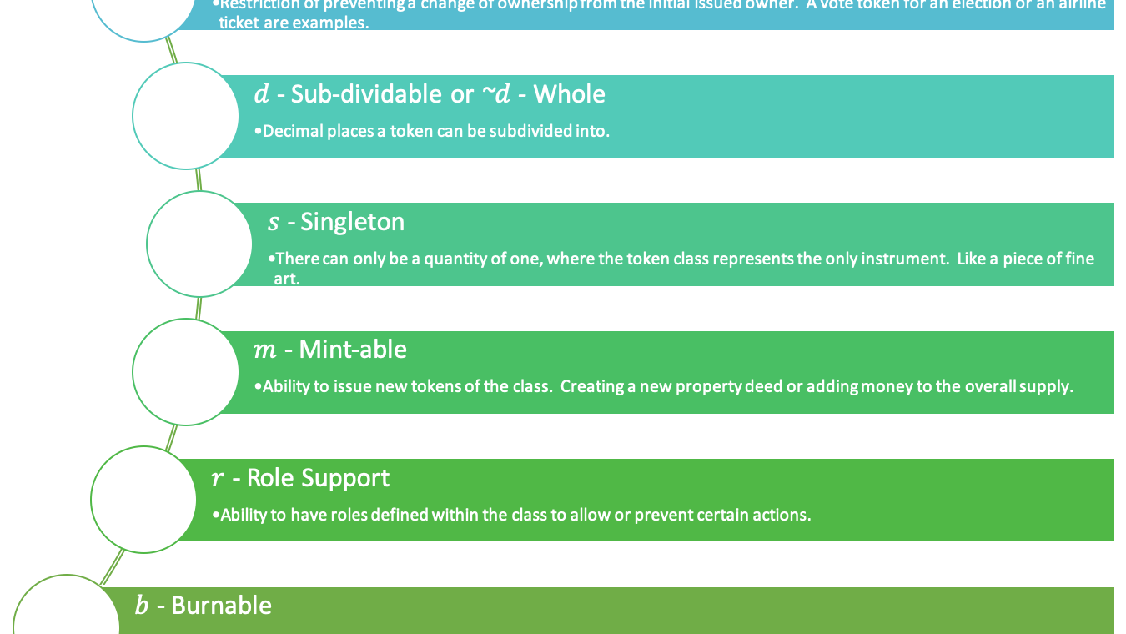
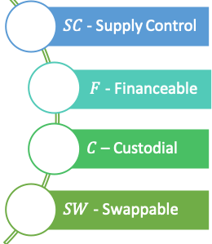
Composition Framework Syntax, Definition & Messages: Types, Properties & Behaviors
$τ_{Ϝ}$ - Fungible
𝜏_Ϝ - Fungible
τ_{N}(τ_{F})- Hybrids
$τ_{Ν}$- Non-fungible
𝜏_Ν- Non-fungible

Slide 4
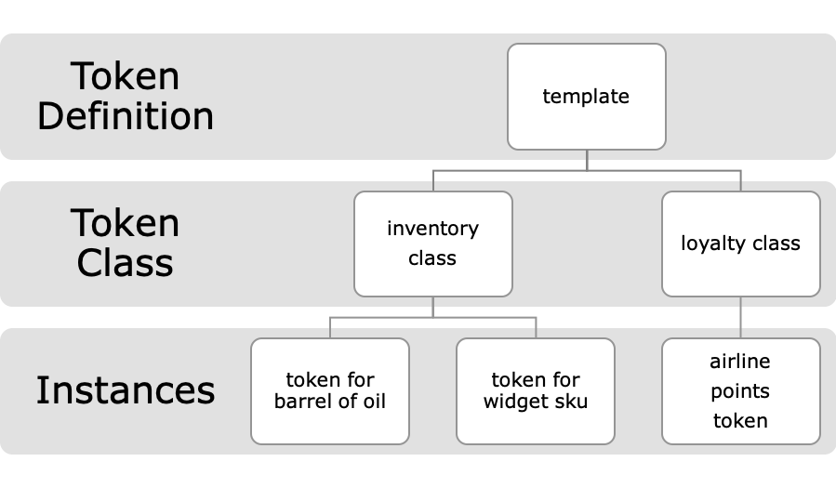
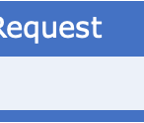
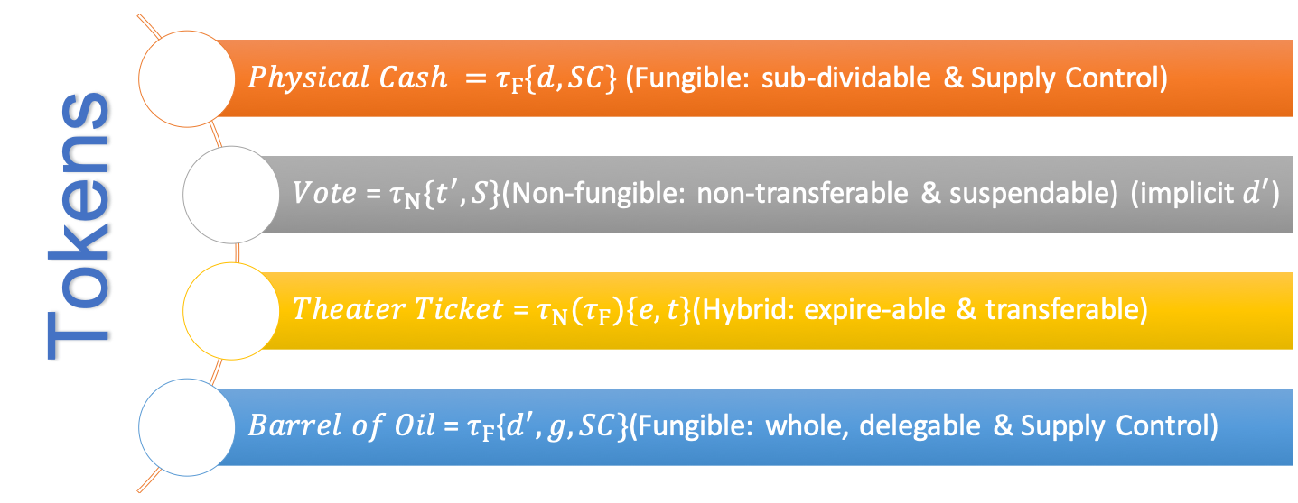
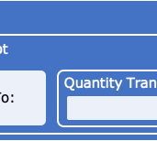
Token Definition
Clear and understood requirements:
implementation agnostic
requirements for developers
standards to validate

Slide 5
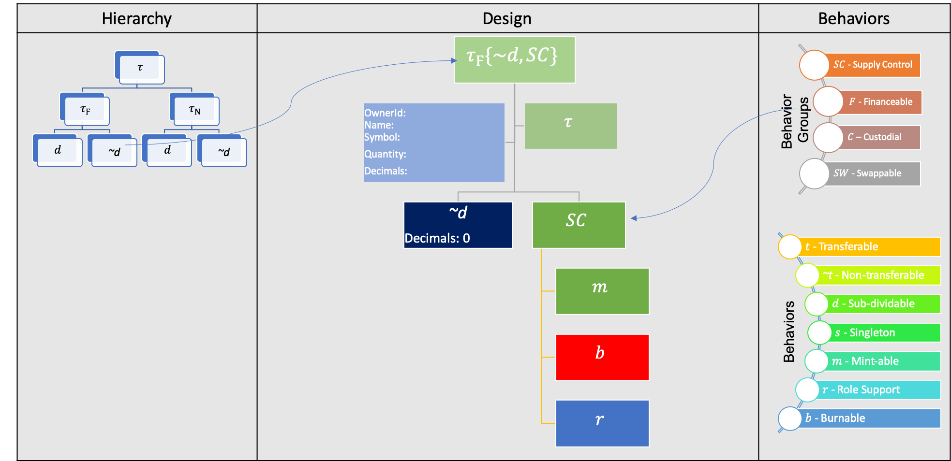
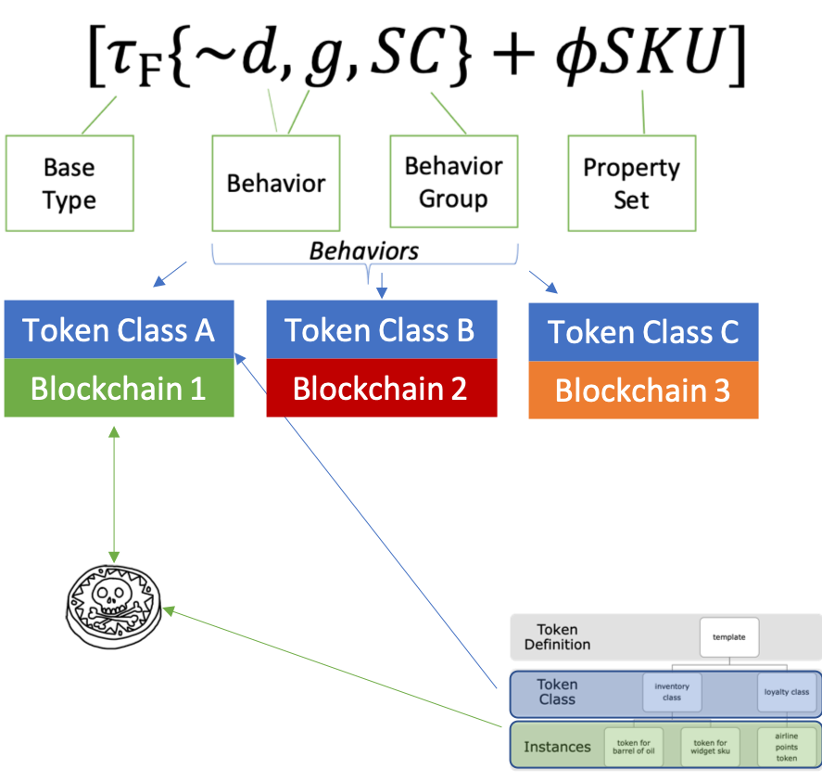
Visualize and Design
No Code

Slide 6
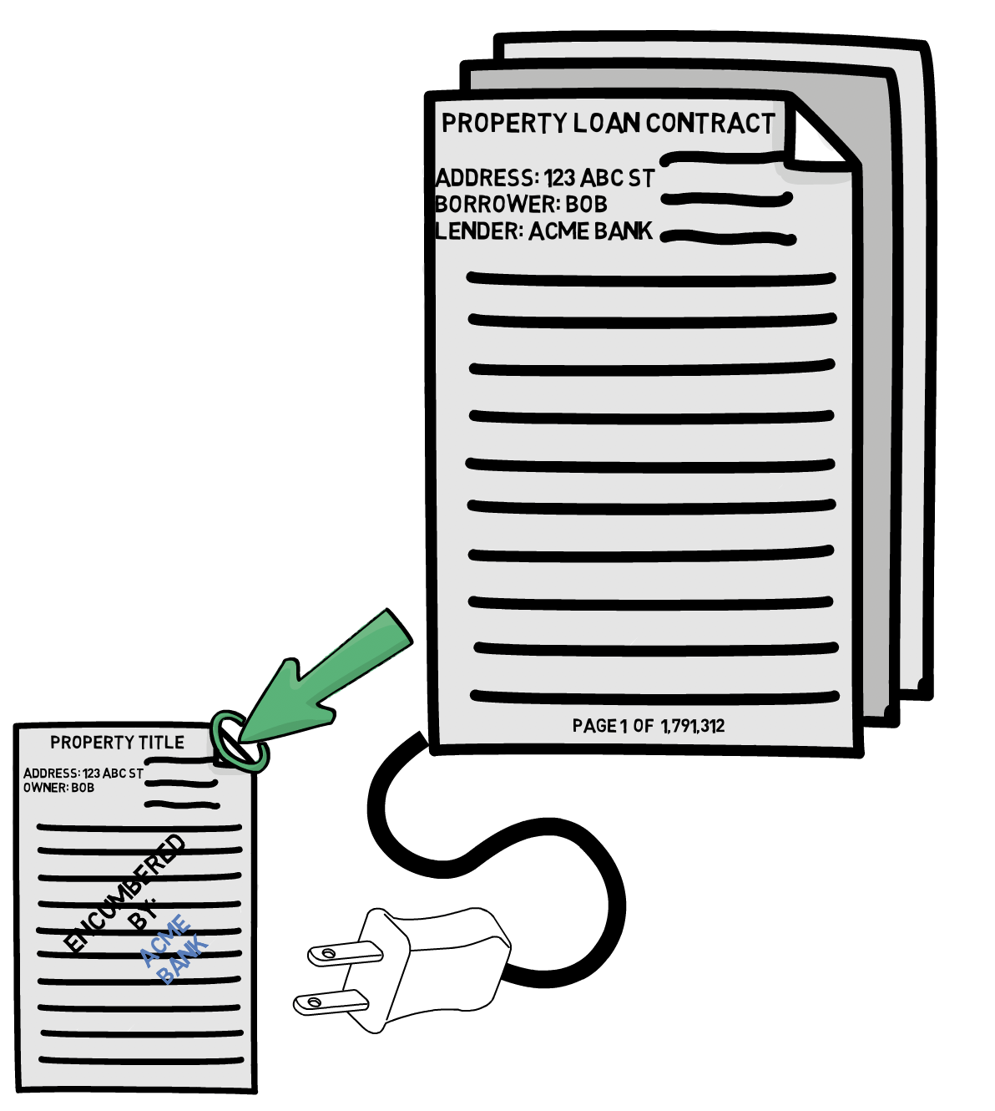
Design for Cross Network & Industry
Technology neutral design independent of any network limitations.
Shared taxonomy to light up cross industry use cases.
Enable YOUR industry to integrate with another by design.
Document Token -> Finance Token
Insurance Token -> Property Asset Token
Etc.

Slide 7
Token Taxonomy Initiative
Complete the Taxonomy Framework
Maintain GitHub:
Base Taxonomy definition
Library of Behaviors, Behavior Groups and Control Messages
GitHub Library for Token Definitions
Destination for definitions, links to the base libraries
Link to known implementations, code and references
SIG and Vendors compose token definitions via Workshops
Contribute new or update behaviors that are not proprietary
Submit Token Definition to the TTI via Pull Request
Certification
Compliance based on base message conformance
Demonstrate behavior implementation
Tools for browsing, contributing and building

Slide 8
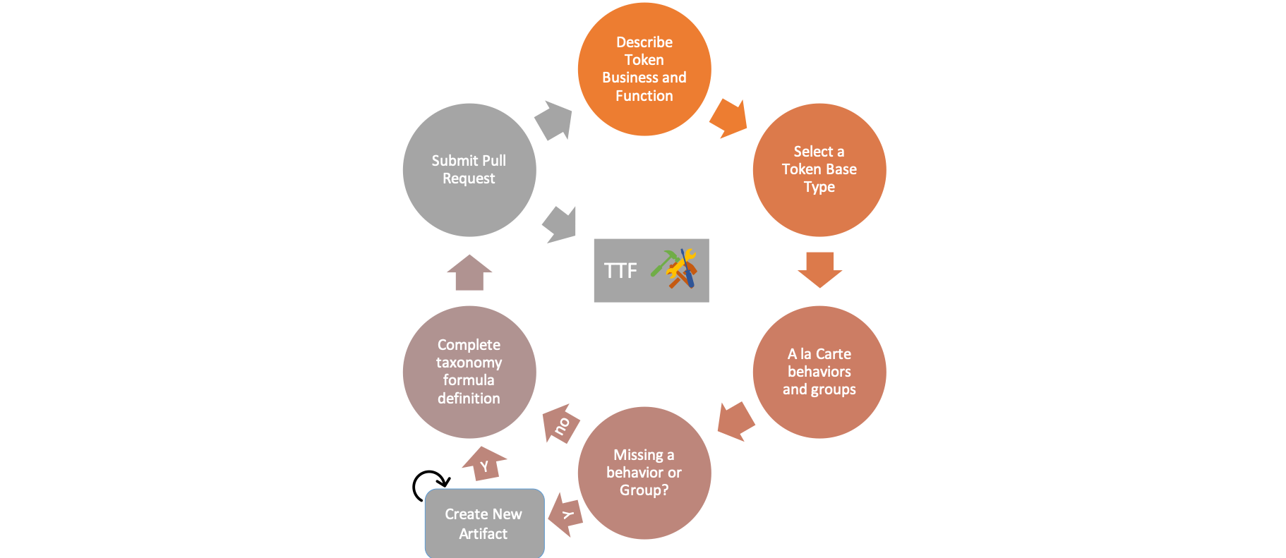
Initiative Process
Initiative Publishes the Framework
Vendors and SIG begin defining artifacts
New Token Definition, behaviors and groups submitted

Slide 9
Questions
http://tokentaxonomy.org
http://medium.com/tokenhall

