Slide 1
tokens-smokens
They are all around us are and how to use them…
Just like Cars!

Slide 2
A Token by any other name…
A digital instrument that represents the value something else, physical or digital item, quality or promise.
Are owned, i.e. the bearer is the owner
A token must be provably authentic to have value. (Meaning a fraudulent token must be highly improbable.)
Well known Tokens all around you:
Dollars, Coins, Tickets, Receipts, License, Deed, Warranty, Order, Check, Confirmation number, Stock, Bond, Coupon…

Slide 3

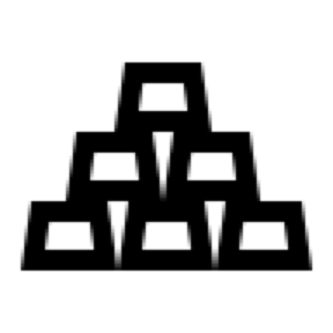










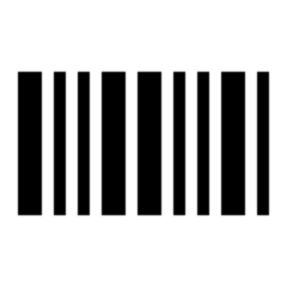



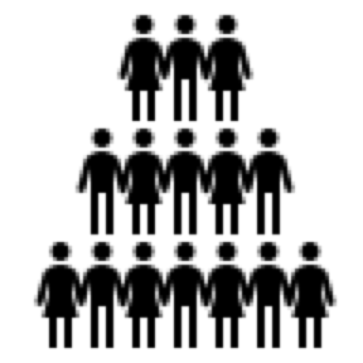
Tokens – Primal Blockchain
A digital representation of value that is authentic or infeasible to counterfeit, in which ownership is proven and the transfer of value secured using cryptography and a shared database that is trusted by their owners.
Value
non-fungible
fungible
Token
sub-dividable
non-fungible
Each token has an Owner
non-sub-dividable
Represented Value can be a physical or digital asset, property, proof/certificate or authorization, etc.
Token ownership can be transferred or not
Value can be fungible or non-fungible, sub-dividable or not, etc.

Slide 4
Not all Tokens are the Same: Value
Value
Non-fungible
Land Titles are in the same class, but the title to the land the Empire State Building is on is not the same as the title to City Hall in Hoboken
Fungible
A dollar bill is the same as another dollar bill and interchangeable

Slide 5
Not all Tokens are the Same: Supply
Tokens have properties and behaviors associated with them.
A token with a defined set of properties and behaviors can be reusable across “domains” and placed in a category or class.
Tokens can have a fixed or variable supply
A token representing money, with the ability create and remove supply, like a central bank
I can create a token for each barrel of oil of a grade. These tokens are interchangeable with each other. I can also remove a token of oil when it is consumed.
I can create a token for Drive Trains as they come off the assembly line but not remove them when used to manufacture a car, but when the car is demolished

Slide 6
Some Tokens can be subdivided and others not…
Some tokens are unique (identity and value) within their class and cannot be split into sub-tokens or shares.
For example, a land title has a single representation and owner. It cannot directly be split into shares with different owners of those shares.* You must split the property in to parcels and issue titles to each new parcel and destroy the original title as it no longer has value.
However, a dollar can be split into change and the original dollar not be destroyed.

Slide 7
Not all Tokens are the Same: behavioral and non-behavioral properties
Tokens, both fungible and non-fungible can have unique properties
But they can be in the same class with different non-behavioral properties
A concert ticket has a Band name, section and seat number but should not be interchangeable, because front row seats are worth more than nose bleed ones.
A theater ticket can be in the same class as the concert ticket with shared properties like section and seat but different properties like Play Name, Raincheck date, etc.

Slide 8
Not all Tokens are the Same: Ownership
Tokens must be owned. The owner of the token has complete control of the token. This car be generally referred to as a Bearer Instrument. Token ownership may be transferred to another owner or be restricted to the owner it was issued to.
If you have a dollar in your wallet, you own it simply by possessing it and may spend it, change the owner or it, however you see fit.
An airline ticket is non-transferable and only has value to the initial owner.
Tokens in a general supply are owned by the creator, once transferred the creator has no control, unless these controls are built into the token.

Slide 9
Not all Tokens are the Same: specialization by behavior
Tokens can have explicit and implicit behaviors
An Equity Share in a publicly traded company has a voting behavior where the owner can vote or delegate the behavior to a proxy.
A token representing a barrel of oil when removed from Supply becomes a receipt.
A token may be encumbered by another entity, a loan for example, and will not allow transfer of ownership until the encumbrance is satisfied.

Slide 10

A Token has a purpose
The combination of a token's properties and behaviors are determined by the business requirements or goal. They can be used to simply represent an asset class to represent raw value like a barrel of oil or have more specific goals like modifying behavior.
A loyalty point – they are everywhere and are designed by the issuer to increase their customer retention and total spend.
They have Supply control so points can be issued to customers and destroyed when redeemed.
They also may have collective behaviors like achieving a “Gold” status by being issued a certain number of them
They can have accelerators like double points for certain uses.

Slide 11
Some Tokens are useful by themselves…
Tokens can act like single vendor gift cards; in that they are only redeemable from the place of issue. They are transferable, which is different than redeeming.
A fuel token, is redeemed for using some utility. Like ride tickets at a theme park. You cannot redeem these to buy food at the theme park, only the rides.
Utility tokens often have a fixed supply but are divisible for many decimal places and usually only redeemable by the issuer for a service or utility that then resells the redeemed tokens into a marketplace in order to sustain its service.

Slide 12
Most tokens were born to be contracted
Represent
Since tokens can represent value and be owned. The owner of the token can become a party in a contract that uses that token. ΩΩΩΩΩ
Leverage
A token can be used as leverage, like collateral to secure a loan
Trade
A token can be sold or traded for a certain number of tokens from another class.
Insured
A token can be insured to protect its value
Encumbered
A token can be encumbered, like a financial loan
Bundled
A token can be combined or bundled into another token (encumbered) like a mutual fund or mortgage backed security

Slide 13

A token without a contract is limited in use
In most cases, the owner of a token wants to know the terms and conditions for the use of the token before agreeing to use it. A contract between parties to exchange or leverage a token provides immense value to the parties wanting to exchange value with one another.
A token on a blockchain can provide near real-time peer to peer settlement between parties.
A contract definition on a blockchain for exchanging these tokens.

Slide 14
Control Benefits
Without a standard way of controlling Tokens, regardless of type and underlying blockchain you can end up requiring a massive number of contract or application combinations to cover all use cases.
Application needs to know how to talk to each network and how to form transactions
Each token can have a different interface for the same capability
For example, if I have 15 token types on an Ethereum network and 10 types of tokens on a Fabric network and want to have a library of trade contracts to be able to trade each Ethereum token for a Fabric token and vice versa. You may need to have a contract for each token on one network to have a contract to trade for each token on the other.
1->1 tokens would be 15*10 or 150 contracts, plus the contracts on the networks adding 25 more.
Allowing contracts to trade multiples begins getting extremely complex…thousands of combinations.
With a common set of tokens and control messages, combinations are drastically reduced

Slide 15

Tokens are like Cars
The implementation of a car is dramatically different based on its type, sports vs. economy, electric vs. gas, etc. Yet, you do not need to learn how to drive an electric car as the controls are the same across all of them.
Token Controls:
Create
Transfer
Issue
Burn
GetBalance
Etc..

Slide 16
Questions?

