Slide 1

TTF – Technical Overview
Moving Tokens Forward
1.0

Slide 2
Overview
GitHub backend and Artifact structure
Taxonomy Object Model (TOM)
Metadata
Serialization
Integration
Taxonomy Service
Simple CRUD for TOM
Read Only publishing at tokentaxonomy.org
Workshops use clone and run the service locally
Extensions
Tools
Maps

Slide 3
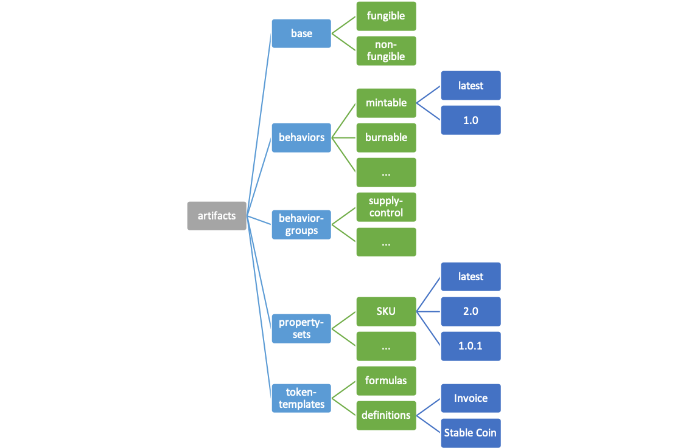
Artifact Hierarchical File Structure
Taxonomy Framework Repo stores artifacts in folder structures by base type, behaviors, behavior-groups, property-sets and tokens.

Slide 4
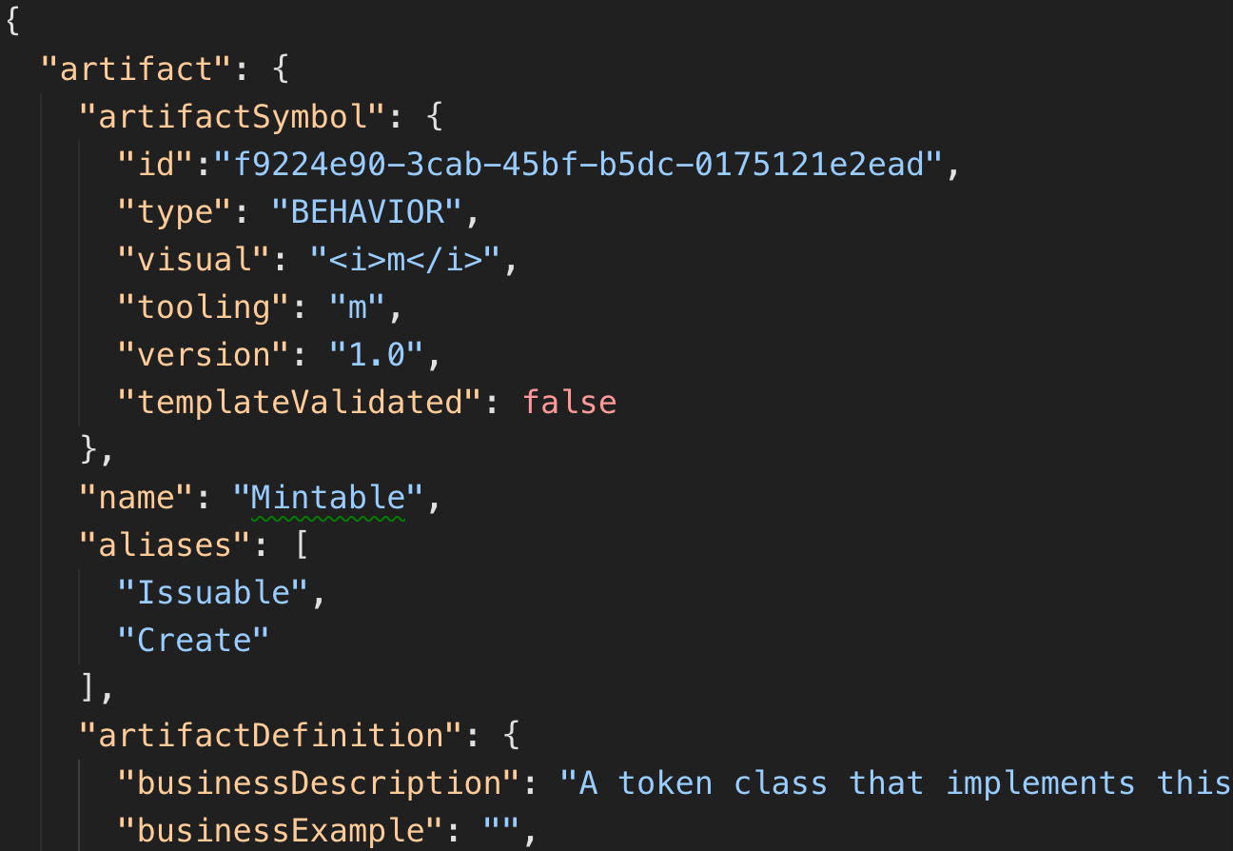
Taxonomy Artifacts
Artifact folder initially contains:
Serialized JSON from TOM to artifactName.json
Template artifactName.proto for message descriptions (optionally detailed)
Template artifactName.md for additional documentation like UML interaction diagrams (optionally detailed)
GitHub based
Artifact Categories using File System Folder/Directory structure
Extensible

Slide 5
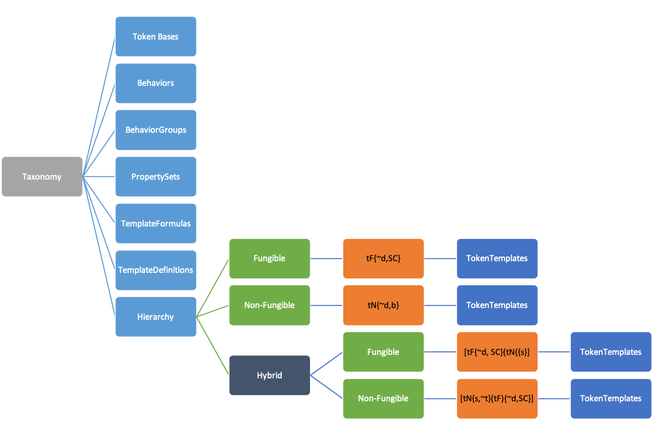
TOM

Slide 6
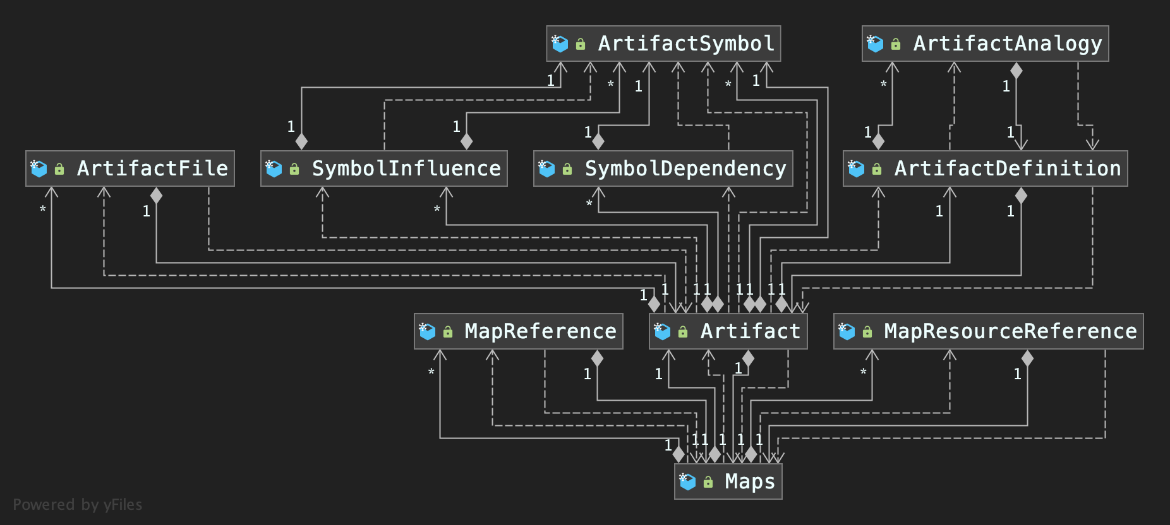
TOM – Artifact Object View
High-Level – diagram too big to fit for all properties.
Proto3 deserializes into native types for dotnet, JVM, Go, Node, etc.

Slide 7

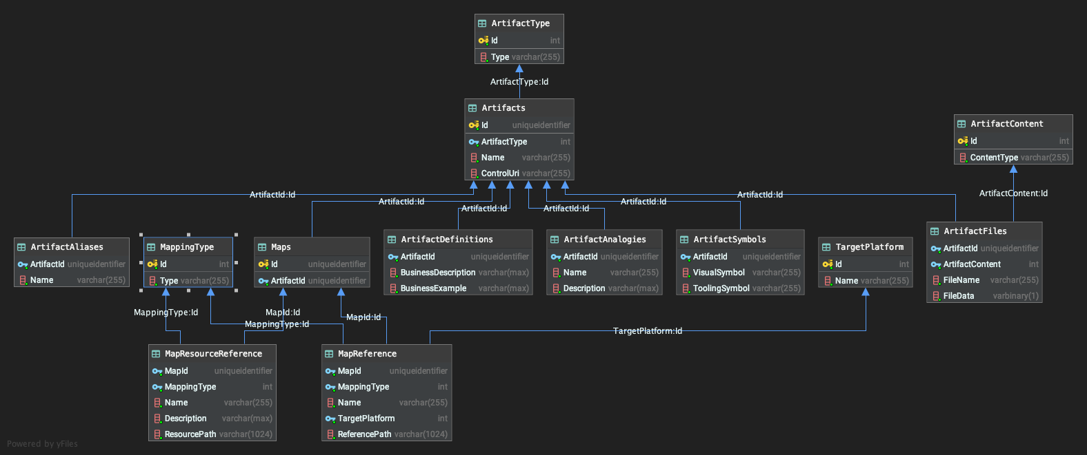
TOM – Artifact Relational View
Artifact Metadata – Type, Symbol, Maps
Definition data – description, examples, analogies, aliases.

Slide 8
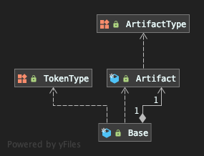
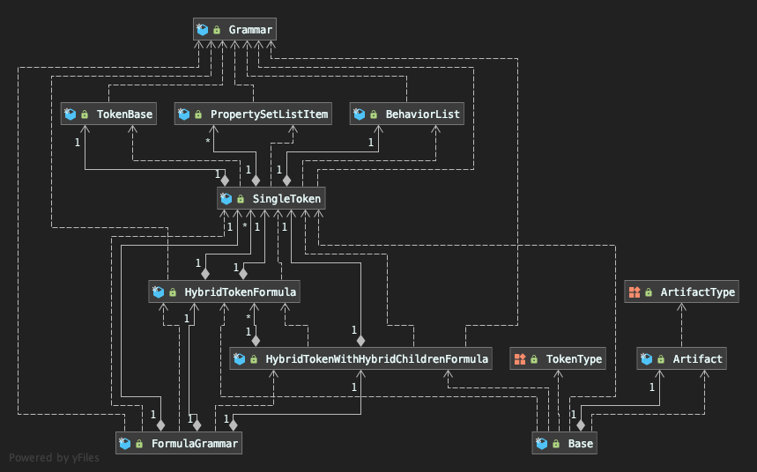
TOM – Base Type
FormulaGrammar is NOT a part of the definition but used for formula validation using grammar and rules.

Slide 9
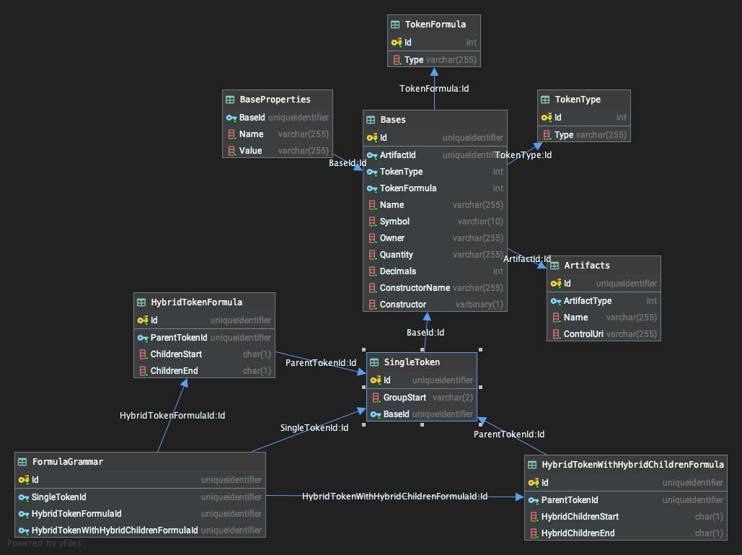
TOM – Base Type Relational View
FormulaGrammar is NOT a part of the definition but used for formula validation using grammar and rules.

Slide 10
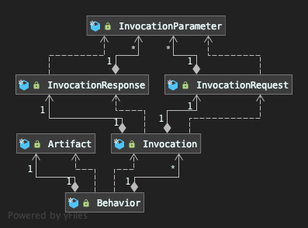
TOM–Behavior

Slide 11
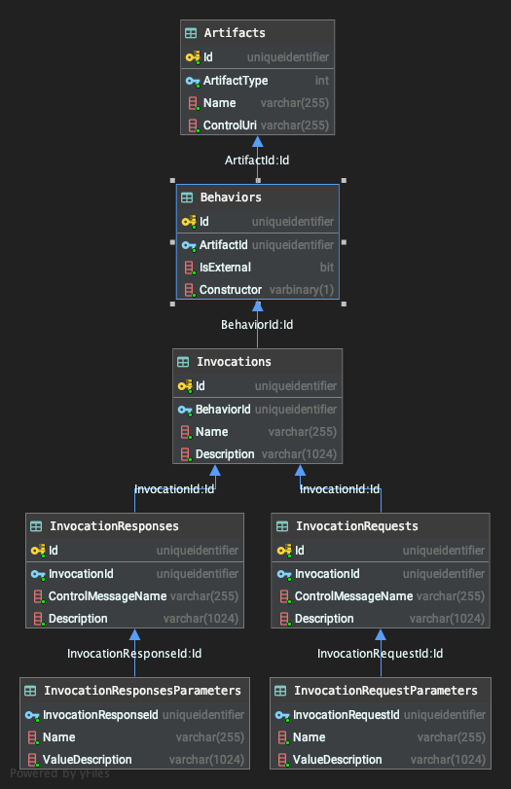
TOM–Behavior
Relational View

Slide 12
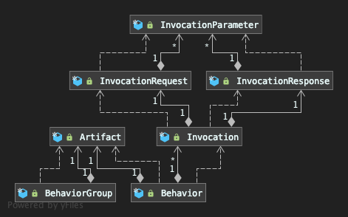
TOM-BehaviorGroup

Slide 13
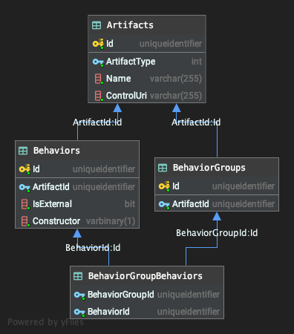
TOM-BehaviorGroup Relational View

Slide 14
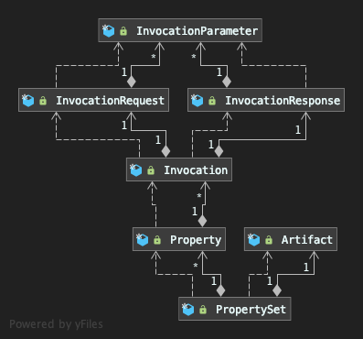
TOM-PropertySet

Slide 15
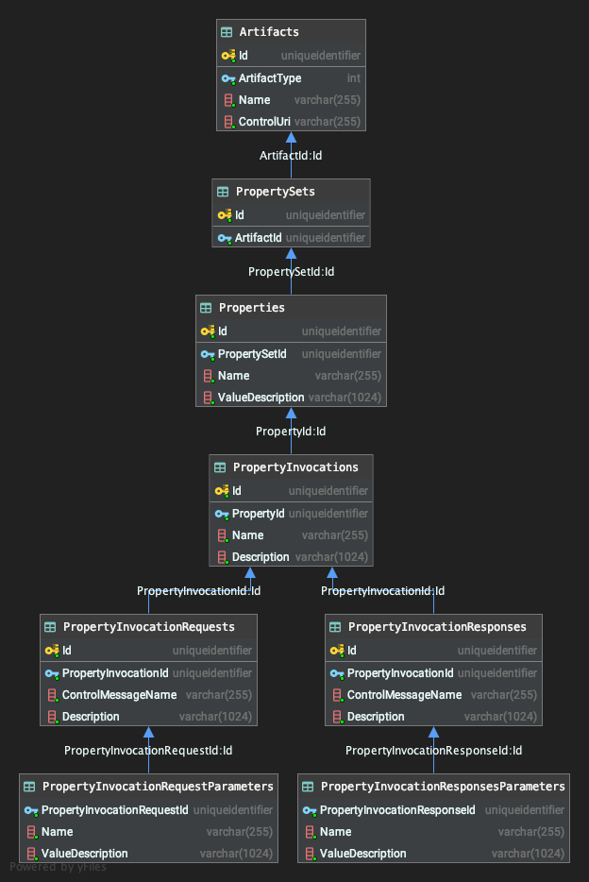
TOM-PropertySet
Relational View

Slide 16
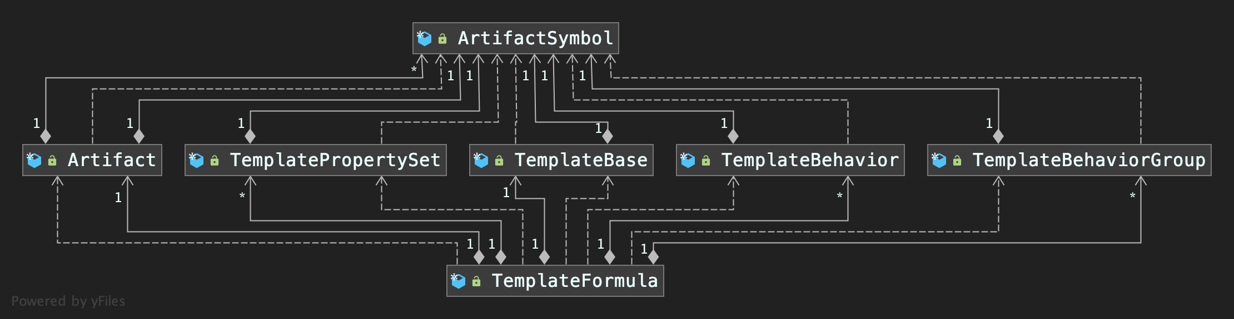
TemplateFormula

Slide 17
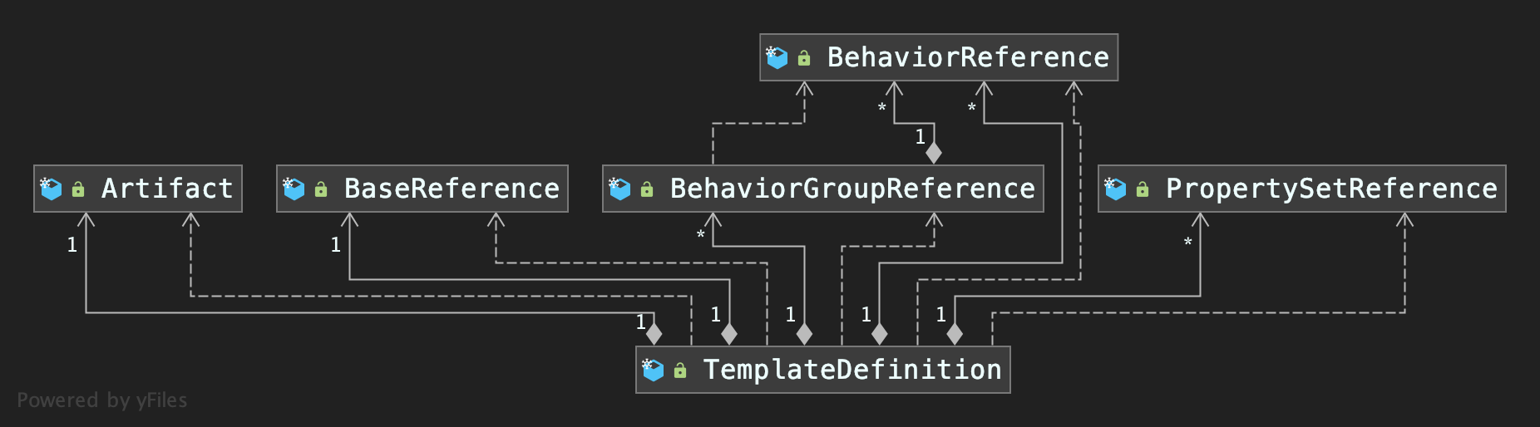
TemplateDefinition

Slide 18
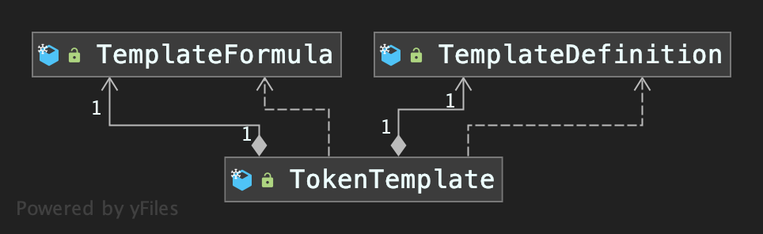
TOM – TokenTemplate

Slide 19

TTF - Architecture
Client
CRUD Methods
gRpc Interface
Taxonomy Service
GitHub - Repo
Clone

Slide 20
Demo
Taxonomy Service and TOM

Slide 21
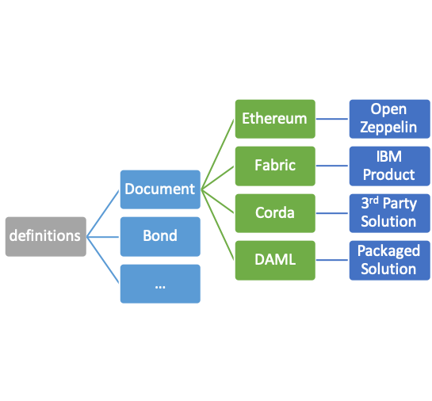
Tooling with Artifacts and Metadata
behaviors
mint
Ethereum
Fabric
burn
…
Open Zeppelin
Chaincode Source
Corda
Kotlin Source
DAML
DAML Source
Artifact metadata supports mapping to:
Source code
Finished implementation
Resource (i.e. regulatory framework or guidance)
Map for taxonomy behavior or property-set to platform specific code. (Solidity, Chaincode, Kotlin, DAML)
Map for token template to a specific implementation. (complete open source, commercial solution, etc.)

Slide 22
Taxonomy Object Model
TTF uses GitHub as the backend for storing artifacts.
Developers can consume the GitHub natively and create artifacts manually.
The Taxonomy Object Model provides a programmable middle extension for navigating the taxonomy and create/update/delete artifacts.
This allows for any application to create a presentation, Web, Mobile or Office experience using the model for general and business users.
Because it stores the data as formatted text, JSON, Proto3 and MD, git hub tracks changes and provides the collaboration tools to facilitate the workshop process.

Slide 23
Extensions Needed
Web Interface for general audiences
Artifact Creation and Editing front ends:
Web
Office & Adobe
Google Docs
…

Slide 24
Discussion

Slide 25
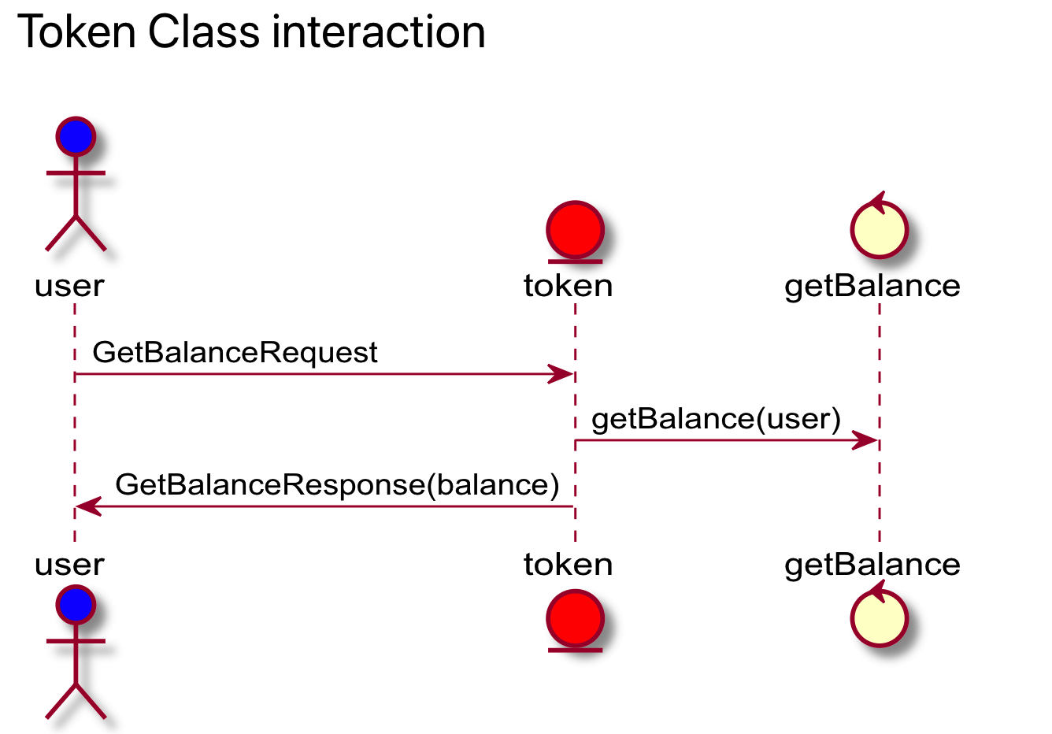
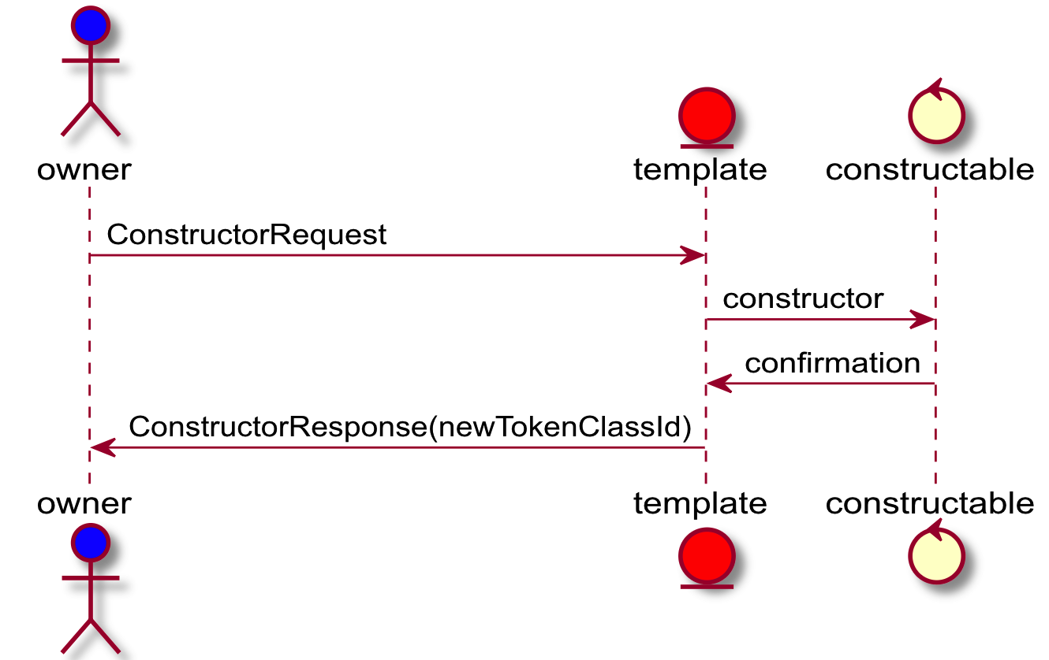
Interaction Sequences
Create Token

Slide 26
Interaction Models
${[τ}_{Ϝ}\{\sim d,SC\}$]+$φSKU$
〖[𝜏〗_Ϝ {~𝑑,𝑆𝐶}]+𝜙𝑆𝐾𝑈
OwnerId: Name: Symbol:
Quantity:
Decimals:
~d
Decimals: 0
$$SC$$
𝑆𝐶
$$m$$
𝑚
$$b$$
𝑏
$$τ$$
𝜏
$$r$$
𝑟
$$τ$$
𝜏
$$φSKU$$
𝜙𝑆𝐾𝑈
Behavior | Control | Properties
Constructable | Constructor | Name, Symbol, Decimals = 0
Mintable | MintRequest | Quantity = 100
Base | GetBalanceRequest
SKU Property-Set | GetSKURequest

