Slide 1

Token Taxonomy Framework (TTF)
4 Kids Addition
1.0

Slide 2




4-Kids Addition
Artifact
Behavior Groups
Property Sets
Token Specification
Design Surface
Behaviors
Token Bases

Slide 3
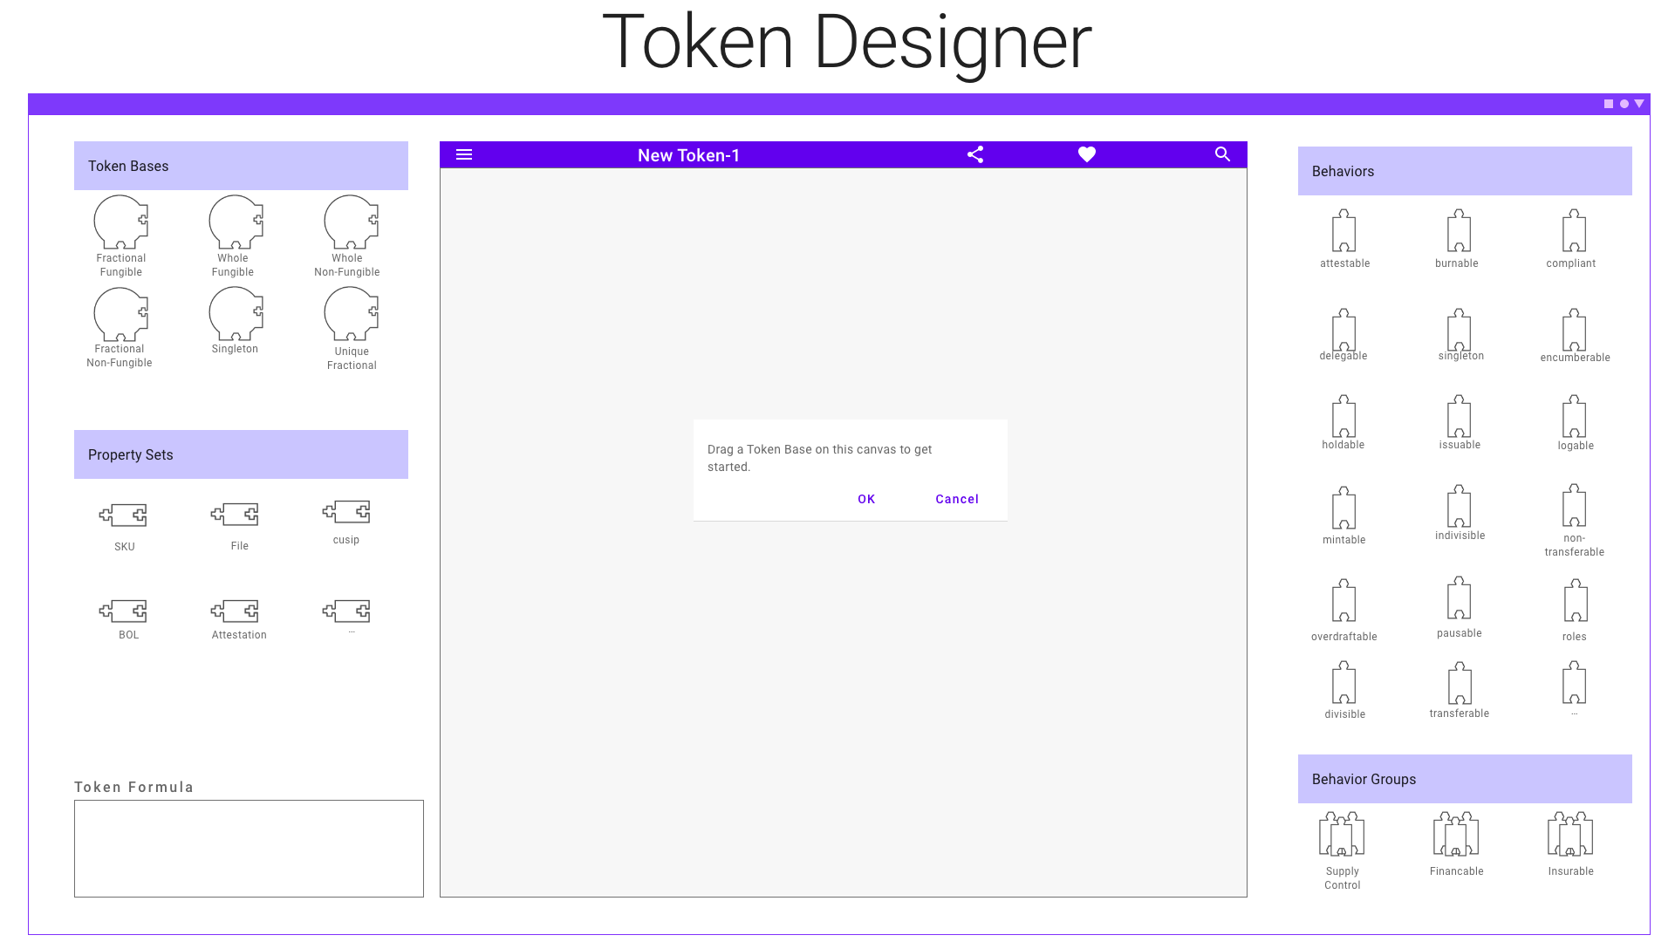

Slide 4
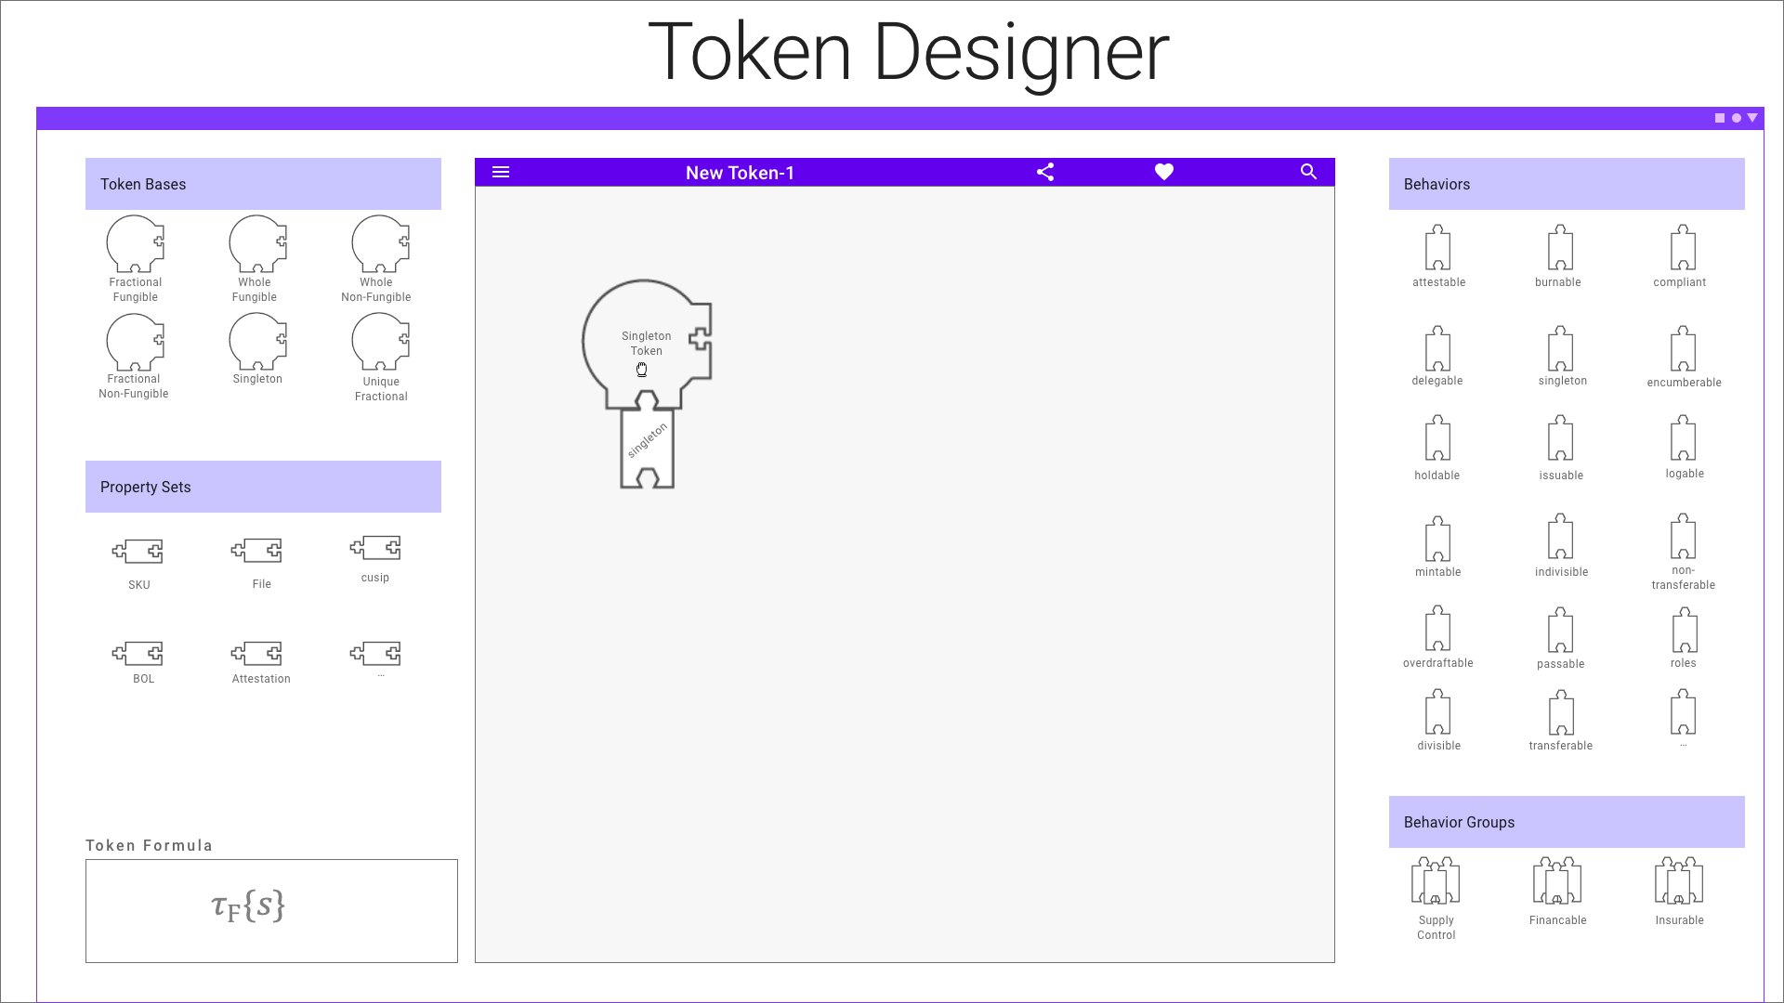

Slide 5
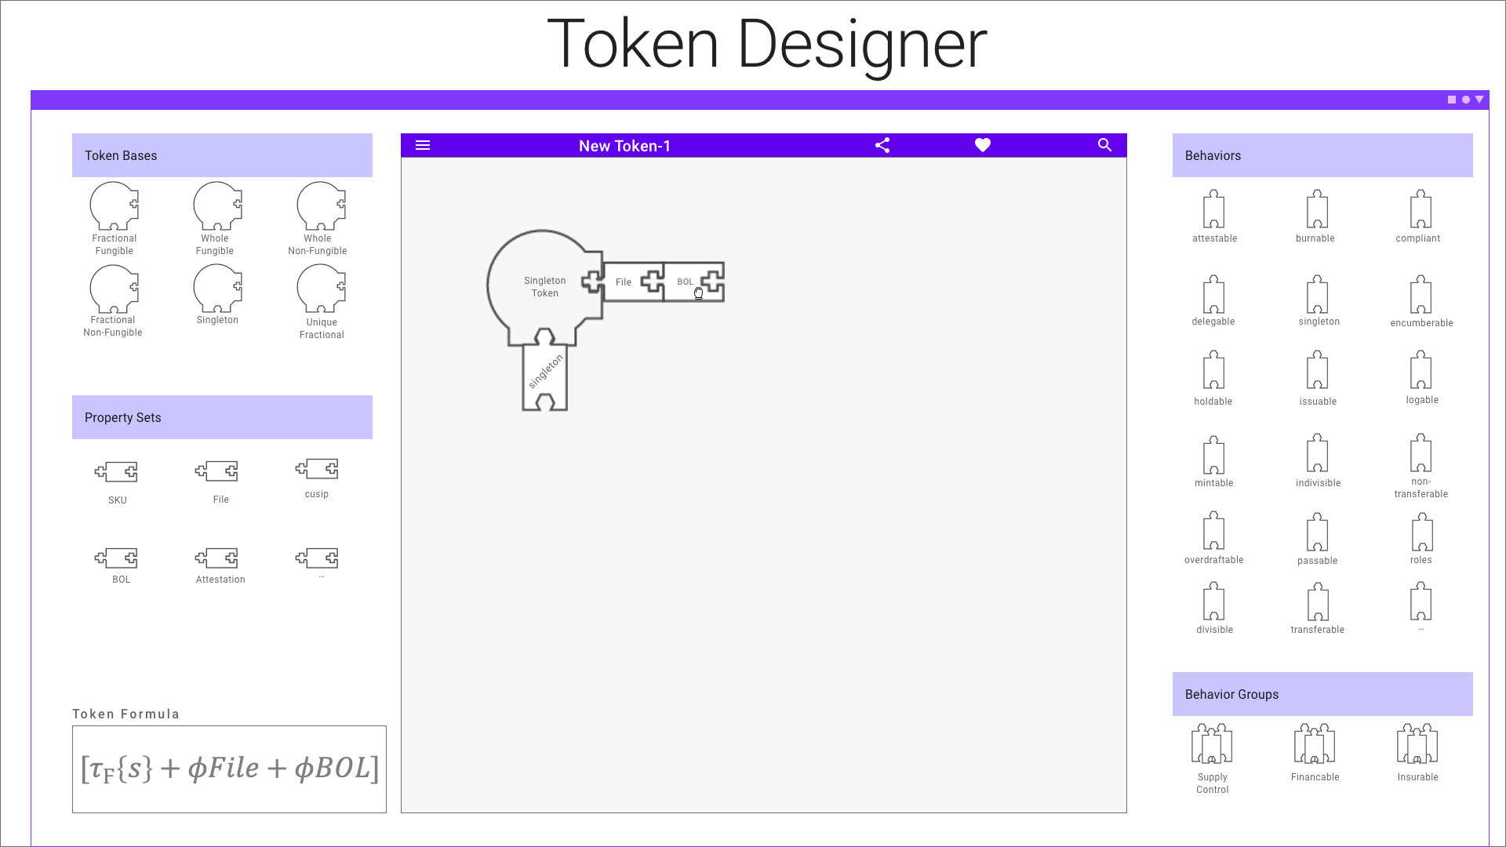

Slide 6
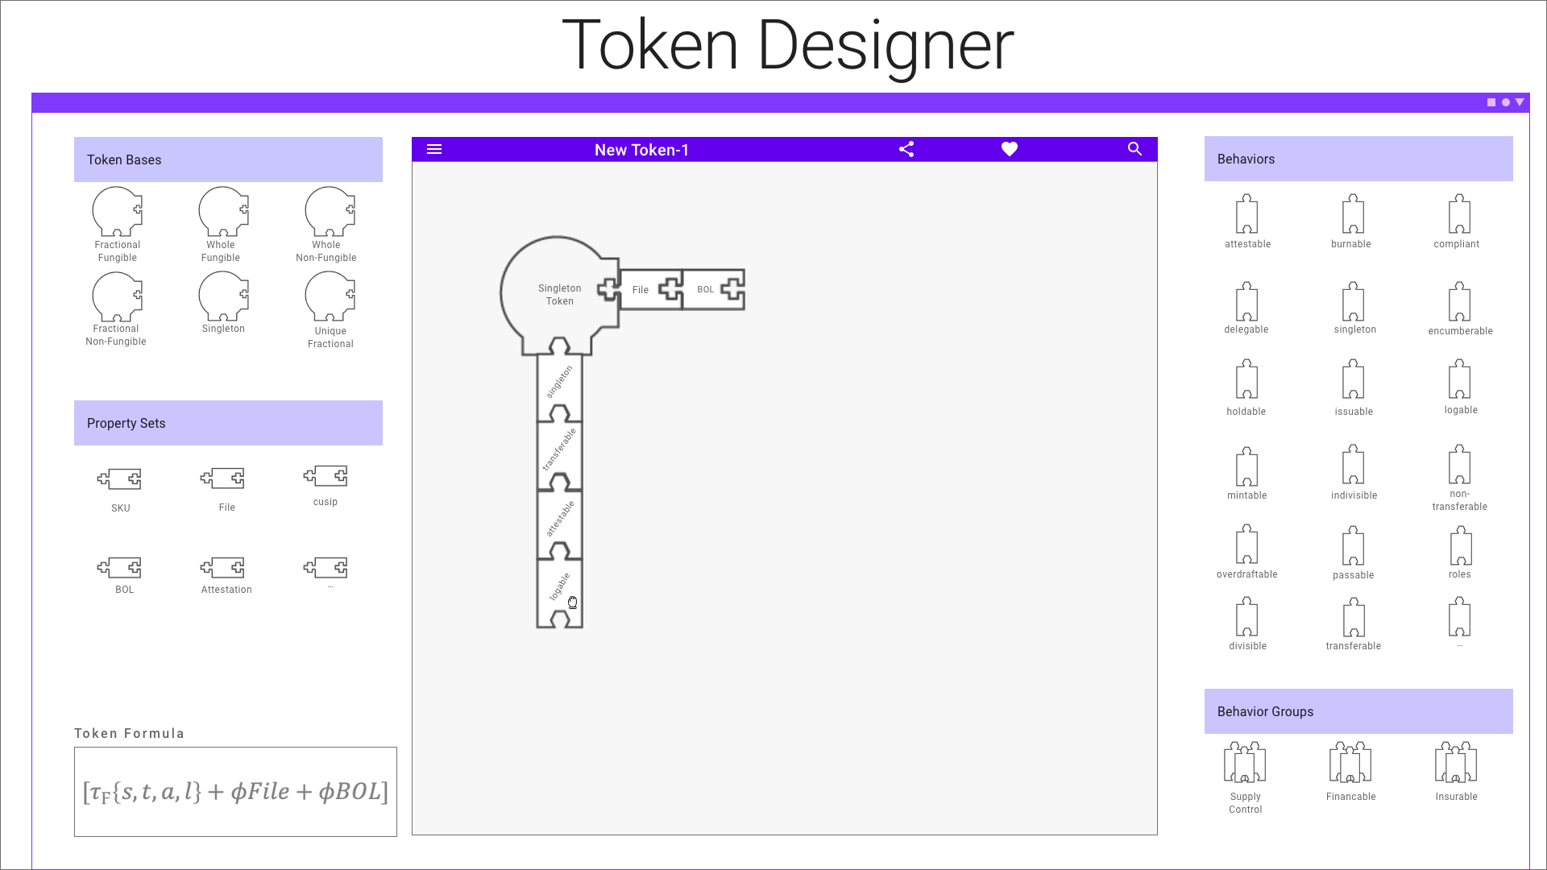

Slide 7


Slide 8
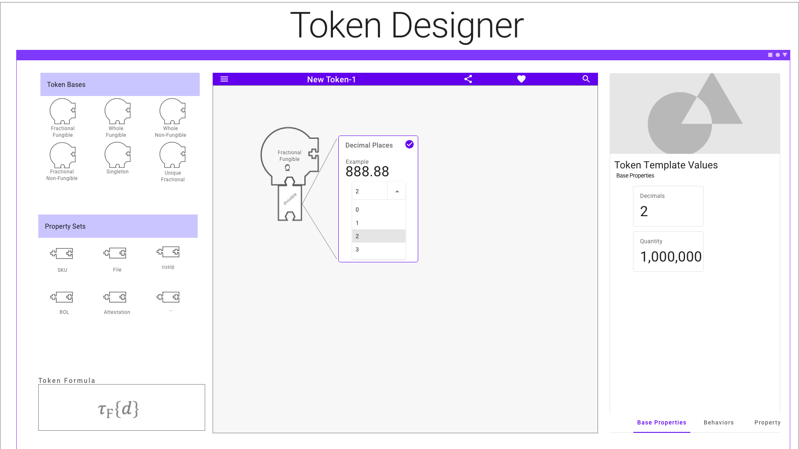

Slide 9
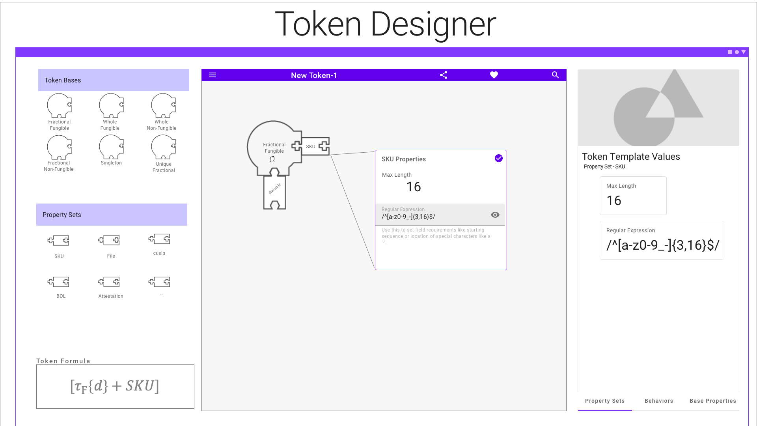

Slide 10
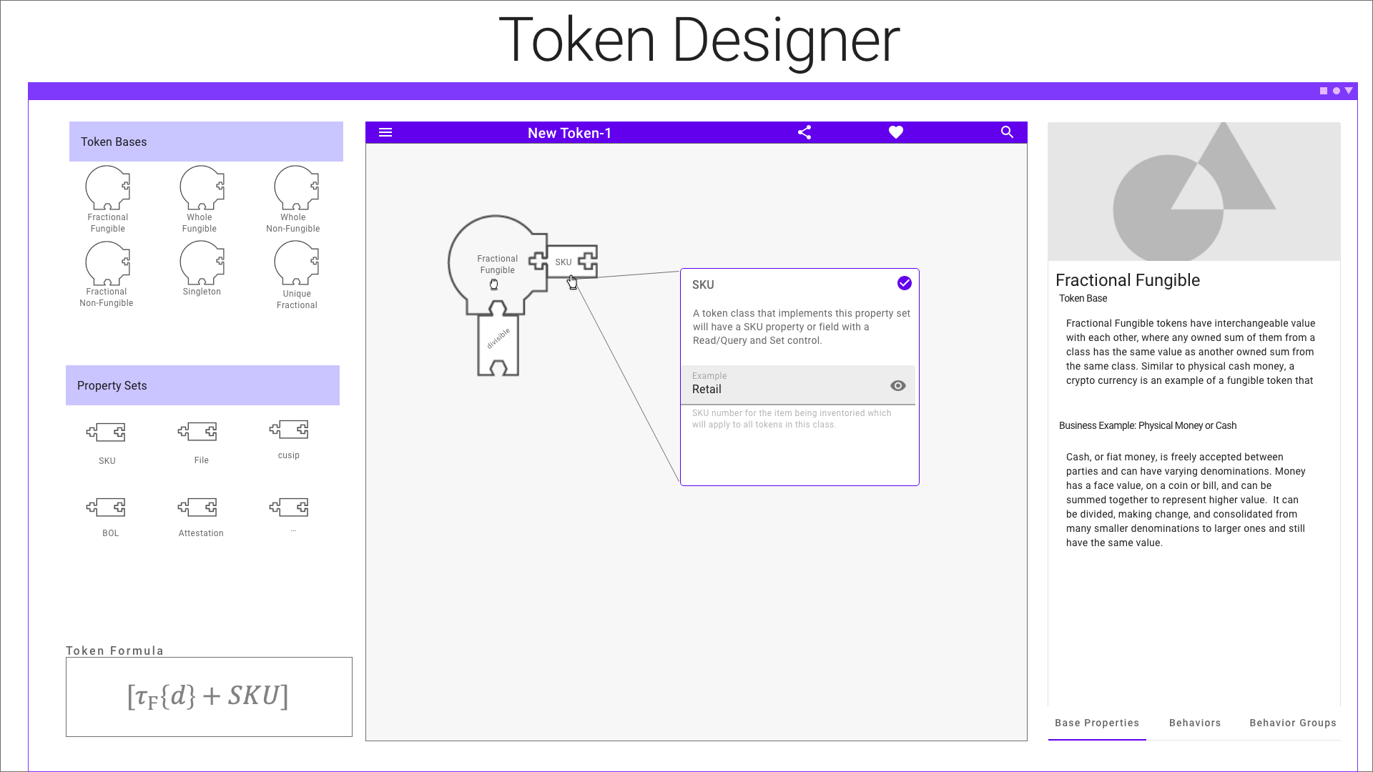

Slide 11
High Level Terms
Loyalty
Definition
Airline
Loyalty
Class
Hotel
Loyalty
Class
Airline Points
Hotel Points
Inventory
Definition
Inventory
Class
Barrel of Oil
Token
Formula
Formula
Template
Definition
Class
Instance
The framework establishes a set of terms for tokens like template formula, definition, class and instance
Token Template = Formula + Definition
An instance belongs to a class which is created from a template
Artifacts are definitions of a token part or complete token definition, template
The framework consists of the base set of artifacts and any new artifact contributed

Slide 12

Baking with Artifacts, Templates & Instances
A Token Class is like a Cake, it is baked from a recipe, i.e. a Template
A slice of this cake is like a Token Instance
A cake is made of ingredients (artifacts) like milk, flour, sugar, etc.
The cake recipe specifies how much of each ingredient to use, when and how long to bake it.
In the TTF:
Ingredients are Artifacts
Recipe is a Template
A Cake is the Class made from the Template
A slice is an instance of the Class

Slide 13
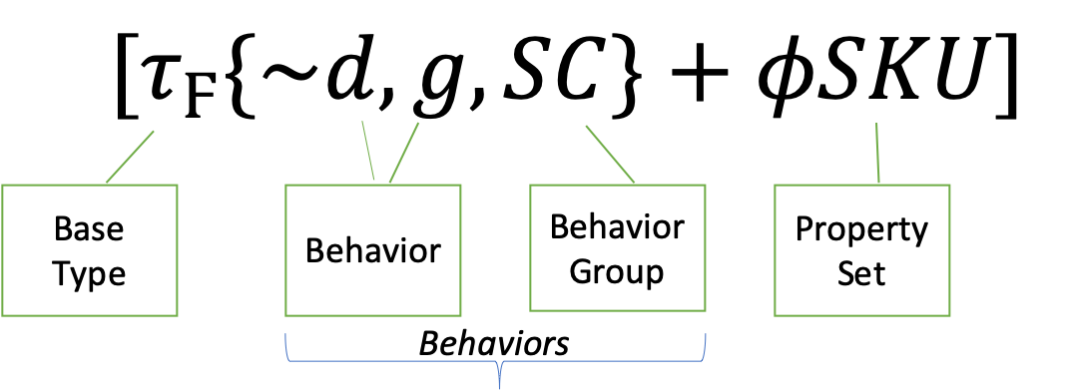
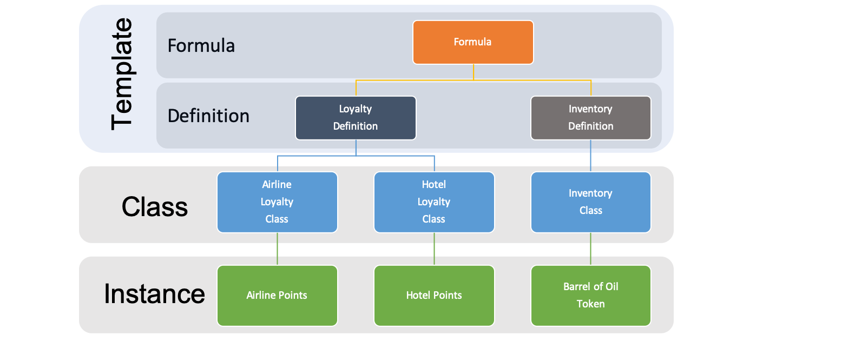
Template Formula
Collection of components from the TTF
Represented by a Formula of Symbols
Symbols link to individual artifacts
Formulas are used to classify templates

Slide 14
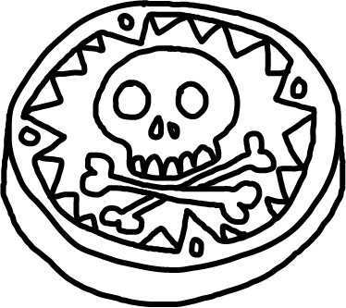
Template Definition, Class & Instance
A Template Definition is based off and paired with a Formula, providing details to complete the Template.
A Token Class is a deployed implementation of a Template to a blockchain.
A Token Instance is a token of a class that you can own and control.
Token Definition
Token Class A
Token Class B
Token Class C
Blockchain 1
Blockchain 2
Blockchain 3

Slide 15
Categories: Base Token, Property Sets, Behaviors & Behavior Groups
Tokens are comprised of properties and behaviors that are interacted with using standard control messages
All Tokens will have a common set of base token properties including simple name/value pair generic properties.
Tokens differentiate themselves based on their behaviors and property sets.
The Taxonomy defines behaviors and properties that are the building blocks of tokens. Some behaviors are already known, the taxonomy just defines them in a standard way and organizes them.
Controls are actions described as messages that are used to invoke a behavior and represent properties.

Slide 16
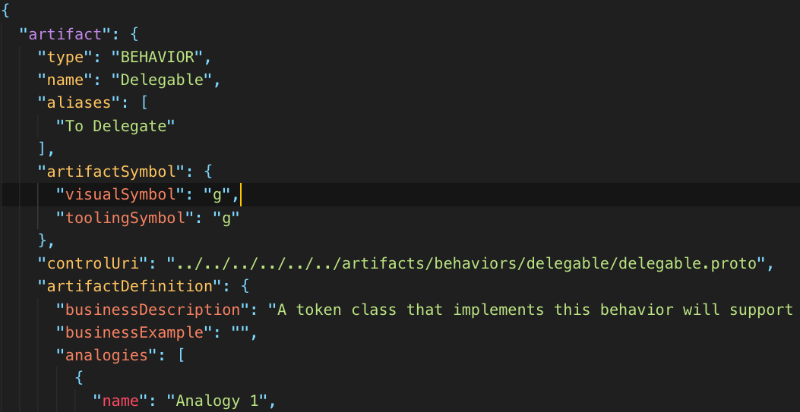
Artifacts
Written in common language so anyone can understand the artifact description and what it does.
Metadata for: (hidden from users)
Tokens
Behavior
Behavior Groups
Property Sets
Token Templates
An artifact is a collection of files placed in a single folder based on the artifact type.
GitHub based
Artifact Categories using File System Folder/Directory structure
Extensible
ArtifactSymbol contains a formula symbol as well as a unique identifier or id which is used to reference the artifact.

Slide 17

Base Token Types & Symbols
Interchangeable having the same value with other tokens of the same class
$τ_{Ϝ}$ Common Fungible
$τ_{Ϝ^{′}}$Unique Fungible
𝜏_Ϝ Common Fungible
𝜏_(Ϝ^′ ) Unique Fungible
Physical money – $τ_{Ϝ^{′}}$
Physical money – 𝜏_(Ϝ^′ )
Loyalty points - $τ_{Ϝ}$
Loyalty points - 𝜏_Ϝ
Different values and should not be interchangeable.
$τ_{Ν}$ Non-fungible
$τ_{Ν^{′}}$ Unique Non-fungible
𝜏_Ν Non-fungible
𝜏_(Ν^′ ) Unique Non-fungible
Property title
Art token
- Theater ticket – non-fungible base – Play name, show date + classes of non-fungible tokens for theater sections.
- Artifact group of tokens owned by other tokens and represent them as a single token.
${ τ}_{Ν}$($τ_{Ϝ}$)
${ τ}_{Ϝ}$($τ_{Ν}$) Hybrids
Notes:
There are currently two kinds of fungible tokens, common, sometimes called account or balance tokens, and unique, or UTXO (unspent transaction output). This distinction might seem subtle, but is important when considering how fungible tokens can be traced and what properties they can have.
Common fungible tokens share a single set of properties, are not distinct from one another and balances are recorded in a central place. These tokens are simply represented as a balance or quanitity attributed to an owners address where all the balances are recorded on the same balance sheet. This balance sheet is distributed, so its not 'centralized' but rather simplified. Common tokens have the advantage of easily sharing a common value like a "SKU" where the change in the value is immediately reflected for all tokens. Like money in a bank account is represented as a balance. Common tokens cannot be individually traced, only their balances between accounts can.
A common fungible token is identified by **&tau;<sub>F</sub>**.
Unique fungible tokens have their own identities and can be individually traced. Each unique token can carry unique properties that cannot be changed in one place and cascade to all and their balances must be summed. These are like bank notes, paper bills and metal coins, they are interchangable but have unique properties like a serial number.
A unique fungible token is identified by **&tau;<sub>F'</sub>**

Slide 18

Classification
A Token Classification has 5 Variables:
Token Type: Fungible or Non-Fungible – the fundamental difference between token types.
Token Unit: Fractional, Whole or Singleton – Quantity and division restrictions.
Value Type: Intrinsic or Reference – the asset type the token represents.
Representation Type: Common or Unique – how balances and property value settings are stored.
Supply: Fixed, Capped-Variable, Gated or Infinite - indicates how many token instances a token class can have during its lifetime.
Template Type: Single or Hybrid – does the token have any child tokens.

Slide 19

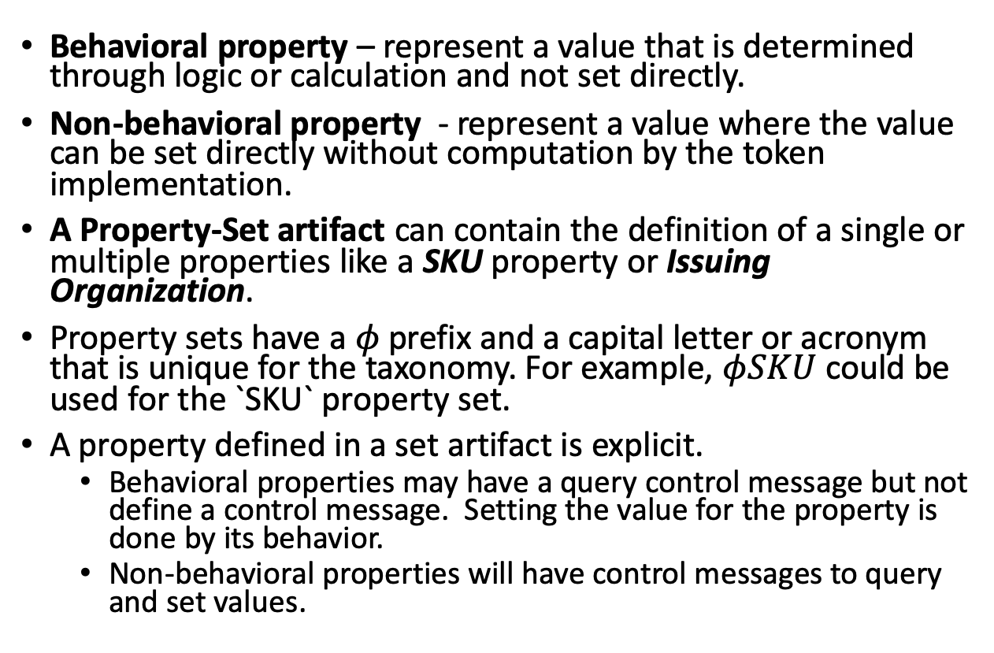
Properties
Behavioral property – represent a value that is determined through logic or calculation and not set directly.
Non-behavioral property - represent a value where the value can be set directly without computation by the token implementation.
A Property-Set artifact can contain the definition of a single or multiple properties like a SKU property or Issuing Organization.
Property sets have a $φ$prefix and a capital letter or acronym that is unique for the taxonomy. For example, $φSKU$ could be used for the `SKU` property set.
A property defined in a set artifact is explicit.
Behavioral properties may have a query control message but not define a control message. Setting the value for the property is done by its behavior.
Non-behavioral properties will have control messages to query and set values.

Slide 20
Behaviors
Behavior – describes a capability or restriction. I.e. Transferable or Non-transferable.
Behavior Property – a property or data element that is required for a behavior. I.e. Divisible requires a decimals property.
D
Notes:
For example, a token can be capable of being subdivided, be restricted to a single owner or be non-transferable
For example, a sub-dividable token must have a decimals property with a number representing the decimal places supported.
$ Token – Decimals = 2 ($.43 or $1.43)
Oil Token - Decimals = 0 (you cannot own a fraction)

Slide 21
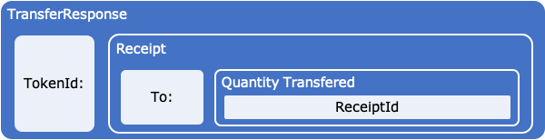
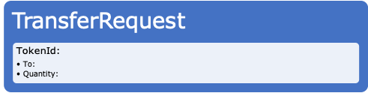
Control Messages
Property-Sets and Behaviors have Control Messages that describe how to get or set the property or invoke a behavior.
Messages usually named starting with a verb like Get or Add
Control messages are paired together with a Request and a Response.
Request messages describe what property to get or behavior to invoke along with any parameters needed for the Control. For example, a TransferRequest message will need to have To and Amount parameters to successfully invoke the Transferable behavior.
A Response message describes what the Requestor is expecting in return from their response. I.e. a receipt, query result, etc.

Slide 22
Common Behaviors
$t$ - Transferable
𝑡 - Transferable
~t- Non-transferable
$d$ - Divisible or ~$d$ – Indivisible/Whole
𝑑 - Divisible or ~𝑑 – Indivisible/Whole
$m$ - Mint-able
𝑚 - Mint-able
$r$ - Role Support
𝑟 - Role Support
Restriction of preventing a change of ownership from the initial issued owner. A vote token for an election or an airline ticket are examples.
Decimal places a token can be divided into.
Ability to issue new tokens of the class. Creating a new property deed or adding money to the overall supply.
$b$ - Burnable
𝑏 - Burnable
Ability to have roles defined within the class to allow or prevent certain actions.
Ability to remove tokens from the supply. A token representing a barrel of oil that gets burned when it is refined is a good example.
Ability to transfer ownership of the token. Basic fungible behavior when using cash money, but also applies to non-fungible tokens.
$s$ - Singleton
𝑠 - Singleton
There can only be a quantity of one, where the token class represents the only instrument. Like a piece of fine art.

Slide 23
Behavior Groups
Behavior Groups are a collection behaviors that are frequently used together.
Encourages Decomposition of lowest level behaviors being defined and combined for maximum re-use.
$$b$$
𝑏
BurnRequest
BurnFrom
BurnFromRequest
BurnResponse
Burn
BurnFromResponse
$$SC$$
𝑆𝐶
b
m
r
$$m$$
𝑚
MintRequest
MintFrom
MintFromRequest
MintResponse
Mint
MintFromResponse
$$r$$
𝑟
AddRoleMemberRequest
RemoveRoleMember
RemoveRoleMemeberFromRequest
AddRoleMemeberResponse
AddRoleMember
RemoveRoleMemeberFromResponse

Slide 24
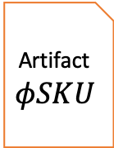
Template Formula Setting Context for Artifacts working together
Artifacts are composed into a formula using references.
Grammar rules will provide the first level of component compatibility.
Formulas represent a branch on the Taxonomy Hierarchy Tree.
Reference
Template Artifact
Artifact $φSKU$

Slide 25
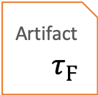




Template Definition Filling in the details…
Individual Taxonomy Artifacts are defined in relative isolation to facilitate reuse.
A single artifact may list a dependency on another artifact but leave details like property values or settings as TBD.
When artifacts are composed together into a Definition, the TDB values can be specified, setting values can be set or recommended for these artifacts in the context of the template.
A Token Template is where Definition is a paired with its Formula
The Definition Id is the also the Token Template and Token Specification Id.
Formula
Definition
reference - $τ_{Ϝ}$
reference - 𝜏_Ϝ
reference - ~d
reference - g
settings
decimals = 0
transferable & burnable
reference - SC
role = minters
apply to mintable
reference - $φ$SKU
reference - 𝜙SKU
15 characters long, starting with a capital letter T
Artifact
$$\sim d$$
Artifact $τ_{Ϝ}$
Artifact
$$g$$
References
Artifact
$$SC$$
Artifact
$$φSKU$$
Reference Values

Slide 26



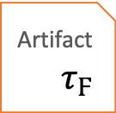


Token Specification
A token template is the combination of its formula + definition.
From a template definition a specification is generated.
The TTF generates the specification upon request from the Template Definition Id
Token
Specification
Definition
reference - $τ_{Ϝ}$
reference - 𝜏_Ϝ
reference - ~d
reference - g
settings
decimals = 0
transferable & burnable
reference - SC
role = minters
apply to mintable
reference - $φ$SKU
reference - 𝜙SKU
15 characters long, starting with a capital letter T
Artifact
$$\sim d$$
Artifact $τ_{Ϝ}$
Artifact
$$g$$
References
Artifact
$$SC$$
Artifact
$$φSKU$$
Reference Values

Slide 27

Branch Classification
Common root Base - $τ$
Classification views:
3 branches: Fungible ${ τ}_{Ϝ}$ and Non-Fungible $τ_{Ν}$ and Hybrid
Branches and views can be created using Template formulas like Fractional Fungibles, Whole Fungibles, Fractional Non-Fungibles or Singletons, etc.
Branch views are created from template references and behaviors.
Template Formulas are branches
A Definition is a node or leaf
Token Template = Formula + Definition
base $τ$
base 𝜏
fungible $τ_{Ϝ}$
fungible 𝜏_Ϝ
fixed quantity
whole
~d
fractional
$$d$$
fractional
𝑑
variable quantity
variable quantity
SKU
Stock
ICO
Fiat Currency
Loyalty
hybrid

Slide 28
Contract Interfaces
Network A
Loan Contract
A Template Formula represents the logical token interface.
Internal behaviors apply only to the token itself and are self invoking.
External Behaviors provide standard contract interfaces across platforms and consortiums. These behaviors are often “end point” properties invoked by an external contract or token.
financeable
Property
Title
Network B

Slide 29
Classification Hierarchy Example
base $τ$
base 𝜏
fungible $τ_{Ϝ}$
fungible 𝜏_Ϝ
non-fungible $τ_{Ν}$
non-fungible 𝜏_Ν
fixed quantity
whole
~d
fractional
$$d$$
fractional
𝑑
variable quantity
variable quantity
fixed quantity
SKU
Stock
Bond
ICO
Fiat Currency
Loyalty
fractional
$d$
fractional
𝑑
singleton
s
non-transferable
vote
composites
transferable
deed
title
Whole
~d
hybrid

Slide 30
Where does the TTF end & implementation begin?
The TTF has extensions, called a Map, allowing each artifact to reference code, implementation or reference materials that are external to the TTF.
For example, you may have a reference for a Token Template Definition that maps to:
Complete source code for a platform and language (i.e. HLF/Chaincode/Go - > url)
A finished solution or implementation (i.e. a link to a website or marketplace offering)
Regulatory guidance (i.e. link to a regulatory agency report)
TTF
Artifacts
Template
Map
External Reference
Your Extension
Notes:
s

Slide 31
Questions
http://tokentaxonomy.org

