Slide 1
Effects of Race and Income on COVID-19 Death Rates in the US
By: Collin Fabian
Analytics Without Borders Conference

Slide 2
Overview
RESEARCH QUESTIONS:
Does a County’s racial makeup and/or median income effect the total number of COVID-19 deaths over the past year? (MAIN EFFECTS?)
Do these factors interact to further effect the total number of COVID-19 deaths over the past year? (INTERACTION EFFECTS?)
Which treatment combinations provide the greatest effect on the average number of COVID-19 deaths per given county?
NOTE:
Model assumptions of ANOVA have been tested and are satisfied.
ASSUMPTIONS:
Population and income statistics from 2019 reflect those of 2021.
P-values less than 0.05 are considered statistically significant.

Slide 3
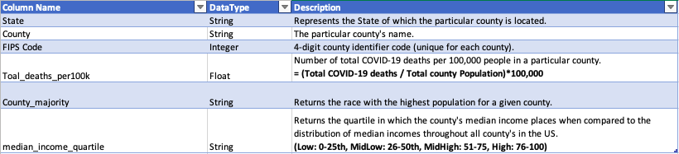
Data: Cleansing/Overview

Slide 4
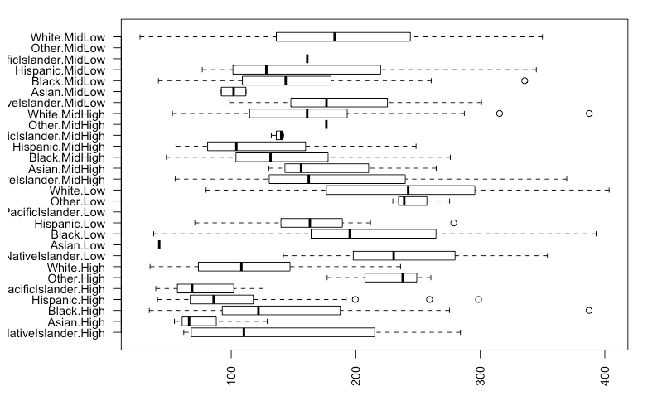
Exploratory Data Analysis
Highest Median Death Values (in order):
White: Low
Other: Low
AmericanIndian/NativeAmerican: Low
Black: Low
White: MidLow

Slide 5
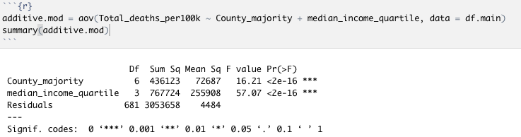
Main Effects: Model
CONCLUSION: Both treatments ‘Racial Majority’ and ‘Median Income Quartile’ independently work to effect a county’s average number of total COVID-19 deaths per 100,000 residents.

Slide 6
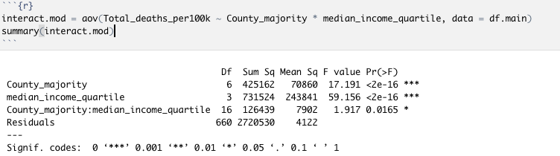
Interaction Effects: Model
CONCLUSION: Treatments ‘Racial Majority’ and ‘Median Income Quartile’ interact to effect a county’s average number of total COVID-19 deaths per 100,000 residents.

Slide 7
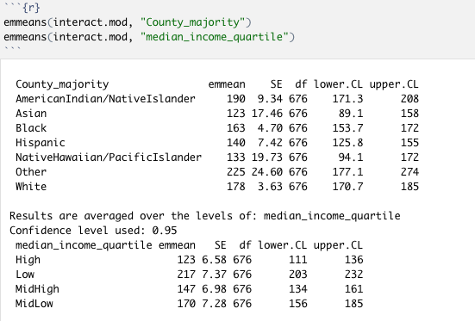
Post-hoc Analysis: Estimated Marginal Means
Highest Marginal Mean Values (in order):
County_majority
Other
AmericanIndian/NativeIslander
White
Black
Hispanic
NativeHawaiian/PacificIslander
Asian
Median_income_quartile
Low
MidLow
MidHigh
High

Slide 8
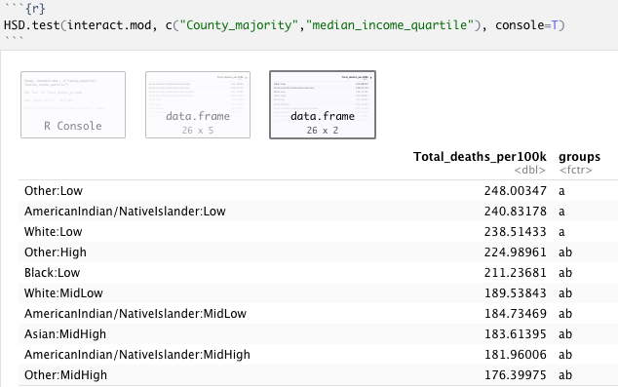
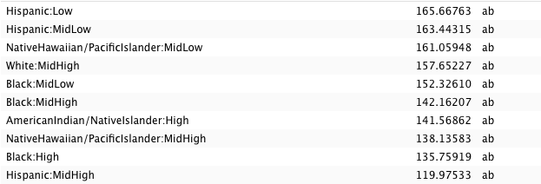
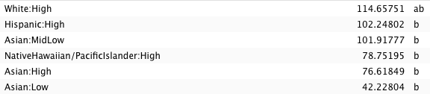

Slide 9
Conclusions
Both main treatment effects, racial majority and median income, both independently effect the average number of COVID-19 deaths for a given county.
Our main treatment effects, racial majority and median income, interact to effect the number of COVID-19 deaths for a given county.
We do not have statistically significant evidence to show that any one specific treatment combination has the highest average number of COVID-19 deaths.
However, we have statistically significant evidence to show that:
Other: Low
AmericanIndian/NativeIslander: Low
White: Low
>
Hispanic: High
Asian: MidLow
NativeHawaiian/PacificIslander: High
Asian: High
Asian: Low

Slide 10
Data: Sources
CDC, “Provisional COVID-19 Death Counts by County and Race”, 2021, National Center for Health Statistics, https://data.cdc.gov/NCHS/Provisional-COVID-19-Death-Counts-by-County-and-Ra/k8wy-p9cg .
US Census Bureau, “Annual County Resident Population Estimates by Age, Sex, Race, and Hispanic Origin: April 1, 2010 to July 1, 2019”, 2010, US Census Bureau, https://www.census.gov/data/tables/time-series/demo/popest/2010s-counties-detail.html .
Economic Research Service, “Unemployment and median household income for the U.S., States, and counties, 2000-2019”, 2000, US Department of Agriculture, https://www.ers.usda.gov/data-products/county-level-data-sets/download-data/

